Slide 1
Homomorphic Encryption Based
Video Copy Detection in Multi-View
Videos Stored in a Cloud
B.Tech Project Presentation | Dept. of Computer Science & Engineering
Eluru College of Engineering and Technology
Department of Computer Science & Engineering | 2025-2026

Slide 2
GUIDE & TEAM
UNDER THE GUIDANCE OF
TEAM MEMBERS
G. Pranith
Mallika Nagasuri
Team Leader
Roll No: 22JD1A0575
M.Tech (CSE)
Sharif Shaik
Member
Assistant Professor · Dept. of CSE
Roll No: 22JD1A05A6
Eluru College of Engineering & Technology
Durga Tejesh Naramamidi
Member
Roll No: 22JD1A0578
Homomorphic Encryption | Video Copy Detection

Slide 3
Abstract
At present, exponential growth in multimedia data transmission takes place due to a significant rise in network bandwidth and video image compression technologies. However, transmission of videos over wireless channels brings unseen risks of sensitive video details being corrupted and distributed illegally. Several encryption models have been presented, yet performance can be further improved. An efficient novel video encryption technique is presented using an enhanced variant of Fully Homomorphic Encryption (FHE) called the EFHE model. By hybridization of Ducas & Micciancio (DM) with the FHE model by Gentry, Sahai & Waters (GSW), matrix operations and vector additions are employed. A new key generation scheme increases encryption speed. The EFHE model is placed on a cloud environment, reducing communication and computation complexity.
Homomorphic Encryption | Video Copy Detection

Slide 4
Introduction
5 Characteristics of
Video Encryption
CC offers on-demand solutions for infrastructure, data maintenance, and service organization. Video services stored in the cloud exhibit higher volume, maximum redundancy, and rapid real-time necessity. In compressed video, parameters like data location indexing and controllable coding rate are required. HE enables clients to validate data integrity while supporting data dynamics. By applying HE, bandwidth requirements are minimized, and the model placed on cloud decreases interaction and processing overload. Security, CR invariability, real-time capability, format invariability, and operability are the five key characteristics video encryption must satisfy.
🔒
Security
📦
Compression Ratio (CR)
⏱️
Real-Time Processing
📄
Data Format Invariability
⚙️
Data Operability
Homomorphic Encryption | Video Copy Detection

Slide 5
Objectives of the System
1. Privacy-Preserving Detection
Protect sensitive video data using homomorphic encryption; operations run directly on encrypted data without exposing content.
2. Secure Cloud-Based Framework
Design a cloud architecture that securely stores and processes video data with feature vectors encrypted before uploading.
3. Accurate Multi-View Detection
Handle multi-view video complexity using view-invariant feature extraction for accurate duplicate detection across diverse camera angles.
4. Encrypted-Domain Feature Matching
Perform similarity matching on encrypted feature vectors via homomorphic operations, eliminating the need for decryption during comparison.
5. Reduce Video Piracy
Identify and prevent storage of duplicate or pirated videos, reducing redundancy and protecting intellectual property rights.
6. Scalable Real-Time Detection
Support large-scale cloud environments with fast processing and real-time querying for platforms handling massive video volumes.
7. Improve Detection Accuracy
Use advanced spatio-temporal and deep learning-based feature extraction to minimize false positives and negatives, even for modified videos.
Homomorphic Encryption | Video Copy Detection

Slide 6
Scope of the System
1. Cloud-Based Video Platforms
Deployable in video streaming platforms, social media, and digital content repositories for large-scale video management.
2. Surveillance & Security Systems
Applicable in multi-view surveillance scenarios to detect duplicate footage while maintaining strict privacy for sensitive data.
3. Copyright Protection
Helps content creators and media companies identify unauthorized distribution of copyrighted videos to protect intellectual property.
4. Scalable Multimedia Databases
Efficiently handles large datasets using cloud infrastructure, supporting indexing across millions of encrypted video features.
5. Integration with Privacy Technologies
Provides a foundation for integrating federated learning and secure multi-party computation in future secure applications.
6. Extension to Other Media Formats
Extendable to audio, images, and 3D data using similar encrypted feature-based approaches beyond video copy detection.
7. Real-Time Monitoring Systems
Implementable in live streaming platforms and online content moderation for immediate real-time detection of duplicate content.
8. Data Protection Compliance
Ensures compliance with modern data privacy laws by keeping all sensitive data encrypted throughout the processing pipeline.
Homomorphic Encryption | Video Copy Detection

Slide 7
System Requirements
⚙ Hardware Requirements
💻 Software Requirements
Processor
Pentium IV 2.4 GHz
OS
Windows
Hard Disk
40 GB
Language
Python
RAM
512 MB
IDE
VS Code
Display
15" Monitor
DB
Local / Cloud
Input
Keyboard & Mouse
Libraries
NumPy, OpenCV, PyCryptodome
Homomorphic Encryption | Video Copy Detection

Slide 8
Functional Requirements
1. User Registration: Allows new users to create an account.
2. User Login: Authenticates users to access the system.
3. Video Upload: Enables users to upload videos to the cloud.
4. Feature Extraction: Extracts important features from videos for comparison.
5. Encrypted Comparison: Compares videos in encrypted form to detect copies.
6. Copy Detection Output: Identifies and marks videos as unique or duplicate
preferences.
Homomorphic Encryption | Video Copy Detection

Slide 9
Non-Functional Requirements
Performance Security: Ensures data is protected using encryption.
Performance: System should process videos efficiently with minimal delay.
Scalability: Can handle increasing number of videos and users.
Reliability: Provides consistent and accurate results.
Usability: Easy for users to interact with the system.
Availability: System should be accessible whenever needed.
Homomorphic Encryption | Video Copy Detection

Slide 10
Existing System
Existing systems rely on feature extraction and matching performed locally or in the cloud, analyzing spatial and temporal features. Multi-view video adds complexity. Most solutions use plaintext processing — requiring videos to be decrypted in the cloud for comparison.
1
2
3
Lack of Privacy
Single-View Limitations
High Computational Cost
Videos must be decrypted in the cloud for processing, exposing them to potential misuse or unauthorized access.
Inefficient handling of multi-view video data due to limited feature fusion and perspective comparison support.
Feature extraction and comparison for high-resolution multi-view videos are computationally expensive.
Homomorphic Encryption | Video Copy Detection

Slide 11
Proposed System (EFHE)
Introduces the EFHE model by hybridizing DM with GSW to perform privacy-preserving video copy detection. Encrypted features are uploaded to the cloud where detection runs directly on encrypted data — the server never sees raw content.
Privacy-Preserving
Supports Multi-View Analysis
The cloud never accesses raw video content, ensuring end-to-end data confidentiality. Features are encrypted on the user side before uploading — the server never sees raw content.
Capable of accurately detecting copies across various camera angles and views using integrated feature models. Multi-view alignment integrates information from diverse perspectives.
Homomorphic Encryption | Video Copy Detection

Slide 12
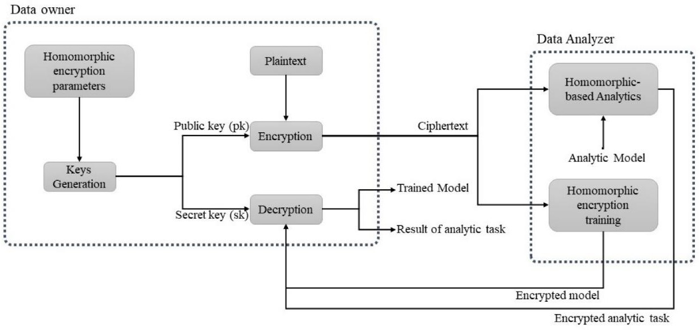
System Architecture — EFHE Working Process
The EFHE model shows three parties: Other Participants (Cloud Service), Untrusted Party (Data Processing + Memory), and Trusted Party (User + Homomorphic Encryption/Decryption Scheme).
Fig. 3 — Working Process of EFHE Method (Source: Geetha N & Mahesh K, Alagappa University)
Homomorphic Encryption | Video Copy Detection

Slide 13
Design — UML Diagrams
UML (Unified Modeling Language) is a standardized general-purpose modeling language managed by the Object Management Group (OMG). The following four UML diagrams are included in this project:
01
Class Diagram
02
Use-Case Diagram
Refines the use-case diagram and defines detailed design by classifying actors into interrelated classes with methods and attributes.
Presents a graphical overview of system functionality in terms of actors, goals (use cases), and dependencies between use cases.
Sequence Diagram
Collaboration Diagram
03
04
Represents time-ordered interactions between objects, showing the exact step-by-step sequence of messages passed.
Groups interactions between objects as numbered interactions to trace sequence and identify all possible communications.
Homomorphic Encryption | Video Copy Detection

Slide 14
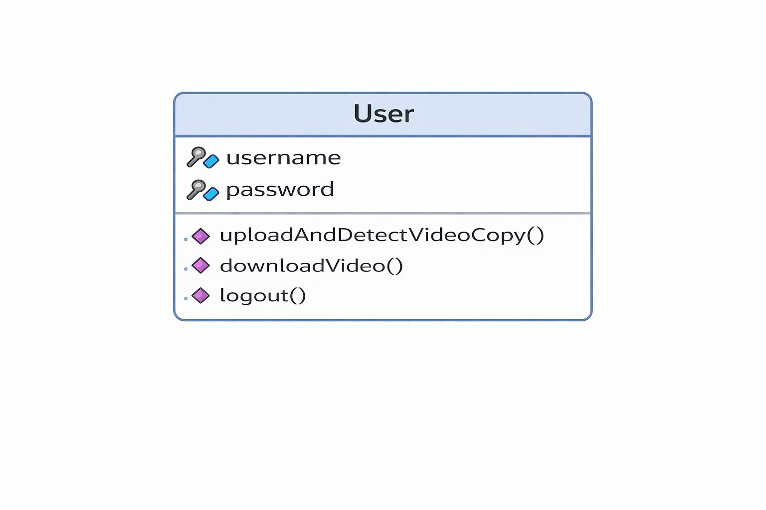
Class Diagram
The class diagram classifies actors into interrelated classes. Each class has methods and attributes — relationships are either 'is-a' or 'has-a'. The User class stores login credentials and exposes core video operation methods.
Class Diagram — User class with attributes (username, password) and methods (upload & detect video copy, download video, logout)
Homomorphic Encryption | Video Copy Detection

Slide 15
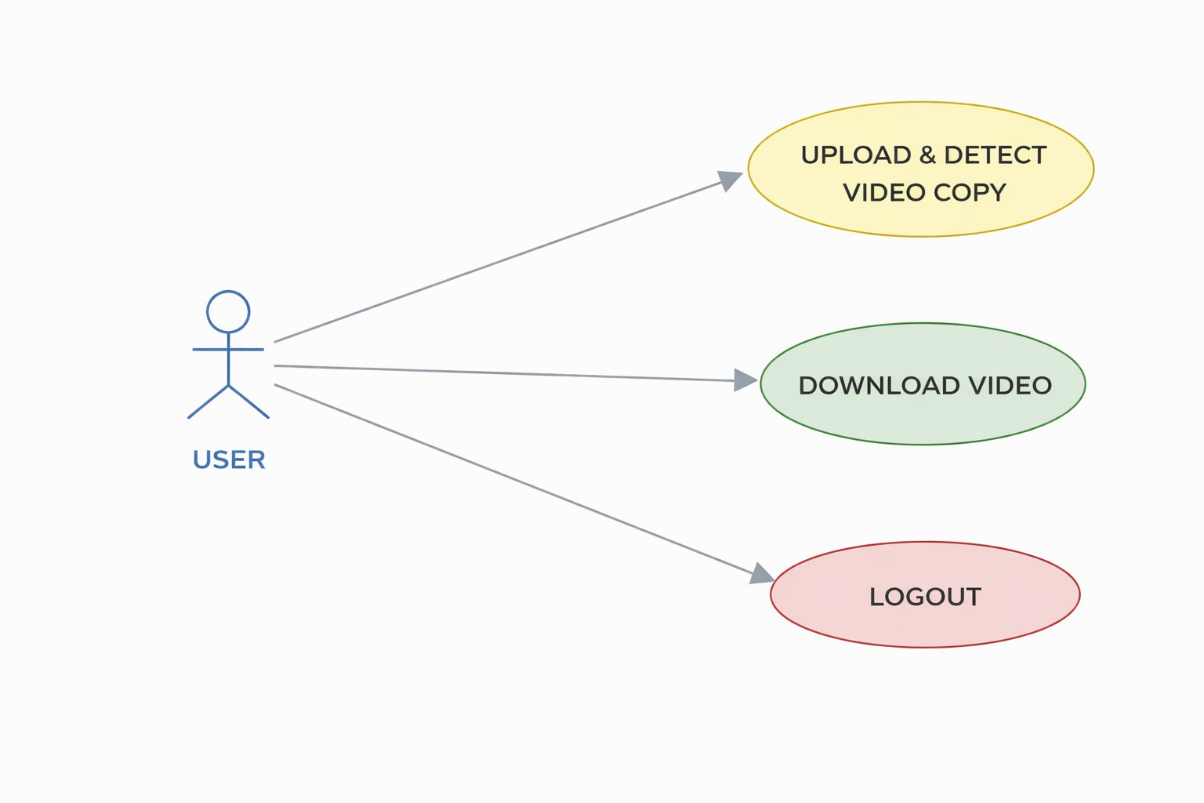
Use-Case Diagram
A use-case diagram presents a graphical overview of system functionality. The actor USER initiates three key operations — Upload & Detect Video Copy, Download Video, and Logout — showing system boundaries and actor goals.
Use-Case Diagram — Actor: USER interacting with three use cases: Upload & Detect Video Copy, Download Video, Logout
Homomorphic Encryption | Video Copy Detection

Slide 16
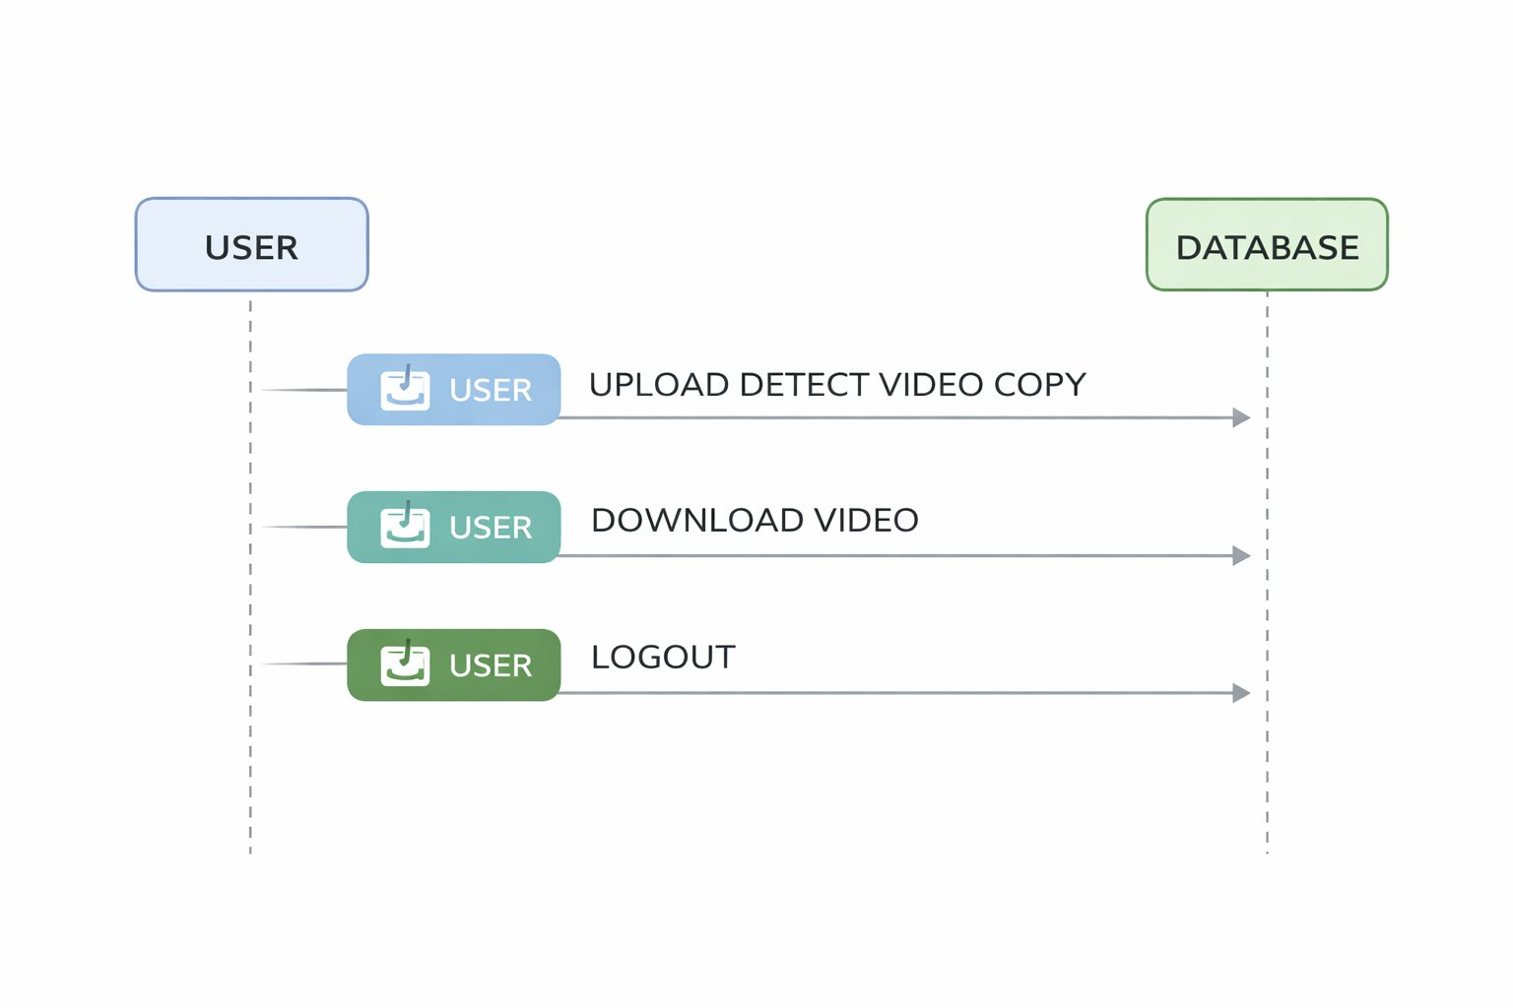
Sequence Diagram
A sequence diagram shows time-ordered interactions between objects. USER and DATABASE objects exchange messages in exact sequence — Upload Detect Video Copy → Download Video → Logout — illustrating the system execution flow step by step.
Sequence Diagram — Time-ordered interactions between USER and DATABASE objects for Upload Detect Video Copy, Download Video, and Logout
Homomorphic Encryption | Video Copy Detection

Slide 17
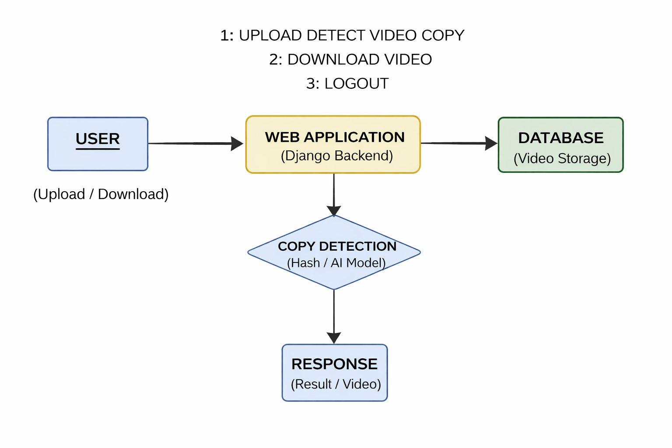
Collaboration Diagram
A collaboration diagram groups all interactions between objects as numbered sequences. USER → DATABASE: 1: Upload Detect Video Copy, 2: Download Video, 3: Logout — identifying all possible communications between system objects.
Collaboration Diagram — Numbered interactions between USER and DATABASE: 1: Upload Detect Video Copy, 2: Download Video, 3: Logout
Homomorphic Encryption | Video Copy Detection

Slide 18
Modules
Data Collection Module:
This module is responsible for collecting video data from different sources. The collected data may include multi-view videos from cameras or cloud storage. It ensures that sufficient and relevant data is gathered for further processing.
Data Pre-processing Module:
In this module, the collected videos are cleaned and prepared for analysis. It includes tasks like resizing frames, removing noise, normalizing data, and converting videos into suitable formats. This step improves the quality of input data.
Feature Extraction using Pre- trained Models:
This module extracts important features from videos using pre-trained deep learning models. These features represent the content of videos in a compact form and help in identifying similarities between videos.
Homomorphic Encryption | Video Copy Detection

Slide 19
Ensemble Classification Module:
This module uses multiple machine learning models together to improve accuracy. By combining different classifiers, it provides better decision-making in identifying whether a video is duplicate or not.
Prediction and Result Display Module:
This module provides the final output of the system. It predicts whether the uploaded video is unique or duplicate and displays the result clearly to the user.
Model Evaluation Module:
This module evaluates the performance of the system using metrics like accuracy, precision, and recall. It helps in analysing how well the model is performing and improving it if needed.
Homomorphic Encryption | Video Copy Detection

Slide 20
Algorithms
Homomorphic Encryption:
This is the core algorithmic component of the system. It allows the cloud server to perform operations directly on encrypted video data without needing to decrypt it.
1.Similarity Comparisons 2.Confidentiality
Feature Extraction & Matching:
The system employs specific algorithms to represent and compare video content:
1. Robust Feature Extraction 2.Spatial and Temporal Analysis
Multi-View Feature Alignment:
Because the project deals with multi-view videos (captured from multiple angles), it uses alignment techniques to integrate these perspectives
1.Perspective Integration
System Implementation Details:
1.Coding language 2. Similarity search
Homomorphic Encryption | Video Copy Detection

Slide 21





Role of Machine Learning
Deep Feature Extraction
Robustness
Privacy-Preserving Inference
Uses Convolutional Neural Networks (CNNs) to transform complex multi-view video frames into compact Feature Vectors (fingerprints).
Ensures the system can detect copies that have been altered through compression, noise, or resizing.
ML allows the system to encrypt only the essential features rather than the entire video, drastically reducing the computational load on HE.
Multi-View Alignment
Encrypted Similarity Matching
ML models (like Siamese Networks) learn to recognize similarities across different camera angles, identifying copies even if the perspective has changed.
Enables the Cloud to perform mathematical operations (like Euclidean Distance) on encrypted data to flag copies without ever decrypting or seeing the video content.
Homomorphic Encryption | Video Copy Detection

Slide 22
System Testing
Unit Testing:
Unit testing is usually conducted as part of a combined code and unit test phase of the software lifecycle, although it is not uncommon for coding and unit testing to be conducted as two distinct phases.
Functional Testing:
Functional tests provide systematic demonstrations that functions tested are available as specified by the business and technical requirements, system documentation, and user manuals. Functional testing is centered on the following items:
Valid Input : identified classes of valid input must be accepted.
Invalid Input : identified classes of invalid input must be rejected.
Functions : identified functions must be exercised.
Output : identified classes of application outputs must be exercised.
Homomorphic Encryption | Video Copy Detection

Slide 23
System Testing
White Box Testing:
White Box Testing is a testing in which in which the software tester has knowledge of the inner workings, structure and language of the software, or at least its purpose. It is purpose. It is used to test areas that cannot be reached from a black box level.
Black Box Testing:
Black Box Testing is testing the software without any knowledge of the inner workings, structure or language of the module being tested. Black box tests, as most other kinds of tests, must be written from a definitive source document, such as specification or requirements document, such as specification or requirements document. It is a testing in which the software under test is treated, as a black box .you cannot “see” into it. The test provides inputs and responds to outputs without considering how the software works.
Homomorphic Encryption | Video Copy Detection

Slide 24
System Testing
Integration Testing:
Software integration testing is the incremental integration testing of two or more integrated software components on a single platform to produce failures caused by interface defects. The task of the integration test is to check that components or software applications, e.g. components in a software system or – one step up – software applications at the company level – interact without error.
Test Results: All the test cases mentioned above passed successfully. No defects encountered.
Acceptance Testing:
User Acceptance Testing is a critical phase of any project and requires significant participation by the end user. It also ensures that the system meets the functional requirements.
Test Results: All the test cases mentioned above passed successfully. No defects encountered
Homomorphic Encryption | Video Copy Detection

Slide 25
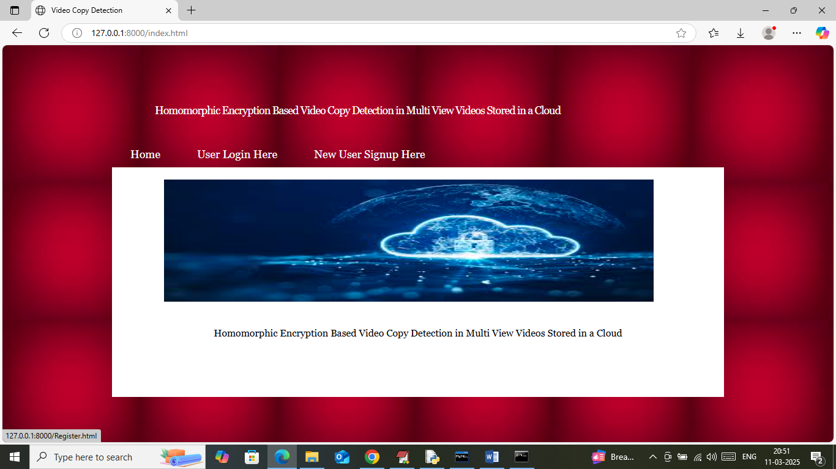
Results
Figure 1: Home Page
Homomorphic Encryption | Video Copy Detection

Slide 26
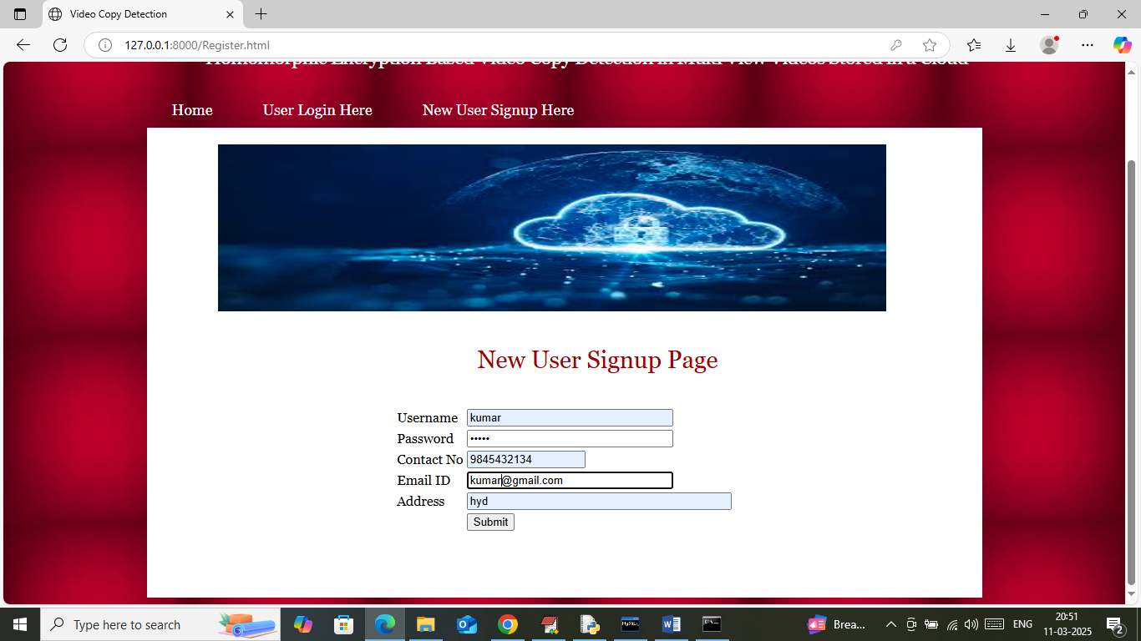
Figure 2: New User Sign-Up
Homomorphic Encryption | Video Copy Detection

Slide 27
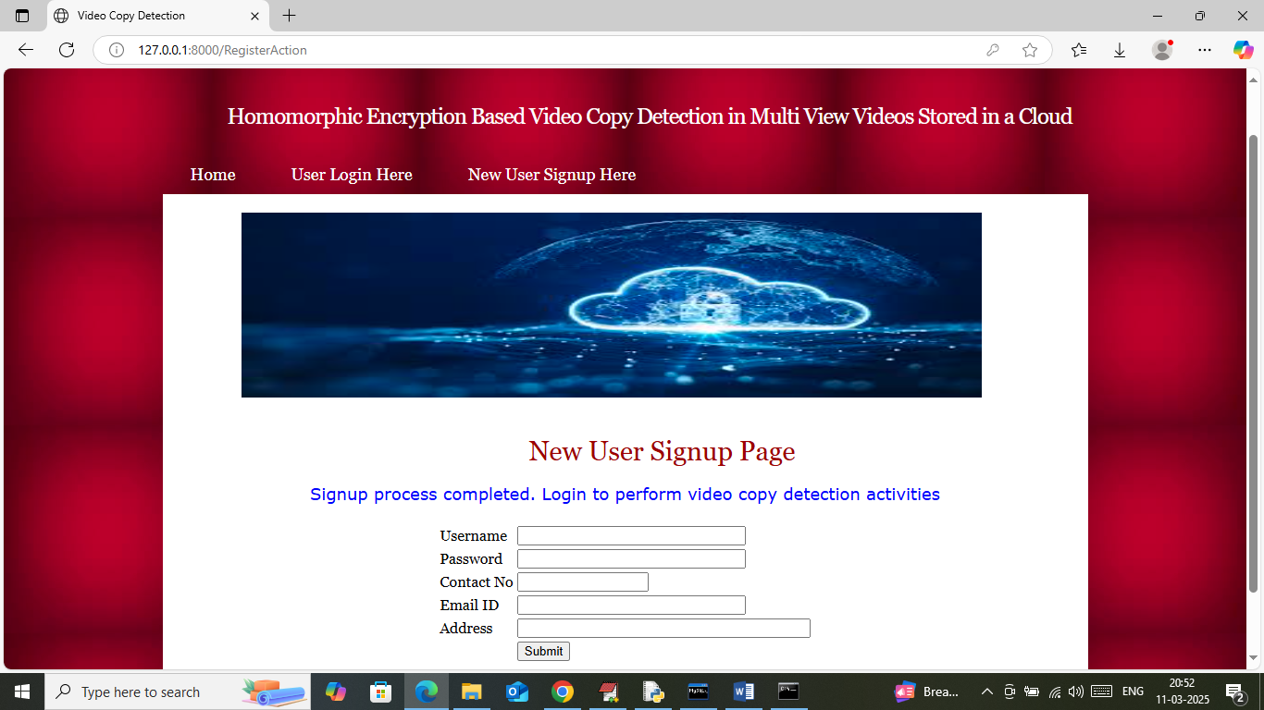
Figure 3: Enter Sign-Up Details
Homomorphic Encryption | Video Copy Detection

Slide 28
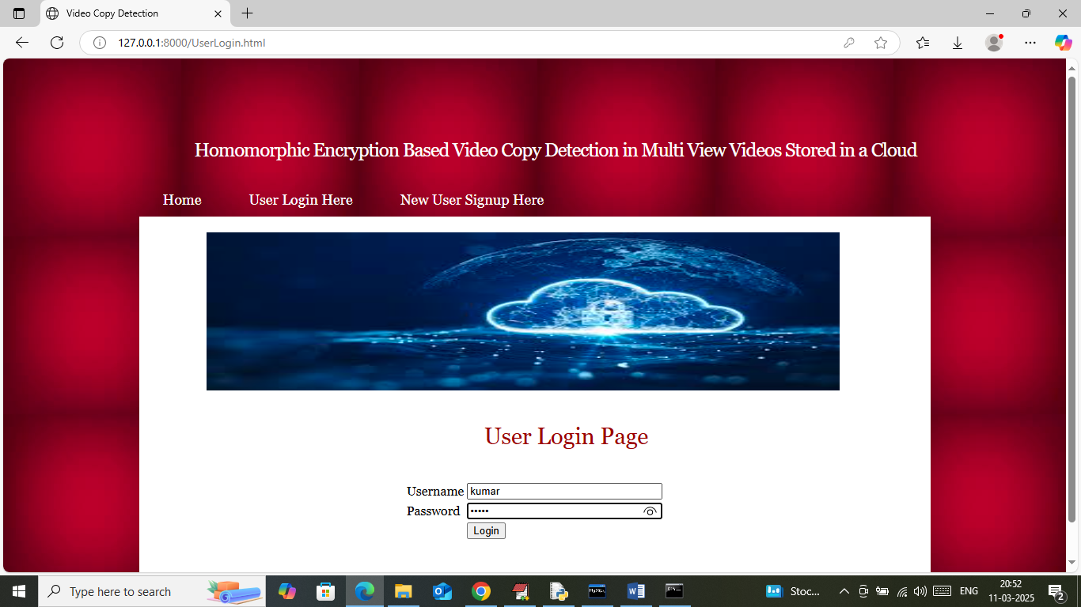
Figure 4: User Login
Homomorphic Encryption | Video Copy Detection

Slide 29
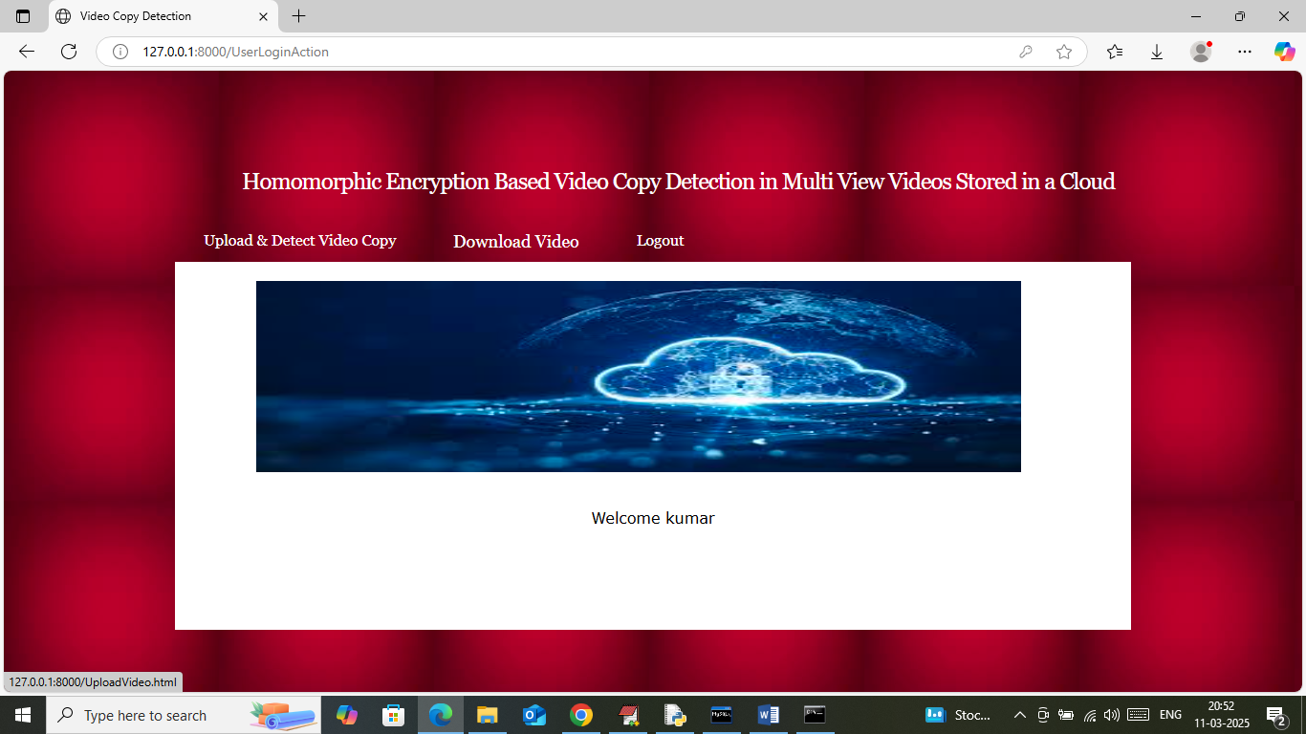
Figure 5: Welcome Page Login
Homomorphic Encryption | Video Copy Detection

Slide 30
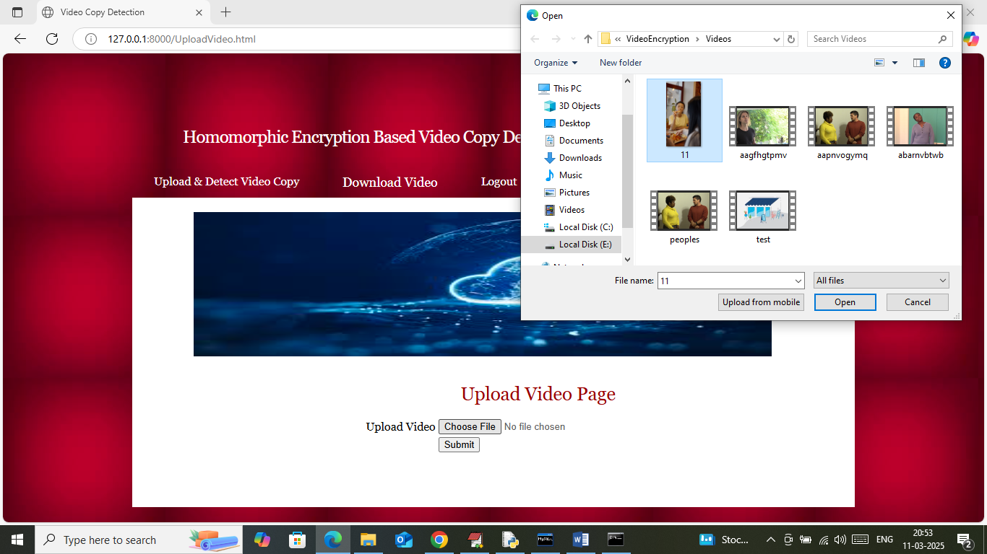
Figure 6: Upload and Detect Video Copy
Homomorphic Encryption | Video Copy Detection

Slide 31
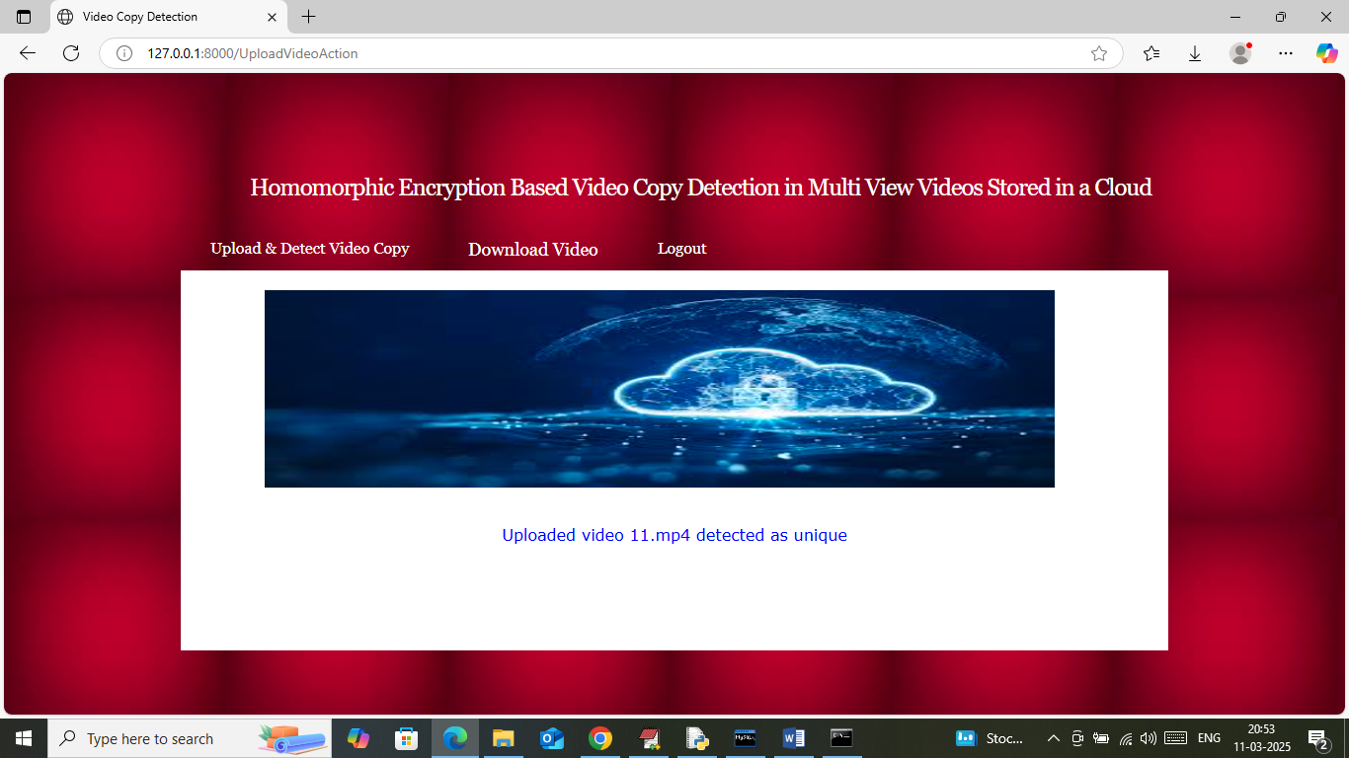
Figure 7: Uploading Video
Homomorphic Encryption | Video Copy Detection

Slide 32

Figure 8: Unique or Copy
Homomorphic Encryption | Video Copy Detection

Slide 33
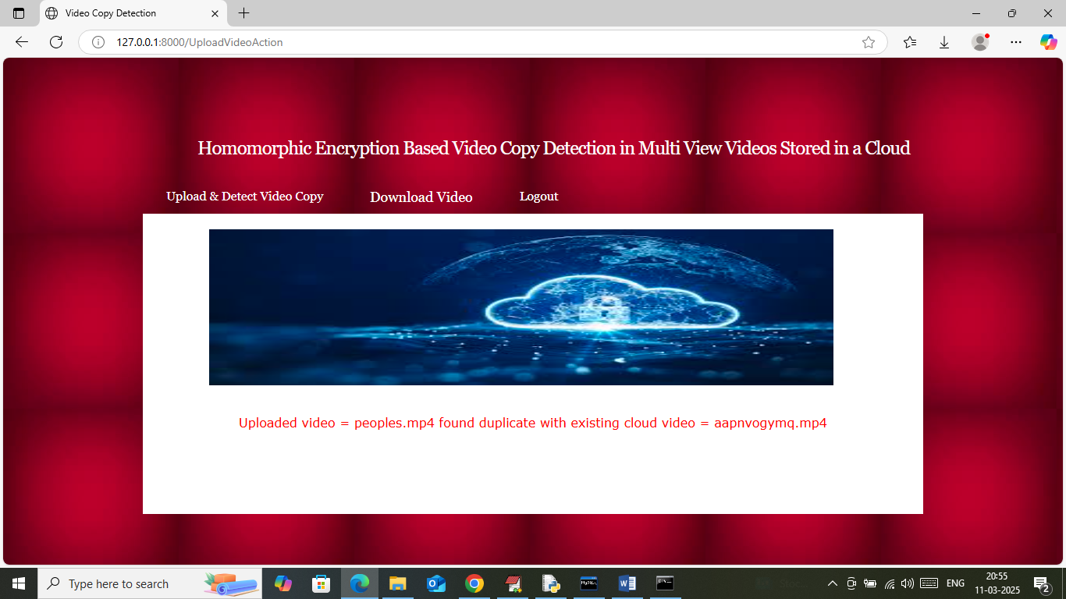
Figure 9: Output
Homomorphic Encryption | Video Copy Detection

Slide 34
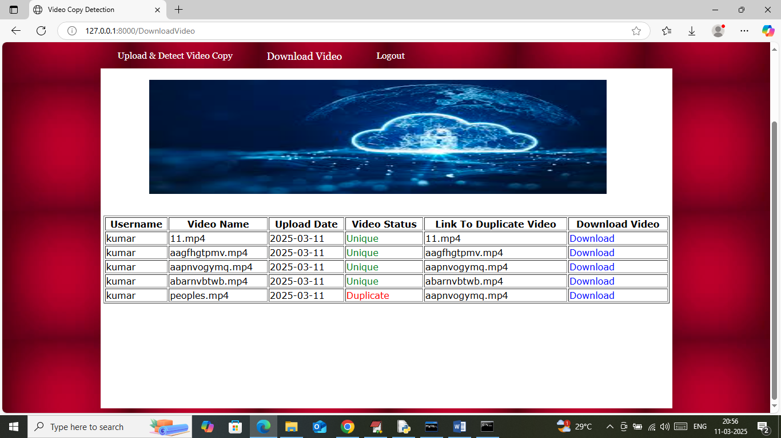
Figure 10: Checking and Downloading Video
Homomorphic Encryption | Video Copy Detection

Slide 35
Previous Papers
H. Zhang, W. Quan , H.-C. Chao, and C. Qiao
“Smart identifier network: A collaborative architecture for the future internet,” IEEE Network, vol. 30, no. 3, pp. 46–51, 2016.
2016
W. Quan, Y. Liu, H. Zhang, and S. Yu
2017
“Enhancing crowd collaborations for software defined vehicular networks,” IEEE Communications Magazine, vol. 55, no. 8, pp. 80–86, 2017.
2017
C. Yuan, Z. Xia, and X. Sun
“Coverless image steganography based on SIFT and BOF,” Journal of Internet Technology, vol. 18, no. 2, pp. 209–216, 2017.
2017
F. Song, Z. Ai, J. Li et al.
“Smart Collaborative Caching for Information-Centric IoT in Fog Computing,” Sensors, vol. 17, no. 11, p. 2512, 2017.
2017
J. Li, W. Yao, Y. Zhang, H. L. Qian, and J. G. Han
“Flexible and fine-grained attribute-based data storage in cloud computing,” IEEE Transactions on Services Computing, vol. 10, no. 5, pp. 785– 796, 2017.
Homomorphic Encryption | Video Copy Detection

Slide 36
Future Enhancement
While the proposed system demonstrates strong capabilities in secure video copy detection, there are several avenues for further improvement and expansion. Future work could focus on optimizing the computational efficiency of homomorphic encryption operations, which currently impose significant overhead on processing times. Research into lightweight or approximate homomorphic encryption schemes may help balance security with real-time performance demands. Another promising direction is the integration of advanced machine learning models, such as transformer-based architectures or graph neural networks, to enhance the extraction of more discriminative and compact features from multi-view videos. This could improve detection accuracy, especially for heavily edited or manipulated video content. Expanding the system to support other types of multimedia, such as audio or 3D point cloud data, would broaden its applicability across diverse content types in cloud storage. Additionally, exploring federated learning frameworks combined with homomorphic encryption could enable decentralized, privacy-preserving collaborative copy detection across multiple organizations or cloud providers. Finally, implementing adaptive thresholding and automated alert prioritization based on confidence scores could improve the system’s usability for content owners, helping to reduce false positives and focus resources on the most critical detections.
Homomorphic Encryption | Video Copy Detection

Slide 37
Conclusion
This project presents a novel approach to video copy detection by integrating homomorphic encryption with advanced view-invariant feature extraction techniques, tailored for multi-view videos stored in cloud environments. By enabling secure computations directly on encrypted data, the proposed system effectively addresses privacy concerns that traditional copy detection methods fail to resolve. The system ensures that sensitive video content remains confidential throughout the detection process, even when hosted on untrusted cloud platforms. Furthermore, the adoption of multi-view robust features improves detection accuracy by accommodating variations in camera angles, lighting, and video modifications, making the system highly reliable for real-world applications such as surveillance, media streaming, and copyright protection. The cloud-native architecture facilitates scalability and efficient handling of large video repositories, while the encryption framework maintains data integrity and access control. Overall, this homomorphic encryption-based framework represents a significant advancement in secure multimedia content management. It not only protects intellectual property rights and user privacy but also complies with emerging data protection regulations. Future work can explore further optimization of homomorphic operations and extend the system to other multimedia formats, contributing to the growing field of privacy-preserving video analytics.
Homomorphic Encryption | Video Copy Detection

Slide 38
Thank You!
We welcome your valuable questions and feedback.
Mallika Nagasuri
Sharif Shaik
Durga Tejesh Naramamidi
mallikanagasuri04@gmail.com
shaiksharif2030@gmail.com
durgatejeshnaramamidi@gmail.com

