Slide 1
MULTI-STAGE
AI Content Generation
Pipeline
By Sharif Ahmed
Chained LLM orchestration • Human-in-the-loop governance • Automated self-refinement
PROJECT 8 • CONTENT GENERATION PIPELINE
Notes:
Introduce the project: a multi-stage AI content generation pipeline. It coordinates separate LLM tasks, includes a human approval checkpoint, and refines drafts before packaging them for different platforms.

Slide 2
Why use a multi-stage pipeline?
Problem framing
Single-prompt limitations
Production needs
Design response
• Generic or repetitive writing
• Weak structure and inconsistent tone
• Limited review before publishing
• Clear stages with focused tasks
• Editorial checkpoints
• Repeatable output formats
Separate research, outlining, drafting,
evaluation, and packaging.
Core idea: make generation a controlled workflow—not one large prompt.
CONTENT GENERATION PIPELINE
Notes:
Explain the motivation. A single prompt can produce generic or repetitive content and offers limited opportunities for structural review. This project separates the workflow into smaller stages with explicit editorial checks.

Slide 3
Pipeline architecture
A human-approved outline guides drafting
1. Research & synthesis
2. Outline blueprint
3. Draft generation
4. Quality control
5. Format adaptation
Topic analysis, audience needs,
key ideas and evidence
➜
Sections, talking points,
word targets
➜
Expand the approved outline
into a coherent draft
➜
Score, critique and refine
when below threshold
➜
Package for the selected
publishing channel
Human gate
Refinement loop
Review, edit, reorder or regenerate the outline.
Low-scoring drafts receive targeted revision.
CONTENT GENERATION PIPELINE
Notes:
Walk through the flow from research to final packaging. The outline is reviewed by a human before drafting. A rubric then determines whether the draft should be refined before formatting.

Slide 4
Stages 1–2: research and outline
Build a plan before writing the full draft
Stage 1 — Research & synthesis
Stage 2 — Outline blueprint
• Break the topic into core questions
• Consider audience needs and pain points
• Identify 4–6 conceptual pillars
• Surface evidence angles and counterarguments
• Generate title and opening-hook options
• Organize sections and talking points
• Estimate word counts and evidence needs
• Pause for human review and approval
Human approval happens before the system expands the outline into a complete draft.
CONTENT GENERATION PIPELINE
Notes:
Stage 1 identifies conceptual pillars, audience needs, evidence angles and counterarguments. Stage 2 turns the findings into a structured outline with titles, section plans, talking points and word targets.

Slide 5
Human-in-the-loop governance
The editor stays in control of the structure
Review
Edit
Approve or regenerate
Inspect the proposed title, sections, talking points, and word targets.
Adjust, reorder, or add custom points before drafting.
Continue with the approved plan—or return to outline generation.
Benefit: the model does not proceed blindly from an unreviewed outline.
CONTENT GENERATION PIPELINE
Notes:
The human gate is a governance feature. The editor can revise or reorder sections, add points, approve the outline, or regenerate it. This reduces the risk of expanding a weak structure.

Slide 6
Quality control and self-refinement
A 100-point editorial rubric
Grammar & syntax
20/20
Clarity & coherence
20/20
Audience & tone
20/20
Outline adherence
20/20
Factuality & depth
20/20
Pass threshold
Below threshold
85/100
Critique-guided refinement
CONTENT GENERATION PIPELINE
Notes:
The rubric assigns 20 points each to grammar, clarity, audience/tone, outline adherence, and factuality/depth. The documented threshold is 85 out of 100. Below-threshold drafts can enter critique-guided refinement. A high score still does not guarantee truth.

Slide 7
Flexible model providers
Local privacy or cloud capability
Local — Ollama
Cloud — OpenAI-compatible APIs
Model: qwen2.5:3b
• Runs on the user's machine
• No per-request cloud API charge
• Useful for private/local workflows
• Requires local compute and setup
Examples in project documentation: GPT models, Groq, DeepSeek, OpenRouter
• Switch providers through configuration/UI
• Requires valid endpoint and credentials
• Usage may incur provider costs
Offline mock mode is also available for demonstrations without a model call.
CONTENT GENERATION PIPELINE
Notes:
The pipeline supports local Ollama with qwen2.5:3b, cloud OpenAI-compatible providers, and offline mock mode. Local inference can avoid sending prompts to a cloud model, while cloud usage depends on provider pricing and credentials.

Slide 8
One refined draft, multiple outputs
Platform-specific packaging
SEO blog post
Social thread
Email newsletter
Executive report
• H1/H2/H3 structure
• Meta description
• Keywords and takeaways
• Image prompt
• 8 numbered posts
• Short, scannable text
• Hashtags and CTA
• Subject line options
• Preview text and TL;DR
• Greeting and sign-off
• Summary
• Findings
• Recommendations matrix
The core content is refined once, then adapted to the chosen channel.
CONTENT GENERATION PIPELINE
Notes:
The final refined content can be transformed into four formats: an SEO blog post, a social media thread, an email newsletter, or an executive report. Each format gets its own structure and conventions.

Slide 9
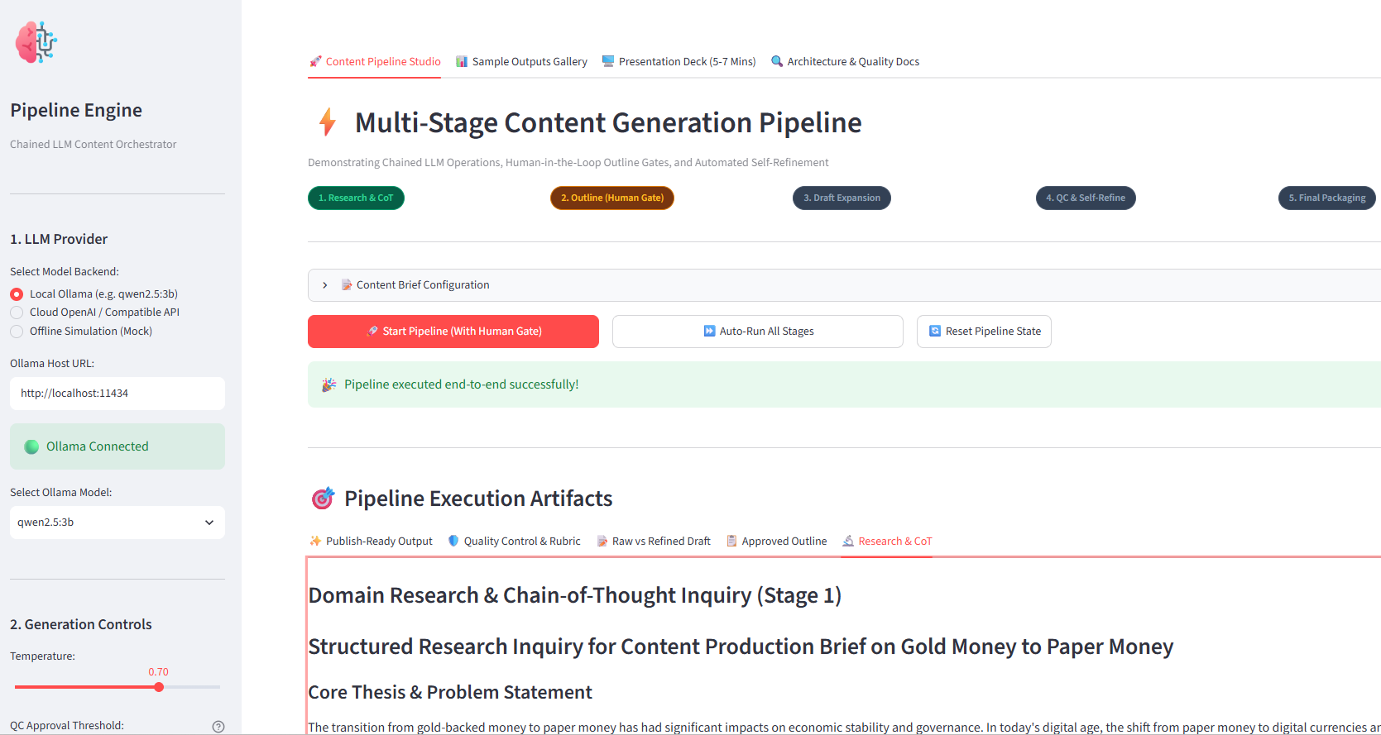
The Streamlit studio
Interactive controls and execution artifacts
CONTENT GENERATION PIPELINE
Notes:
Use this screenshot to orient the audience to the Streamlit studio: provider selection and generation controls on the left, pipeline actions and execution artifacts in the main workspace.

Slide 10
Implementation stack
Modular code with a lightweight web UI
Python + Streamlit
LangChain LCEL
Model adapters
Application UI and workflow controls
Composes the staged LLM chains
Ollama, cloud-compatible APIs, mock mode
Core modules
Validation approach
config.py — data schemas and configuration
models.py — model/provider factory
prompts.py — stage-specific prompts
chains.py — pipeline orchestration
evaluator.py — scoring and JSON parsing
CLI runner for repeatable test runs
Pre-generated samples for review
Mock mode for offline demonstrations
CONTENT GENERATION PIPELINE
Notes:
The implementation uses Python and Streamlit for the interface, LangChain LCEL for orchestration, and a provider abstraction for local/cloud/mock models. Modular files separate schemas, model creation, prompts, chains, and evaluation.

Slide 11
Benefits and practical limitations
A workflow aid—not a guarantee of correctness
What it improves
What still needs attention
• More structured drafting
• Human control before expansion
• Explicit quality criteria
• Reusable output formats
• Choice of local or cloud models
• LLM scores are not independent proof of truth
• Sources and claims need human verification
• Small local models may produce weaker research/writing
• API availability, latency, and cost vary
Quality gates support editorial consistency; they do not replace fact-checking.
CONTENT GENERATION PIPELINE
Notes:
Emphasize the distinction between consistency and correctness. An LLM evaluator is useful for structured critique but cannot independently validate factual claims. Human fact-checking and source verification remain important.

Slide 12
TAKEAWAY
From one prompt to a
controlled content workflow
Research → Outline → Human approval → Draft → Evaluate & refine → Package
Questions?
Thank you
PROJECT 8 • CONTENT GENERATION PIPELINE
Notes:
Close with the central idea: a controlled, reviewable workflow makes AI-assisted content generation more structured. Invite questions.

