Slide 1
Project 2: Data Analysis & Visualization Agent
From raw CSV/Excel data to AI-assisted insights
Python
• Pandas
• Streamlit
• Ollama/OpenAI
• Matplotlib
By Sharif Ahmed
Notes:
Introduce the project and state the goal: automate the first stages of data analysis while keeping execution controlled.

Slide 2
1. Problem & Objective
Raw datasets require repetitive inspection before useful analysis.
The agent automates structure detection, EDA, questions, charts, and explanations.
Goal: turn raw data into actionable insights through natural language.
Notes:
About 45 seconds. Emphasize that the system combines conventional data science with an LLM.

Slide 3
2. System Architecture
Streamlit upload → Pandas profiling → automatic EDA
LLM creates a structured analysis plan
Restricted Pandas expression is validated and executed
Matplotlib generates the requested visualization
UI returns result + chart + natural-language explanation
Notes:
About 60 seconds. Explain the LLM is a planner, while Pandas performs the actual computation.

Slide 4
3. Model Flexibility
Local Ollama: qwen2.5:3b (recommended), gemma3:4b
Ollama cloud-capable option: gpt-oss:120b-cloud if available
OpenAI API mode is also supported
Same application pipeline; only the LLM provider/model changes
Notes:
About 45 seconds. Mention that local mode can run without paid API usage.

Slide 5
4. Safety & Error Handling
No unrestricted Python REPL is exposed to the model.
Only dataframe-oriented expressions using df, pandas, and NumPy are accepted.
Imports, OS/file/network access, eval/exec, and similar operations are rejected.
If a generated expression fails, the agent gets one repair attempt.
Notes:
About 60 seconds. This is an important engineering point and likely Q&A topic.

Slide 6
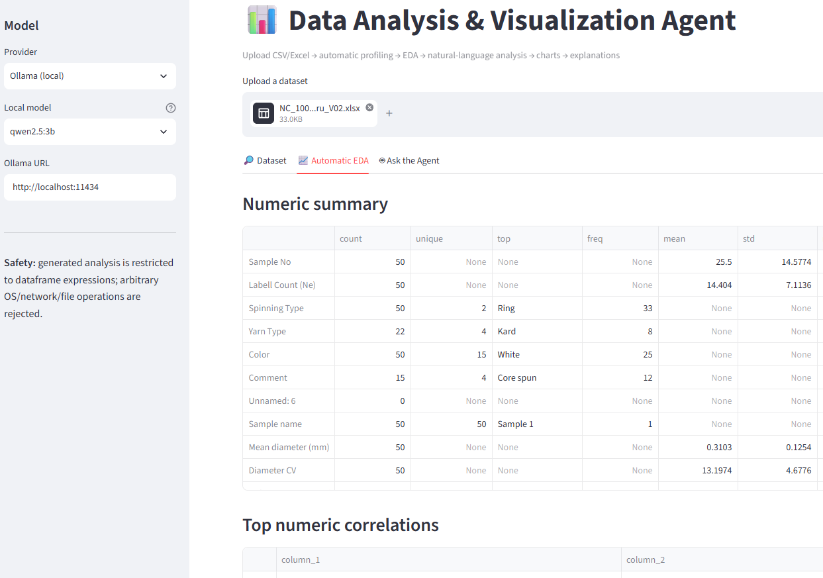
5. Interface
Notes:
Ask: What is the average sales by region? Show the generated chart and explain how the model selected the grouping and aggregation.

Slide 7
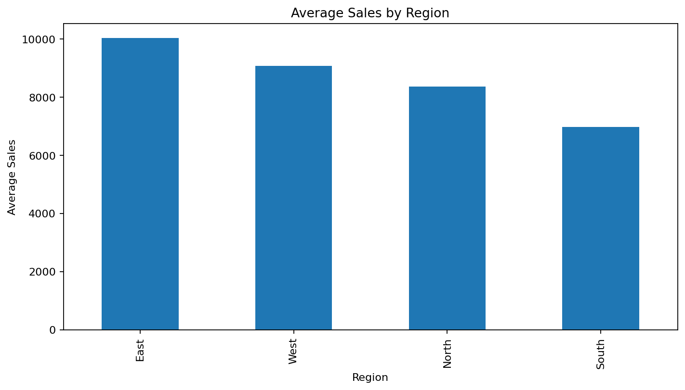
6. Demo: Sales Dataset
Notes:
Ask: What is the average sales by region? Show the generated chart and explain how the model selected the grouping and aggregation.

Slide 8
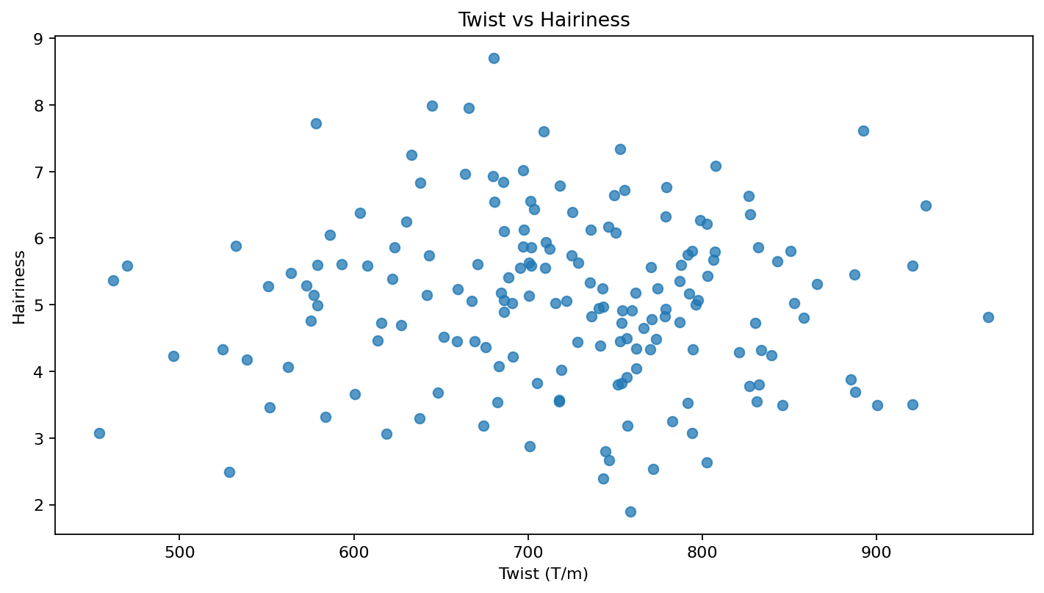
7. Demo: Yarn Quality Dataset
Notes:
Use the textile example: Show the relationship between twist and hairiness. This connects the project to textile engineering and research data.

Slide 9
8. Results & Learning Outcomes
Automated dataset understanding and EDA
Natural-language questions over structured data
Dynamic visualizations driven by the query
Explanations alongside numerical results
Safe execution and graceful error handling
Reusable architecture for future research datasets
Notes:
About 45 seconds. Close by connecting the implementation to the assignment learning objectives.

