Slide 1
Network Intrusion Detection System
Using Machine Learning
Detecting Normal vs. Attack Network Traffic | NSL-KDD Dataset
Logistic Regression · Decision Tree · Random Forest
Name
Course
Professor
SOURAV
Introduction to OSS
JUNAID RASHID
Introduction to Open Source Software · Sejong University · Instructor: Junaid Rashid · June 2026

Slide 2
2
Why Do We Need Intrusion Detection?
"Can a machine automatically tell the difference between normal traffic and an attack?"
🌐
Millions of packets per second
⚠️
Attacks are growing rapidly
Too much traffic for humans to inspect manually
DoS, Probe, R2L, U2R — new threats emerge daily
👁️
Manual inspection is slow
🤖
ML detects threats automatically
Security teams cannot review every log by hand
Train once — classify millions of packets in real time
🛡️
IDS raises alerts instantly
✅
Our solution — binary classification
Flags suspicious connections before damage occurs
Normal = 0 | Attack = 1 using NSL-KDD

Slide 3
3
Project Overview
WHAT IT DOES
TECH STACK
📦
Loads & preprocesses NSL-KDD dataset
Language
Python 3.13
🤖
Trains 3 machine learning classifiers
Dataset
NSL-KDD (auto-downloaded)
📊
Compares models & selects the best
ML Library
scikit-learn
💾
Saves best model for future predictions
Charts
matplotlib + seaborn
🖼️
Generates 6 visualisation charts (PNG)
Saving
joblib (model persistence)
🖥️
Interactive CLI for live predictions
Docs
README · LICENSE · requirements

Slide 4
4
Dataset — NSL-KDD
125,973
22,544
41
Training Records
Testing Records
Features
KDDTrain+.txt
KDDTest+.txt
per record
Each record = one network connection · Features: duration · protocol · src_bytes · dst_bytes · error rates · connection counts ...
ORIGINAL — 22+ ATTACK CLASSES
SIMPLIFIED — BINARY LABELS
● normal
Normal traffic
○ neptune
DoS attack
0 — NORMAL
○ portsweep
Probe attack
Legitimate network traffic
→
○ back
DoS attack
○ satan
Probe attack
1 — ATTACK
○ warezclient
R2L attack
Any of the 22+ attack categories
○ rootkit
U2R attack
○ ... +15 more

Slide 5
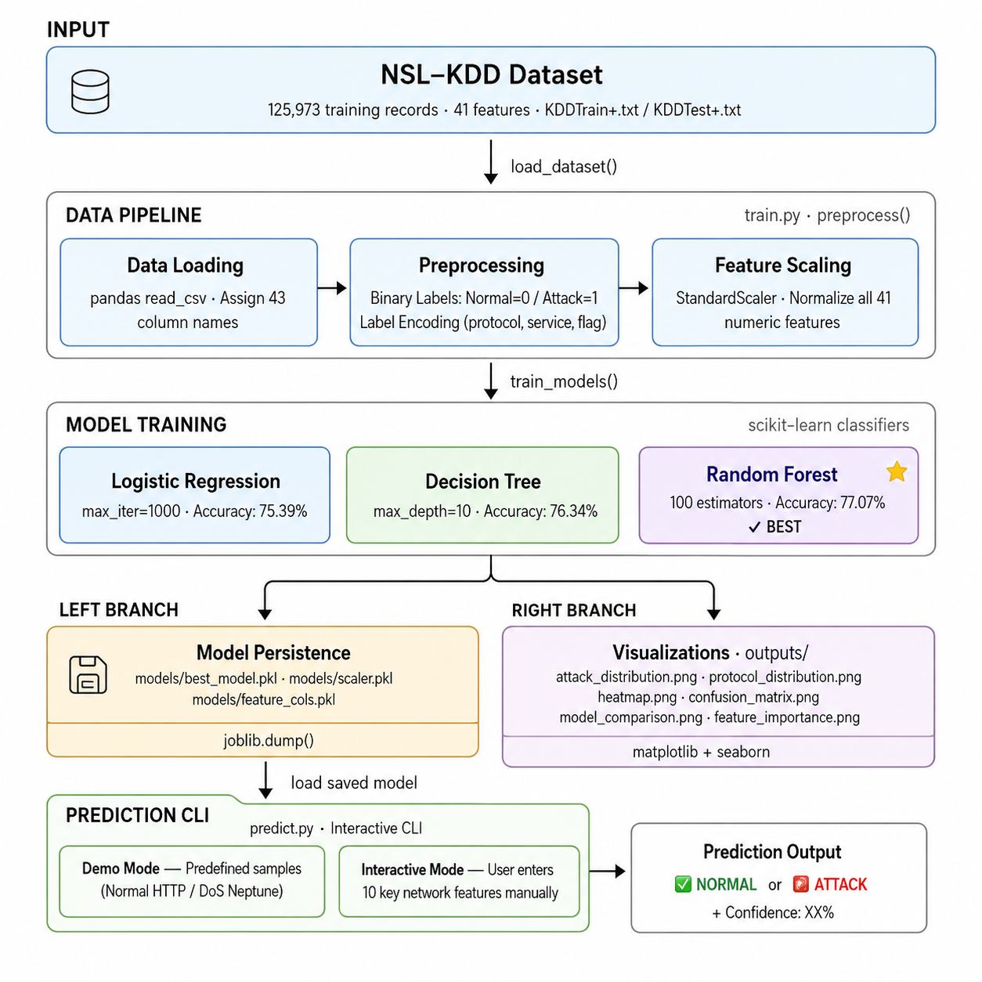
5
System Workflow — Step by Step

Slide 6
6
Data Preprocessing
🏷️
STEP 1
Binary Label Conversion
Before:
"normal", "neptune", "portsweep", "smurf" ...
After:
0 = Normal Traffic | 1 = Attack (any type)
Balance:
Normal: 67,343 | Attack: 58,630 (training set)
🔢
STEP 2
Categorical Feature Encoding
Why?
ML models require numeric input — cannot use raw text
3 columns:
protocol_type · service · flag → integers
Method:
sklearn LabelEncoder · fitted on train + test combined
📐
STEP 3
Feature Scaling — StandardScaler
Why?
src_bytes = 0 – 1.3 billion vs duration = 0 – 58,329
Method:
StandardScaler: zero mean, unit variance for all 41 features
Result:
No single feature dominates the model due to its scale

Slide 7
7
Machine Learning Models
📈
Logistic Regression
🌳
Decision Tree
🌲
Random Forest
ACCURACY
ACCURACY
ACCURACY
75.39%
76.34%
77.07%
Parameters:
Parameters:
Parameters:
max_iter = 1000 · random_state = 42
max_depth = 10 · random_state = 42
n_estimators = 100 · n_jobs = -1
Key Points:
Key Points:
Key Points:
Fast baseline — trains in seconds
Easy to visualise & explain
Best accuracy — selected & saved
Highly interpretable results
Captures non-linear patterns
Ensemble of 100 decision trees
Works well with scaled features
No scaling strictly required
Robust to noise & overfitting
BEST MODEL — SAVED
All models from scikit-learn (open source) · Trained: 125,973 records · Tested: 22,544 records

Slide 8
8
Results & Visualisations
MODEL COMPARISON — KDDTest+
6 CHARTS AUTO-GENERATED
MODEL
ACCURACY
F1
attack_distribution.png
Normal vs Attack count bar chart
Logistic Regression
75.39%
0.75
protocol_distribution.png
Decision Tree
76.34%
0.76
TCP / UDP / ICMP traffic breakdown
heatmap.png
Random Forest ✅
77.07%
0.77
Feature correlation (top 15 features)
confusion_matrix.png
CONFUSION MATRIX — Random Forest
True vs Predicted — Random Forest
True Normal → Predicted Normal:
9,433 (correct)
model_comparison.png
True Normal → Predicted Attack:
278 (false alarm)
Accuracy bar chart for all 3 models
True Attack → Predicted Normal:
4,892 (missed)
feature_importance.png
True Attack → Predicted Attack:
7,941 (correct)
Top 15 important features (RF)
⚠️ KDDTest+ contains novel attack types not seen in training — tests real-world generalisation

Slide 9
9
Live Prediction — Command-Line Interface
> py main.py --predict
Sample A — Normal HTTP Traffic
Sample B — DoS Neptune Attack
INPUT VALUES:
INPUT VALUES:
Protocol
TCP
Protocol
TCP
Service
HTTP
Service
HTTP
src_bytes
215
src_bytes
0 (nothing sent)
dst_bytes
45,076
dst_bytes
0 (no response)
logged_in
1 (Yes)
serror_rate
1.00 (SYN flood!)
serror_rate
0.00 (no SYN errors)
count
511 (max connections)
NORMAL
ATTACK DETECTED
Confidence: ~94%
Confidence: ~99%

Slide 10
10
Open Source Project Files
📄
README.md
📦
requirements.txt
⚖️
LICENSE (MIT)
The front page of any open source project
Guarantees reproducibility for everyone
Legal permission to use the code
> Explains what the project does
> Lists all 6 libraries + versions
> Without a license — unusable legally
> Shows installation & usage steps
> pip install -r requirements.txt
> MIT = most permissive license
> Lists features and sample output
> Recreates exact environment instantly
> Anyone can use, copy, modify & share
> Renders automatically on GitHub
> Eliminates 'works on my machine'
> Only: keep the copyright notice
> Without it — no one uses the code
> Core open source principle
> Makes the project truly open source

Slide 11
11
Project Structure & How to Run
PROJECT FILE STRUCTURE
HOW TO RUN (2 commands)
NIDS-Project/
|
+-- main.py <- Entry point
+-- train.py <- Training + charts
+-- predict.py <- Prediction CLI
|
+-- data/
| +-- KDDTrain+.txt (auto-dl)
| +-- KDDTest+.txt (auto-dl)
|
+-- models/
| +-- best_model.pkl (RF saved)
| +-- scaler.pkl
|
+-- outputs/
| +-- attack_distribution.png
| +-- heatmap.png
| +-- ... (6 charts total)
|
+-- README.md
+-- requirements.txt
+-- LICENSE
1 Install dependencies
pip install -r requirements.txt
One-time setup — installs all 6 libraries
2 Train models + generate charts
py main.py --train
Downloads data, trains 3 models, saves 6 charts
3 Run live predictions
py main.py --predict
Interactive CLI — demo samples or custom input
4 Or train + predict together
py main.py --all
Full pipeline in one single command

Slide 12
12
Summary & Conclusion
125,973
3
77.07%
6
Records Trained
ML Models
Best Accuracy
Charts Made
WHAT WAS BUILT
WHAT I LEARNED
> Complete Python ML pipeline
- End-to-end ML pipeline in Python
end-to-end, fully runnable
- Importance of preprocessing (encoding + scaling)
> NSL-KDD data auto-downloaded
- Evaluating & comparing multiple models
no manual setup needed
> 3 classifiers trained & compared
- Open source best practices
LR · DT · RF
> Best model saved as .pkl
FUTURE IMPROVEMENTS
reusable anytime
-> Multi-class attack classification
> Interactive prediction CLI
demo + custom input mode
-> Deep learning / Neural Networks
> Full open source documentation
-> Real-time dashboard with Streamlit
README · LICENSE · requirements
Thank You, Feel Free To Ask Any Questions!

