Slide 1
Md. Shariful Islam ID : 192-15-13143 Section B

Slide 2
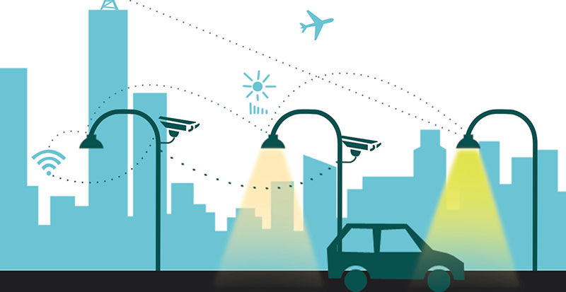
SMART STREET LIGHT

Slide 3
ABOUT THE PROJECT
My project is about Smart Street Light where Interfacing LDR with an Arduino, Interfacing an LED with the Arduino and then programming the Arduino in such a way that when light intensity decreases the LED turns ON.

Slide 4
WHAT I AM WORKING ON
I am going to execute my project through online simulation platform called “Tinkercard ”. We can also implement this project practically.

Slide 5
MAJOR REQUIREMENTS
02
03
01
04
Arduino UNO Board
Resistors
Jumper Wires
LDR
05
06
07
Power supply
NPN Transistor
Bulb

Slide 6
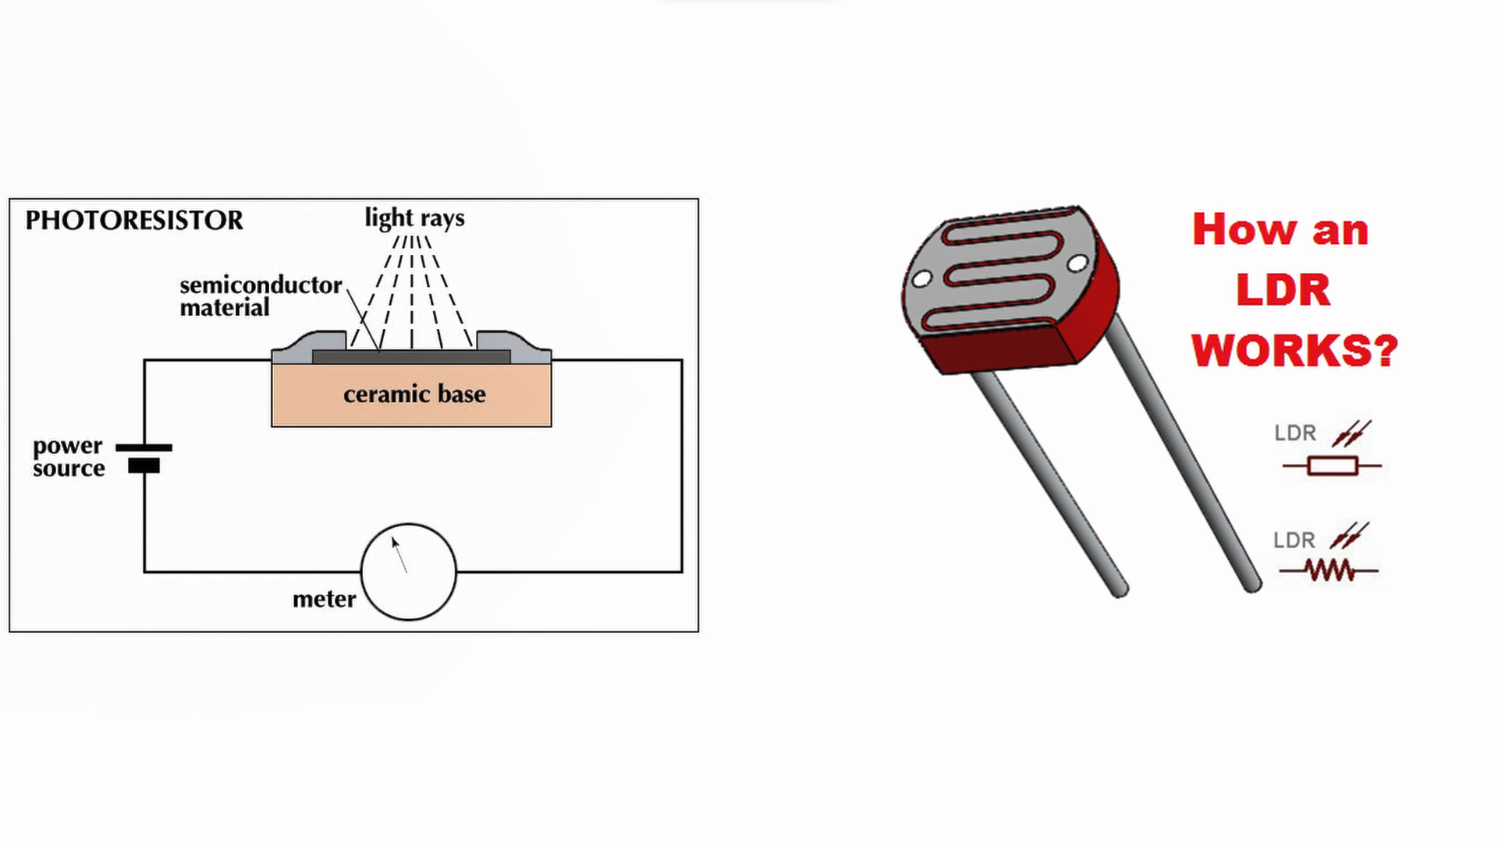
WORKING PROCESS OF LDR

Slide 7
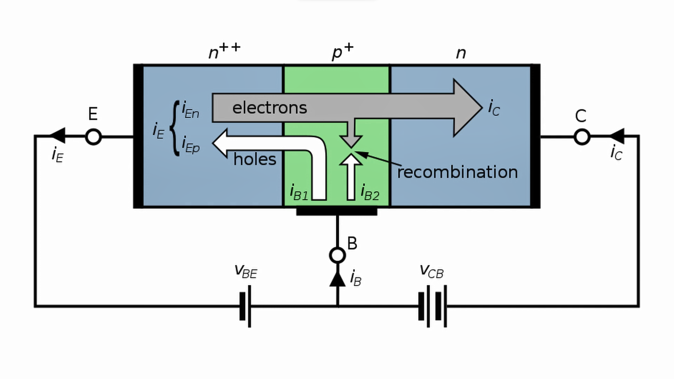
WORKING PROCESS OF N-P-N TRANSISTOR

Slide 8
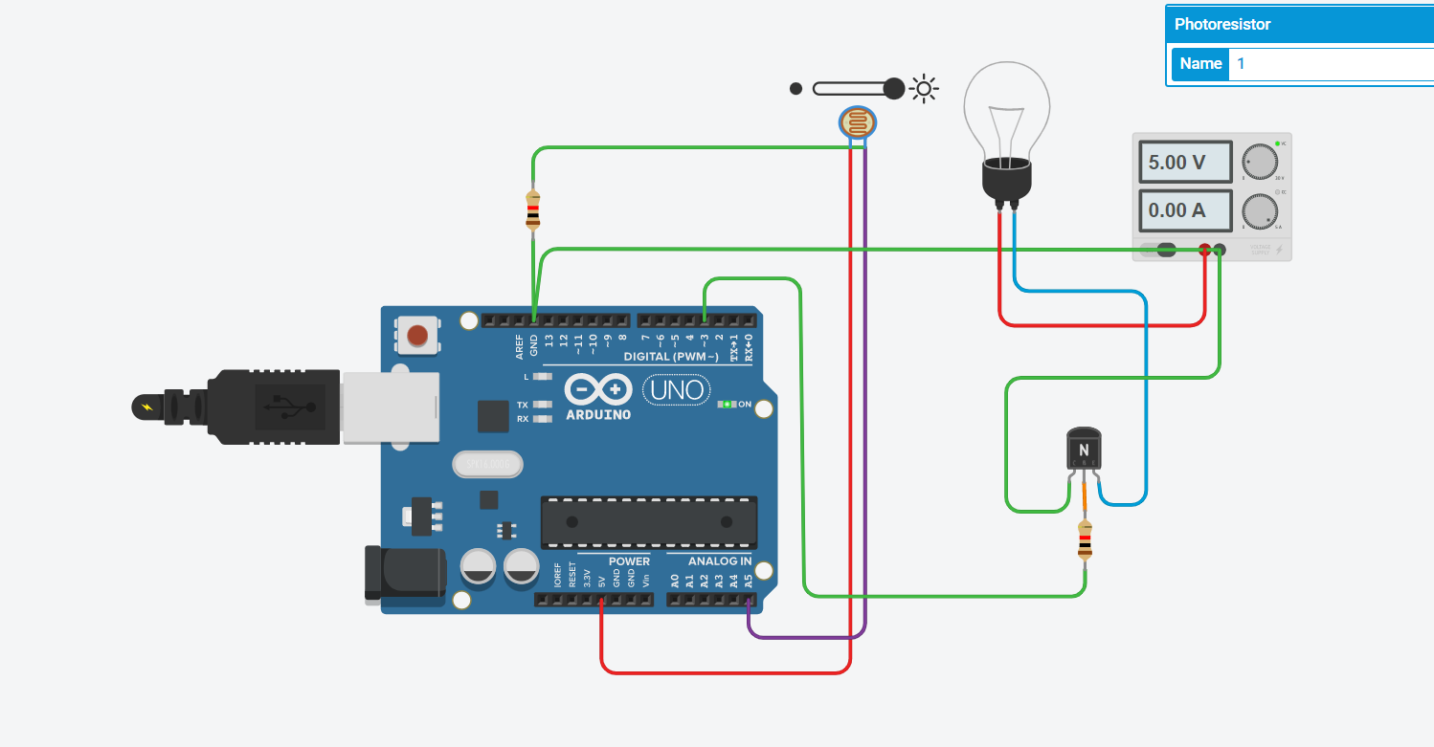
WHEN LIGHT INTENSITY IS HIGH

Slide 9
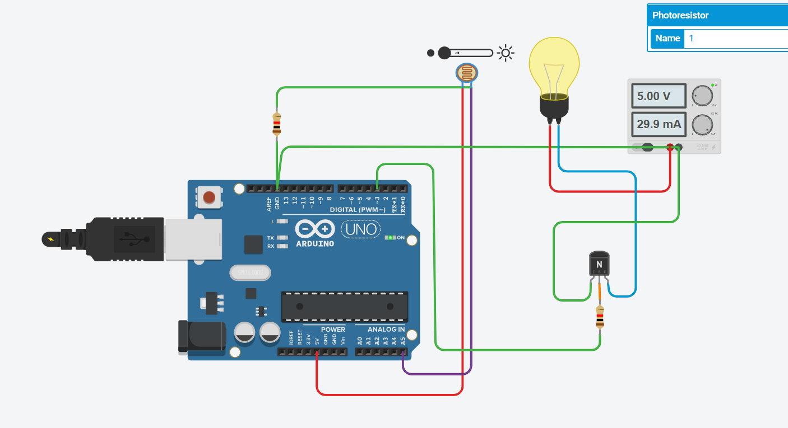
WHEN LIGHT INTENSITY IS LOW

Slide 10
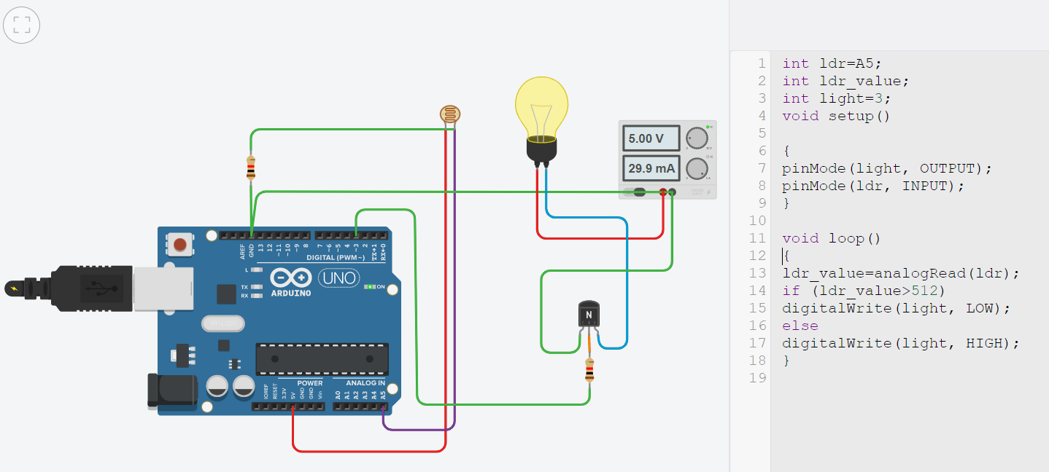
COADING PART

Slide 11
BUDGET
Since I am using Arduino UNO Board, Resistors, Jumper Wires, LDR, Bulb, Power supply, NPN Transistor-these components which are not so expensive, we can accomplish this project with a affordable budget.

Slide 12
THANK YOU

