Slide 1
WELCOME
ANGULARJS APP
‘ON TOPIC (BLOG)’
1
DEVELOPERD BY SHARIFUL ISLAM
GO TO
1
2
3
4
5
6
7
8
9
+
+
+

Slide 2

SUBMITTED TO
MD. MOSHAHIDUL ISLAM
PROJECT CONSULTANT, J2EE
IDB-BISEW
GO TO
1
2
3
4
5
6
7
8
9
+
+
+

Slide 3




TECHNOLOGY USED
ANGULAR JS
HIBERNATE
JAVA
BOOTSTRAP
CLIENT SITE
ORM
BUSINESS LOGIC
FRONT END
SINGLE PAGE APPLICATION
CREATE MODEL POJO
LOGIC TO MODEL
RESPONSIVE VIEW
GO TO
1
2
3
4
5
6
7
8
9
+
+
+

Slide 4
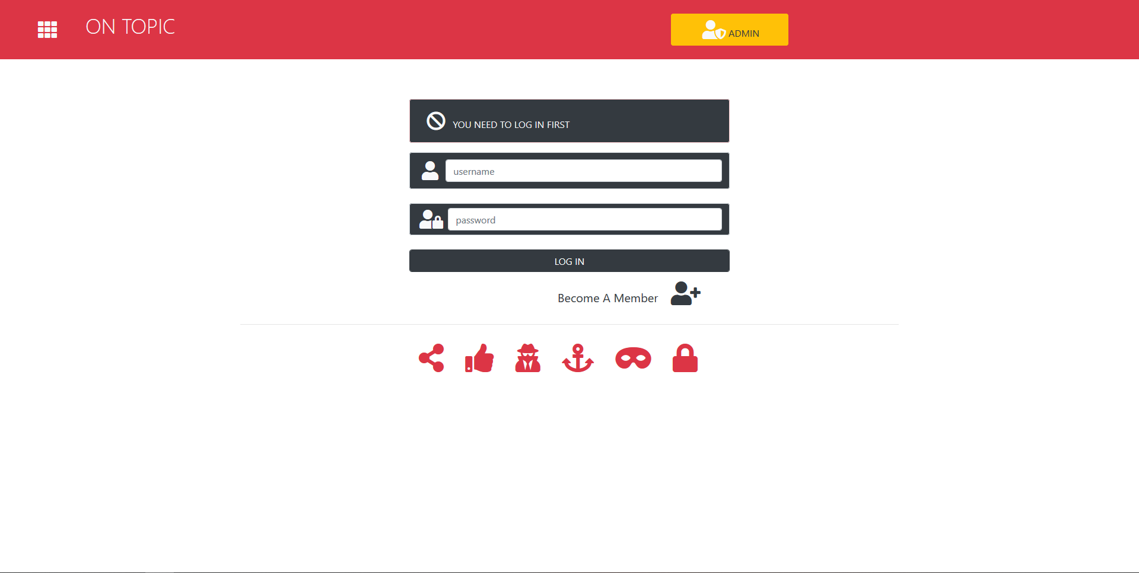
LOG IN AS MEMBER
GO TO
1
2
3
4
5
6
7
8
9
+
+
+

Slide 5
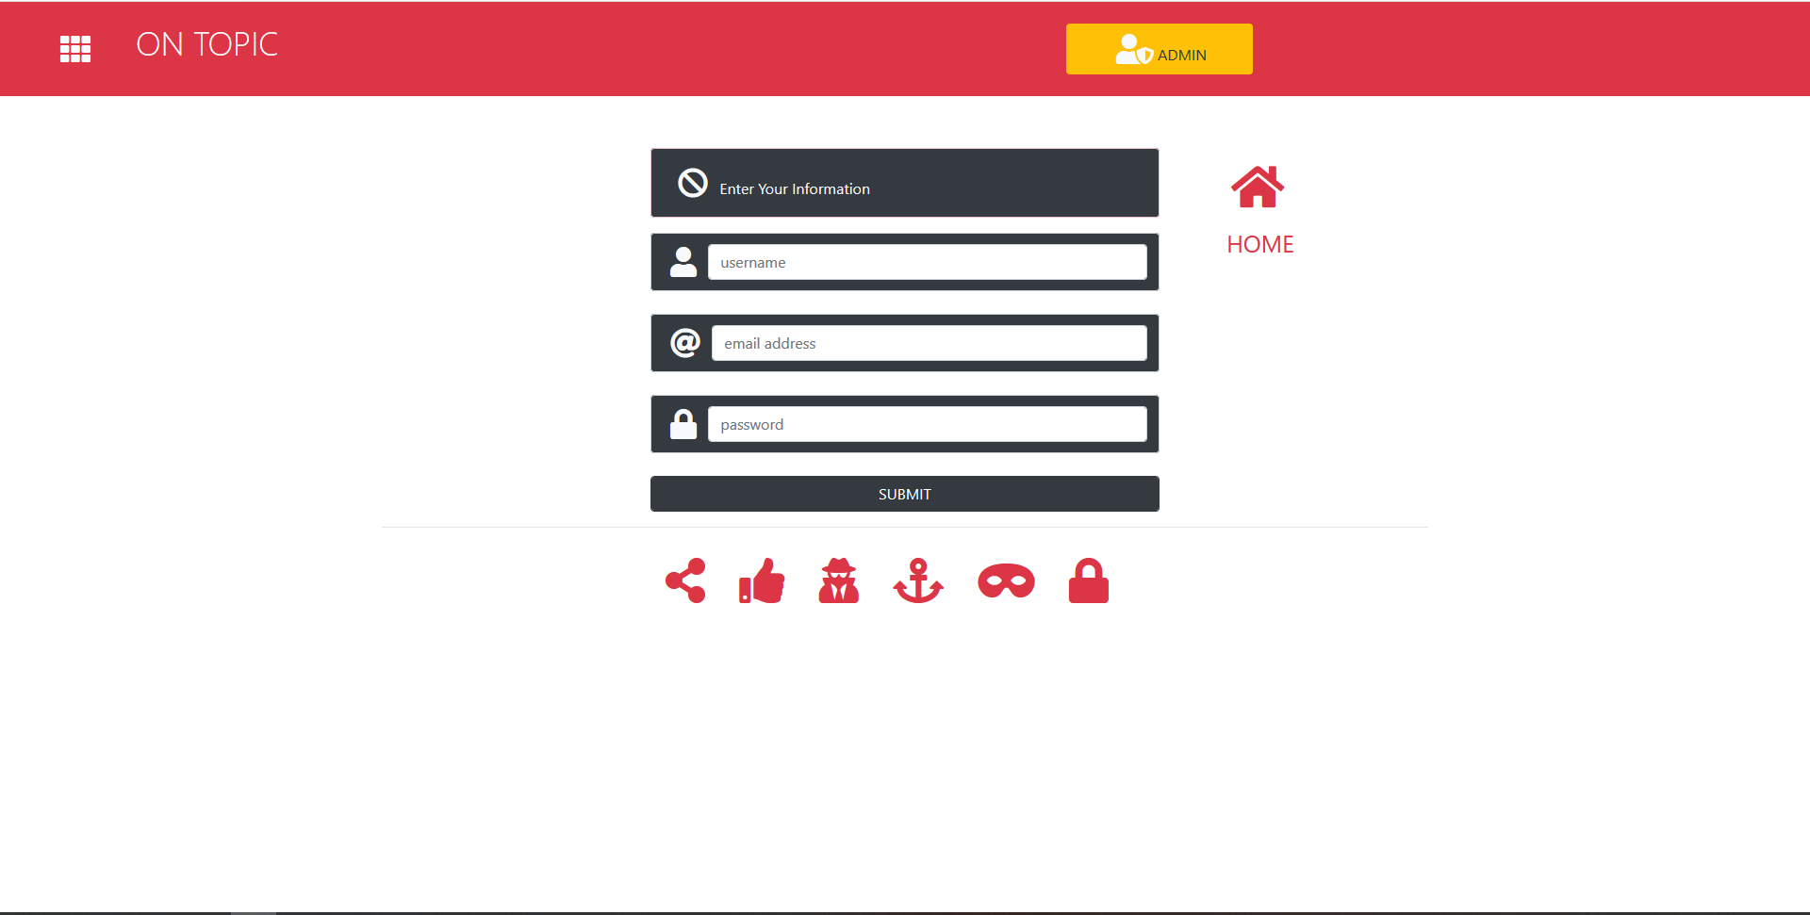
BECOME A MEMBER
GO TO
1
2
3
4
5
6
7
8
9
+
+
+

Slide 6

MEMBER TIMELINE
GO TO
1
2
3
4
5
6
7
8
9
+
+
+

Slide 7
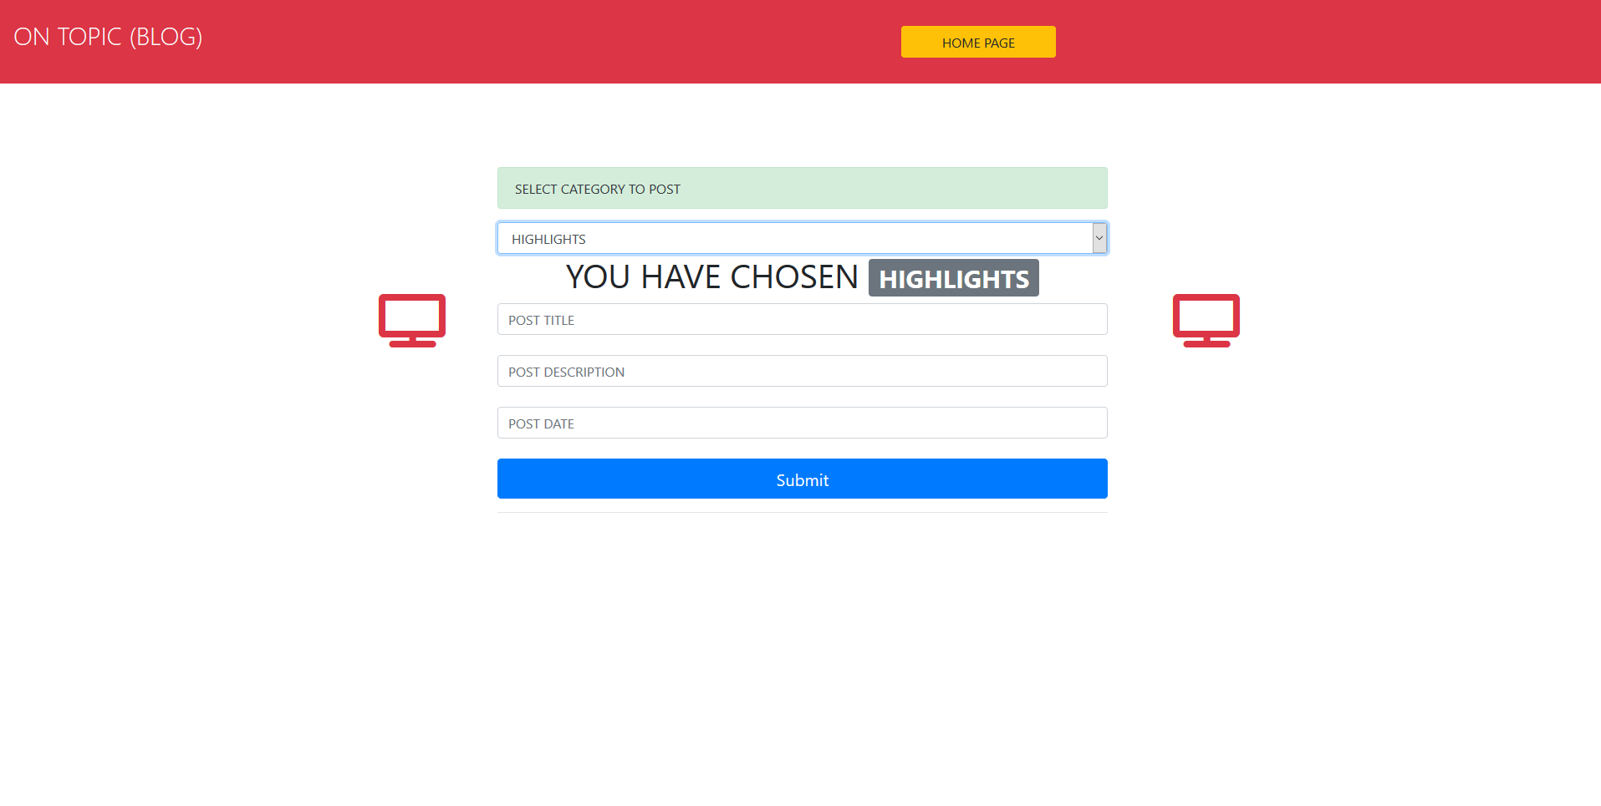
CREATE NEW POST
GO TO
1
2
3
4
5
6
7
8
9
+
+
+

Slide 8

POST FORMAT
GO TO
1
2
3
4
5
6
7
8
9
+
+
+

Slide 9

ADMIN PANEL
GO TO
1
2
3
4
5
6
7
8
9
+
+
+

Slide 10
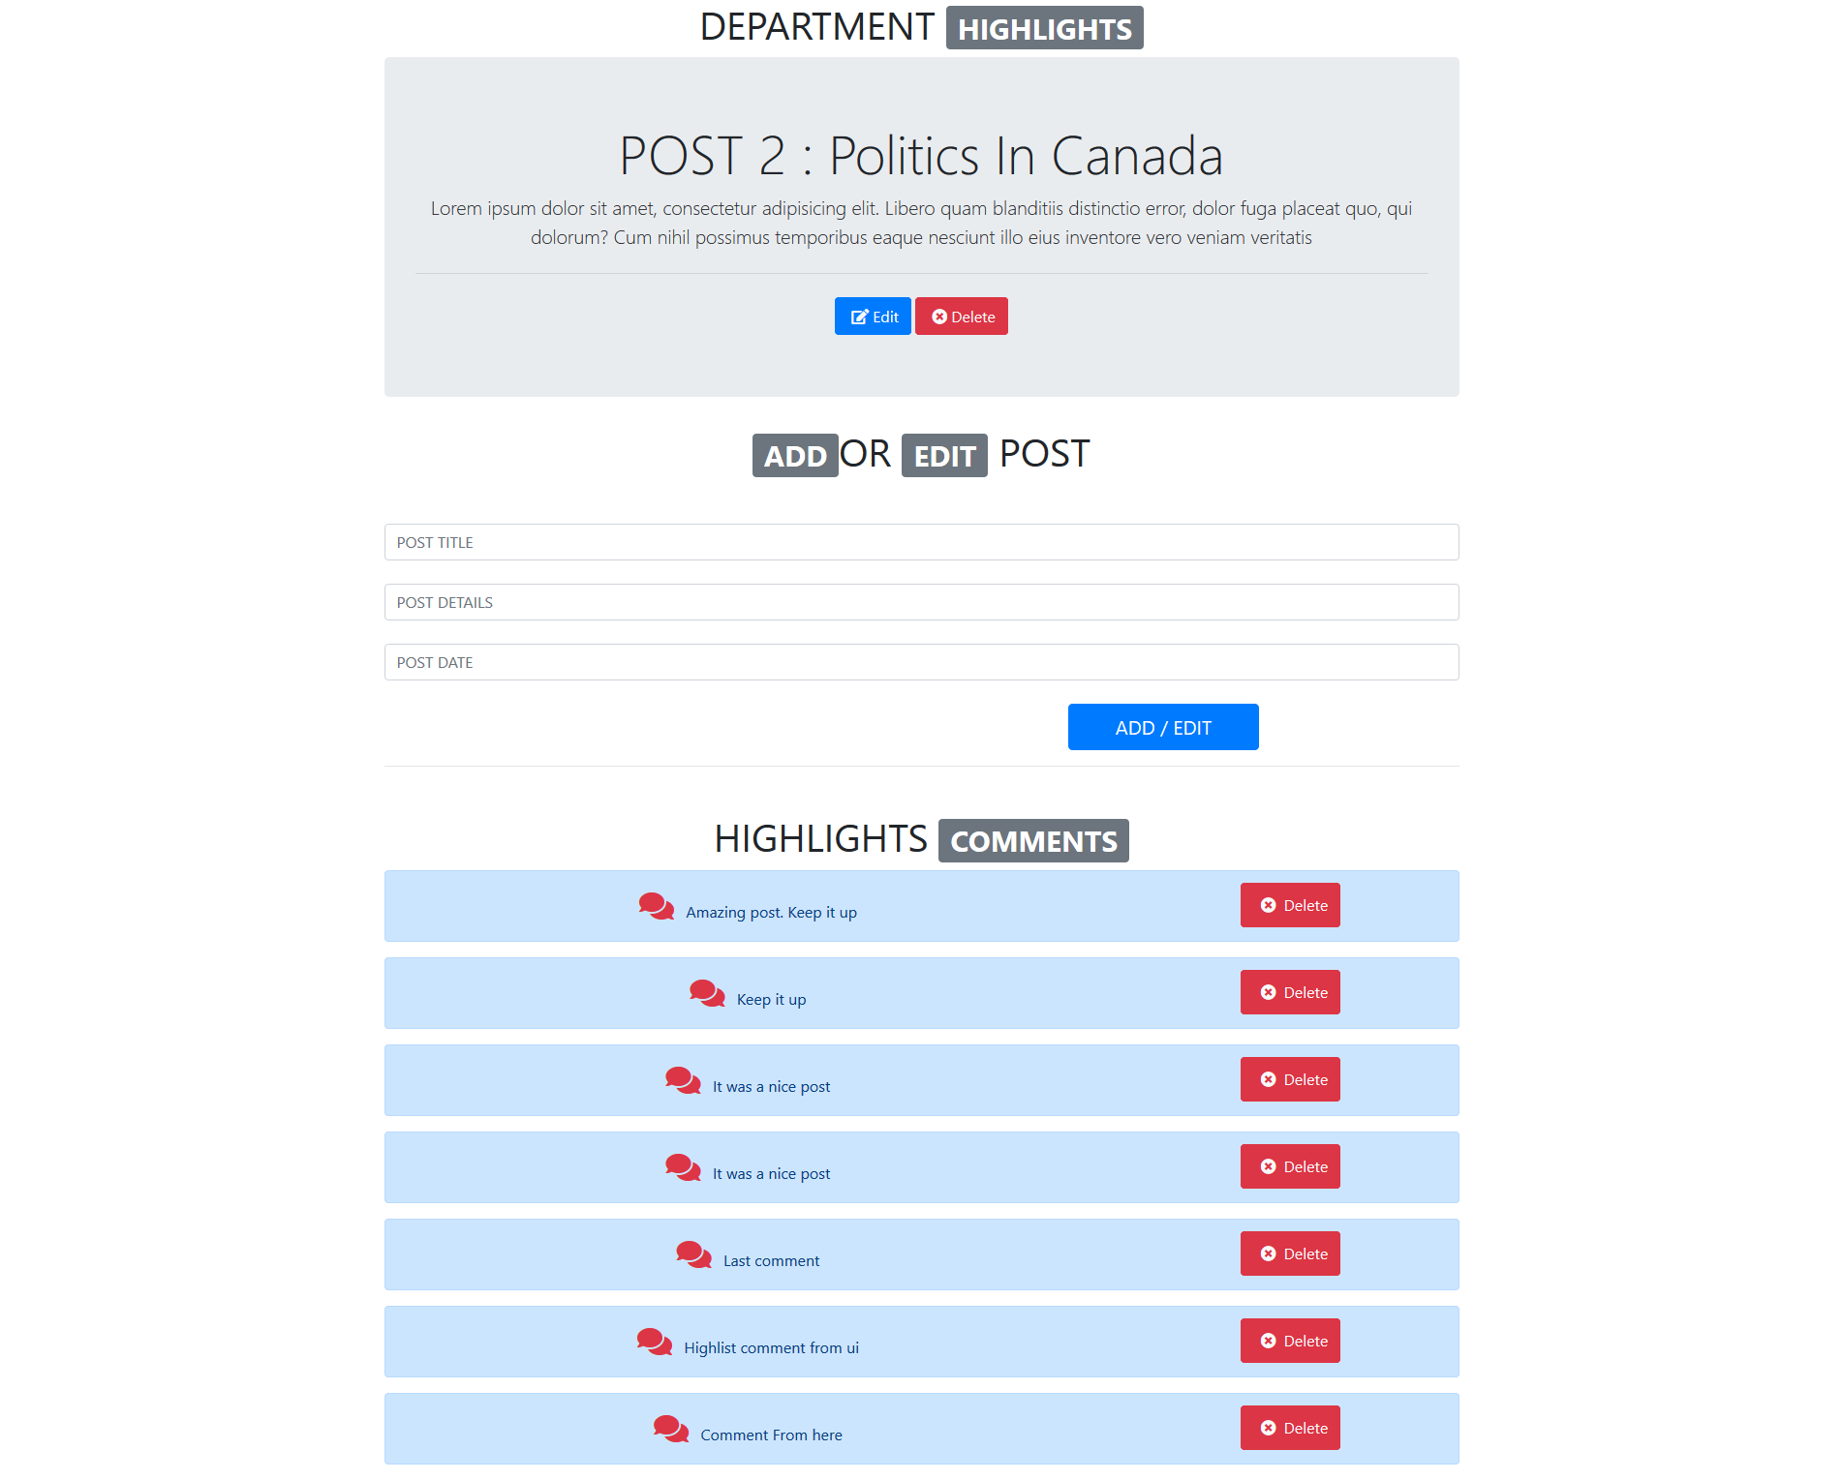
ADMIN PANEL
GO TO
1
2
3
4
5
6
7
8
9
+
+
+

Slide 11
THANK YOU
VISIT US ANYTIME
GO TO
1
2
3
4
5
6
7
8
9
+
+
+

