Slide 1
WELCOME
SPRING ANGULARJS
‘SHOPPING CART’
1
DESIGNED BY SHARIFUL ISLAM
GO TO
1
2
3
4
5
6
7
8
9
+
+
+

Slide 2

SUBMITTED TO
MD. MOSHAHIDUL ISLAM
PROJECT CONSULTANT, J2EE
IDB-BISEW
GO TO
1
2
3
4
5
6
7
8
9
+
+
+

Slide 3
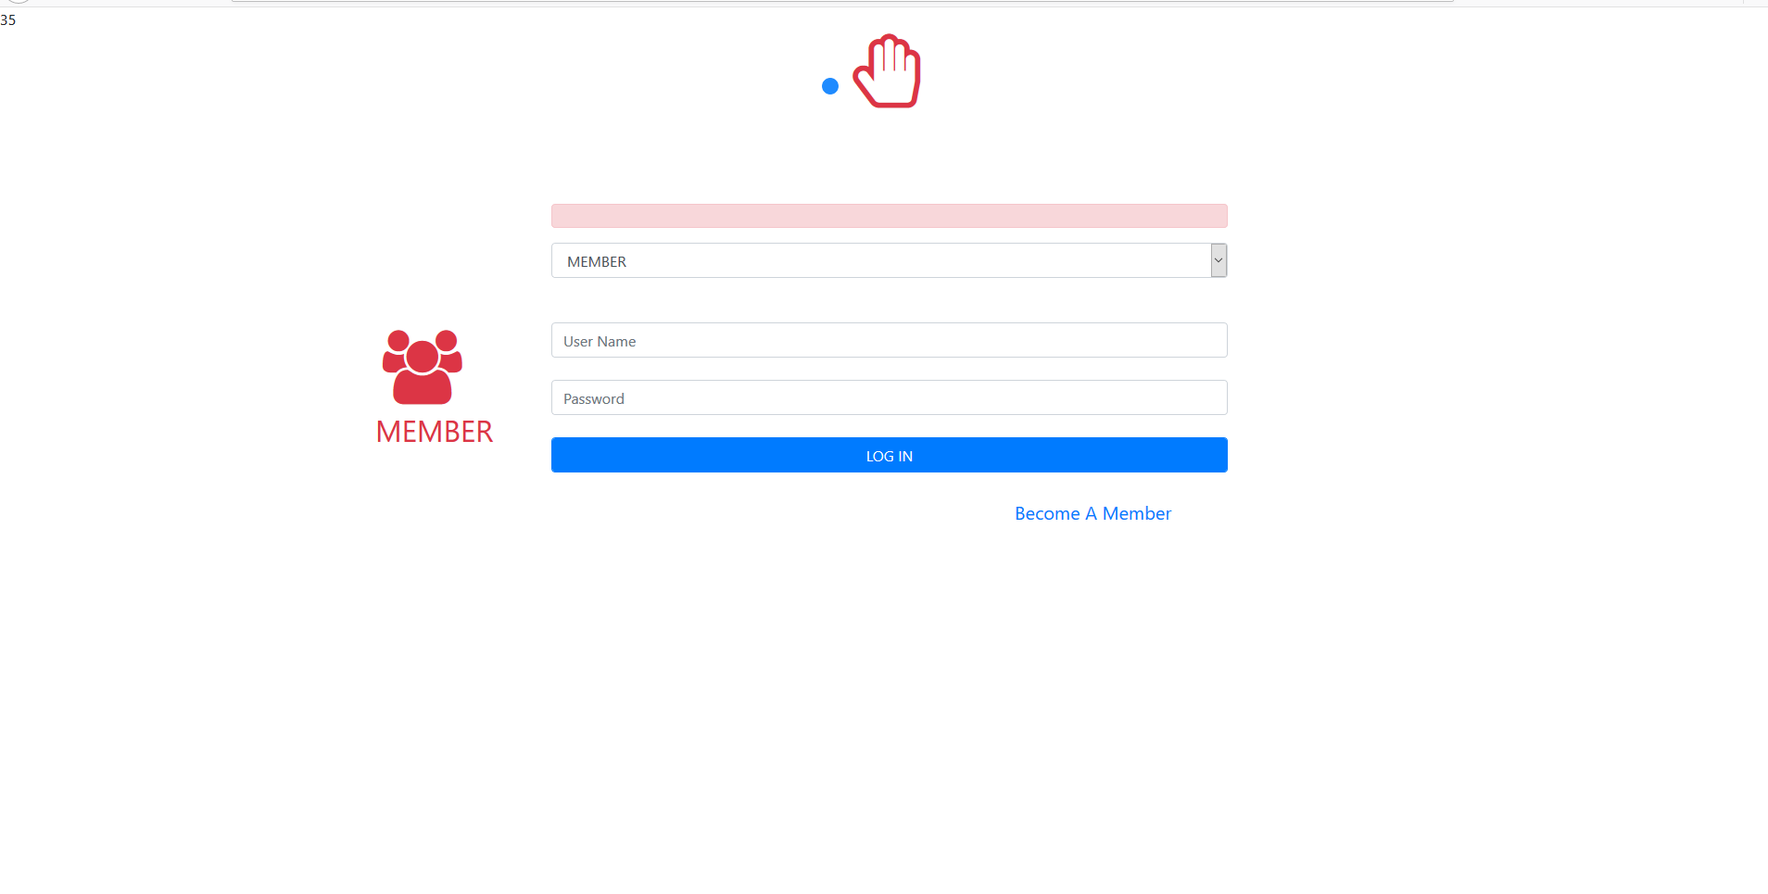
LETS TAKE A LOOK
GO TO
1
2
3
4
5
6
7
8
9
+
+
+

Slide 4
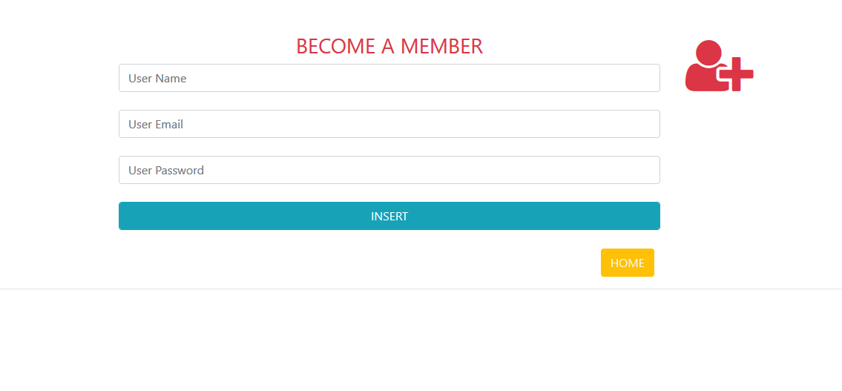
LETS TAKE A LOOK
GO TO
1
2
3
4
5
6
7
8
9
+
+
+

Slide 5
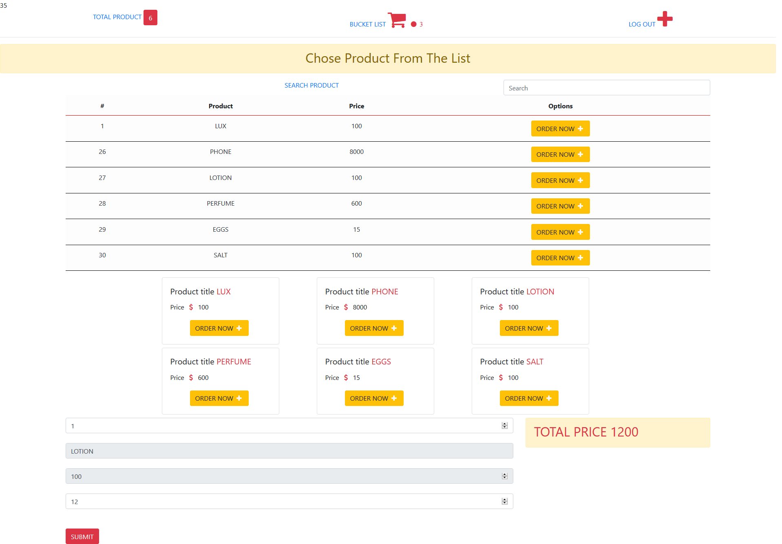
LETS TAKE A LOOK
GO TO
1
2
3
4
5
6
7
8
9
+
+
+

Slide 6
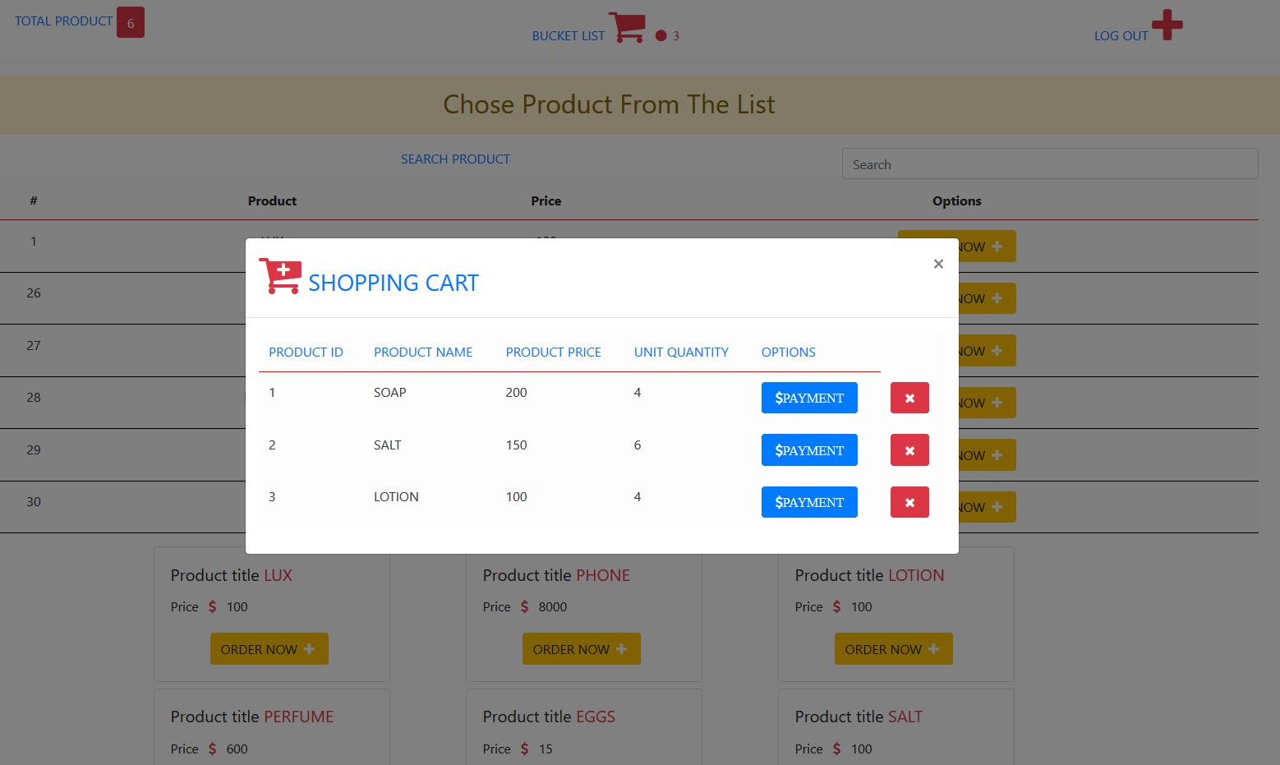
LETS TAKE A LOOK
GO TO
1
2
3
4
5
6
7
8
9
+
+
+

Slide 7
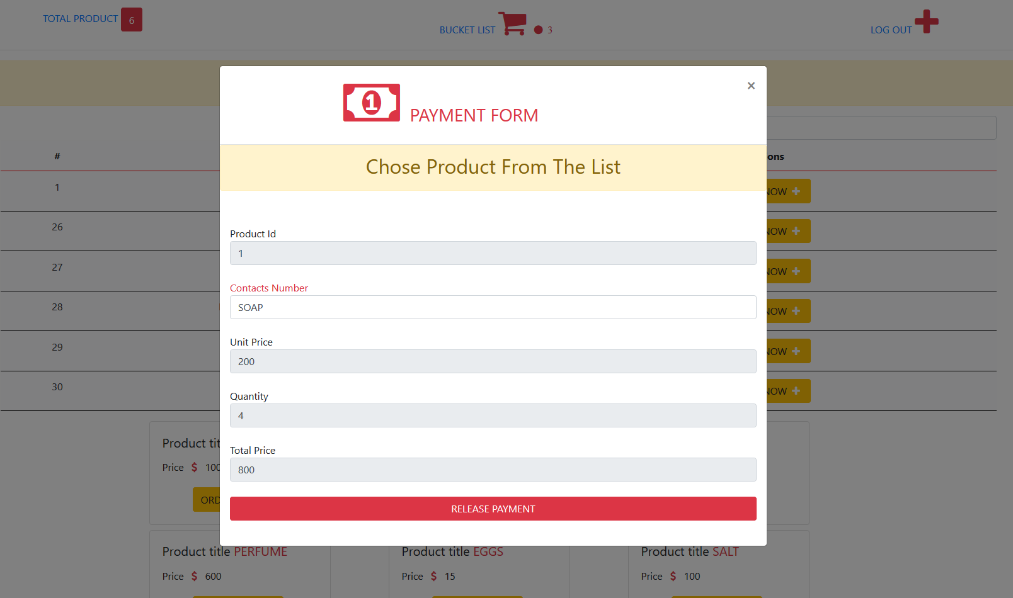
LETS TAKE A LOOK
GO TO
1
2
3
4
5
6
7
8
9
+
+
+

Slide 8
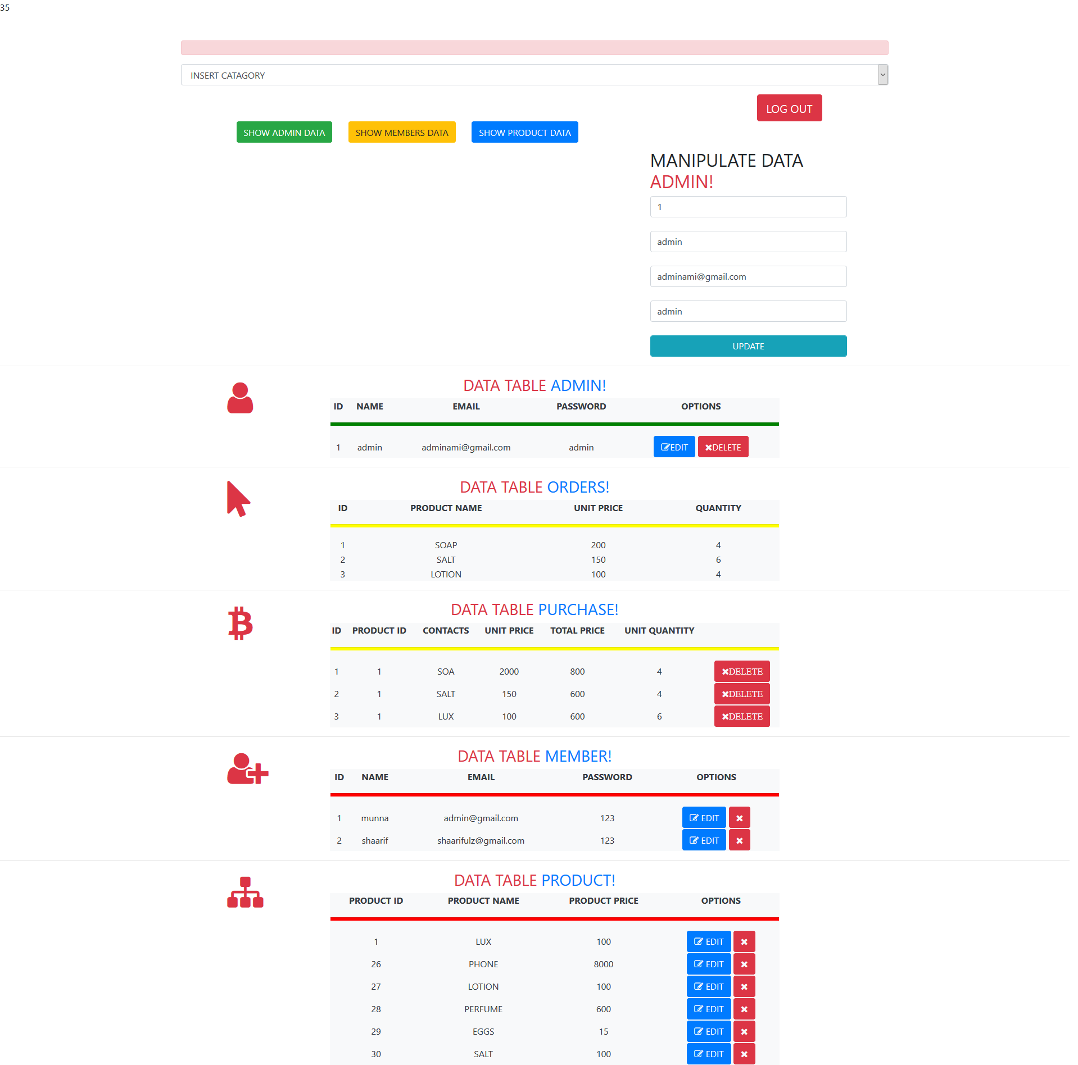
LETS TAKE A LOOK
GO TO
1
2
3
4
5
6
7
8
9
+
+
+

Slide 9
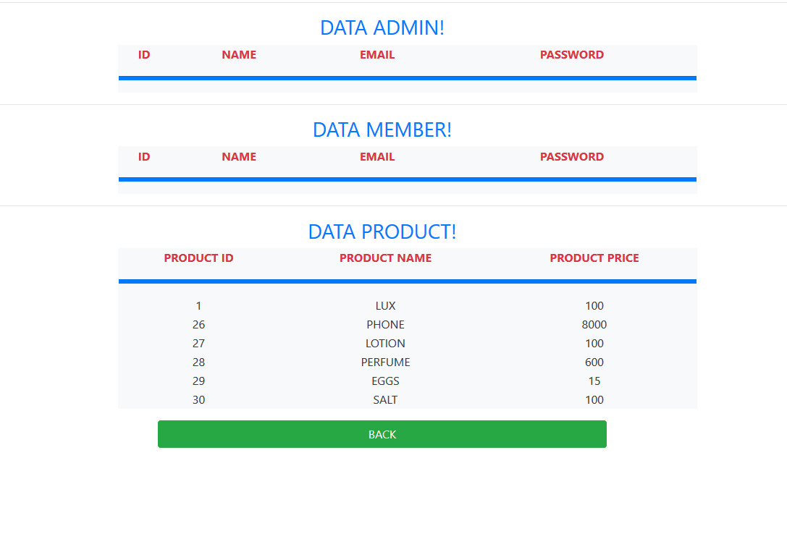
LETS TAKE A LOOK
GO TO
1
2
3
4
5
6
7
8
9
+
+
+

Slide 10



OUR SPECIALITY
BEST SELLER
HOME DELIVERY
SUPPORT
AWERD
AWERD
AWERD
BEST SELLER AWERD 2017
CUSTOMER SATISFACTION 100%
24/7 SUPPORT TEAM SERVICES
GO TO
1
2
3
4
5
6
7
8
9
+
+
+

Slide 11
THANK YOU
VISIT US ANYTIME
GO TO
1
2
3
4
5
6
7
8
9
+
+
+

