Slide 1
Introduction to databases Subqueries

Slide 2
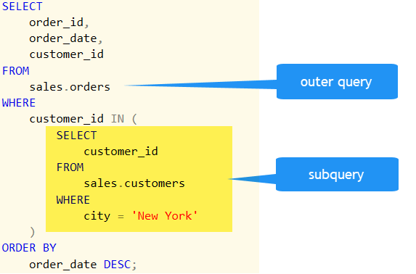
What is a Subquery
A Subquery or Inner query or a Nested query in SQL is a query inside another SQL query and inserted inside the WHERE clause. A SQL Subquery is used to return information that will be used in the primary query as a condition to additionally limit the information to be recovered.

Slide 3



Why we use Subquery
Suppose you want to write a query to find out who earns a salary greater than Abel’s salary.
To solve this problem, you need two queries: one to find what Abel earns, and a second query to find who earns more than that amount.
You can solve this problem by combining the two queries, placing one query inside the other query.
Using a Subquery to Solve a Problem
Who has a salary greater than Abel’s?
Main Query:
Which employees have salaries greater than Abel’s salary?
Subquery:
?
What is Abel’s salary?

Slide 4
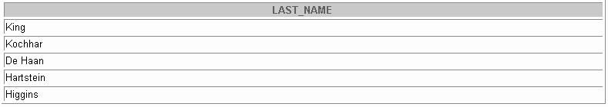
Syntax
Using a Subquery
SELECT select_list
FROM table
WHERE expr operator
(SELECT FROM
SELECT last_name
FROM WHERE
employees salary >
11000
select_list table);
(SELECT salary FROM employees
WHERE last_name = 'Abel');
The subquery (inner query) executes once before the main query.
The result of the subquery is used by the main query (outer query).

Slide 5
Guidelines for Using Subqueries
Enclose subqueries in parentheses.
Place subqueries on the right side of the comparison condition.
The ORDER BY clause in the subquery is not needed
Use single-row operators with single-row subqueries and use multiple-row operators with multiple-row subqueries.

Slide 6
Types of Subqueries
Single-row subqueries: Queries that return only one row from the inner SELECT statement
Multiple-row subqueries: Queries that return more than one row from the inner SELECT
statement
Single-row subquery
Main query |  |  | returns
 | Subquery
ST_CLERK
Multiple-row subquery
Main query |  |  | returns
 | Subquery
ST_CLERK SA_MAN

Slide 7
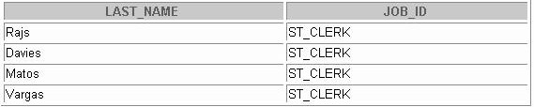
Single-Row Subqueries
Single-Row Subqueries
A single-row subquery is one that returns one row from the inner SELECT statement. This type of subquery uses a single-row operator. The slide gives a list of single-row operators.
Example
Display the employees whose job ID is the same as that of employee 141.
SELECT last_name, job_id
FROM WHERE
employees job_id =
(SELECT job_id FROM employees
WHERE employee_id = 141);

Slide 8
Executing Subqueries
Executing Single-Row Subqueries
Using Group Functions in a Subquery
SELECT last_name, job_id, salary FROM employees
WHERE job_id = ST_CLERK
(SELECT job_id FROM
WHERE
SELECT last_name, job_id, salary
FROM employees WHERE salary =
2500
(SELECT MIN(salary)
employees employee_id = 141)
2600
(SELECT salary FROM employees
WHERE employee_id = 143);
FROM employees);
AND salary >

Slide 9
What Is Wrong with This Statement?
SELECT employee_id, last_name FROM employees
WHERE salary =
SELECT last_name, job_id FROM employees
WHERE job_id =
(SELECT MIN(salary) FROM employees
GROUP BY department_id);
(SELECT job_id FROM employees
WHERE last_name = 'Haas');
Single-row operator w^{ith}
Subquery returns no values
multiple-row subquery
ERROR at line 4:
ORA-01427: single-row subquery returns more than one row
no rows selected

Slide 10
Multiple-Row Subqueries
Multiple-Row Subqueries
Subqueries that return more than one row are called multiple-row subqueries. You use a multiple-row operator, instead of a single-row operator, with a multiple-row subquery. The multiple-row operator expects one or more values.
SELECT last_name, salary, department_id
FROM WHERE
employees
salary IN (SELECT
FROM
MIN(salary) employees
GROUP BY department_id);
Example
Find the employees who earn the same salary as the minimum salar y for each department.
The inner query is executed first, producing a query result. The main query block is then processed and uses the values returned by the inner query to complete its search condition. In fact, the main query would look like the following to the Oracle Server:
SELECT last_name, salary, department_id
FROM WHERE
employees
salary IN (2500, 4200, 4400, 6000, 7000, 8300, 8600, 1 7000);

Slide 11

Using the ANY Operator in Multiple-Row Subqueries
The ANY operator (and its synonym the SOME operator) compares a value to each value returned by a subquery. The slide example displays employees who are not IT programmers and whose salary is less than that of any IT programmer. The maximum salary that a programmer earns is $9,000.
SELECT employee_id, last_name, job_id, salary
FROM WHERE
employees salary < ANY
9000, 6000, 4200
(SELECT salary FROM employees
WHERE job_id = 'IT_PROG') AND job_id <> 'IT_PROG';

Slide 12

Using the ALL Operator in Multiple-Row Subqueries
The ALL operator compares a value to every value returned by a subquery. The example in the slide displays employees whose salary is less than the salary of all e mployees with a job ID of IT_PROG and whose job is not IT_PROG.
SELECT employee_id, last_name, job_id, salary
FROM WHERE
employees salary < ALL
9000, 6000, 4200
(SELECT salary FROM employees
WHERE job_id = 'IT_PROG') AND job_id <> 'IT_PROG';

Slide 13
Practice
Create a query to display the empno and ename of all employees who earn more than the average salary. Sort the results in ascending order of salary
Write a query that displays the empno and ename of all employees who work in a department with any employee whose last name contains a u.
Display the last name, department number, and job ID of all employees whose department location ID is 1700.

Slide 14
Practice
Display the last name and salary of every employee who reports to King.
Display the department number, last name, and job ID for every employee in the Executive department.
Display the employee numbers, last names, and salaries of all employees who earn more than the average salary and who work in a department with any employee with a u in their name.

