Slide 1
ACL
ACCESS CONTROL LIST

Slide 2
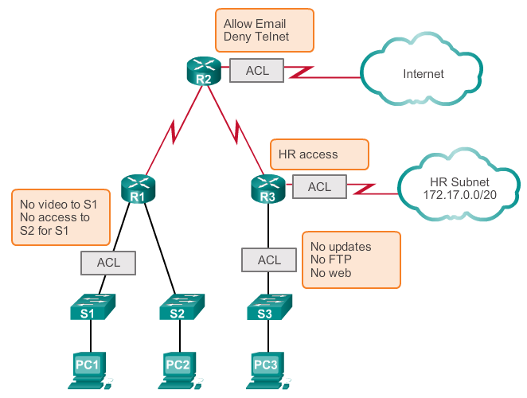
What is an ACL?

Slide 3
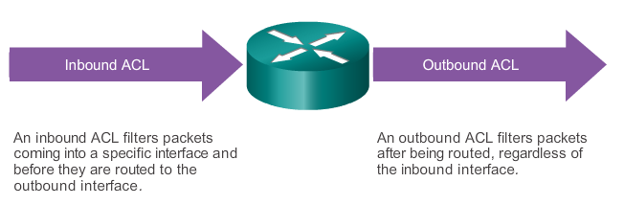
ACL Operation
The last statement of an ACL is always an implicit deny. This statement is automatically inserted at the end of each ACL even though it is not physically present. The implicit deny blocks all traffic. Because of this implicit deny, an ACL that does not have at least one permit statement will block all traffic.

Slide 4
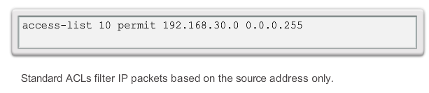
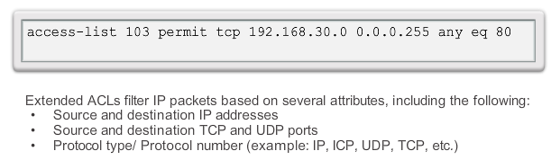
Types of Cisco IPv4 ACLs
Standard ACLs
Extended ACLs

Slide 5
General Guidelines for Creating ACLs
The Three Ps
One ACL per protocol - To control traffic flow on an interface, an ACL must be defined for each protocol enabled on the interface.
One ACL per direction - ACLs control traffic in one direction at a time on an interface. Two separate ACLs must be created to control inbound and outbound traffic.
One ACL per interface - ACLs control traffic for an interface, for example, GigabitEthernet 0/0.

Slide 6
Where to Place ACLs
Every ACL should be placed where it has the greatest impact on efficiency. The basic rules are:
Extended ACLs - Locate extended ACLs as close as possible to the source of the traffic to be filtered.
Standard ACLs - Because standard ACLs do not specify destination addresses, place them as close to the destination as possible.
Notes:
9.1.5.1 Where to Place ACLs

Slide 7
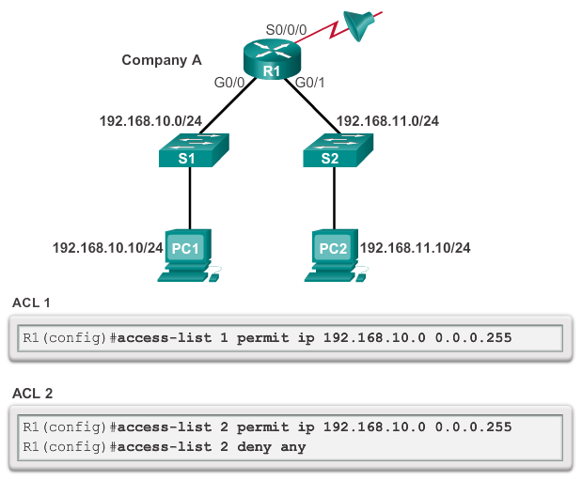
Entering Criteria Statements
Notes:
9.2.1.1 Entering Criteria Statements

Slide 8
Internal Logic
Rule 1
  You can not deny something you have all ready permitted
Rule 2
  You can not permit something you have all ready denied
Rule 3
  If nothing is permitted nothing will pass
Rule 4
  The best ACL in the world does nothing if it is not applied
Notes:
9.2.1.4 Internal Logic

Slide 9
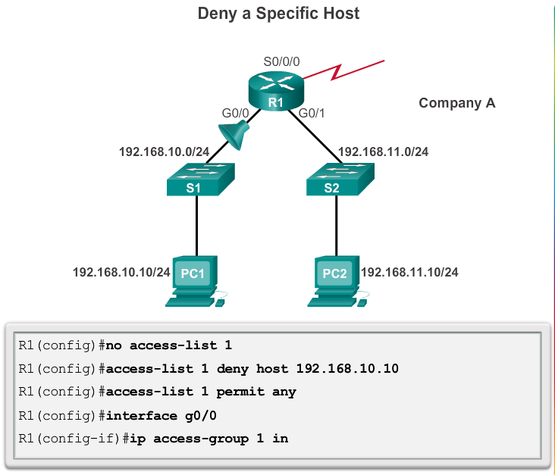
Applying Standard ACLs to Interfaces

Slide 10
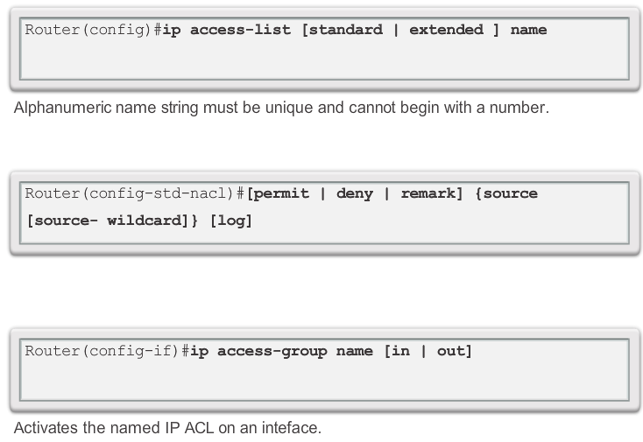
Creating Named Standard ACLs
Notes:
9.2.1.7 Creating Named Standard ACLs

Slide 11
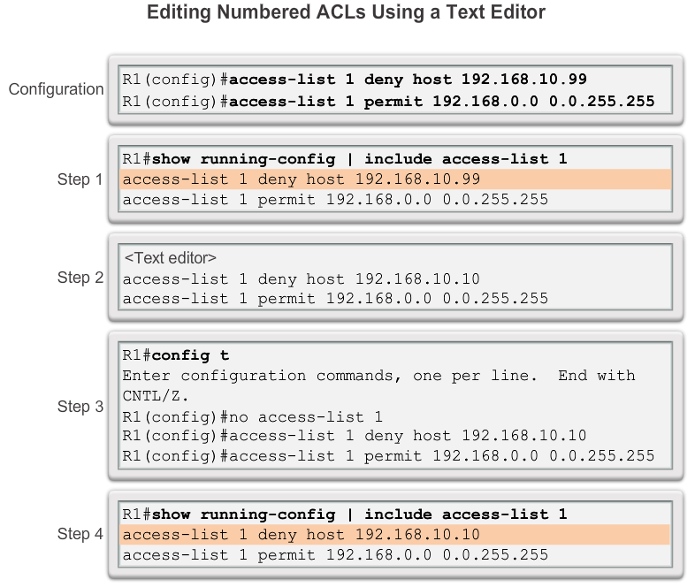
Editing Standard Numbered ACLs

Slide 12
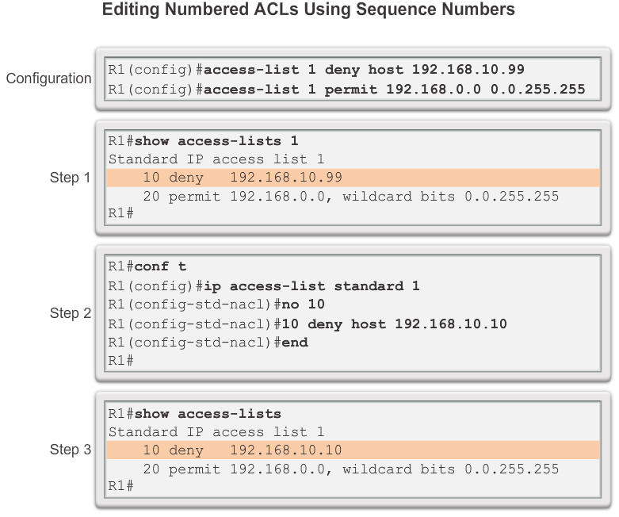
Editing Standard Numbered ACLs

Slide 13
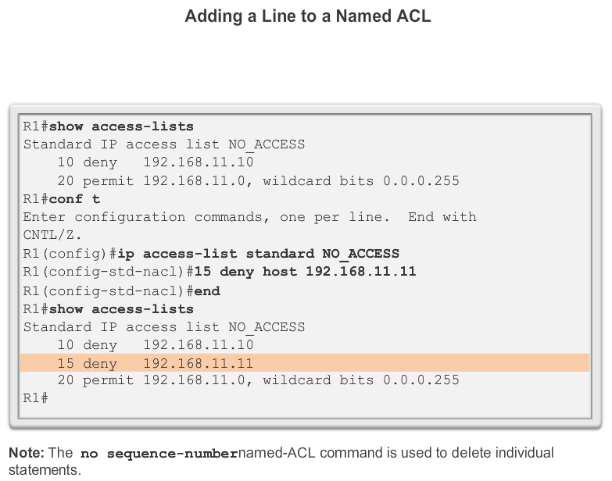
Editing Standard Named ACLs

Slide 14
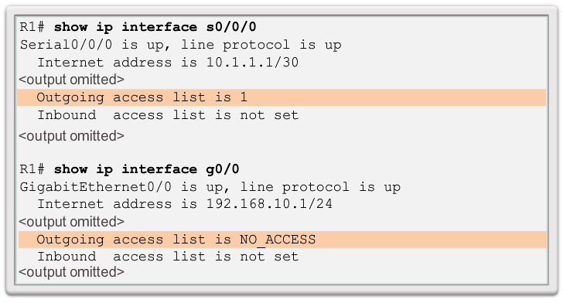
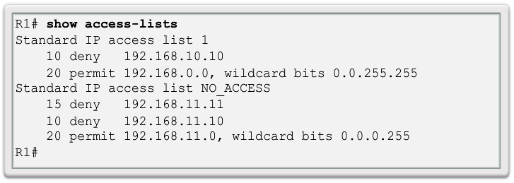
Verifying ACLs
Notes:
9.2.2.4 Verifying ACLs

Slide 15
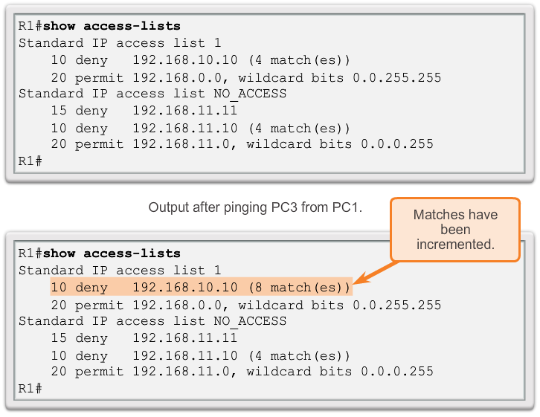
ACL Statistics
Notes:
9.2.2.5 ACL Statistics

Slide 16
ACL Statistics
ip access-list TRAFFIC_USE
10 permit tcp any any eq 80
20 permit tcp any any eq 20
30 permit tcp any any eq 21
40 permit tcp any any eq 23
50 permit udp any any eq 67
60 permit udp any any eq 68
70 permit ip any any
Notes:
9.2.2.5 ACL Statistics

Slide 17
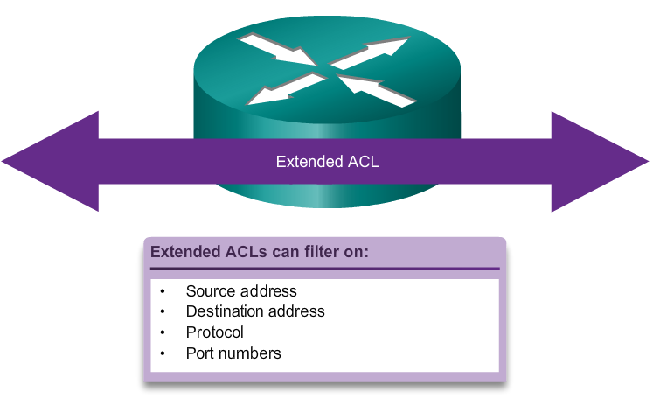
Extended ACLs
Notes:
9.3.1.1 Extended ACLs

Slide 18
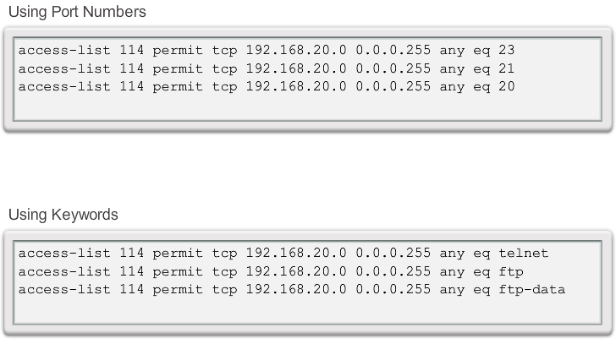
Extended ACLs
Notes:
9.3.1.2 Extended ACLs (Cont.)

Slide 19
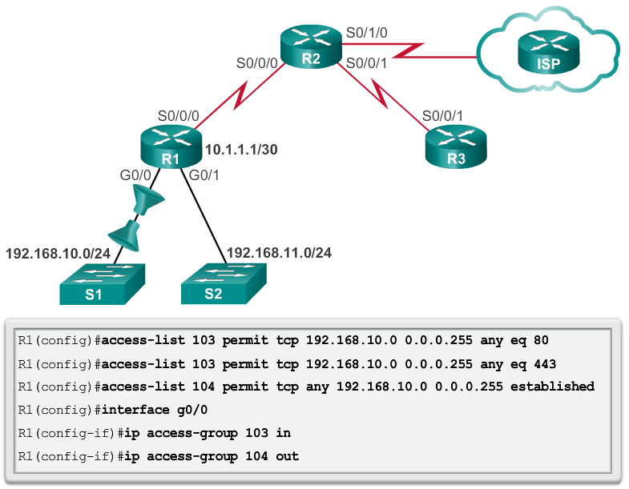
Applying Extended ACLs to Interfaces

Slide 20
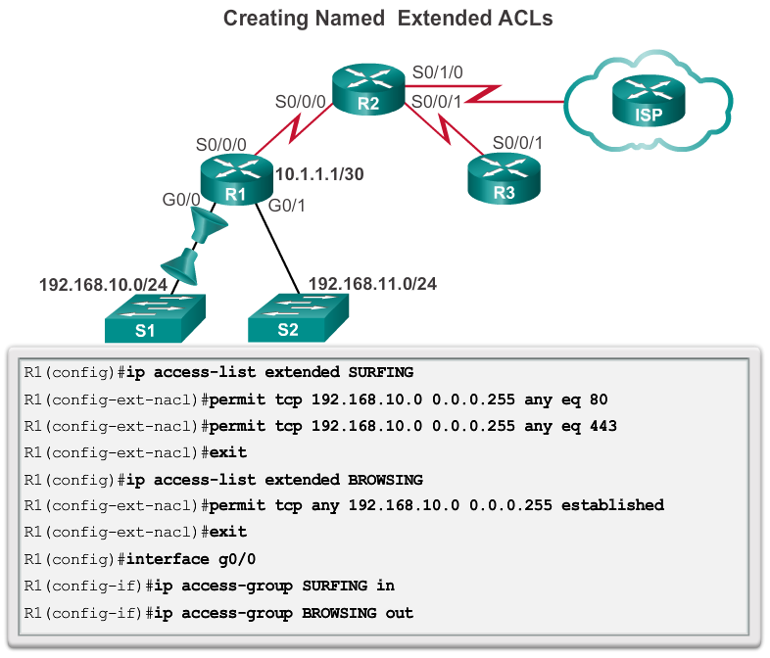
Creating Named Extended ACLs

