Slide 1
NAT
(Network Address Translation)

Slide 2
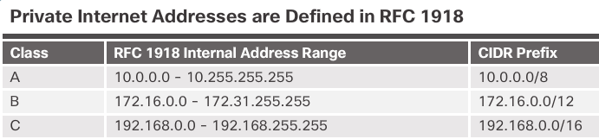
IPv4 Private Address Space
Private IP addresses are used within an organization and home
networks.
These are the IP addresses you will see assigned to company devices.

Slide 3
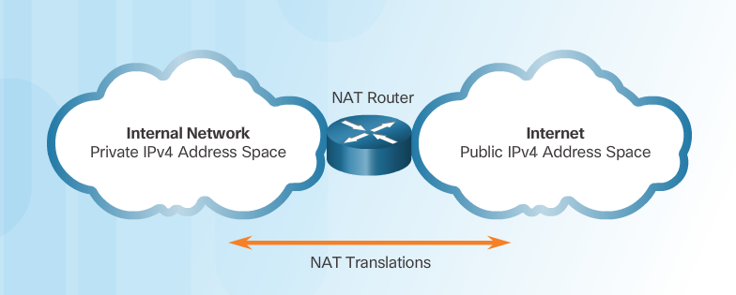
IPv4 Private Address Space
Private IP addresses cannot be routed over the Internet.
NAT is used to translate private IP addresses to public addresses that can be routed over the Internet.
One public IPv4 address can be used for thousands of devices that have private IP addresses.

Slide 4
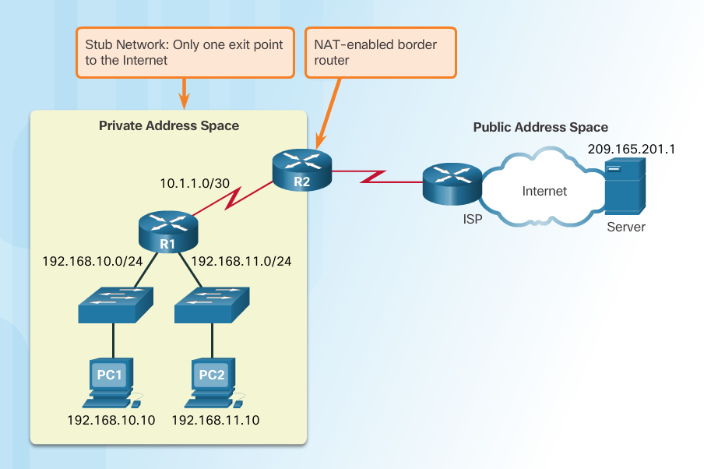
What is NAT?
Important Concept—NAT is enabled on one device (normally the border or edge router)
Private IP addresses cannot be routed over the Internet.
NAT is used to translate private IP addresses used inside a company to public addresses that can be routed over the Internet.
NAT hides internal IPv4 addresses from outside networks.
  Companies use the same private IPv4 addresses so outside devices cannot tell one company’s 10.x.x.x network from another company’s 10.x.x.x network.
A NAT-enabled router can be configured with a public IPv4 address.
A NAT-enabled router can be configured with multiple public IPv4 addresses to be used in a pool or NAT pool for internal devices configured with private addresses.

Slide 5
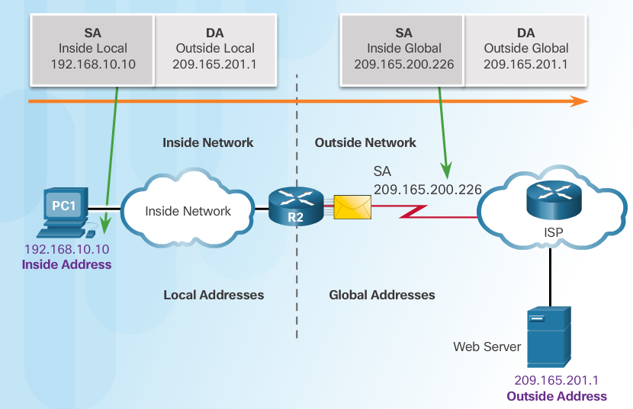
NAT Terminology
Four types of addresses: inside, outside, local, and global
  Always consider the device that is having its private address translated to understand this concept.
  Inside address – address of the company network device that is being translated by NAT
  Outside address – IP address of the destination device
  Local address – any address that appears on the inside portion of the network
  Global address – any address that appears on the outside portion of the network

Slide 6
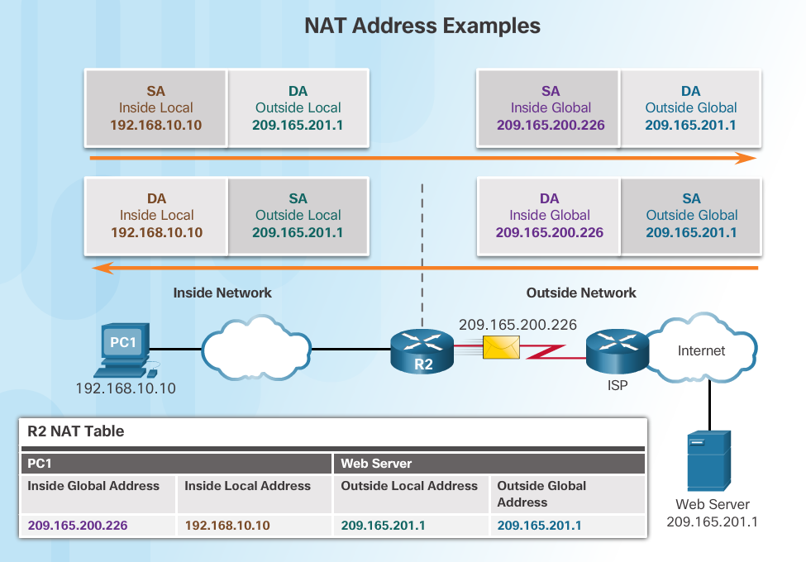
NAT Terminology

Slide 7
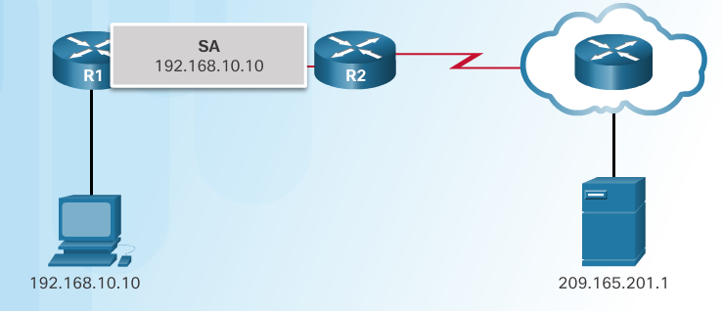
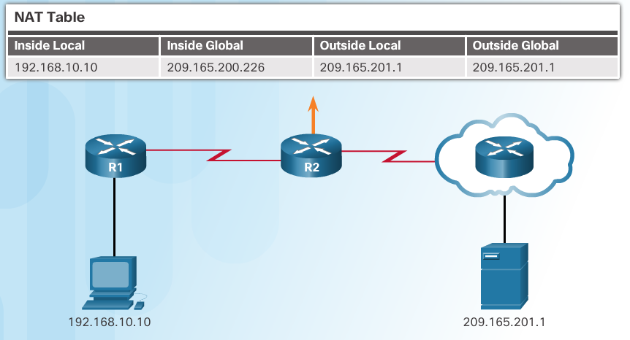
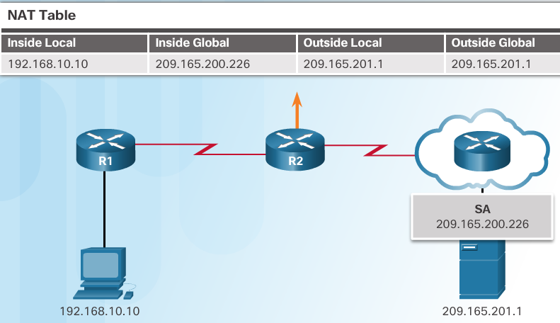
How NAT Works
1. The private (internal) IP address gets translated to a public IP address used to reach the external server.

Slide 8
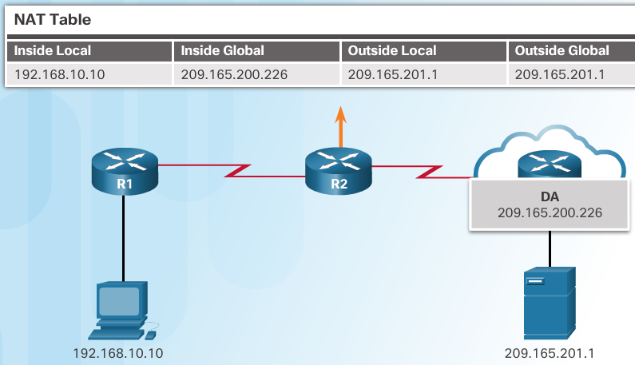
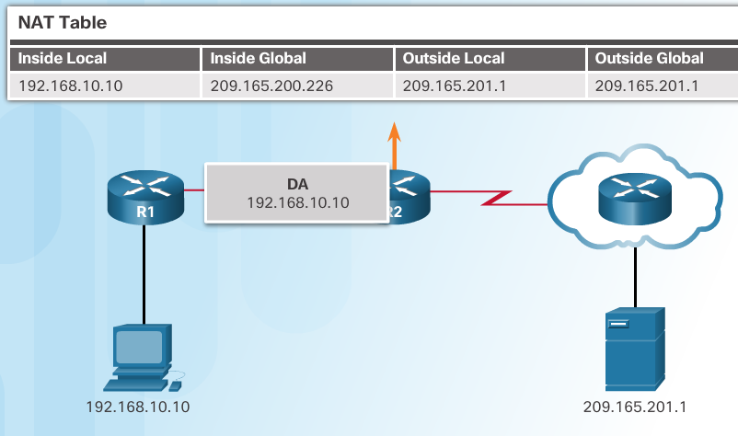
How NATWorks
2. The translated public address is used by the server to send the requested information to the device that actually has a private IP address assigned to it.
3. The NAT-enabled router consults the routing table to see what private address requested the data.

Slide 9
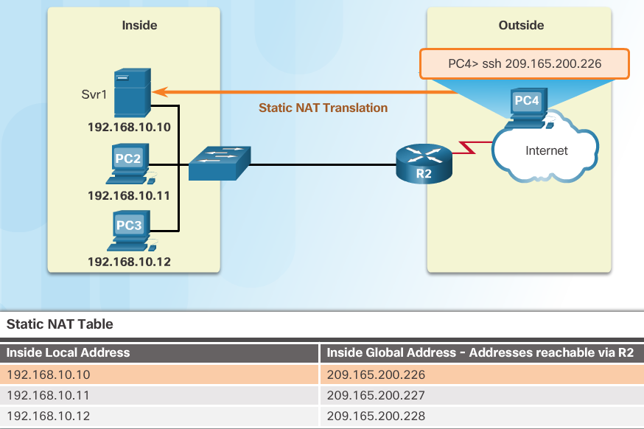
Types of NAT
Static NAT
Static address translation (static NAT) assigns one public IP address to one private IP address
Commonly used for servers that need to be accessed by external devices or for devices that must be accessible by authorized personnel when offsite
One-to-one address mapping between local and global addresses

Slide 10
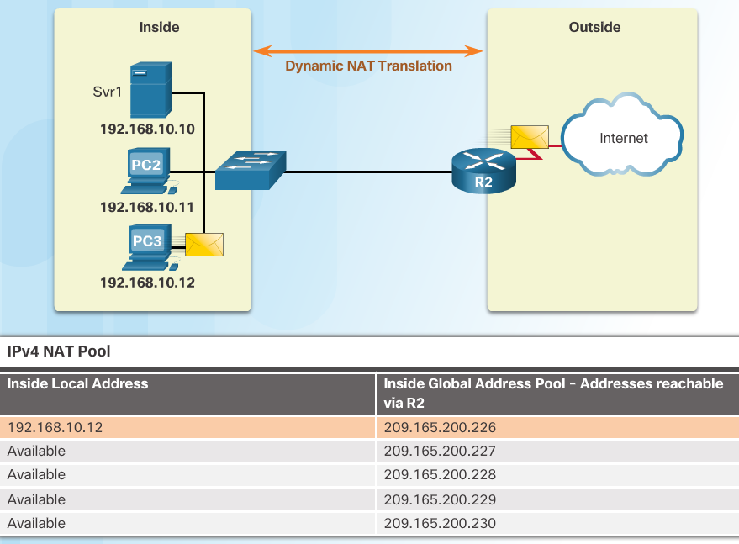
Types of NAT
Dynamic NAT
Dynamic NAT assigns a public IP address from a pool of addresses to each packet that originates from a device that has a private IP address assigned when that packet is destined to a network outside the company.
  Addresses are assigned on a first-come, first serve basis
  The number of internal devices that can transmit outside the company is limited to the number of public IP addresses in the pool.

Slide 11
Configure NAT
Notes:
9 – NAT for IPv4
9.2 – Configure NAT

Slide 12
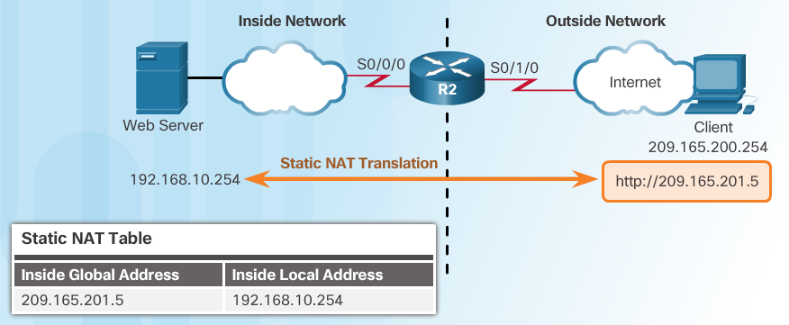
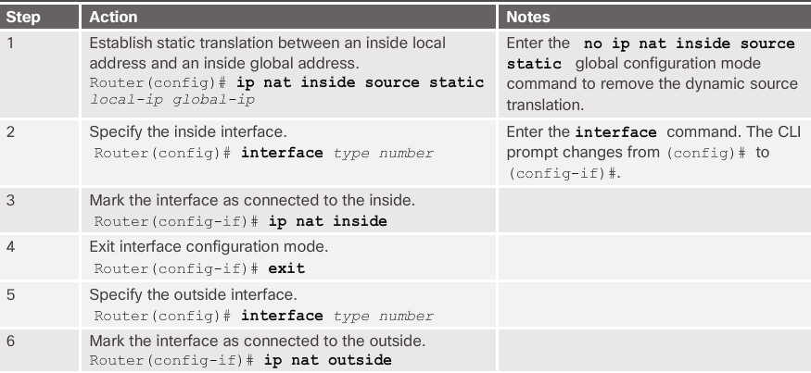
Configuring Static NAT
Configure Static NAT

Slide 13
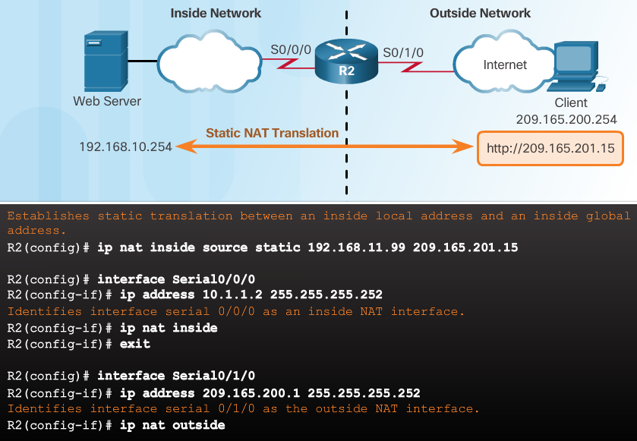
Configuring Static NAT
Configure Static NAT (Cont.)
Inside interface
Outside interface
Remember that any interface on the border router that is on the inside network must be configured with the ip nat inside command. This is a common mistake for those new to NAT.

Slide 14
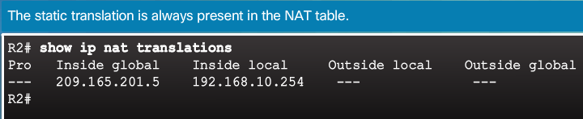
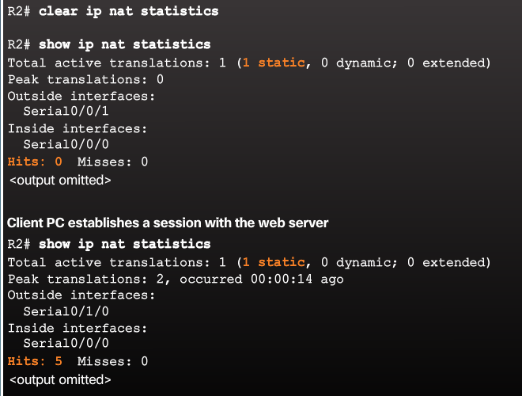
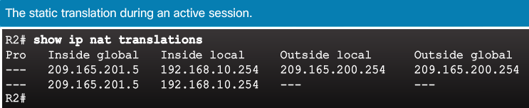
Configuring Static NAT
Verifying Static NAT
A best practice is to clear statistics when verifying that NAT is working.
Important commands:
show ip nat translations
show ip nat statistics

Slide 15
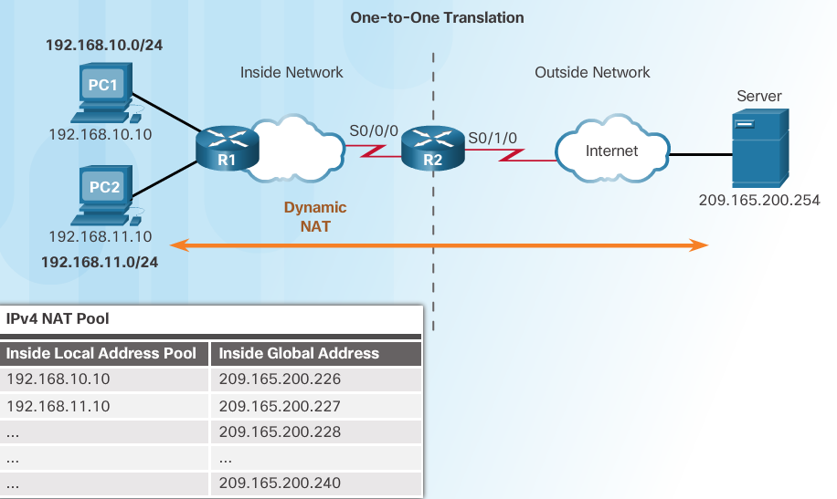
Configure Dynamic NAT
Dynamic NAT Operation
Remember that dynamic NAT uses a pool of public IPv4 addresses.
Use the same concepts of inside and outside NAT interfaces as static NAT.

Slide 16
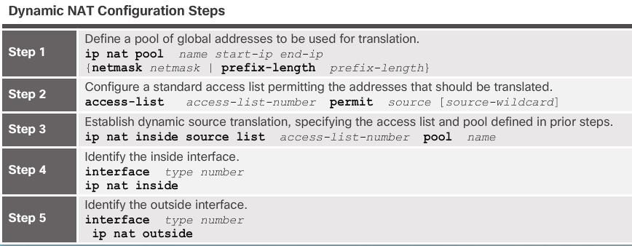
Configure Dynamic NAT
Configuring Dynamic NAT

Slide 17
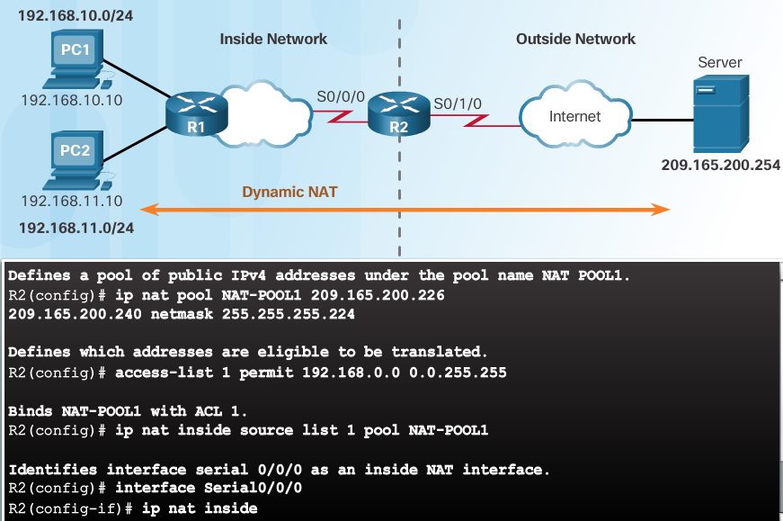
Configure Dynamic NAT
Configuring Dynamic NAT

Slide 18
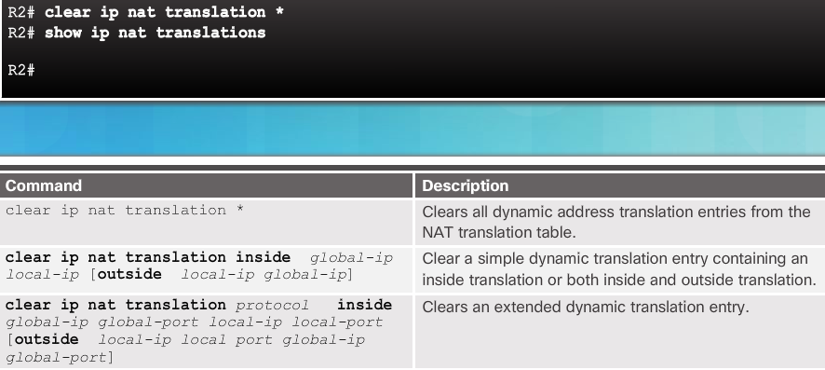
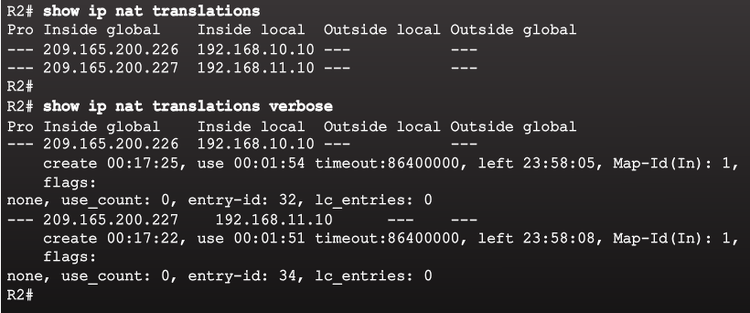
Configure Dynamic NAT
Verifying Dynamic NAT

Slide 19
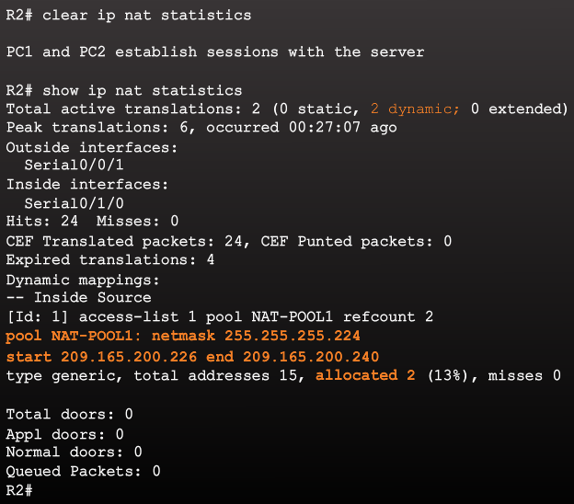
Configure Dynamic NAT
Verifying Dynamic NAT

