Slide 1

WCG | Pricing Analytics

Slide 2

02
TABLE OF CONTENTS
INTRODUCTION
APPROACH & RECOMMENDATION
METHODOLOGY
MODEL COMPARISONS
IMPLEMENTATION
LIMITATIONS
WCG

Slide 3
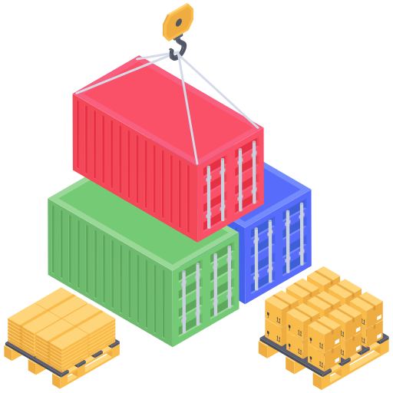

03
Introduction
Warwick Container Group (WCG) specialises in offering a wide range of flexible leasing options to meet both short and long-term needs.
Revenue Management (RM) models are highly beneficial in offering solutions to help improve revenue using price optimisation and inventory management.
WCG

Slide 4


04
Current Approach
Our Recommendation
Leasing at the local branches with traditional paper based booking with limited digital booking
Implementing the revenue management (RM) model into WCG’s daily operations
Problems
Benefits
Accepting Container-Booking Request based on experience and intiution
Unutilized inventory
No forecasting for demand and price
Data-driven decision making
Improved container utilisation
Using historical booking data and trends to forecast demand
WCG
Notes:
Overview
WCG has sought the use of RM techniques in pricing models and leasing solutions to maximise revenue and efficiency.
We aim to show how the implementation of the revenue management (RM) model into WCG’s daily operations can improve its core competitiveness, maximize revenue and address issues related to cost control, asset utilization, etc.

Slide 5
05
Methodology
PHASE 1
Problem formulation
PHASE 2
Objective function and constraint formulation
PHASE 3
Reporting
Identifying the parameters:
Length of leasing
Week returned
Weekly price of leasing
Inventory
Revenue management model creation to maximize the objective function
Revenue
Return on Investment
Load factor
WCG

Slide 6


06
Model Comparison
 | WCG MODEL | GP5 MODEL | INCREASE
REVENUE | 679,000 | 749,588 | 10.39%
ROI | 15% | 16.7% | 1.7%
LOAD FACTOR | 5.72 | 6.16 | 0.44%
Rise in Total Number of Containers Leased
Improved Customer Responsiveness
Higher Container Usage
Substantial Increase in 8-Week and 16-Week Leasing Revenue
WCG

Slide 7

Implementation of RM model
07
Booking requests must be submitted digitally to keep track of the record
1. Receiving Requests
2. Data
3. Optimisation
4. Decision Making
5. Update
Run the model with each leasing request to automate data updates
Accumulation of data from each branch for centralized analysis
Respond how many requests to accept according given situations
Utilize historical data to forecast weekly demand and pricing by considering inventory and leasing types
WCG
Notes:
Data collection and digitalization – Booking requests must be submitted digitally for decision making and keep track of the record and accumulation of data from each branch for centralized analysis.
Demand and pricing - Utilize historical data to forecast weekly demand and pricing and integrate into the model.
Inventory management - Consider initial container inventory and total availability, evaluating the impact of leasing types on stock levels.
Updates and optimization - Run the model with each leasing request to automate data updates, forecasting, and decision-making.

Slide 8





08
 | Limitations | Potential Solution
Limited Data | Provided data will not be sufficient enough for accurate interpretation | Expand data sources across different years and branches
Leasing Model | Only round-trip leasing considered | Adopt linear network management with flexible return locations
Pricing and Demand | Model uses outdated static data | Integrate dynamic market trends and update forecasts regularly
Customer Differentiation | Fails to prioritize by customer size | Incorporate size based differentiation for improved satisfaction and profitability
WCG
Notes:
LIMITED DATA:
Provided data will not be sufficient enough for accurate interpretation and analysis of data make it difficult to make potential forecasts.
Solution: Expand data sources across different years and branches.
2. LEASING MODEL:
Only round-trip leasing considered.
Solution: Adopt linear network management with flexible return locations.
3. PRICING AND DEMAND:
Model uses outdated static data.
Solution: Integrate dynamic market trends and update forecasts regularly.
4. CUSTOMER DIFFERENTIATION:
Fails to prioritize by customer size.
Solution: Incorporate size-based differentiation for improved satisfaction and profitability.

Slide 9

09
WCG

