Slide 1
Quantum – Intelligent trading
Revolutionizing stock trading with AI-powered predictions

Slide 2
The Challenge
Data Deluge
Traders face a vast, complex sea of information. Sifting through it is overwhelming
Emotional Trading
Emotional decisions often lead to losses. Quantum helps you keep a cool head
Missing Tools
A lack of predictive tool hinders success. Quantum gives you and edge

Slide 3
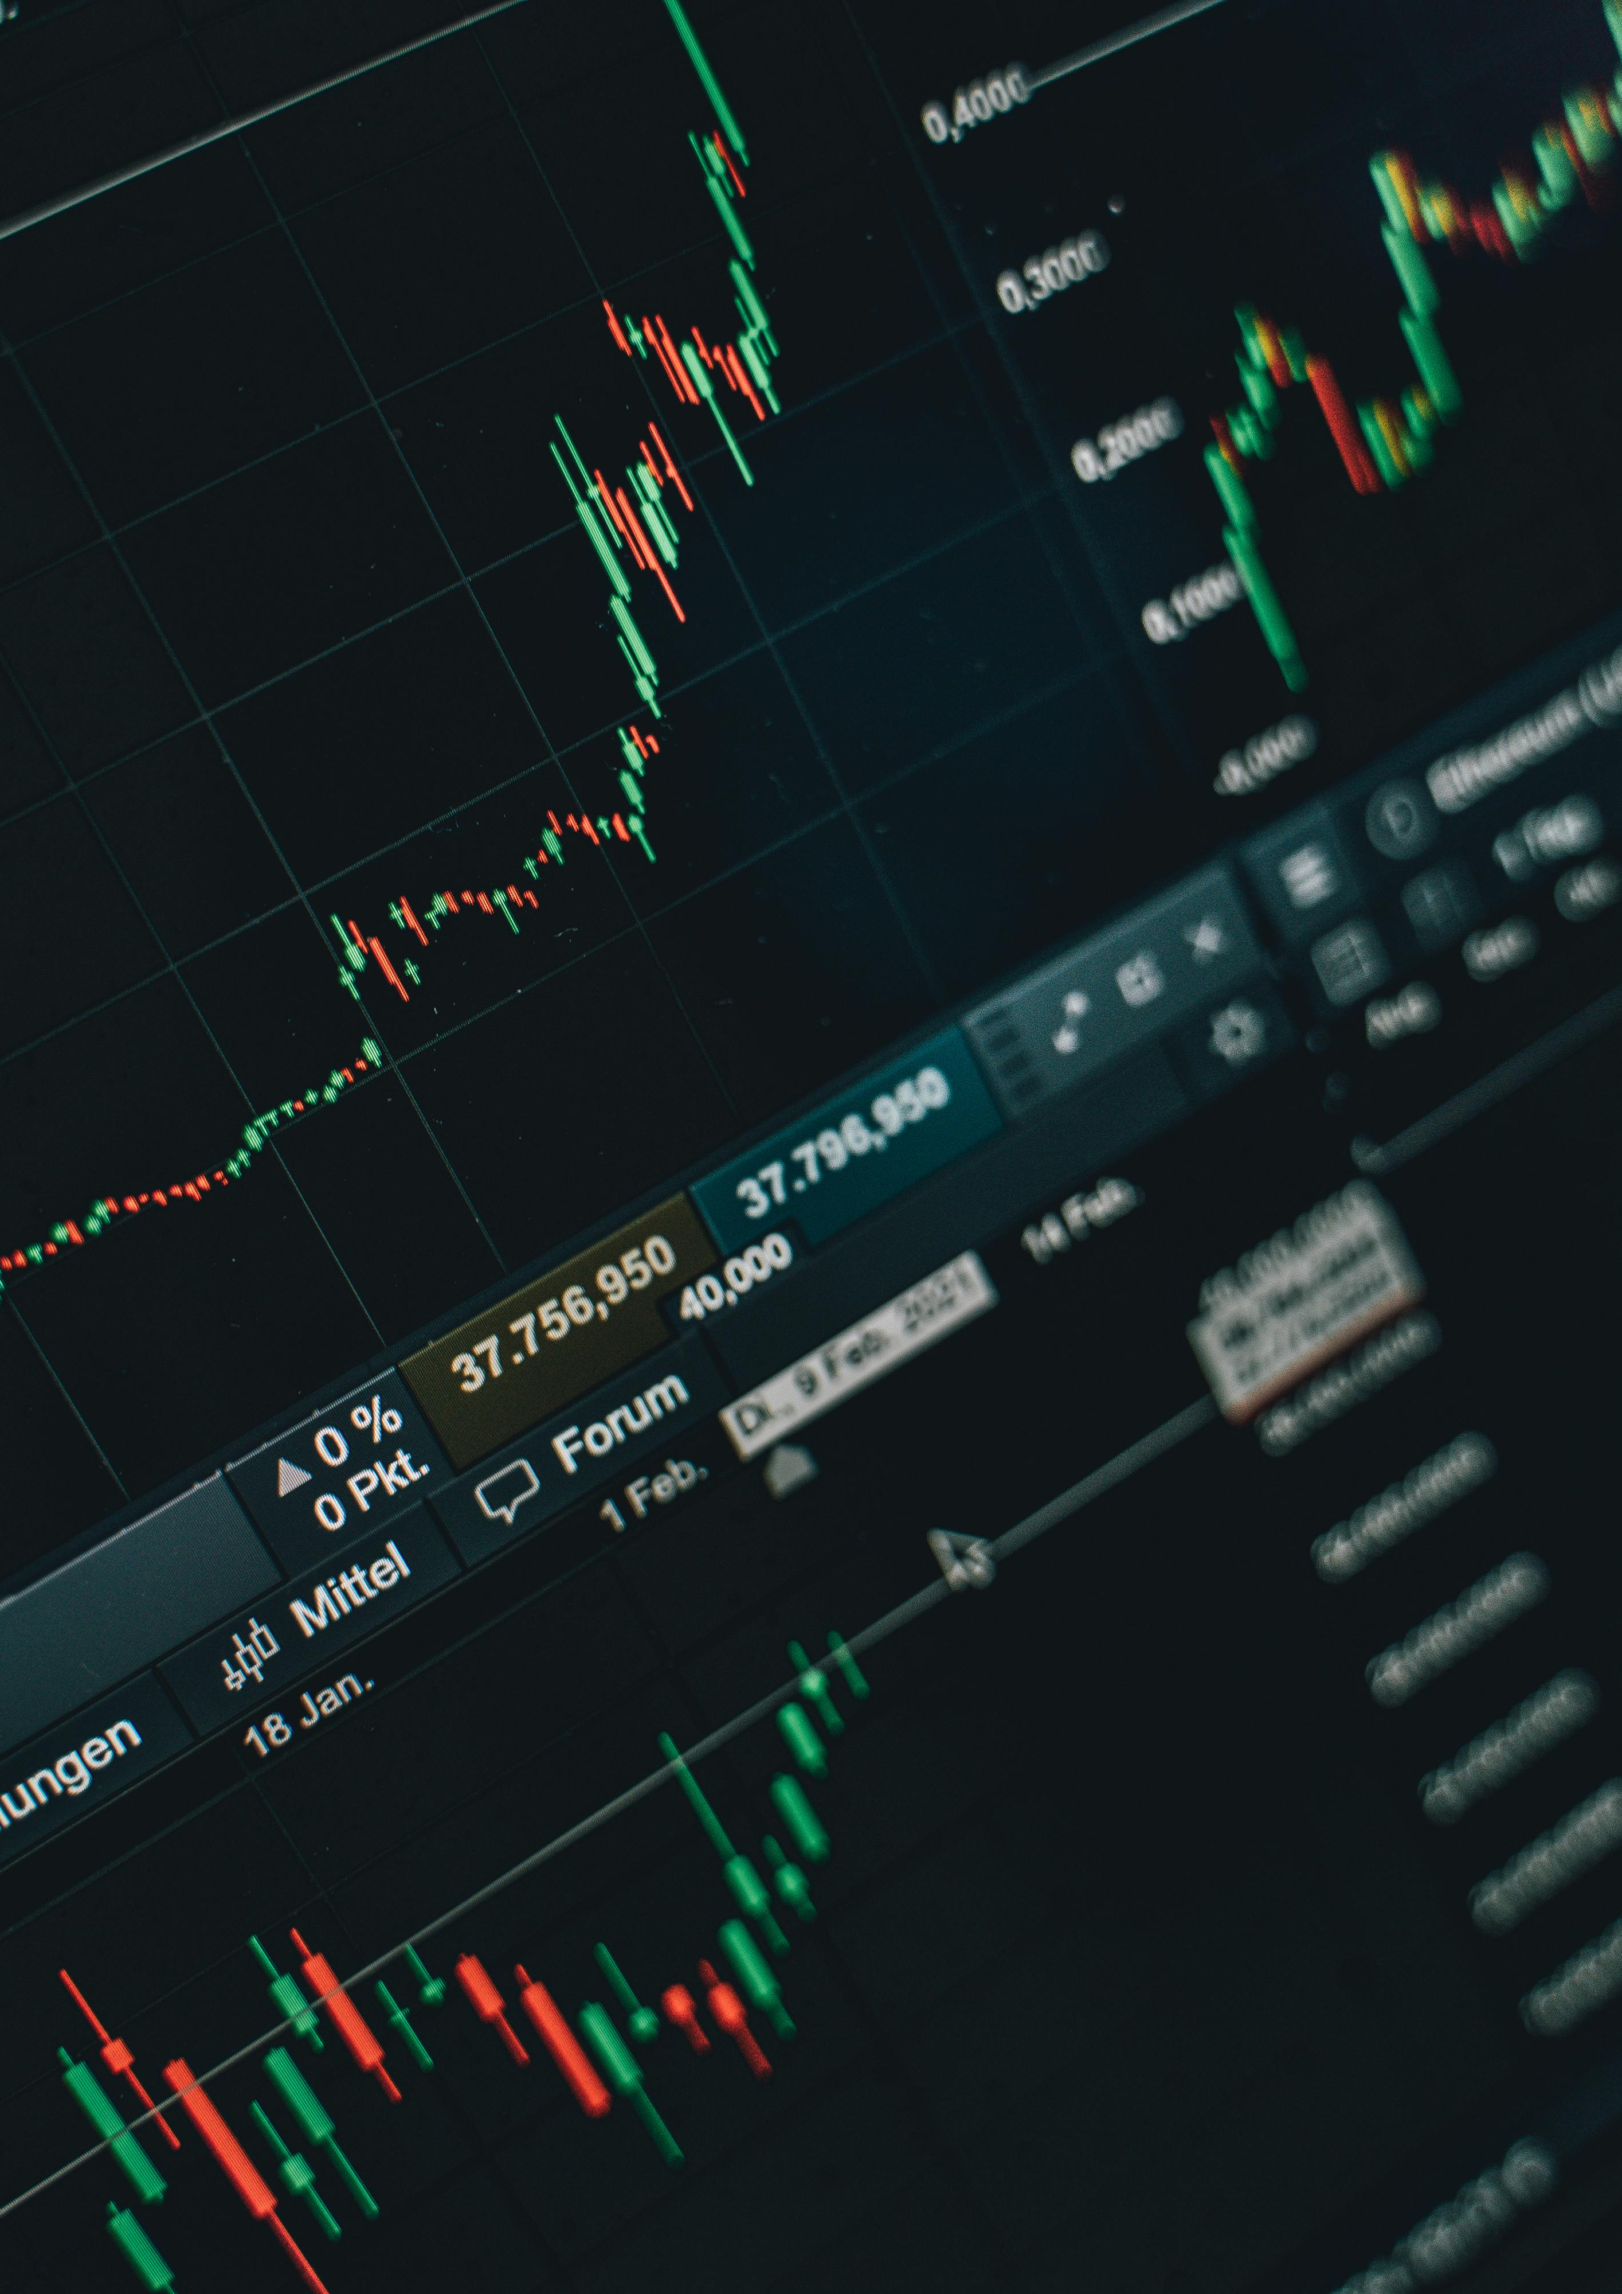
Quantum's Solution: AI-Powered 'Predict'
Predict Feature - Your AI advantage in the stock market. Enter any stock ticker
Price Forecasts – Get AI driven forecasts with up to 85% accuracy in back-tested scenarios
Advanced Machine Learning – Quantum uses advanced machine learning to produce reliable estimates.

