Slide 1
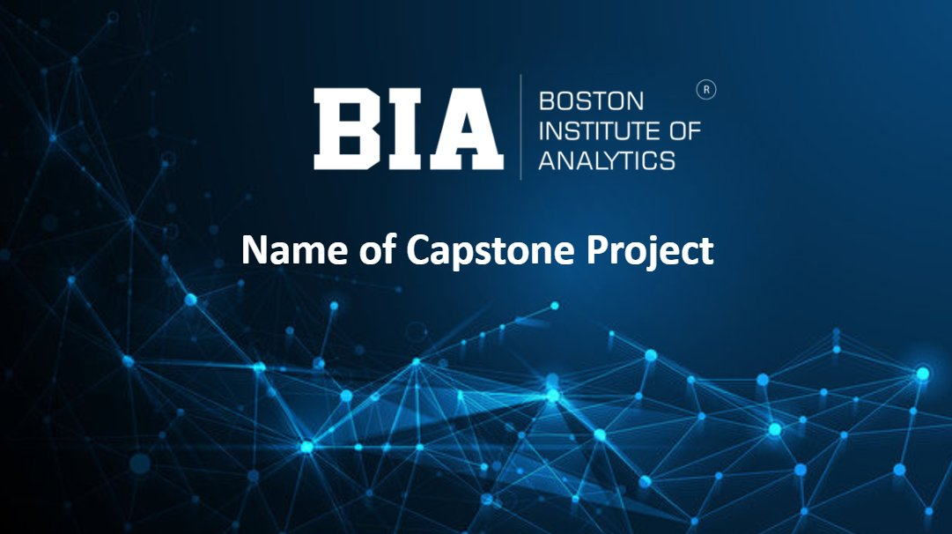
E-Commerce Customer
Market Segmentation
Shariq Adnan | Data Science with AI | Boston Institute of Analytics
CONFIDENTIAL: The information in this document belongs to Boston Institute of Analytics LLC.

Slide 2
Agenda
01
02
03
Introduction & Problem Statement
Dataset Overview
EDA: Market Insights
04
05
06
EDA: Temporal Patterns
RFM Analysis
Pre-Processing & Optimal K
07
08
09
Customer Segments
Classification Model & Results
Conclusion & Business Impact
BIA
BOSTON
INSTITUTE OF
ANALYTICS
CONFIDENTIAL: The information in this document belongs to Boston Institute of Analytics LLC. Any unauthorized sharing of this material is prohibited and subject to legal action under breach of IP and confidentiality clauses.

Slide 3
Introduction & Problem Statement
AT A GLANCE
What is this project about?
5,41,909
E-commerce retailer serves thousands of customers — but treats them all the same. This project uses data science to group customers by behaviour so the business can take targeted action for each group.
Transactions
4,335
Customers Profiled
The Problem
4
High-value buyers receive no special attention
Segments Discovered
At-risk customers drift away unnoticed
99.65%
Marketing budget is wasted on wrong audiences
Classification Accuracy
44
No system to predict a new customer's value
VIP Customers Isolated
Solution: RFM + K-Means Clustering + Random Forest Classifier
BIA
BOSTON
INSTITUTE OF
ANALYTICS
CONFIDENTIAL: The information in this document belongs to Boston Institute of Analytics LLC. Any unauthorized sharing of this material is prohibited and subject to legal action under breach of IP and confidentiality clauses.

Slide 4
Dataset Overview
Key Numbers
Raw Features (8 columns)
Feature | Description
InvoiceNo | Transaction ID — prefix 'C' = cancellation/return
StockCode | Unique product code
Description | Product name (some nulls — dropped)
Quantity | Units purchased — negative = returned items
InvoiceDate | Date and time of transaction
UnitPrice | Price per unit (£)
CustomerID | Unique customer ID — nulls = guest checkouts
Country | Customer's country of residence
5,41,909
Transactions
4,335
Unique Customers
37
Countries Covered
£18,714
VIP Monetary Threshold
44
VIP Customers Isolated
8 engineered features added after cleaning: Total_Price · Hour · Month · Day · Day_of_Week · ReturnCount · Recency · Frequency · Monetary
BIA
BOSTON
INSTITUTE OF
ANALYTICS
CONFIDENTIAL: The information in this document belongs to Boston Institute of Analytics LLC. Any unauthorized sharing of this material is prohibited and subject to legal action under breach of IP and confidentiality clauses.

Slide 5
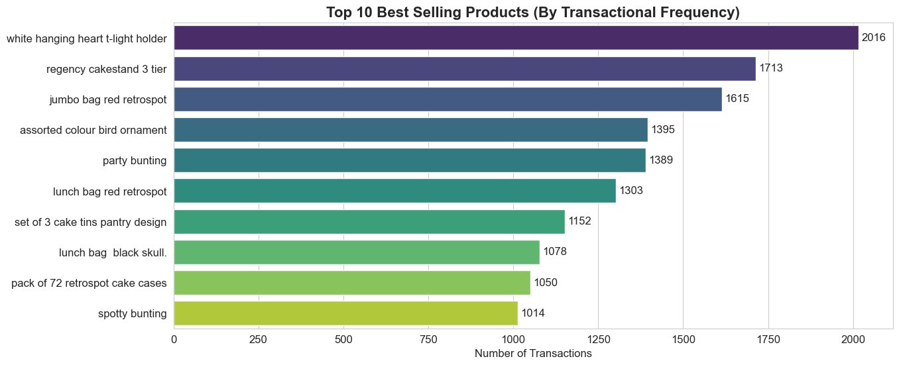
EDA: Market Insights
Top product 'White Hanging Heart T-Light Holder' has 2,016 transactions — almost 2× the 10th product. Hero products must always stay in stock.
UK dominates with ~96.6% of all transactions. This is a domestically focused business — UK-first logistics is critical.
BIA
BOSTON
INSTITUTE OF
ANALYTICS
CONFIDENTIAL: The information in this document belongs to Boston Institute of Analytics LLC. Any unauthorized sharing of this material is prohibited and subject to legal action under breach of IP and confidentiality clauses.

Slide 6
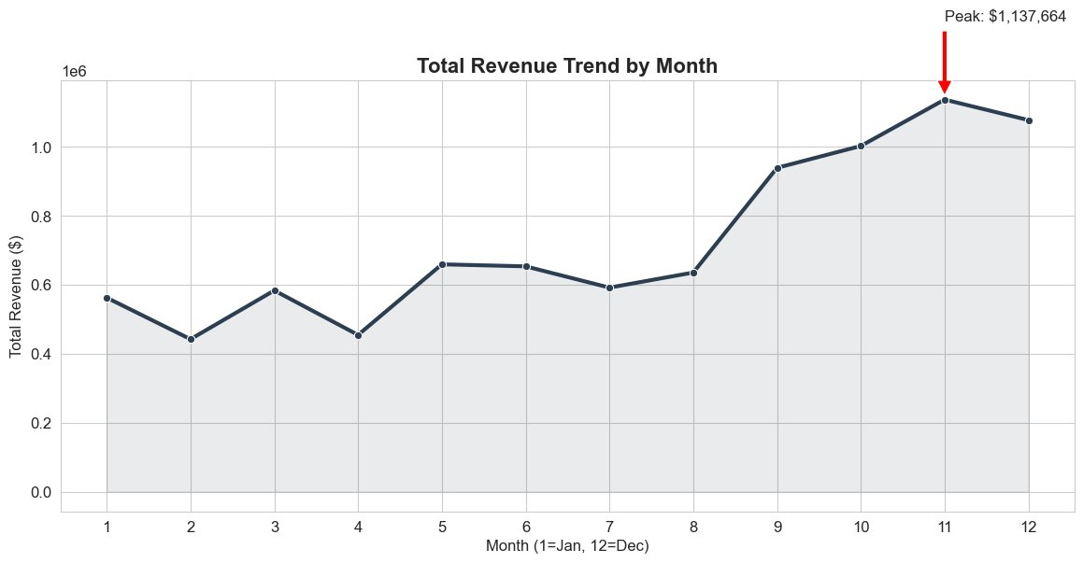
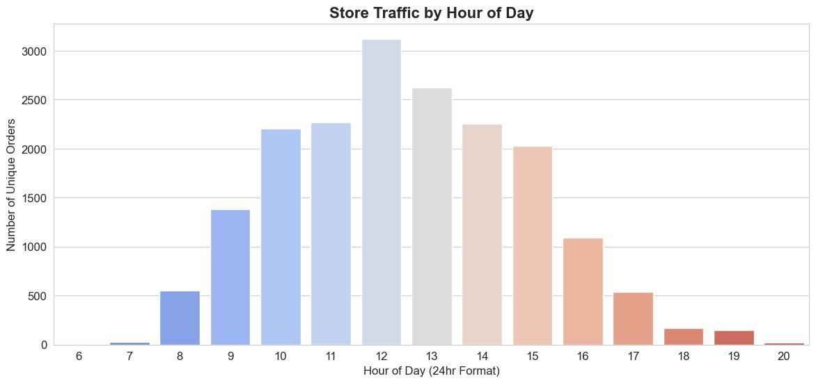
EDA: Temporal Patterns
Revenue by Month
Store Traffic by Hour
Peak revenue: $1.137M in November — holiday gifting effect. Businesses must scale inventory from October onwards.
12 PM golden hour: 3,120 orders — 2.8× more than 8 AM. Run flash sales and push notifications exactly at noon.
BIA
BOSTON
INSTITUTE OF
ANALYTICS
CONFIDENTIAL: The information in this document belongs to Boston Institute of Analytics LLC. Any unauthorized sharing of this material is prohibited and subject to legal action under breach of IP and confidentiality clauses.

Slide 7
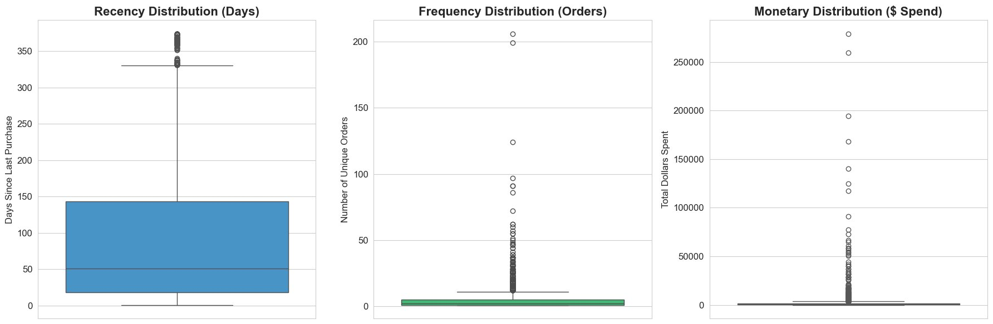
RFM Analysis — Customer Behavioural Scoring
R
Recency
Days since last purchase
Avg: 93 days
F
Frequency
Unique orders placed
Avg: 4.2 orders
M
Monetary
Total spend across all orders
Avg: £2,017
IMPORTANT: Some customers spent £279,000+ and ordered 200+ times. These 'whales' would distort clustering if not handled first — this is why VIP isolation is the first pre-processing step.
BIA
BOSTON
INSTITUTE OF
ANALYTICS
CONFIDENTIAL: The information in this document belongs to Boston Institute of Analytics LLC. Any unauthorized sharing of this material is prohibited and subject to legal action under breach of IP and confidentiality clauses.

Slide 8
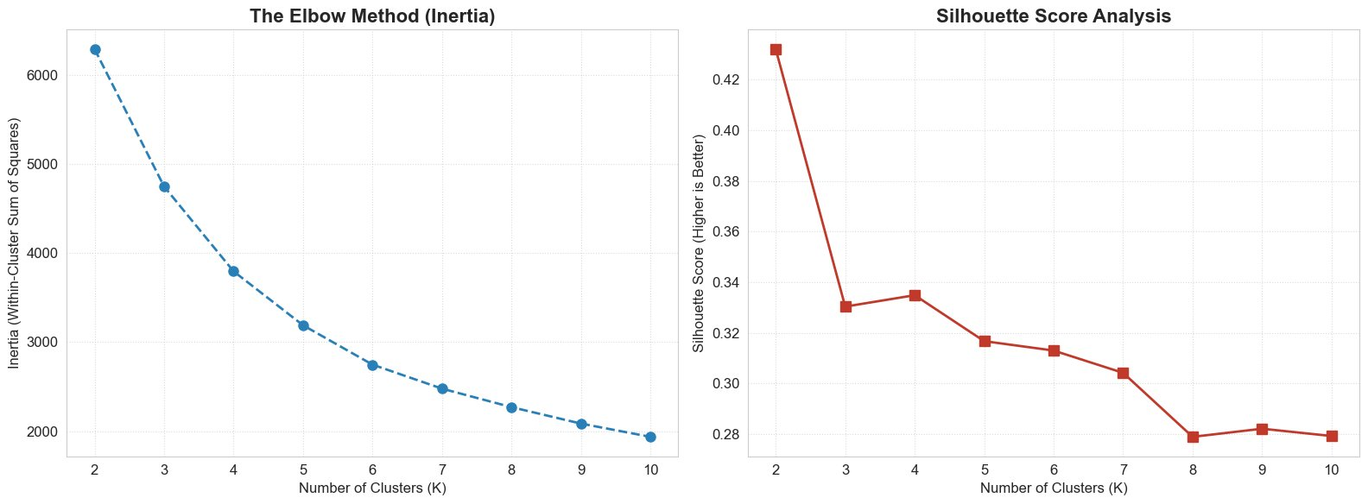
Pre-Processing & Finding Optimal K
Step 1: VIP Isolation
→
Step 2: Log Transform
→
Step 3: Standard Scaling
99th %ile ≥ £18,714 → manually labelled, removed from K-Means pool
log(x+1) applied to R, F, M → compresses skewness
Z-score → mean=0, std=1 across all features (equal weight)
VERDICT — Both Elbow Curve and Silhouette Score independently confirm K = 3. Using two methods eliminates human bias and gives statistical confidence in the choice.
BIA
BOSTON
INSTITUTE OF
ANALYTICS
CONFIDENTIAL: The information in this document belongs to Boston Institute of Analytics LLC. Any unauthorized sharing of this material is prohibited and subject to legal action under breach of IP and confidentiality clauses.

Slide 9
Customer Segments
Segment | Share | Recency | Frequency | Monetary | Action
VIP Segment | 9.9% | Low | Very High | ≥ £18,714 | Exclusive rewards & account managers
Loyal Regulars | 31.5% | Low | High | Moderate | Loyalty programme & referral bonuses
Casual Buyers | 20.3% | Medium | Low | Low | Personalised recs & upsell campaigns
At-Risk / Churning | 38.2% | High | Declining | Low | Win-back emails & time-limited offers
38.2% at risk — nearly 4 in 10 customers may never return without intervention.
VIPs are only 9.9% but generate outsized revenue — protect them above all.
The 4-tier model enables targeted action: VIP concierge · loyalty rewards · upsell flows · win-back campaigns.
BIA
BOSTON
INSTITUTE OF
ANALYTICS
CONFIDENTIAL: The information in this document belongs to Boston Institute of Analytics LLC. Any unauthorized sharing of this material is prohibited and subject to legal action under breach of IP and confidentiality clauses.

Slide 10
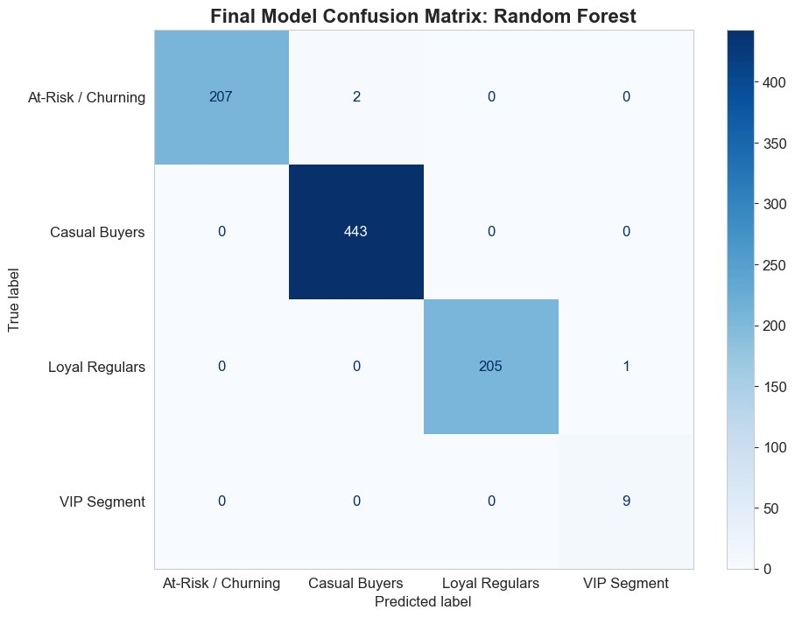
Classification Results — Champion Model: Random Forest
Model | Train Acc | Test Acc | Overfit Gap
Random Forest ✓ | 100.00% | 99.65% | 0.35%
Decision Tree | 100.00% | 99.65% | 0.35%
KNN | 99.60% | 99.54% | 0.06%
LightGBM | 99.88% | 99.42% | 0.46%
SVM | 99.65% | 99.19% | 0.46%
Logistic Reg. | 99.25% | 99.08% | 0.17%
Naive Bayes | 93.60% | 92.73% | 0.87%
Confusion Matrix
🏆 Champion: Random Forest — 99.65% Test Accuracy | Precision 0.97 | F1-Score 0.98 | Recall 1.00 (macro avg)
BIA
BOSTON
INSTITUTE OF
ANALYTICS
CONFIDENTIAL: The information in this document belongs to Boston Institute of Analytics LLC. Any unauthorized sharing of this material is prohibited and subject to legal action under breach of IP and confidentiality clauses.

Slide 11
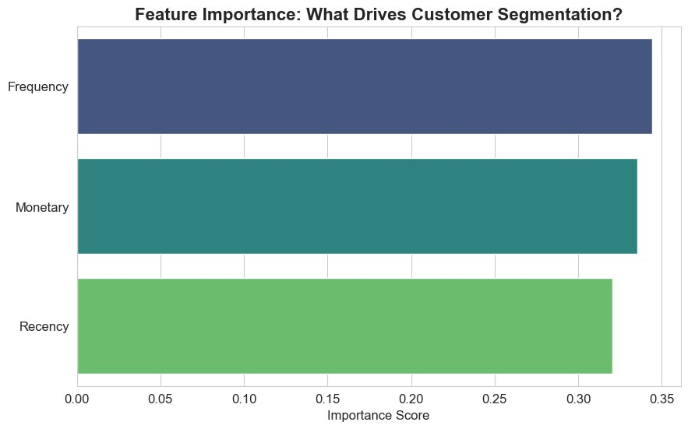
Feature Importance — What Drives Segmentation?
The trained Random Forest reveals how much each RFM feature contributed to its predictions.
Frequency ~34%
Monetary ~33%
Recency ~32%
How often a customer orders is the #1 signal. High-frequency buyers are Loyal Regulars or VIPs.
Total spend closely tracks frequency. Near-equal weight validates the VIP monetary isolation decision.
Days since last purchase flags At-Risk churners — high recency days = customer drifting away silently.
✓ All 3 features contribute almost equally (~33% each) — model is balanced, unbiased & not over-reliant on any single metric
BIA
BOSTON
INSTITUTE OF
ANALYTICS
CONFIDENTIAL: The information in this document belongs to Boston Institute of Analytics LLC. Any unauthorized sharing of this material is prohibited and subject to legal action under breach of IP and confidentiality clauses.

Slide 12

Thank You!
Shariq Adnan | Data Science with AI | Boston Institute of Analytics
CONFIDENTIAL: The information in this document belongs to Boston Institute of Analytics LLC. Any unauthorized sharing of this material is prohibited and subject to legal action under breach of IP and confidentiality clauses.

