Slide 1

“Towards global technological excellence”
real time visualization box
For the Degree of Bachelor of Technology in
Electronics and Telecommunication Engineering
Department of Electronics and Telecommunication Engineering Government College of Engineering, Amravati
Guided By Group 20
N. G. Pardeshi Akash Taksale (18004005)
Shubham Dainiwal (18004045)
Sharique Ahmad (18004080)

Slide 2
Content
1. Introduction
2. Objective
3. Block diagram
4. Working
5. References

Slide 3
Introduction
Problem faced by blind people in day to day life
37 million people are blind in world
To build a system that can detect objects and can convert them in Audio
Cheap, easy to use system
Use Raspberry pi, Camera module and Object detection Algorithm

Slide 4
Objective
Learning of Python and basic algorithm to detect object such as pen,bottle etc.
Integration of camera module with Raspberry Pi to detect object in real time.
To write algorithm to convert image detected by Raspberry Pi to audio format.
Real time testing and integration of RTVB.

Slide 5
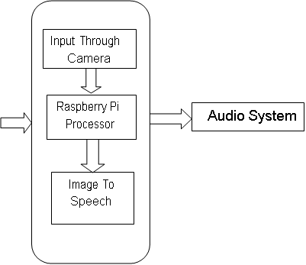
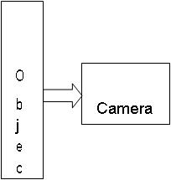
Block Diagram

Slide 6
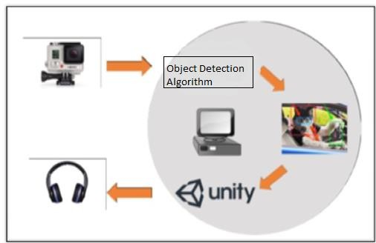
Working
1.First we capture an images using camera module.
Then we extract the features of an image.
2.For the detection of object in real time, we use
Raspberry Pi Camera Module V2 which has 8
megapixel native resolution which is
connected to the Raspberry Pi board via a short
ribbon cable.
3. For processing the image we use processor name
Raspberry Pi 3 Model B.
4. We here detect an image with the help of camera and then process the image boundaries and detect object accordingly.
5. Here, we have used an YOLO V3 like algorithm for object detection.
6.The Audio System program is used to convert detected image into audio, then object detected by system speech out by it’s name.

Slide 7

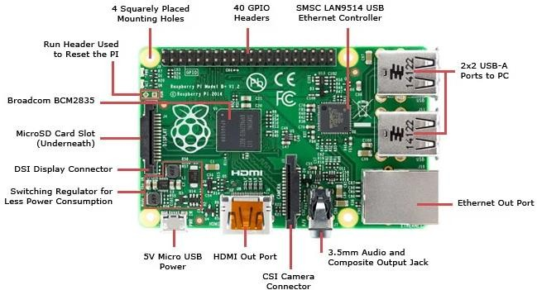
Raspberry Pi
Features
CPU: Quad-core 64-bit ARM Cortex A53 clocked at 1.2GHz
GPU: 400MHz Video Core IV multimedia
Memory: 1GB LPDDR2-900 SDRAM (i.e.900MHz)
USB ports:4
Video outputs: HDMI, composite video (PAL and NTSC) via 3.5 mmjack
Network: 10/100Mbps Ethernet and 802.11n WirelessLAN
Peripherals: 17 GPIO plus specific functions, and HAT IDbus
Bluetooth:4.1
Power source: 5 V via MicroUSB or GPIOheader
Size: 85.60mm ×56.5mm

Slide 8
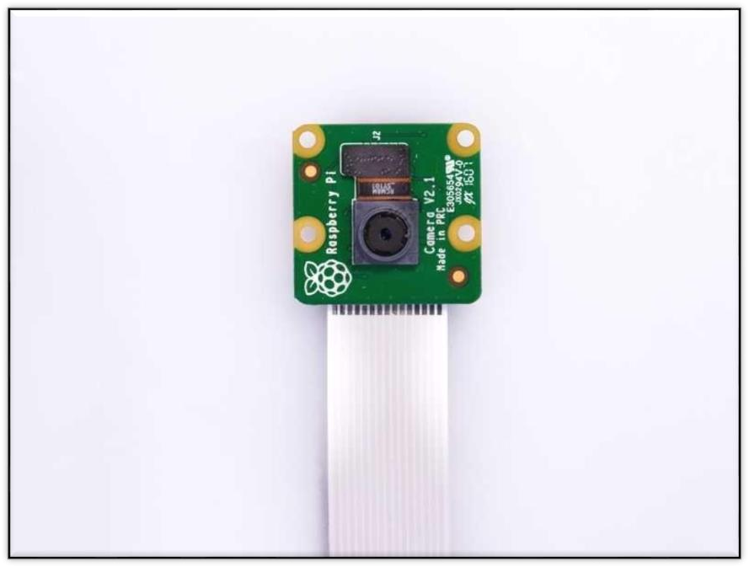
Camera Module
Features
Fixed focus lenson-board
Improved resolution - 8 megapixel native resolution sensor-capable of
3280 x 2464 pixel staticimages
Supports 1080p30, 720p60 and 640x480p90video
Size 25mm x 23mm x9mm
Weight just over3g
Connects to the Raspberry Pi board via a short ribbon cable(supplied)
Camera v2 is supported in the latest version of Raspbian , Raspberry Pi's preferred operating system
Uses the Sony IMX219PQ image sensor - high-speed video imaging and high sensitivity
1.4m X 1.4m pixel with Omni BSI technology for high performance (high sensitivity, low crosstalk)

Slide 9
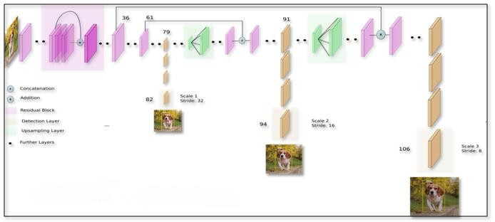
Object Detection Algorithm
Features
The biggest advantage of using YOLO is it's superb speed and can process 45 frames per second.
This also understands generalized object representation.
Fast, good for real time processing.
Can be trained end to end to improve accuracy.

Slide 10
Reference
[1.] Shaoqing Ren, Kaiming He, Ross Girshick, and Jian Sun. Faster r-cnn: Towards real-time object detection with region proposal networks. In Advances in Neural Information Processing Systems, pages 91–99, 2015.
[2.] Ross Girshick. Fast r-cnn. In Proceedings of the IEEE International Conference on Computer Vision, pages 1440–1448, 2015.

Slide 11
Thank You

