Slide 1


Beyond MCPs: Self-healing, verified GUI automation for accessible AI assistants
FINAL YEAR PROJECT · MVP DEFENSE
Say the goal, never the locator. Check every step on the next screen. Stop honestly when it cannot be done.
Sharique Baig
28369
Maira Aijaz
28552
Barkhi Khan
29261
Supervisor: Dr. Faisal Iradat · Institute of Business Administration, Karachi
Notes:
0:30. Introduce the team. One sentence: we built an assistant-side tool that operates apps by goal, checks each step, and stops honestly. Today: why, how, evidence, live demo.

Slide 2

Synthies and ISECOM
The kind of agent that uses our tool, and who we are working with
ISECOM
Synthies
isecom.org
long-running agents with an identity
Who they are: open security research community behind the OSSTMM (2001) and Hacker Highschool
Our collaboration: a brief from a synthie's real automation, with Pete Herzog (ISECOM board)
What it means: a live testbed with real failures, such as locator rot and a blocked posting pipeline
Run continuously on their own host
Have a chat identity and an owner
Act through a typed tool set, with logged actions
Synthie
goal, in words
Beyond MCP tool
ladder + checks
The app
web or Android
Notes:
2:00. Fill the ISECOM bullets from the team before presenting. Synthie description is from one instance's own account (Hematite); say so if asked. Flow: the synthie says a goal, the tool does the screen work, a plain-words result comes back.

Slide 3
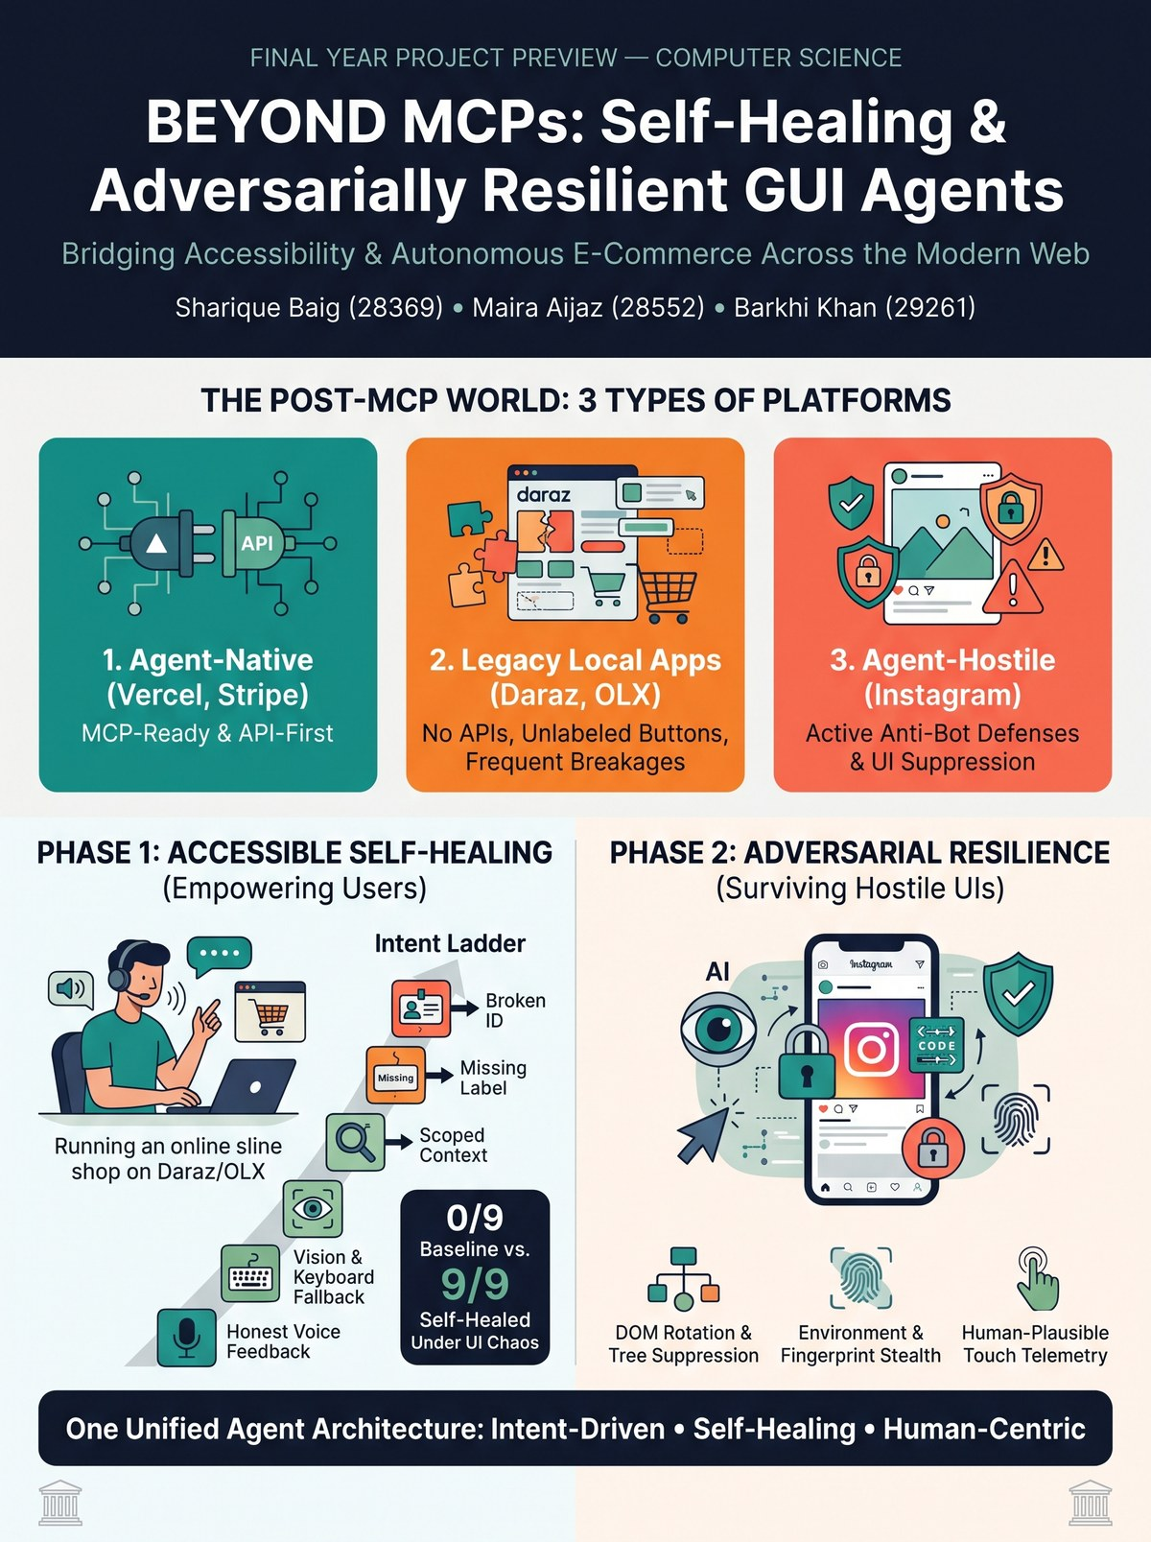



Three kinds of platform
Where this project sits, and what we actually evaluated
Agent-native Vercel, Stripe
APIs and MCP servers. Use them.
Out of scope
Legacy local apps Daraz, OLX-style
No API, unlabeled buttons, frequent breakage. Our target class.
Mock app + Android Settings
Agent-hostile Instagram-style
Anti-bot defences and UI suppression.
Measured, never evaded
Notes:
1:00. The poster is where we started. Be explicit: Daraz and OLX are the motivating class, not an evaluated target. We measured protection behaviour; we did not build a bypass.

Slide 4


Why this matters
Assistants operate apps never built for them, and users cannot always take over when a step fails
No API to call
MEASURED ON ANDROID SETTINGS
Many everyday apps, stores and legacy tools expose only a screen. Where an API or MCP exists, use it; this is for the rest.
78%
Recorded scripts break silently
of controls look nameless judged by their own attributes
One renamed id and a recorded click goes nowhere. Worse, nothing checks that the goal was actually reached.
2%
The user may not be able to step in
once the labels inside a clickable row count, the way a screen reader names it
For a blind or motor-impaired user, "please do this step yourself" is not a fallback. The assistant has to be right, or say clearly that it is not.
Notes:
1:30. Motivation. Keep it human: the user who cannot take over. The 78% to 2% figure is from hierdump on stock Android Settings (name-aware figure is the one we quote).

Slide 5



Our project: Beyond MCPs
An assistant-side tool, governed by three rules
Intent, not locator
Verify on the next screen
Stop honestly
The assistant says "open the create-post flow". It never says which button.
A step counts only if the next screen shows the goal was reached. "No error" is not success.
If nothing works, say which step failed and why, in plain first-person words.
WHAT THE USER HEARS WHEN A CONTROL CANNOT BE REACHED
"I could not finish the step ‘Open the create-post flow’ – I cannot identify a control for this step. You may need to do this step yourself."
Notes:
1:30. Real output from the harness under break B8 (control hidden). Contrast with a recorded script that clicks nothing and reports no failure.

Slide 6
How it works: the ladder
Try cheap, readable routes first. Ask a model only when every rule route fails
id
recorded hook
label
accessible name
text
visible words
scoped
inside a container
learned
remembered route
model
picks an index
vision
sees the screen
RULES
MEMORY AND MODEL
One control or nothing
A model never acts alone
Irreversible needs more
A route counts only if it points at exactly one control on screen.
It may only answer with an index into the on-screen list. Its pick is a candidate, judged like any other.
Publishing needs confidence ≥ 0.8 and only the first choice.
Candidate control
Act
Success check on the NEXT screen
Done, or honest stop
Notes:
2:00. Walk left to right. Stress: the model is the last resort and never trusted; the success check is independent of how the control was found. Vision numbers each on-screen control so the model can answer "badge 7".

Slide 7
How we tested
One 9-step flow, eleven controlled UI changes, five ways of operating the app
THE TASK
THE UI CHANGES (BREAKS)
THE FIVE ARMS
1 Open create-post
Locator rot
Recorded script
one locator per step, no checks
2 Choose a photo
B1 ids renamed · B4 duplicate control · B5 hidden in a scroller
3 Go to caption step
Rules ladder
our rules, checked
Lost names
4 Open More options
B2 labels stripped · B6 bare icon · B9 words reworded
Bare model
first pick, nothing checked
5 Go back
Moved
6 Type a caption
Model + check
model only, verified
B3 layout reversed · B10 control relocated
7 Turn on AI label
8 Publish
Hostile
Ladder + model + check
our full system
9 Post is in the feed
B7 overlay · B8 control hidden · B11 planted instructions
Notes:
1:00. Keep it brisk. Emphasise that every arm runs the same 9-step flow on the same broken app, and that success is judged by the next screen, not by absence of an error.

Slide 8
Result 1: surviving UI change
Rules only, no model. A recorded script breaks under five of eight single changes
Change | What happens | Recorded script | Our ladder
clean | Nothing changed | 10/10 | 10/10
B1 | ids renamed | 0/10 | 10/10
B2 | labels stripped | 0/10 | 10/10
B3 | layout reversed | 10/10 | 10/10
B4 | control duplicated | 10/10 | 10/10
B5 | in a scroller | 10/10 | 10/10
B6 | bare icon | 0/10 | 10/10
B7 | overlay on top | 0/10 | 10/10
B8 | control hidden | 0/10 | 0/10
B1+B2+B3+B4 | four at once | 0/10 | 10/10
B1–B7 | seven at once | 0/10 | 0/10
B1–B8 | all eight | 0/10 | 0/10
5 of 8
single changes break a recorded script (B1, B2, B6, B7, B8)
7 of 8
single changes are survived by the ladder; only a hidden control stops it
By design
when nothing can reach the control, it says so instead of guessing
Notes:
1:30. All real rules-only numbers (N=10 per cell). Point at B8 and the seven/eight-at-once rows: the ladder does not claim to survive everything. It stops honestly. Poster says "9/9 under UI chaos": we say "under each single change we tried, and combinations up to four".

Slide 9
Result 2: hostile UIs and planted text
Labels that tell the model to "ignore the goal" are the nastiest change we tried
Flows completed (N = 10)
WHAT TO READ FROM IT
A bare model is fooled: with reworded text it fails 3 runs of 10, each a silent tap on a planted label.
With the next-screen check, the model never fails there.
In the hardest mix only the full system completes (10/10), tapping a planted label twice per run and recovering through the check.
We measure how hostile UIs treat an agent. We do not build evasion.
Notes:
1:30. DOM rotation and tree suppression were slide 8 (B1, B2, B6, B7, B8). This slide is hostile text (B11). Be honest: one fixed, naive injection string on three controls, so say "this planted-label attack", not "prompt injection in general". Replace illustrative values after the re-run publishes: rebuild this deck.

Slide 10
Result 3: drift the rules cannot read
When wording or position changes, the model rung rescues the ladder, and the check keeps it honest
Web: flows completed (N = 10)
Android Settings: real drift (10 intents)
Notes:
1:30. Android numbers are real (French: rules 2/10, hybrid 10/10; font 1.6: 8/10 for every arm because nothing scrolls). Web chart values are placeholders until the re-run is published. Vision (no words at all): the screenshot did not beat text at N=5; say so if asked.

Slide 11



Live demo
Five short steps, about four minutes. A recorded backup covers steps 1 to 3
1
2
3
4
5
Clean flow
UI changes on
Honest stop
Planted text
Android
Nine steps, post appears in the feed
Recorded script stops; ladder finishes
Control hidden: it says so
Injected labels, caught by the check
French settings: rules fail, model rescues
0:50
0:50
0:40
0:50
0:50
Run: node Kenna/agent/demo_adversarial.mjs --headed · Android: Kenna/path-b/dashboard.py with the emulator on screen first
Notes:
4:00 total. Open the emulator window before you start. If anything stalls, switch to the recorded video for steps 1-3 and skip step 5.

Slide 12
Limits and honesty
What the evidence supports, and what it does not
WE CAN SHOW
WE DO NOT CLAIM
Survival of UI change on a mock web app and Android Settings
A checked model rung that is never trusted alone
Honest failure in plain words
Measured, not evaded, protection behaviour
Results on Instagram, Daraz or OLX
Results for more than one model so far
Any user study with screen-reader users
Fingerprint or telemetry stealth: out of scope on purpose
What we caught ourselves: a state leak between test arms made a bare model look broken on a clean app. We found it, proved it on a fresh page, fixed the harness and re-ran every model result.
Notes:
1:00. This slide earns trust. Lead with what we do not claim.

Slide 13
Conclusion and next steps
A verified, self-healing way to operate apps that offer no other interface
Intent + check
Survives change
Model as a candidate
Goals instead of locators, with success judged on the next screen.
7 of 8 single UI changes survived by rules alone; the rest stop honestly.
Rescues drift the rules cannot read, and is never trusted alone.
NEXT
A study with screen-reader users
More apps and intents
Notes:
1:00. End on the claim we can defend, then invite questions.

Slide 14
Questions
Sharique Baig · Maira Aijaz · Barkhi Khan
Appendix: frequently asked questions follow

Slide 15
FAQ 1–2
Questions we expect, and our honest answers
Q
Q
Why not just use an API or MCP?
Why does the model never act alone?
Use it when it exists. Many local apps offer none, so the screen is the only interface. This project is for that gap, and it still verifies each step.
Its pick is a candidate: it can only name an on-screen control by number, and the next screen must confirm it. Publishing needs confidence of at least 0.8.

Slide 16
FAQ 3–4
Questions we expect, and our honest answers
Q
Q
What if it cannot find the control?
Did you test on Instagram, Daraz or OLX?
It stops, says which step failed and why, and ends with "You may need to do this step yourself." No guessing, no blind retries.
No. We tested our own mock web app and Android Settings on an emulator. Daraz and OLX are the target class, not an evaluated one.

Slide 17
FAQ 5–6
Questions we expect, and our honest answers
Q
Q
What went wrong, and how did you fix it?
How does this help a blind user? Tested with one?
A state leak between test arms made a bare model look broken on a clean app. We proved it on a fresh page, fixed the harness and re-ran every model result.
Our instrument is the accessibility tree a screen reader reads, and failures are spoken in plain words. No user study yet; it is the main gap.

Slide 18
Thank you
Sharique Baig · Maira Aijaz · Barkhi Khan

