Slide 1
WOXSEN UNIVERSITY
School of Technology | DBMS Course Project
CAR RENTAL
Reservation & Return System
Final Presentation
N. Varshith
Mohammed Sharjeel
M. Vishnu Vivekananth
25WU0101087
25WU0101076
25WU0101067

Slide 2

Agenda
Overview
1
Problem Description
Title, objectives, scope, users
2
ER Diagram & Schema
Entities, keys, relationships, 3NF
3
Database & Queries
Create, insert, joins, aggregates
4
User Interface Demo
Insert, delete, view records live
5
Questions
Ask us about any part
2

Slide 3




Problem Statement
1 | Problem
Small rental shops track bookings and returns on paper or spreadsheets. This leads to:
Double Bookings
Lost Returns
Wrong Billing
Same car reserved for overlapping dates
No record of when or how a car came back
Late fees and damages missed or miscalculated
Our solution: a MySQL-backed system that manages cars, customers, reservations, returns and payments in one place, with a simple UI.
3

Slide 4

Objectives, Scope & Users
1 | Problem
Objectives
Scope
Intended Users
- Store car and customer data centrally
- Prevent double booking
- Record returns, late fees, damages
- Track advance and final payments
- Generate revenue and usage reports
- Keep data accurate with constraints
- Car inventory and availability
- Reservation create / cancel
- Return inspection and fees
- Payment records and receipts
- Reports: revenue, overdue, top customers
- Out of scope: online payment gateway, GPS tracking
- Admin: manages cars, rates, reports
- Counter staff: bookings, returns, payments
- Customers: rent cars through staff
Why a DBMS? Shared data, no duplication, integrity, fast queries.
4

Slide 5







Project at a Glance
Numbers
5
25+
4
Tables
Records
FK Links
3NF
3
2
Normalized
UI Actions
Query Types
5

Slide 6

Life of a Rental
Story
Available
Reserved
Rented
Returned
Paid
Car sits free in the lot
Ravi books Swift, 4-8 Oct
Pickup: status Active
Late fee / damage added
Payment row saved
Each step updates the Car.status and adds rows to Reservation, Car_Return and Payment.
6

Slide 7
ER Diagram
2 | ER & Schema
CUSTOMER
RESERVATION
CAR
customer_id (PK)
name
phone, email
license_no
makes 1 : N
reservation_id (PK)
customer_id (FK)
car_id (FK)
pickup_date, due_date
status
for N : 1
car_id (PK)
brand, model
reg_no
daily_rate, status
1 : 0..1
Legend
Total participation: Reservation (needs a customer and a car)
Partial: Car_Return (only after pickup), Payment
CAR_RETURN
PAYMENT
return_id (PK)
reservation_id (FK)
return_date
late_fee, damage_charge
paid by 1 : N
payment_id (PK)
reservation_id (FK)
amount, pay_date
method
7

Slide 8
Relational Schema
2 | ER & Schema
CUSTOMER
CAR
RESERVATION
CAR_RETURN
PAYMENT
customer_id PK
name
phone
email
license_no UNIQUE
car_id PK
brand, model
reg_no UNIQUE
daily_rate
status
reservation_id PK
customer_id FK
car_id FK
pickup_date
due_date, status
return_id PK
reservation_id FK
return_date
late_fee
damage_charge
payment_id PK
reservation_id FK
amount
pay_date
method
Foreign keys: Reservation.customer_id > Customer, Reservation.car_id > Car, Car_Return.reservation_id > Reservation, Payment.reservation_id > Reservation
8

Slide 9
Business Rules & Constraints
2 | ER & Schema
No double booking
One return per reservation
A car cannot be reserved for overlapping dates. Checked before every insert; car status changes to Reserved / Rented.
Car_Return.reservation_id is UNIQUE. A return can exist only after pickup.
Valid customers only
Data integrity checks
Customer needs a unique license_no. Reservation needs a valid customer_id and car_id (foreign keys).
CHECK daily_rate > 0 and due_date >= pickup_date. Payments of 1 or more per reservation (advance + final).
Billing: Total = days x daily_rate + late_fee + damage_charge | late_fee = late days x daily_rate x 1.5
9

Slide 10
Normalization up to 3NF
2 | ER & Schema
1NF
2NF
3NF
Atomic values, no repeating groups. Each phone, date and fee is a single value.
Every table has a single-column key, so no partial dependency is possible.
No transitive dependency: car and customer details live only in their own tables.
Example: storing customer name in Reservation would depend on customer_id, not the reservation key. We keep it in Customer to avoid that.
10

Slide 11
Database & Table Creation
3 | Database
CREATE TABLE Customer (
customer_id INT PRIMARY KEY
AUTO_INCREMENT,
name VARCHAR(50) NOT NULL,
phone VARCHAR(15),
email VARCHAR(60),
license_no VARCHAR(20) UNIQUE
);
CREATE TABLE Car (
car_id INT PRIMARY KEY,
reg_no VARCHAR(15) UNIQUE,
daily_rate DECIMAL(8,2)
CHECK (daily_rate>0));
CREATE TABLE Reservation (
reservation_id INT PRIMARY KEY,
customer_id INT NOT NULL,
car_id INT NOT NULL,
pickup_date DATE,
due_date DATE,
status VARCHAR(10),
FOREIGN KEY (customer_id)
REFERENCES Customer(customer_id),
FOREIGN KEY (car_id)
REFERENCES Car(car_id),
CHECK (due_date>=pickup_date)
);
11

Slide 12
Insert & SELECT Queries
3 | Database
Sample output (replace with your real result)
-- min. 5 records per table
INSERT INTO Car VALUES(1,'Swift','TS09AB1234',1800);
name | reg_no | due_date
Ravi | TS09AB1234 | 2026-10-08
Anita | TS10CD5678 | 2026-10-09
Kiran | TS08EF9012 | 2026-10-12
-- JOIN
SELECT c.name, car.reg_no, r.due_date
FROM Reservation r
JOIN Customer c USING(customer_id)
JOIN Car car USING(car_id)
WHERE r.status='Active';
-- AGGREGATE
SELECT car_id, SUM(amount)
FROM Payment GROUP BY car_id;
What we show live
Create database, tables, inserts, then joins and aggregates (COUNT, SUM, GROUP BY).
12

Slide 13
More Queries We Run
3 | Database
Real questions the rental shop asks, answered with SQL
-- 1. Cars available now
SELECT * FROM Car WHERE status='Available';
-- 2. Overdue rentals
SELECT reservation_id FROM Reservation
WHERE due_date<CURDATE() AND status='Active';
-- 3. Top customers by spend
SELECT c.name, SUM(p.amount) AS spent
FROM Customer c JOIN Reservation r USING(customer_id)
JOIN Payment p USING(reservation_id)
GROUP BY c.name ORDER BY spent DESC;
Concepts covered
-- 4. Average rental length
SELECT AVG(DATEDIFF(due_date,pickup_date))
FROM Reservation;
-- 5. Cars never rented
SELECT model FROM Car
WHERE car_id NOT IN
(SELECT car_id FROM Reservation);
JOIN (inner), GROUP BY, ORDER BY, SUM, AVG, COUNT, DATEDIFF, subquery (NOT IN), WHERE filters.
13

Slide 14
Reports: What the Data Tells Us
3 | Database
Rs 48,600
3
1
Total Revenue
Active Rentals
Late Returns
SELECT car.model, SUM(p.amount)
FROM Payment p
JOIN Reservation r USING(reservation_id)
JOIN Car car USING(car_id)
GROUP BY car.model
ORDER BY SUM(p.amount) DESC;
14

Slide 15
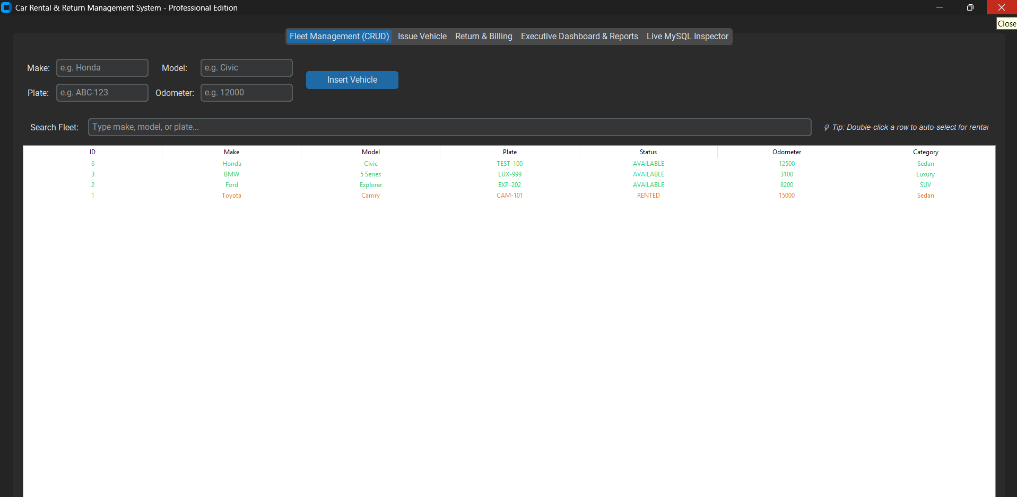
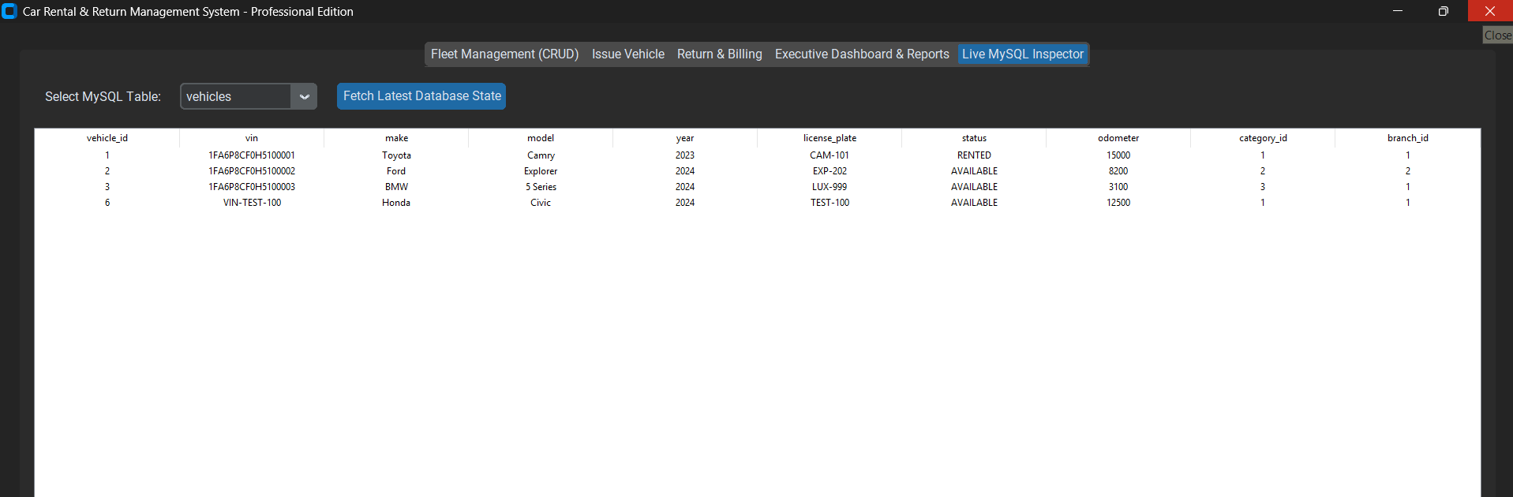
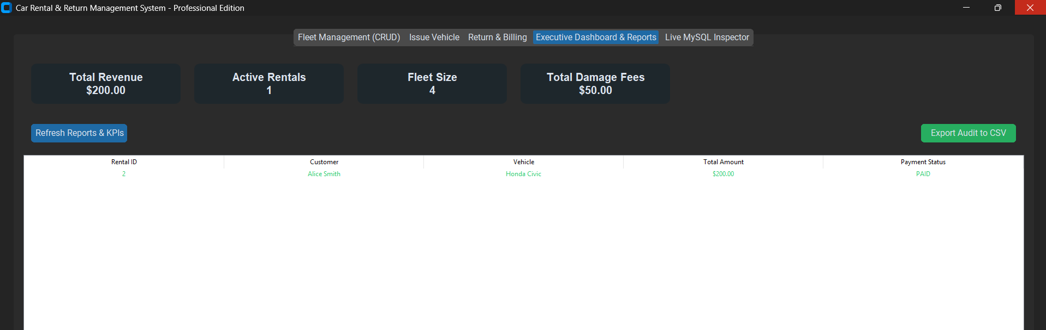
User Interface Demo
4 | UI
Insert: New Reservation
Delete: Cancel Reservation
View: All Reservations
Customer: Ravi
ID: 1004
1001 Ravi Active
Car: Swift
Customer: Anita
1002 Anita Returned
Pickup: 04-10
Status: Active
1003 Kiran Active
Due: 08-10
1004 Sana Active
Save
Delete
Refresh
15

Slide 16
Rental Workflow & Tech Stack
4 | UI
Browse Cars
Reserve
Pickup
Return
Pay
Database
Front end
Connector
MySQL
Python GUI
(python-mysql-connector)
16

Slide 17
Conclusion & Future Scope
Wrap-up
What we achieved
Future scope
- Normalized 3NF schema, 5 tables
- Constraints prevent bad data
- Join and aggregate reports
- Working UI: insert, delete, view
- Online payment gateway
- Email / SMS reminders
- Role-based login
- Revenue dashboard
17

Slide 18
Questions?
Thank you

