Slide 1
Extremism

Slide 2
Presented by
Noman
Zain
Arooj
Sharjeel
Moeez

Slide 3
What is Extremism
"The holding of extreme views or beliefs that go beyond what is considered reasonable or acceptable in society. It often leads to intolerant attitudes and in some cases, violent actions.”

Slide 4
Blasphemy
"It’s when someone’s words or actions cross the line, disrespecting the sacred beliefs, symbols, or figures that people hold dear."

Slide 5
Objectives of discussion
To argue that blasphemy should not be treated as a Hadd offence.
To underscore that there is no ijma on the existence of a mandatory death penalty for non-Muslims.
To underscore that the current narrative on the law is not an accurate representation of the Hanafi tradition and therefore, not an accurate representation of the Islamic legal tradition.
To argue that the law cannot be indiscriminately applied to both Muslims and non-Muslims.
To highlight the fact that the option of a pardon exists within the Islamic legal tradition for those who insult the Prophet.

Slide 6
A Brief History
Texts from religions
Jewish
In Jewish history, blasphemy was considered a grave offense under the Torah, specifically prohibiting disrespect toward God’s name (Leviticus 24:16). It was punishable by death in ancient Israel, reflecting the centrality of reverence for God in Jewish law and culture.
Christianity
In Christian history, blasphemy was viewed as a severe sin, particularly in medieval times, involving disrespect toward God. It was often met with harsh punishments, including death.
Hinduism
In Hindu history, blasphemy was typically seen as disrespect toward sacred deities or practices, often resulting in social ostracism or public humiliation.

Slide 7


Suppression of free speech
Tyrannical regimes often use blasphemy laws to suppress free speech like Galileo was tried for heresy and blasphemy by the Catholic Church for supporting the heliocentric model, leading to his forced house arrest

Slide 8
Colonial background
Controversial laws of 1860
Section 295 and 298 were introduced
Mahase Rajpal case 1927
He was murdered by Ilm-ud-din, a man seeking revenge for the perceived insult

Slide 9
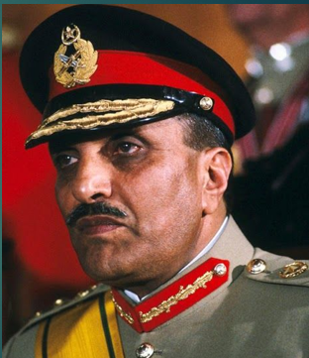
Blasphemy laws in Pakistan
General Zia Ul Haq's role
Introduced laws like section 295-A,295-B and 295-C that criminalized any kind of hate speech against Islam.
Section 298-B and 298-C were also introduced

Slide 10
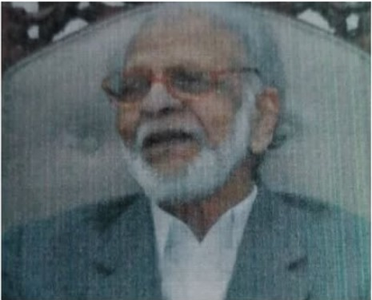
Elephant in the room
Ismail Quraishi
In 1984, a lawyer, Ismail Qureshi, falsely told Provincial sharia court that Muslim scholars have ijma on the death penalty on blasphemy. This led to the introduction of Section 295(c), which imposed the death penalty for blasphemy against the Prophet Muhammad (PBUH)
It was not passed through presidential ordinance

Slide 11
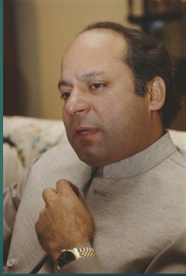
Nawaz's Role
In 1991 the punishment of life imprisonment was removed from the law, making the death penalty mandatory and fixed, without any possibility of repentance.
By forcefully imposed by Nawaz Sarif, Section 295-C finally took on the form that it has retained till this day.

Slide 12
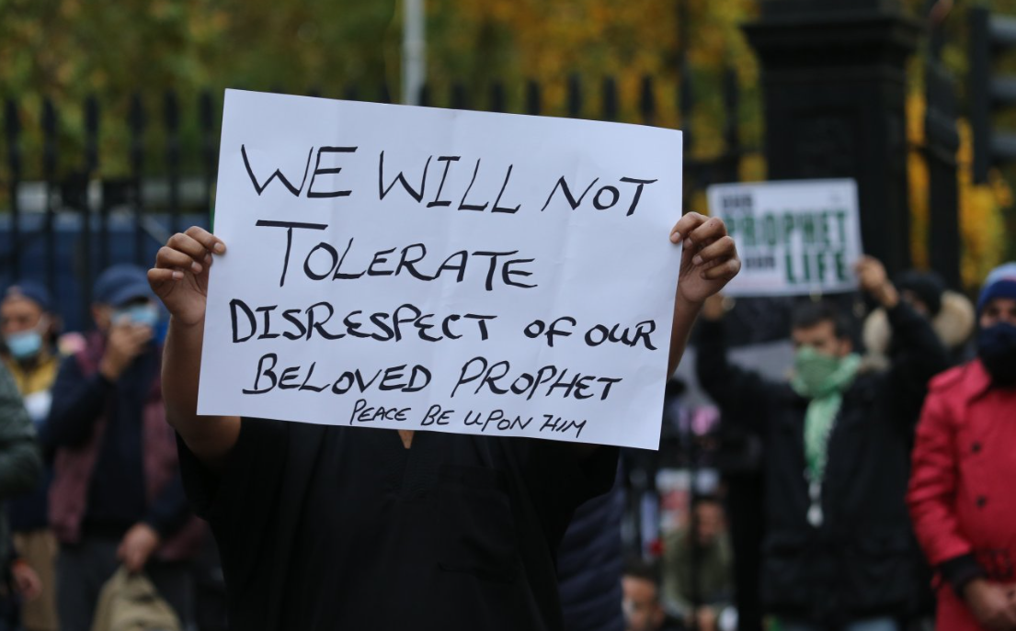
Why blasphemy laws are important
Maintaining societal order and upholding Islamic principles
Preserving honor of sacred personalities

Slide 13



The Love of the Prophet Muhammad (PBUH) in Islam
Prophet Muhammad (PBUH) is not just a spiritual guide but the embodiment of excellence.
Quran explicitly states in Surah Al-Ahzab (33:6) that the Prophet is "dearer to the believers than their own selves"
Offensive acts like The Satanic Verses by Salman Rushdie and cartoons of Prophet Muhammad (PBUH) in Charlie Hebdo can be prevented

Slide 14
From Islamic Sharia:
Imam Ahmed ibn e hanbal
Scholars like Imam Ahmad bin Hanbal have supported severe penalties for blasphemy, arguing that it serves as both justice for the crime and a deterrent for others.

Slide 15
Other Scholars
Ibn Taymiyyah,
In his work As-Sarim Al-Maslul Ala Shatim Ar-Rasul, holds that the deliberate insult of the Prophet by a Muslim is an act of apostasy, deserving the death penalty.
Al-Bazzazi
A Hanafi jurist, stated that blasphemy by a Muslim is so grave that it takes precedence over repentance, as it disrupts societal harmony and insults the foundation of Islam.

Slide 16
The Historical dishonesty

Slide 17
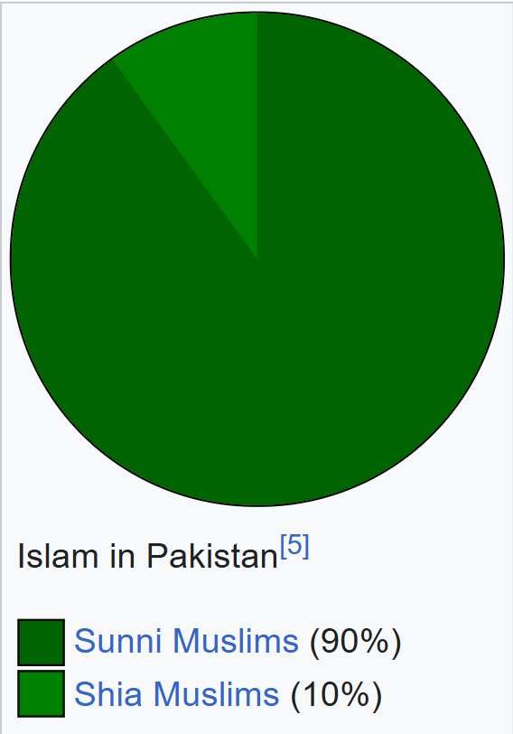
Islam in Pakistan

Slide 18
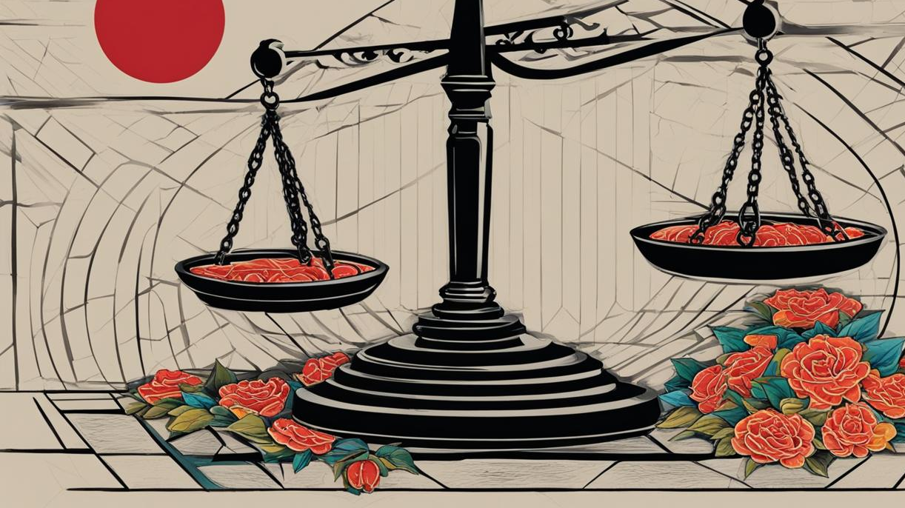
Hadd and Tazeer
Hadd refers to fixed punishments for certain offenses as intended by Allah, considered mandatory under Islamic law.
Tazeer pertains to discretionary punishments for other crimes, left to the discretion of the Islamic judge.

Slide 19
Sunni Jurripodence
Imam Abu Hanifa
Maintains that blasphemy punishment is not Hadd.
Ibn taymiyah
Reinforced Abu Hanifas statement

Slide 20
Other Scholars
Ibn Al Bazzazi
Misinterpreted Abu Hanifa's stance on punishment for non mulims
Ibn Abidin
Corrected Bazzaz i's mistake issuing Fatwa on blasphemy as a Tazeeri offence.

Slide 21
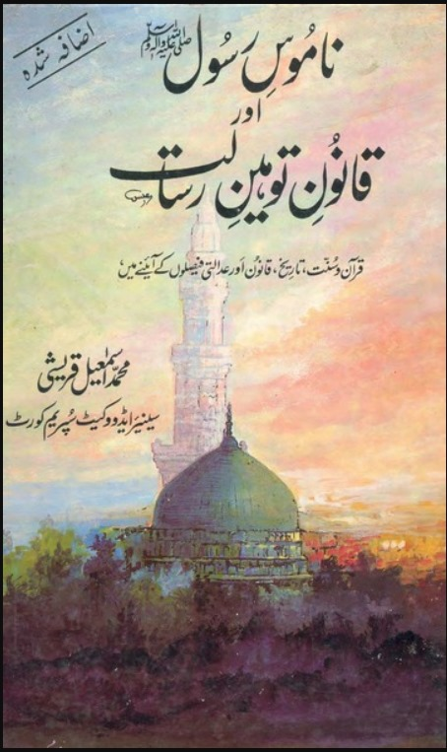
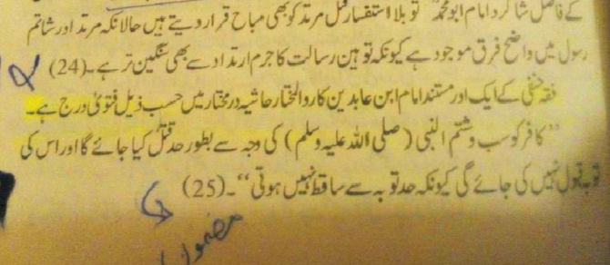
Changing the law
Falsely quoted Al Bazzazi on having ijma of scholar on Capital punishment for non Muslims

Slide 22
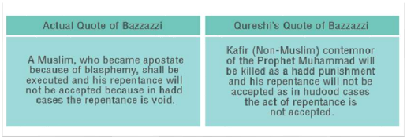

Slide 23
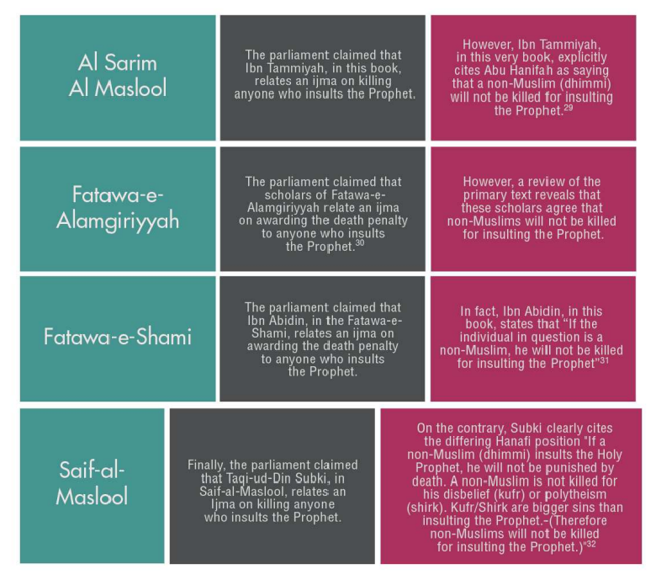

Slide 24
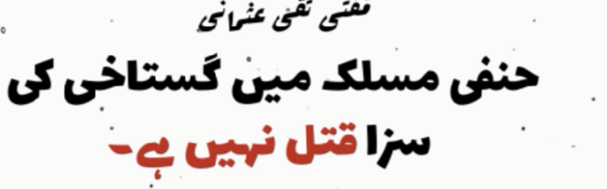
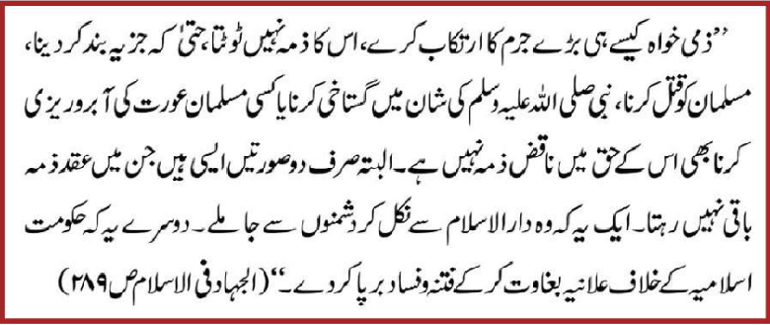

Slide 25
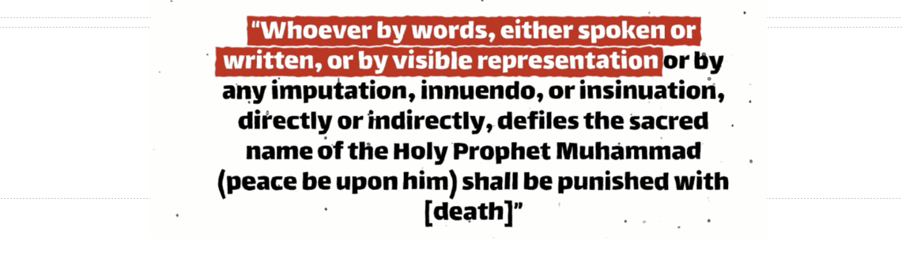
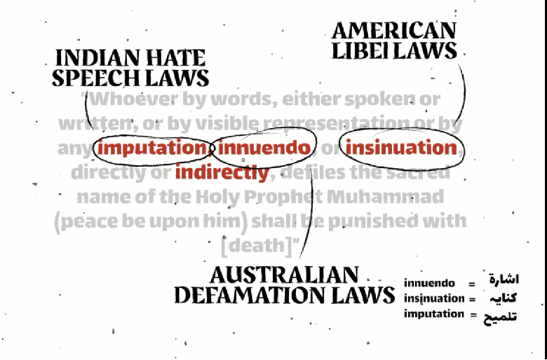

Slide 26
Effects of blasphemy

Slide 27
Mob Lynching
"Refers to a group of people taking the law into their own hands, violently attacking and often killing someone without any legal authority or due process. It’s driven by anger, prejudice, or the desire for vigilante justice".

Slide 28
Effects of Mob lynching
Asia Bibi case
1).In 2009 she was accused of blasphemy over a Muslim woman on drinking from the same container.
2).Her sentenced to death sparked international outrage
Salman Taseer case
He was assassinated by his bodyguard, Mumtaz Qadri, for opposing Pakistan’s blasphemy laws and supporting clemency for Asia Bibi.

Slide 29

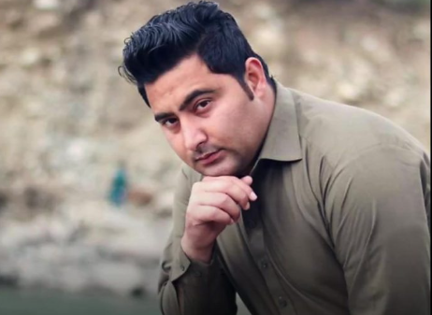
Priyantha Kumara Case
In 2021, Priyantha Kumara, a Sri Lankan factory manager in Sialkot, was falsely accused of blasphemy and killed by a mob of factory workers.
Mashal khan case
In 2017, Mashal Khan, a 23-year-old university student, was lynched by fellow students in Mardan after being falsely accused of blasphemy.

Slide 30
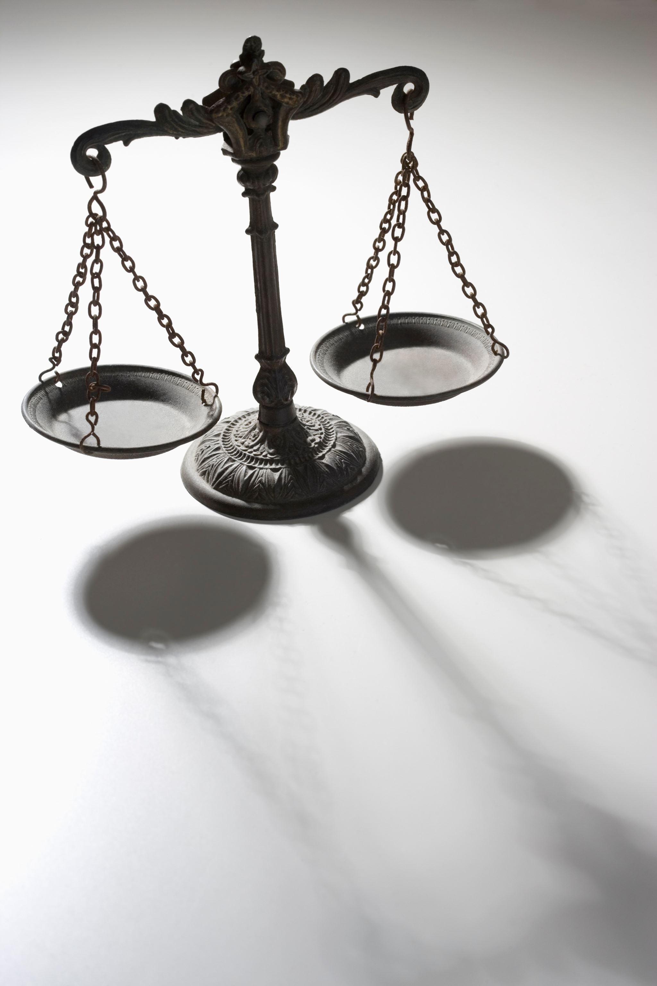
Misuse of blasphemy laws

Slide 31

For personal gain
Khaleel Tahir Sindhu, a lawyer and former Member of the Punjab Assembly. In 2013, Sindhu was alleged to have exploited blasphemy allegations against a Christian man over a land dispute. The man was falsely accused of desecrating the Quran.
Misinterpretation of religion
Ismail Qureshi misinterpreted fatwas to make sure that section 295c was passed.

Slide 32
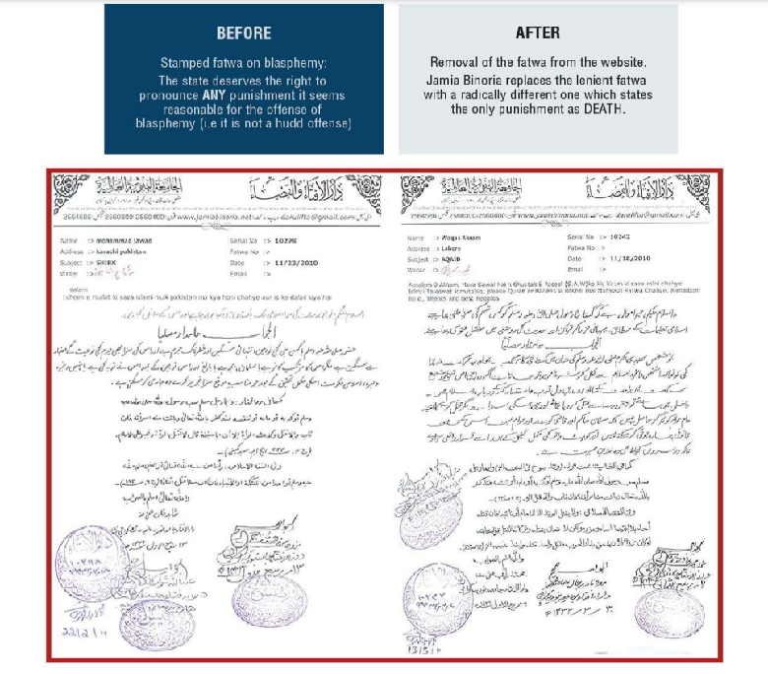

Slide 33
Problems with Blasphemy laws
Weapon Against Minorities
These laws are often used as a tool for persecution, especially against non-Muslims, who are more vulnerable to accusations.
Fear Over Freedom
These laws create an environment of fear, stifling debate, creativity, and intellectual freedom

Slide 34
What did we learnt
While not all accused are innocent, extrajudicial killings, such as 14 reported in 2023 alone, highlight the deep injustice in how these laws are enforced. Reform is vital—not to blasphemy, but to ensure due process, prevent misuse, and align actions with the Islamic principles of justice and mercy.

