Slide 1
18th Amendment

Slide 2

Presented by
Arooj
Moeez
Noman
Sharjeel
Zain

Slide 3
Historical Background

Slide 4
Lahore resolution
This resolution emphasized on self-governance in ‘autonomous units’, ensuring that these units could independently manage their political, economical and cultural affairs.

Slide 5
Issues in East Pakistan
Economic disparities and political exclusion:
East Pakistan received a relatively small amount of budget for development despite contributing 60% in country's revenue among many more.
Shiekh Mujeeb’s key points on autonomy:
Proposed a federal system of government.
Provinces should have control over its own trade and foreign reserves.
The power of taxation and revenue collection should be vested in the federating units and the federal centre would have no such power.

Slide 6
Separation
Mujeeb's points showed the frustration and lack of trust of Bengali people over West Pakistan.
01
Imposition of Urdu, exploitation of resources by West Pakistan and lack of provincial autonomy led East Pakistan to separation.
02
If promises of Lahore resolution were to be realized practicality, it could have saved Bangladesh liberation war.
03

Slide 7

Balochistan
Despite contributing significantly to Pakistan's natural gas supply, Balochistan received minimal economic royalties.
Balochistan has experienced five major insurgencies(1948, 1958, 1963, 1973, and post-2000s) due to grievances over exploitation, lack of autonomy, and heavy-handed federal control.

Slide 8

KPK
The province became a frontline during the Soviet-Afghan War and later the War on Terror, bringing instability, terrorism, and economic damage.
KPK produced significant hydropower, but profits were retained by the federal government, leaving the province underfunded for local development.

Slide 9
Political challenges

Slide 10

Political instability from Quaid’s death onwards
Since his death in 1948, It’s always has been unrest in political landscape.
The constitutional development was delayed (until 1956).
Economic and political inequalities rose , especially in Balochistan, KPK and East Pakistan.
Military interventions

Slide 11
Constitutional problems and Martial laws
Ethnic and regional disputes delayed the adoption of the first constitution until 1956, reflecting political instability.
Ayub Khan introduced the 1962 Constitution, which centralized power in the presidency and sidelined provinces.
Economic disparities and political marginalization of East Pakistan fueled unrest, culminating in Mujib’s Six Points (1966).
The Bangladesh freedom War occurred after the federal government refused to transfer power to Mujib and Co. after the 1970 elections, leading to East Pakistan's secession and the creation of Bangladesh.

Slide 12
Bhutto & Zia
Under Zulfikar Ali Bhutto, Pakistan adopted the 1973 Constitution, introducing a parliamentary system and federal structure.
General Zia-ul-Haq overthrew Bhutto in a coup and imposed martial law.
Zia centralized power further, curbing political freedoms and sidelining provinces.
Bhutto’s unlawful Execution

Slide 13
Democratic instability
Politically overthrown governments of Benazir Bhutto and Nawaz Sharif caused democratic instability.
General Pervez Musharraf outcasted Nawaz Sharif in a coup and imposed Martial law in 1999.
Musharraf's policies focused on centralization, exacerbating regional grievances, especially in Balochistan.
The killing of Nawab Akbar Bugti in 2006.

Slide 14
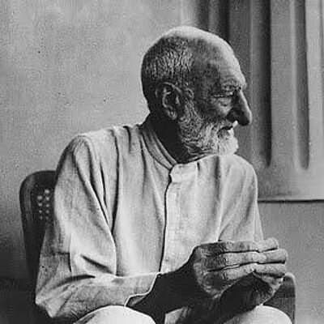
Sardar Bacha Khan
Championed autonomy for Pashtun-majority areas
pre and post-partition.
Opposed the One-Unit Scheme (1955), which he
believed marginalized smaller provinces.
Used peaceful means to demand provincial
self-governance and equality in decision-making.

Slide 15

Abdul Wali khan
Played a vital role in framing the 1973 Constitution,
advocating for federalism and provincial autonomy.
Criticized centralized policies under Ayub Khan
and Zia-ul-Haq, which undermined provincial representation.
Continued the fight for devolution of power, laying
groundwork for later reforms like the 18th Amendment.

Slide 16
Constitutional History

Slide 17
Colonial Era
During colonial rule, British governance in the subcontinent was centralized. Regions like had little to no autonomy and were controlled by the colonial government.
The colonial legacy of centralized governance, economic exploitation, and ethnic marginalization heavily influenced post-independence Pakistan.
The government of Indian act 1935 was still affecting the law and order of Pakistan till 1956.

Slide 18

Misuse of power
The 1956 Constitution introduced Pakistan’s first framework of governance, emphasizing federalism and democracy. However, it lasted only two years before Ayub Khan’s military coup in 1958.
The abuse of power during Ayub Khan’s era highlighted the dangers of excessive centralization.

Slide 19
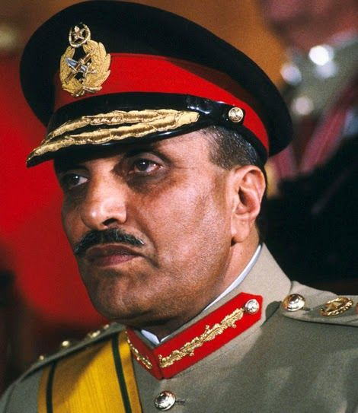
8th Amendment
General Zia-ul-Haq’s 8th Amendment (1985) introduced Article 58(2)(b), giving the President sweeping powers to dismiss the National Assembly and the Prime Minister.
This amendment disrupted parliamentary
democracy and federalism.

Slide 20
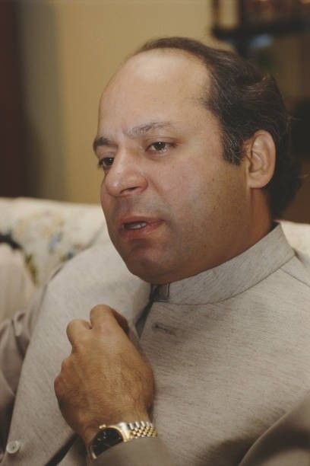
13th Amendment
The 13th Amendment, introduced by Nawaz government, repealed Article 58(2)(b), removing the President's power to dissolve the National Assembly.
This shift restored authority to the parliament, enhancing democratic governance and ensuring greater stability by reducing the likelihood of abrupt dismissals.
.

Slide 21
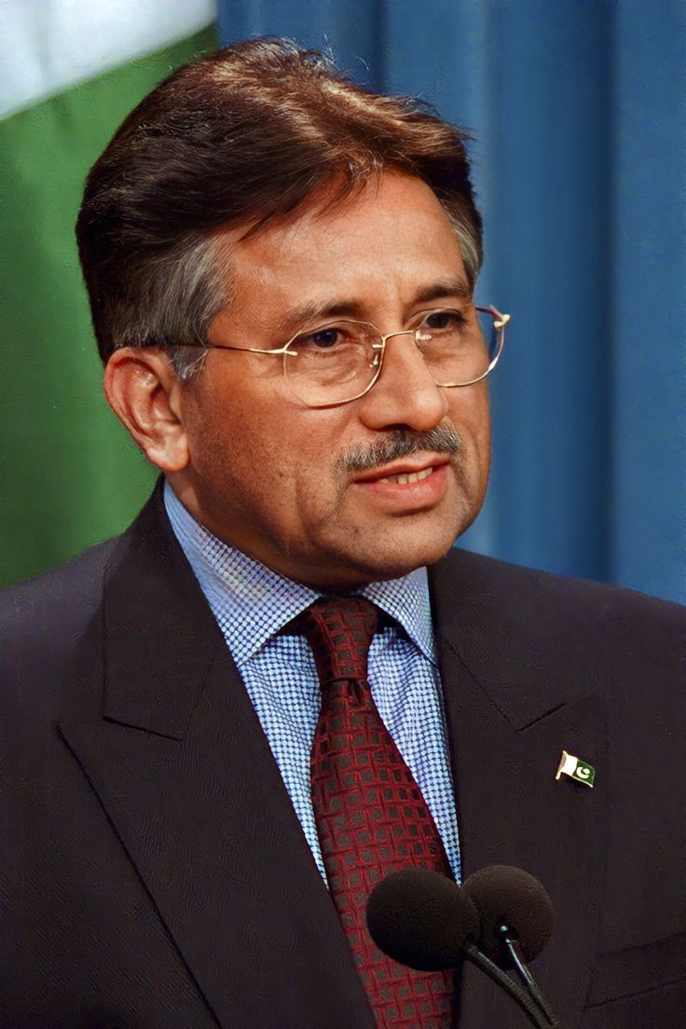
17th Amendment
The 17th Amendment, enacted during Pervez Musharraf’s presidency, reinstated Article 58(2)(b), granting the President the power to dissolve the National Assembly.
This amendment tilted the balance of power back towards the executive, limiting parliamentary sovereignty.
.

Slide 22
The Revival

Slide 23
18th Amendment (2010)
The 18th Amendment, passed in April 2010, marked a turning point, restoring provincial autonomy and strengthening democracy, fostering a more balanced federation.
It abolished Article 58(2)(b), which had allowed the President to dissolve the National Assembly. This change curtailed presidential powers, reinforcing parliamentary sovereignty and ensuring the continuity of democratic governance.

Slide 24
Important articles
Article 6 (High Treason)
Strengthened to prevent unconstitutional takeovers by explicitly stating that aiding, abetting, or collaborating in suspending or subverting the Constitution is an act of treason.
Article 25-A (Right to Education)
Introduced free and compulsory education as a fundamental right for children aged 5 to 16 years.
Article 70 & Concurrent List
Concurrent Legislative List abolished, transferring subjects like health, education, and agriculture to provincial governments.
Article 91 (Prime Minister)
Restored the Prime Minister as the chief executive, reducing the President’s role to a ceremonial figure.

Slide 25
More of them
Article 143 (Federal-Provincial Disputes)
Clearly defined the hierarchy: in case of conflict between federal and provincial laws, the federal law would prevail.
Article 160 (National Finance Commission - NFC Award)
Guaranteed provinces a larger share in the divisible pool of national resources.
Article 172 (Ownership of Natural Resources)
Ensured provinces had joint ownership of oil, gas, and minerals within their boundaries.
Article 175-A (Judicial Commission)
Reformed the process of appointing judges to the Supreme Court and High Courts, making it more transparent and merit-based.

Slide 26
A little bit more
Article 247 (Tribal Areas)
Paved the way for integrating the tribal areas (FATA) into the mainstream legal and administrative structure.
Article 260 (Definition of Federation)
Renamed NWFP as Khyber Pakhtunkhwa, reflecting its ethnic identity.

Slide 27
Irony of Time
Bhutto outright rejected Mujib’s Six Points calling for provincial autonomy.
This rejection was one of the primary reasons for the breakup of Pakistan.
The Grand U-Turn
In 2010, the same PPP-led government, spearheaded the 18th Amendment.
The PPP’s journey from rejecting provincial autonomy to championing it through the 18th Amendment is a striking example how history often compels leaders and institutions to revisit and rectify their past decisions, albeit after significant loss and upheaval.

Slide 28
Difference it made

Slide 29
Impacts of 18th amendment
Worker's welfare
Aimed to devolve labor rights and workers welfare from federal to provincial government.
Minimum wage limit.
Share of wealth and Control over local resources
Balochistan got enough funds for Gwadar safe city project.
Gilgit got full control over its trades of its extracted gemstones like Emeralds.
Education
Provinces were given autonomy to design their own curriculum based on their culture and languages.

Slide 30

Recent instances
Pakistan former prime minister Imran Khan tried to dissolve national assembly in 2022, but his move was prevented by article 58(1) which was added in 18th amendment.
His attempts to impose single national curriculum was also stopped by article 140-A which ensured provinces to manage their curriculum on their own.

Slide 31
Critique
Weakened Central Government
Critics argued it reduced the central government's ability to manage national issues.
Provincial Fragmentation:
Increased autonomy raised fears of heightened regional tensions and fragmentation between the provinces.
Ambiguities in Legal framework
Lack of clarity over jurisdictional matters between federal and provincial governments.
Problems in governance
Despite the 18th Amendment's mandate in Article 140A for provincial governments to devolve power
to local governments, many provinces have not fully implemented this, leading to concerns about centralized control.

Slide 32
Conclusion
Restoration of Democracy
Provincial Autonomy
Strengthening Federalism
Challenges in Implementation
Need for Local Governance

Slide 33


Slide 34


