Slide 1
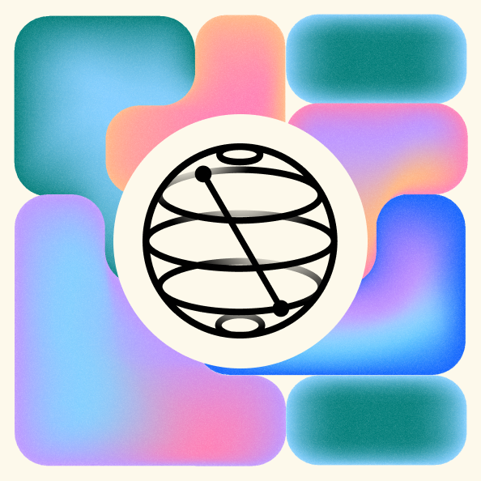
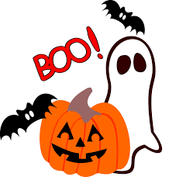
Qiskit Fall Fest 2023
Halloween Edition Oct 28th 2023
Time: 9AM – 3PM US ET
https://github.com/Shark-y/QiskitFallFest

Slide 2
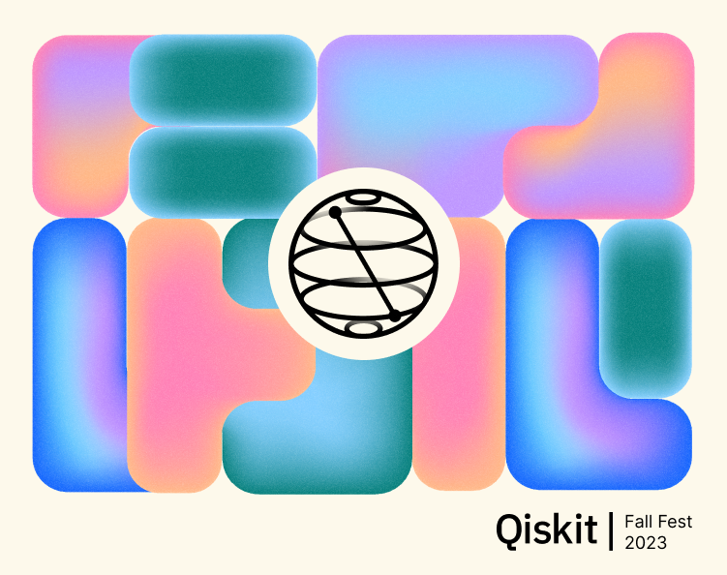

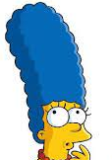
Theme: Spooky Action at a distance
God does not throw dice!
Audience: undergraduate, graduate students in CompSci, ECE, Physics.
Topics: Qubit architectures, Quantum gates, Entanglement, IBM roadmap, noise mitigation, and more.
Al, I think God a small gambling problem

Slide 3
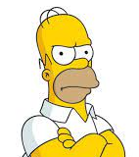
Quantum Program
09:00 AM Dr. Yuan Liu (NCSU): A Quantum Information Science Perspective on Quantum Chemistry.
10:00 AM Dr. Ted Yoder (IBM Research): Simulating quantum error-correction and new qLDPC codes.
11:00 AM IBM-Q Tutorials
12:00 AM Lunch
01:00 PM Dr. Nick Bronn: Outlook for Quantum Computing with Superconducting Qubits.
02:00 PM Dr. Jack Morgan: Quantum Algorithms for Financial Models in a Regime Switching Economy.
Forget ChatGPT. Quantum computers are the real deal

Slide 4
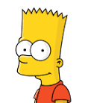
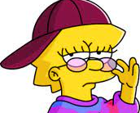
The A-Team of Speakers
Ay caramba! How do I put my qubits in superposition Liz?
Dr. Nick Bronn (IBM Research): Outlook for Quantum Computing with Superconducting Qubits.
Dr. Ted Yoder (IBM Research): Simulating quantum error-correction and new qLDPC codes.
Dr Jack Morgan : UNC-CH Quantum computational algorithms for derivative pricing and credit risk in a regime switching economy.
Dr. Yuan Liu (NCSU): A Quantum Information Science Perspective on Quantum Chemistry: from NISQ to Fault Tolerance.
Bart, use a Hadamard gate

Slide 5
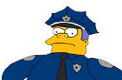
Qiskit/Jupyter Cheat sheet
Install python 3.8+ (Win32) https://www.python.org/downloads/windows/
$ pip install qiskit[visualization]
$ pip install notebook
IBMQ: https://quantum-computing.ibm.com/
Heisenberg, Planck, and Bohr ought to be arrested as violators of the laws of physics

Slide 6
Speaker Bios
Dr. Nick Bronn: After earning his Ph.D. in experimental Condensed Matter Physics from the University of Illinois, supported in part by a National Science Foundation Graduate Research Fellowship, Nick joined IBM Quantum as a post-doctoral researcher in 2013. Continuing as a Research Staff Member since 2015, he has been responsible for developing and integrating quantum hardware and deploying quantum systems over the cloud, and now leads digital content creation for advanced Qiskit users, enablement of advanced IBM Quantum capabilities through collaborative research, and supports the education of the quantum community at large.

Slide 7
Dr. Yuan Liu: Yuan Liu is currently a postdoctoral researcher in the Research Laboratory of Electronics and Department of Physics at the Massachusetts Institute of Technology. He will join NC State as an assistant professor in the Department of Electrical and Computer Engineering and Department of Computer Science in January 2024.Liu received his B.S. in physics from Tsinghua University in Beijing, M.S. in electrical engineering, and a Ph.D. in chemical physics from Brown University in Providence, Rhode Island. He studies quantum and classical algorithms to solve challenging problems in quantum chemistry and chemical physics, including correlated electronic structure and real-time dynamics. Liu also studies protocols to leverage continuous-variable quantum systems such as bosonic oscillators for computation, information/signal processing and sensing. Another topic is the study of algorithmic-level quantum error correction.

Slide 8
Dr Ted Yoder received his PhD in physics from MIT in 2018 with a thesis about new constructions in quantum error-correction. He joined the theory team at IBM Quantum shortly thereafter. His research spans quantum algorithms and error-correction with a focus on practical implementations on today’s hardware.
Dr. Jack Morgan is Research Assistant at the Kenan Institute of Private Enterprise. He works in Dr. Eric Ghysels's Financial Technology (Fintech) lab writing and testing quantum algorithms for quantitative finance. He received his B.S. in physics from Haverford College where he conducted early universe cosmology research. Jack is interested in quantum programs with practical financial and logistics applications in the NISQ era.

Slide 9
Supplemental Materials
Kickoff: https://www.crowdcast.io/c/fallfestkickoff
Tutorials: https://www.crowdcast.io/c/fallfest3utcn
Airtable: https://airtable.com/applCQ71D4Jkgn2Xy/shr9iIzRYbe4ACZwP/tblveoSQ6mdHYLa3Y

