Slide 1

QuackHacks Spring 2024
Time: 11AM – 6PM US ET
https://github.com/Shark-y/hackathons

Slide 2
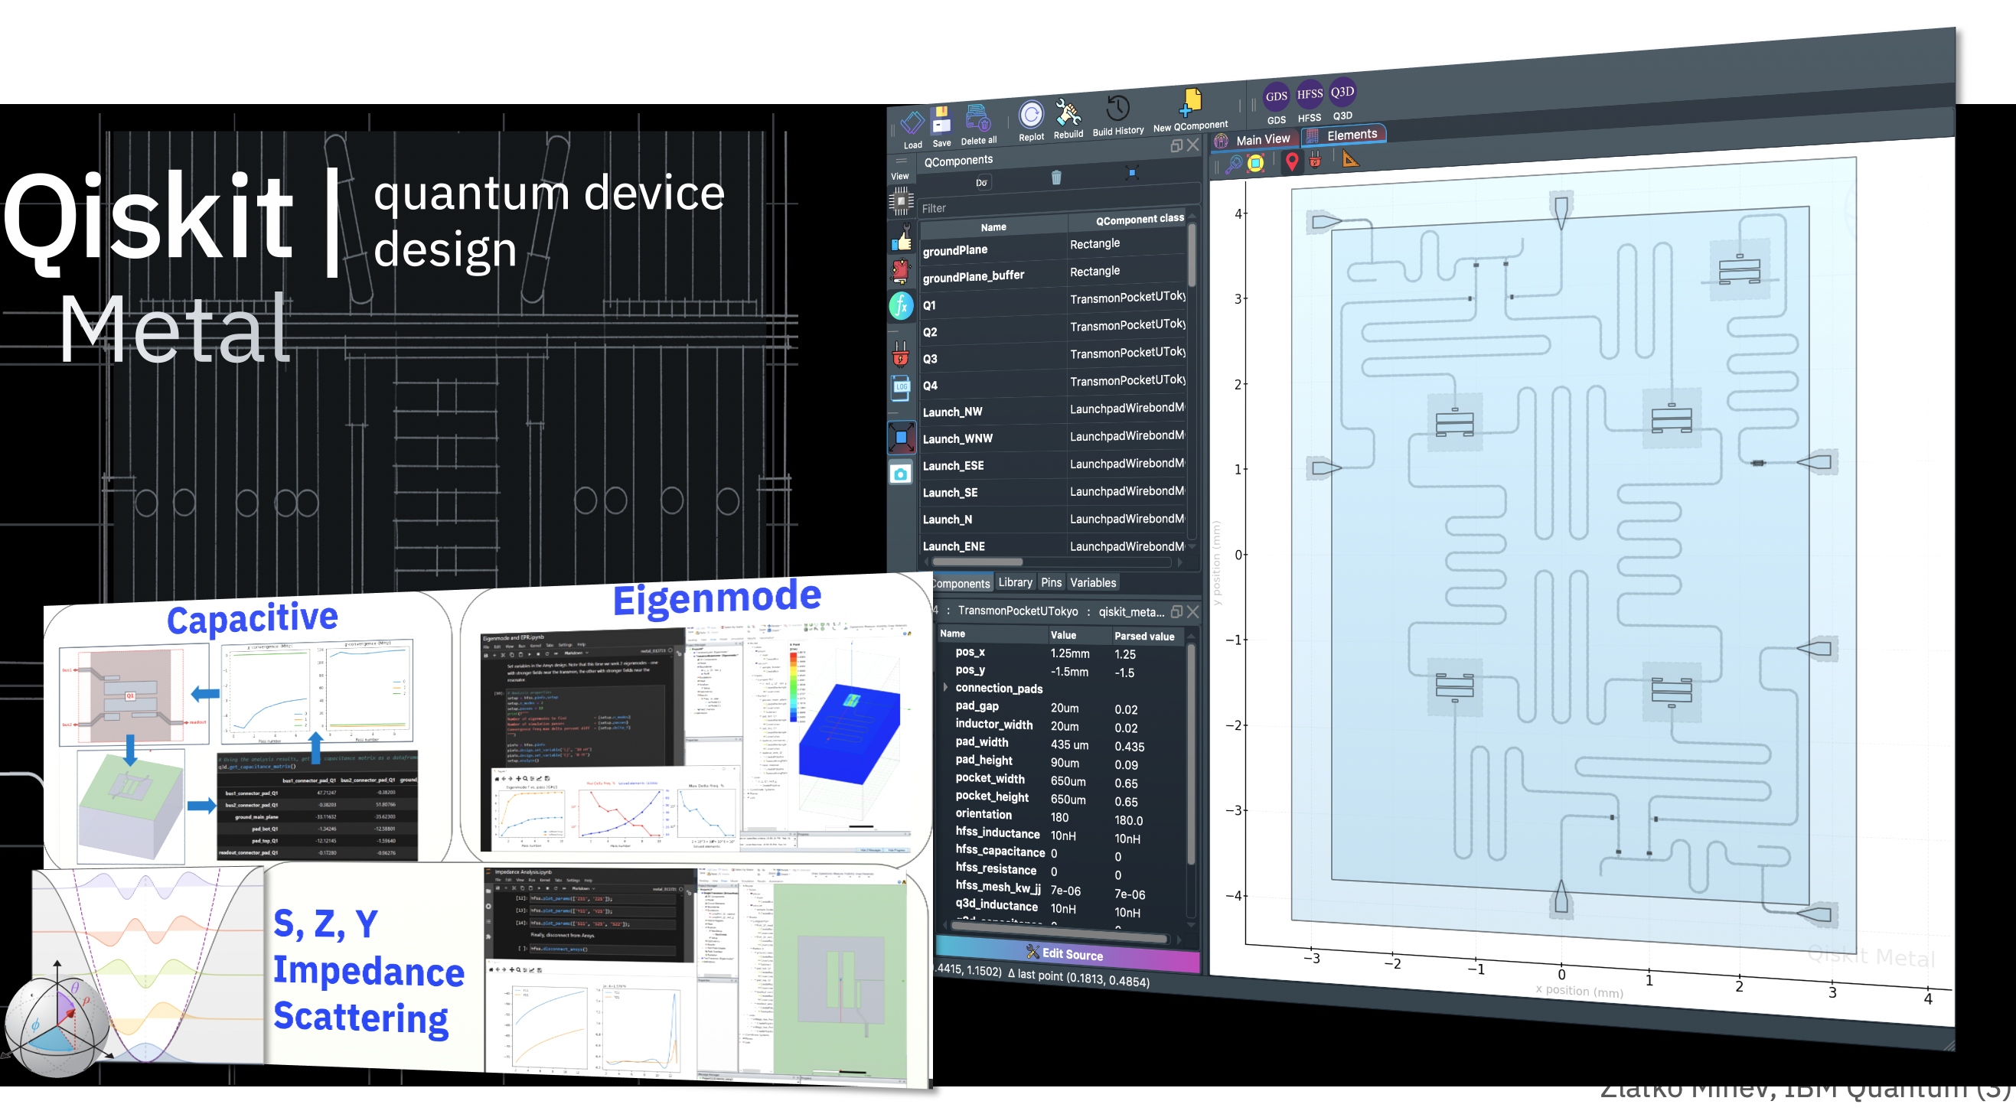
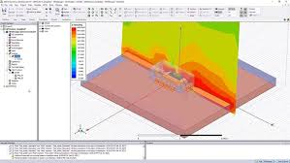
Theme: Quantum Chip Design and Analysis using Qiskit Metal & Ansys

Slide 3
Schedule
11:00 AM Speaker 1
12:00 AM Lunch
01:00 PM Challenges start: https://github.com/Shark-y/hackathons
05:00 PM Submissions: https://quackhacks-spring24.devpost.com/

Slide 4
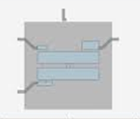
Qiskit Metal Basics
Qubit: the basic unit of information in quantum computing and counterpart to the bit (binary digit) in classical computing.
TransmonPocket: it is a qubit for a ground plane, with two pads connected by a junction.
Details: https://qiskit-community.github.io/qiskit-metal/apidocs/qiskit_metal.qlibrary.TransmonPocket.html

Slide 5
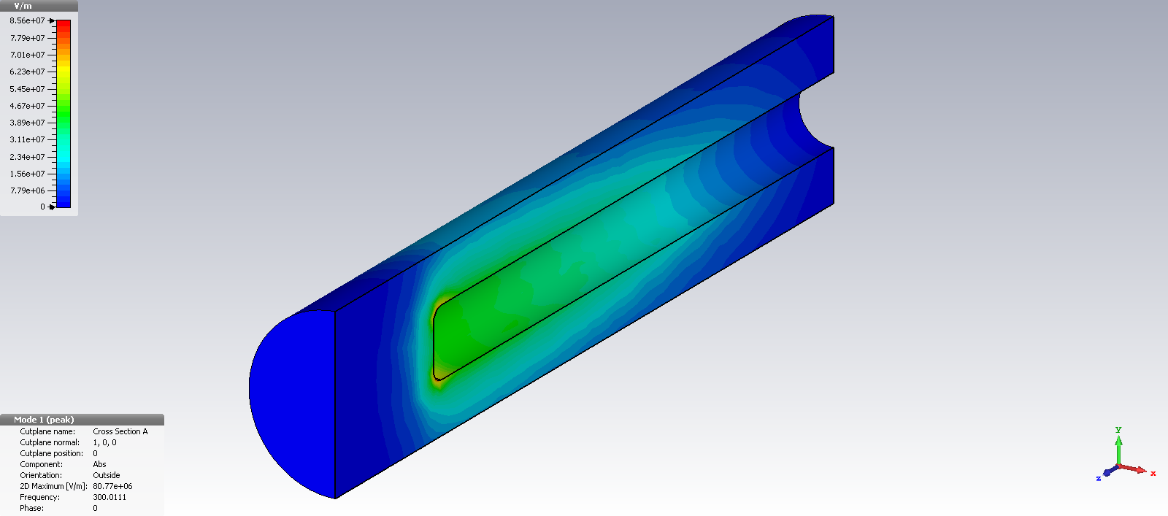
Eigenmode Analysis: mode of vibration of an oscillating system. Eigenvalue represents the periodicity of a system. Eigenvector represents the beginning time for any resources on a system. While eigenmode shows periodic behavior of a system. https://www.rfcurrent.com/eigenmode-solvers#:~:text=Eigenmode%20analysis%20is%20concerned%20with,or%20HFSS%20provide%20such%20analysis.

Slide 6
EPR (pyEPR) - Energy Participation Ratio
pyEPR package : used for the design and quantization of Josephson quantum circuits.
The energy participation, a number between zero and one — in a single-step electromagnetic simulation.
Designed to unify the design of dissipation and Hamiltonians around a single concept
https://pyepr-docs.readthedocs.io/en/latest/api/pyEPR.html

