Slide 1
Kagome Lattice – Open Science 2022
A solution for the state preparation of the Kagome Lattice in a quantum computer

Slide 2
Our Solution
Our solution is implemented as a python program where all the parameters of the VQE algorithm are fed as command line arguments.
Ansatz Options
Name | Description | Default Value
-a, --ansatz_type | Ansatz type: ExcitationPreserving: Heuristic excitation-preserving wave function. EfficientSU2: A hardware efficient SU(2) 2-local circuit. PauliTwoDesign: The Pauli Two-Design ansatz. TwoLocal: The two-local circuit. RealAmplitudes: A heuristic trial wave function. | EfficientSU2
Name | Description | Default Value
-ol, --opt_level | Circuit optimization level (1-3) | 1
-ui, --uniform_interaction | Heisenberg Model uniform interaction value. | Edge weight
-up, --uniform_potential | Heisenberg Model uniform potential | 0.0
-w, --weight | Lattice edge weight. | 2.4
-s,--shots | Number of execution shots. | 2048

Slide 3
Optimizer Options
Name | Description | Default Value
-o, --optimizer_type | Optimizer type: SPSA: Simultaneous Perturbation Stochastic Approximation SLSQP: Sequential Least Squares Programming. COBYLA: Constrained Optimization By Linear Approximation. UMDA: Continuous Univariate Marginal Distribution Algorithm GSLS: Gaussian-smoothed Line Search. GradientDescent: The gradient descent minimization routine. L_BFGS_B: Limited-memory BFGS Bound optimizer. NELDER_MEAD: Performs unconstrained optimization. POWELL: The Powell algorithm with unconstrained optimization NFT: Nakanishi-Fujii-Todo algorithm. | SPSA
-i, --max_iter | Maximum number of iterations or function evals used by the optimizer. | 175

Slide 4
Resilience and Scalability
Name | Description | Default Value
-r, --resilience_type | Resilience type (1-3): T-Rex: 1 ZNE: 2 PEC: 3 | 2
Scalability
The program is designed to run in any quantum processor with any number of qubits. For example to run in Geneva (27 qubits) with an NFT optimizer and uniform potential:
$ python3 kagome_solution.py -b ibm_geneva -t ibm_geneva -q 27 -a EfficientSU2 -w 1.0 -o NFT -up -1.0

Slide 5
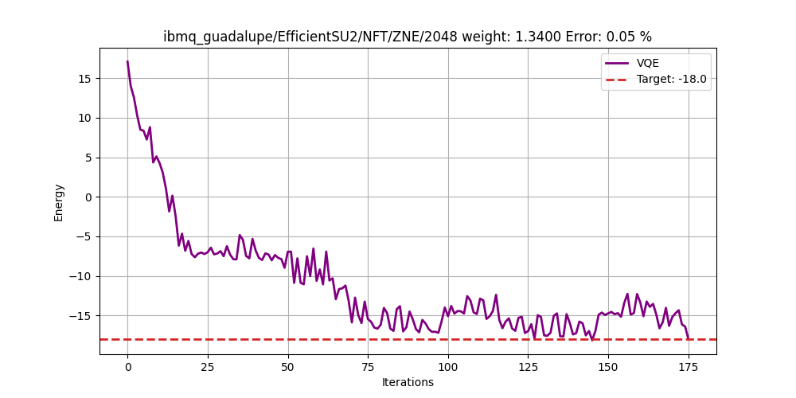
Our Results: Solution 1 - Error 0.05%
Backend: ibmq_guadalupe Ansatz: EfficientSU2 (reps=1,entanglement='reverse_linear') Optimizer : NFT(maxiter=175) Resilience : ZNE (2) Shots: 2048, Edge weight: 1.34000 | Execution time (s): 12390.63 Expected ground state energy: -18.00000000 Computed ground state energy: -17.99098307 Result eigen value: -17.99098307 Relative error: 0.05009404%

Slide 6
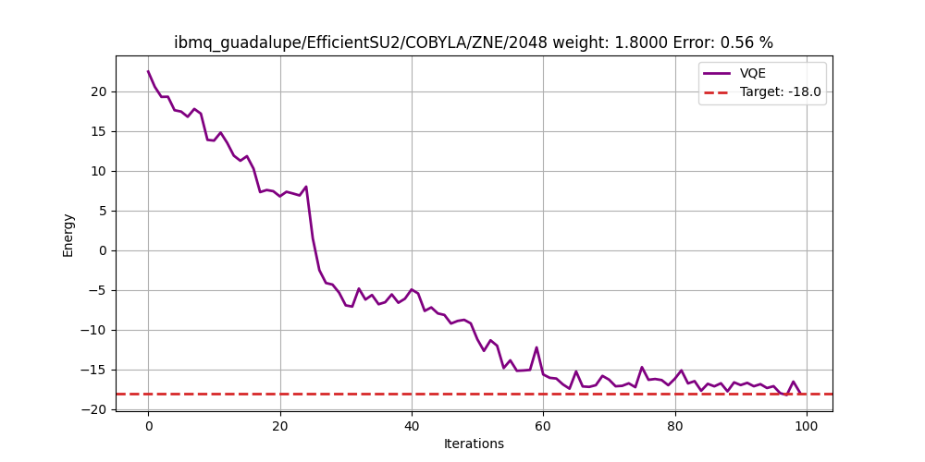
Our Results: Solution 2 - Error 0.56%
Backend: ibmq_guadalupe Ansatz: EfficientSU2 (reps=1,entanglement='reverse_linear') Optimizer : COBYLA (maxiter=100) Resilience : ZNE (2) Shots: 2048, Edge weight: 1.80000 | Execution time (s): 23294.63 Expected ground state energy: -18.00000000 Computed ground state energy: -17.89892578 Result eigen value: -17.89892578 Relative error: 0.5615%

Slide 7
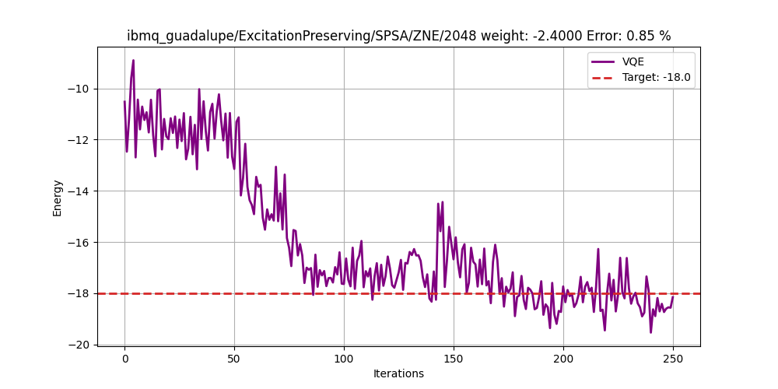
Our Results: Solution 3 - Error 0.85%
Backend: ibmq_guadalupe Ansatz: ExcitationPreserving (reps=1,entanglement='linear') Optimizer : SPSA(maxiter=100) Resilience : ZNE (2) Shots: 2048 Edge weight: -2.4000 | Execution time (s): 113953.17 Expected ground state energy: -18.00000000 Computed ground state energy: -18.15273438 Result eigen value: -18.15273438 Relative error: 0.848%
Solution 1

Slide 8
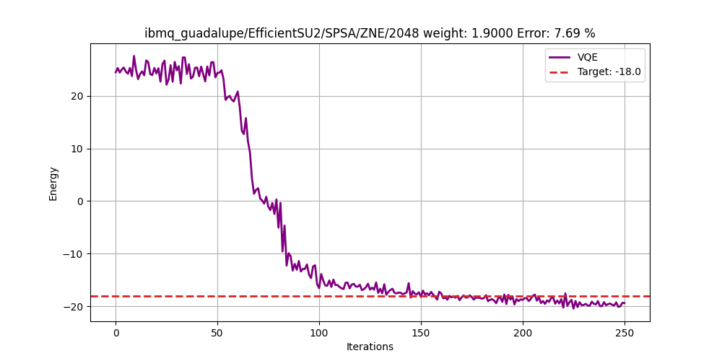
Other Solution - Error 7%
Backend: ibmq_guadalupe Ansatz: EfficientSU2 (reps=1, entanglement='reverse_linear') Optimizer : SPSA(maxiter=100) Resilience : ZNE (2) Shots: 2048 Edge weight: 1.9000 | Execution time (s): 102658.02 Expected ground state energy: -18.00000000 Computed ground state energy: -19.38377279 Result eigen value: -19.38377279 Relative error: 7.687%

