Slide 1
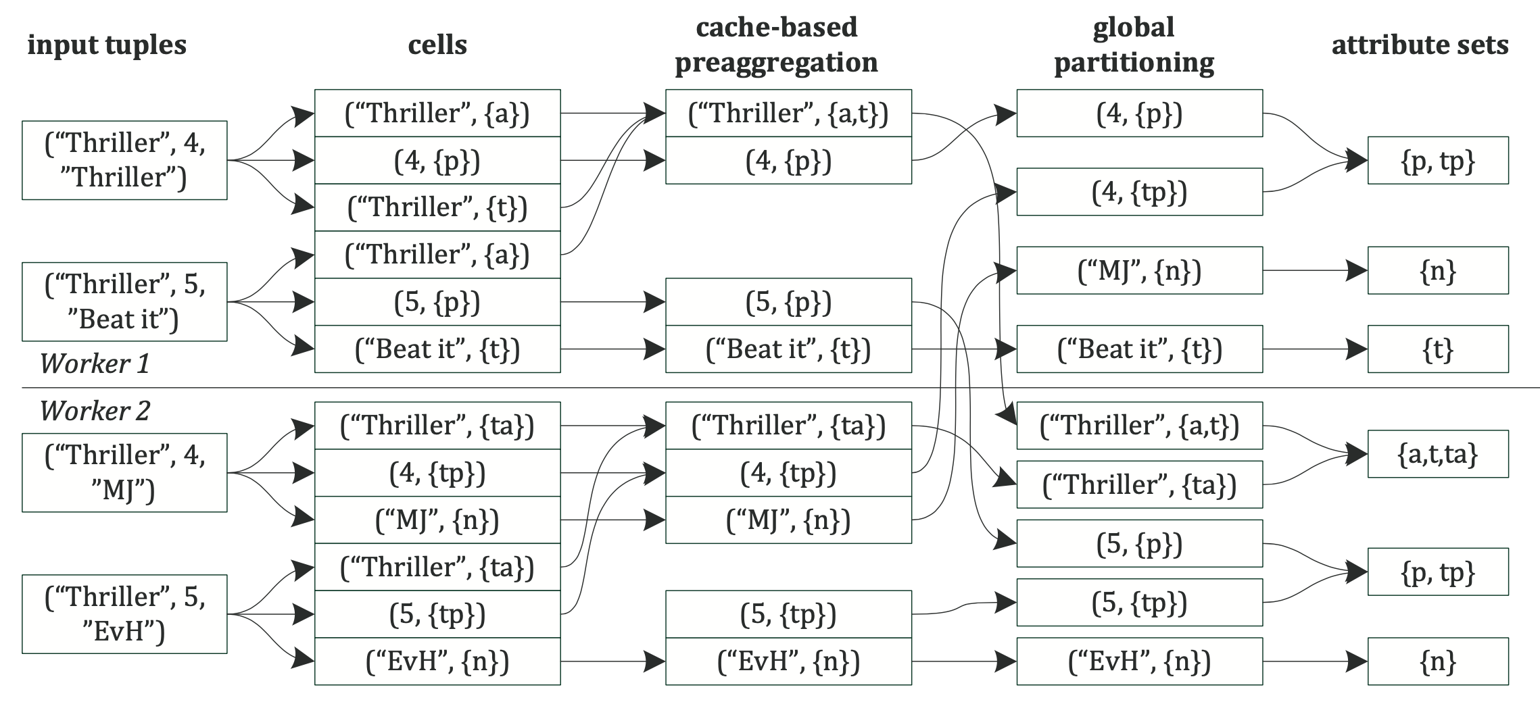
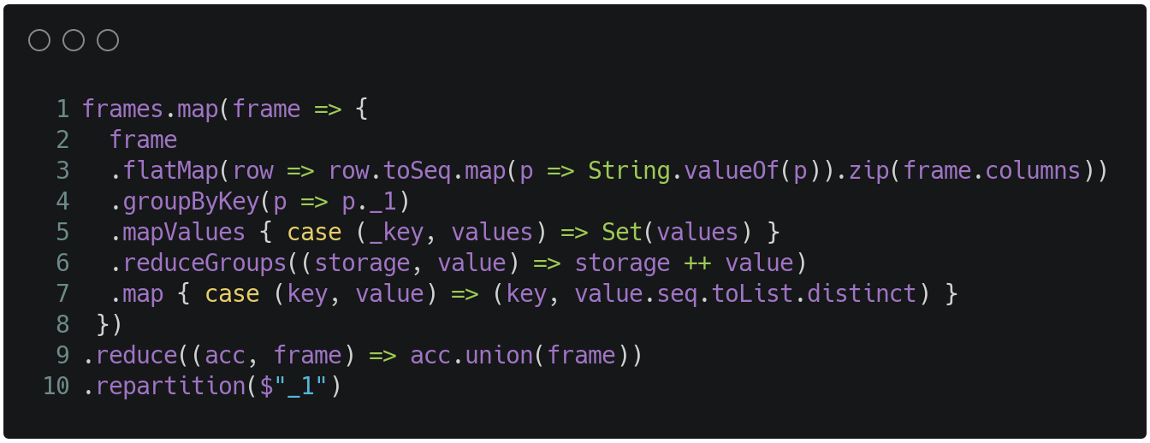
Kruse, Sebastian, Thorsten Papenbrock, and Felix Naumann. "Scaling out the discovery of inclusion dependencies." Datenbanksysteme für Business, Technologie und Web (BTW 2015) (2015).
Group “ElixirEvangelists“
Assignment 4: ddm-idd – Full Outer Join in Spark

Slide 2
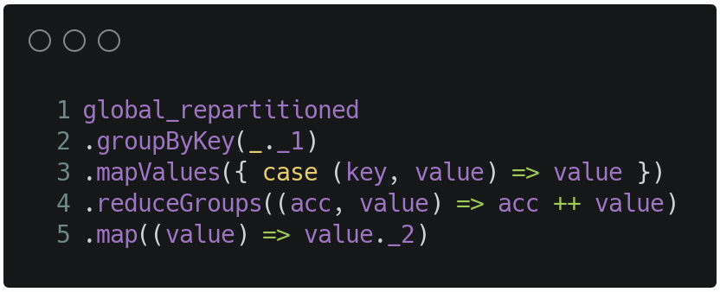
Kruse, Sebastian, Thorsten Papenbrock, and Felix Naumann. "Scaling out the discovery of inclusion dependencies." Datenbanksysteme für Business, Technologie und Web (BTW 2015) (2015).
Group “ElixirEvangelists“
Assignment 4: ddm-idd – Full Outer Join in Spark

Slide 3
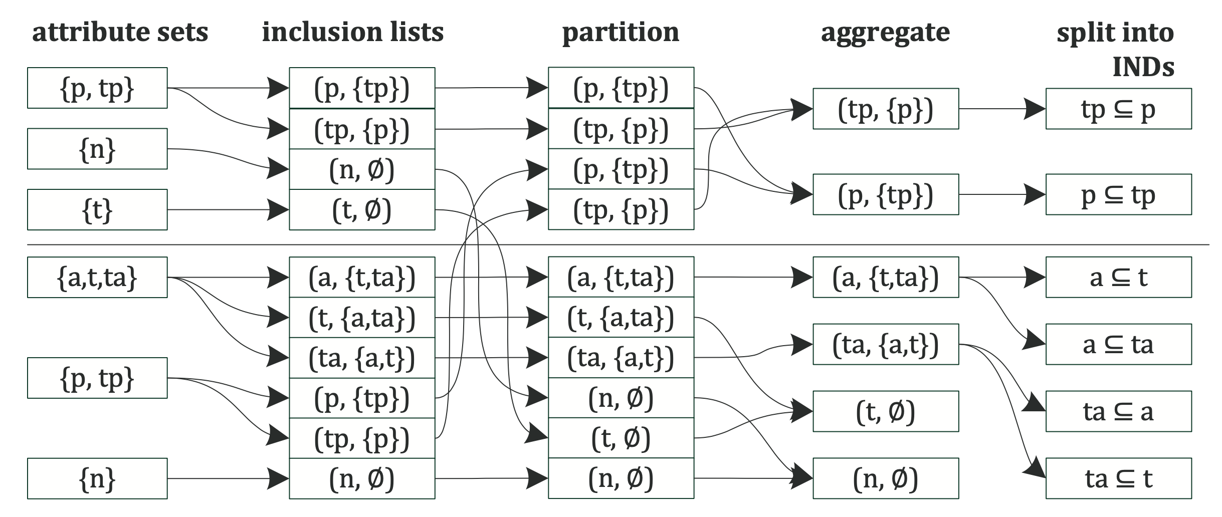
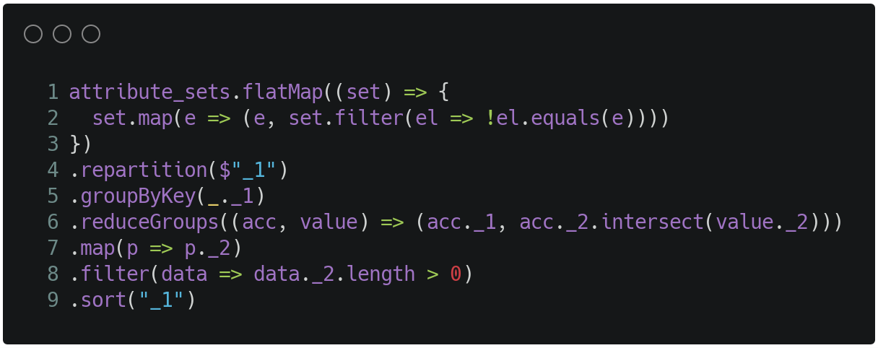
Kruse, Sebastian, Thorsten Papenbrock, and Felix Naumann. "Scaling out the discovery of inclusion dependencies." Datenbanksysteme für Business, Technologie und Web (BTW 2015) (2015).
Group “ElixirEvangelists“
Assignment 4: ddm-idd – Derive ID from Outer Join

Slide 4
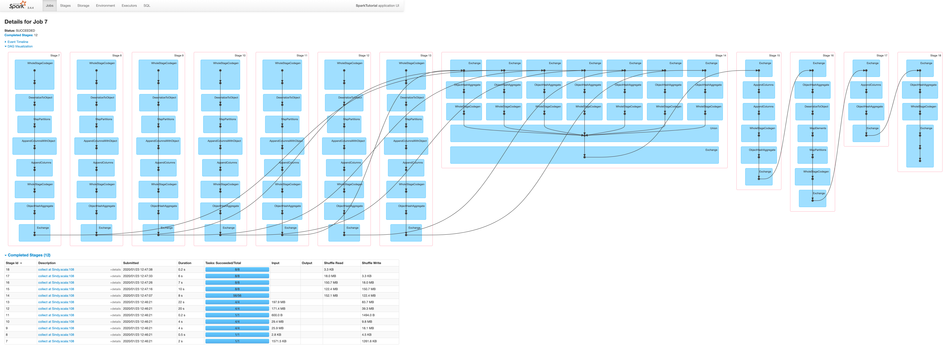
Group “ElixirEvangelists“
Assignment 4: ddm-idd – DAG created with the Spark History Server

