Slide 1
Ant Colony Optimization
Metaheuristiken und Simulation
03.05.2018 | Tim Walz, Christoph Meise

Slide 2
#01 | Zusammenfassung und Kernproblem
#02 | Diversifikation, Intensivierung, Terminierung
#03 | Implementierung

Slide 3
#01
Zusammenfassung und Kernproblem

Slide 4
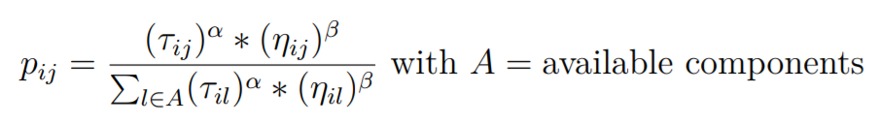
Zusammenfassung
Notes:
Even though a single ant has very simple abilities, a colony of ants is able to accomplish astonishing tasks. When ants start seeking a path between their colony and a source of food they find the optimal route in a short period of time. This behavior appears as intelligent when observing it from an upper scale, but is the result of local and elementary interactions.
The ability to find the shortest path is explained by the fact that ants communicate in an indirect way over the environment by laying trails of pheromone. Ants randomly choose paths, but a direction is more likely the more pheromone is on the ground.
The ant colony optimization algorithm (ACO) is a metaheuristic inspired by this exact behavior of the ants. Metaheuristics can be described as stochastic algorithms with randomization and local search.
This approach guides the course of an embedded
heuristic to search beyond the local optimum by taking advantage of high level strategic
problem solving. In contrast to heuristics, metaheuristics are generic strategies that may be used to solve any combinatorial optimization problem.
The ACO algorithm is very good at solving the traveling salesman problem, but it can also be used to solve the multidimensional bin packing problem or more precisely the load planning optimization problem. For this purpose it can be implemented as follows.

Slide 5
#02
Diversifikation, Intensivierung, Terminierung

Slide 6
Diversifikation, Intensivierung

Slide 7
Terminierung

Slide 8
#03
Implementierung

Slide 9
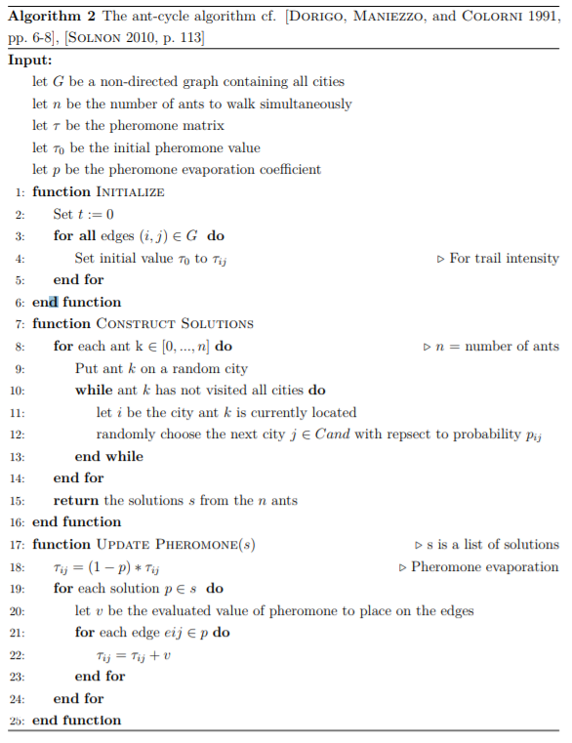
Implementierung

Slide 10
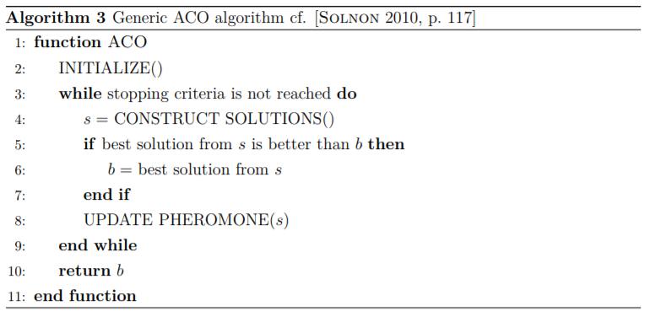
Implementierung

Slide 11
Noch Fragen?

