Slide 1
Gamification
Software Engineering 07.04.2016
- Christoph Meise

Slide 2
Structure
1 Introduction
2 Examples
3 CaptainUp
4 Demo
5 Tutorial
6 Possible risks and issues
7 Conclusion
8 Sources

Slide 3

1 Introduction
controversial topic that reached the business world 2010
concept of applying game mechanics and game design techniques to non-gaming environments
Issue to engage and motivate people in a long term
basic desires and needs of the users
Competition, Achievement, Status, Altruism and Community

Slide 4
1 Introduction
Most common technique is rewarding the user for completing tasks - badges, points, levels
Game mechanics other than rewards are challenges and leaderboards
Creating a competitive environment
Everyone should have the same opportunities
psychological concepts such as motivation, behavior, personality
autonomy, purpose and mastery are key requirements to motivate people
Notes:
Autonomy: creativity, choice and freedom
Purpose: altruism or a reason why
Mastery: learning, levels and personal development

Slide 5




2 Examples
Notes:
Nike+ - users are rewarded having an active lifestyle
My Starbucks Reqards -> customer loyalty
Ebay Carma
Stack Overflow -> engage people to write many high quality answers

Slide 6
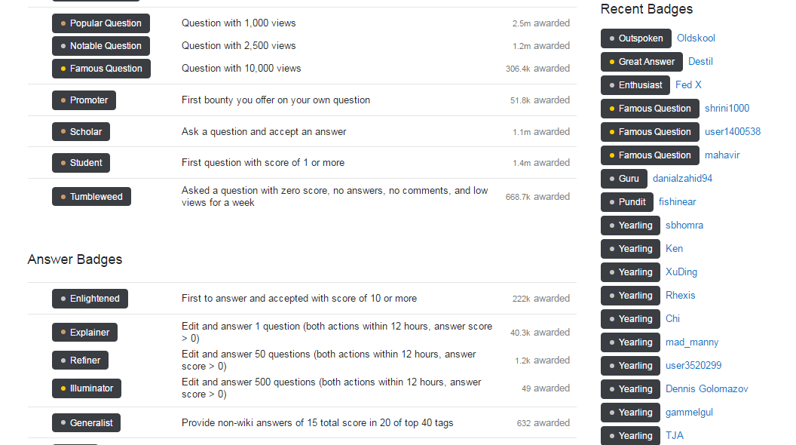
2 Examples
Notes:
uses gamification to showcase talents, expertise and accomplishments between users

Slide 7
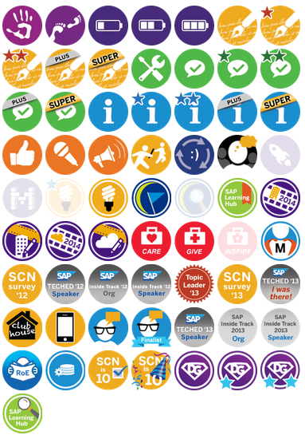
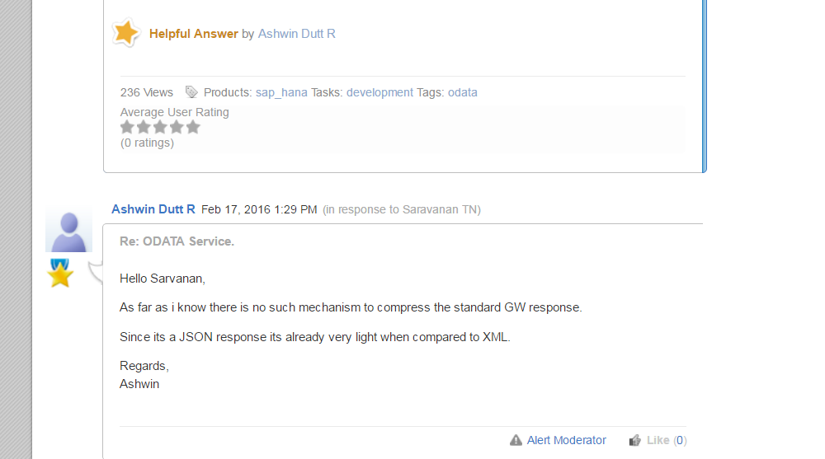
2 Examples
Notes:
SAP SCN
A lot of badges and missions
Basically a lot like stack overflow
Also to motivate people writing many high quality answers

Slide 8

3 CaptainUp
CaptainUp as a Software as a Service gamification platform for mobile apps and websites
offer built-in experience with game mechanics such as levels, challenges, social collaboration etc.
Basic version and premium version

Slide 9

4 Demo

Slide 10

5 Tutorial
Run your server with e.g. XAMPP & Apache
Open a html test page with localhost in your browser

Slide 11
5 Tutorial
Go on https://captainup.com/users/sign_up and create a profile
On the dashboard click on get started
copy the HTML code snippit and paste it into the body of your HTML test page code

Slide 12
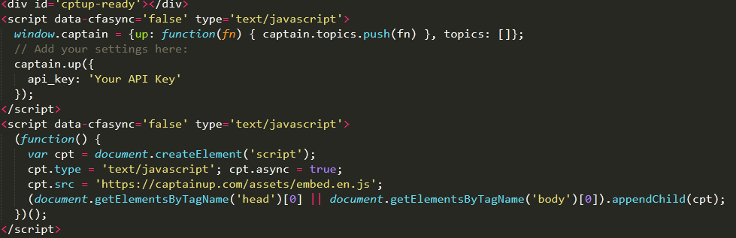
5 Tutorial

Slide 13
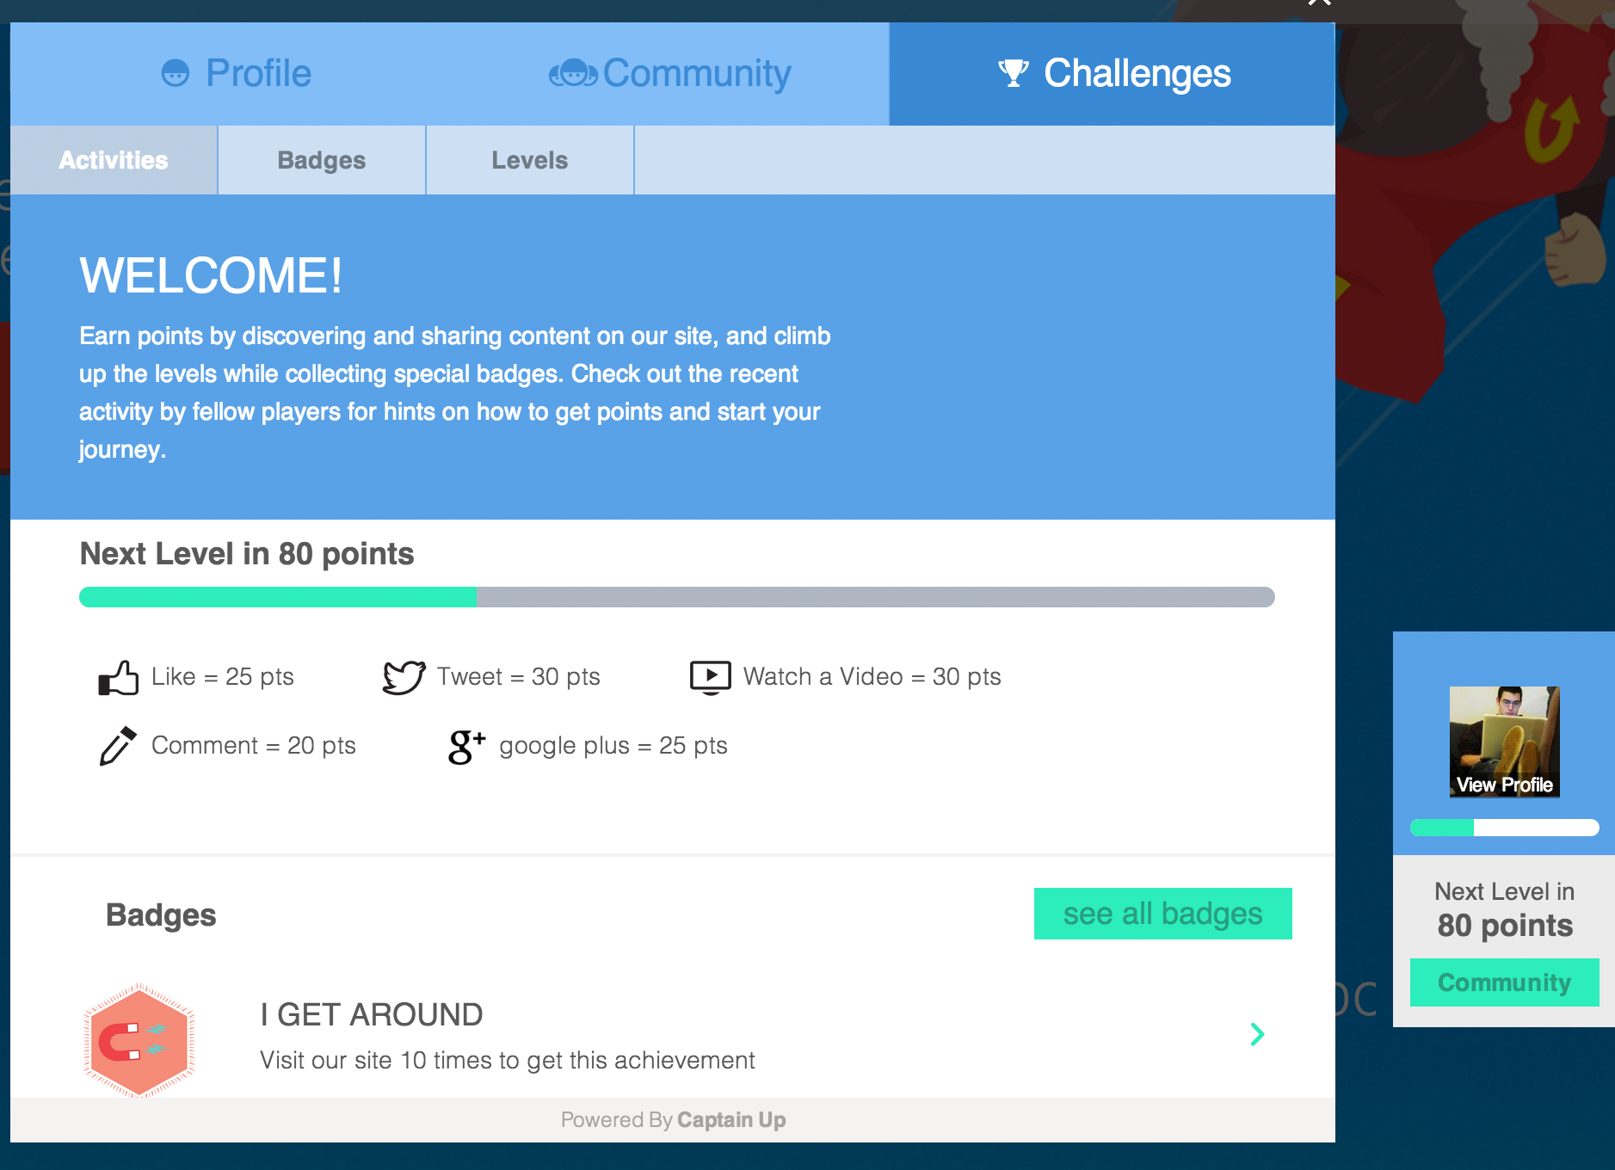
5 Tutorial

Slide 14
6 Possible risks and issues
Why gamification can fail
Lack of planning and strategy
Bad processes
Poor design
Unrealistic expectations
Rewards for top performers
Notes:
Only effective with specific behaviors trying to achieve specific goals
Needs to account for different user personalities to get the right behaviors
2. Gamifying bad goals is as bad as ignoring goals altogether -> goals have to be advantageous to the business
3. Missing motivation / motivation gaps – only points and badges are not good enough anymore if its not well done
4. Just implementing gamification plugins like captainup will not do the trick – there are many more factors involved that have to be considered
5. The whole gamification should not only be for the top performers
-> better leaderboards for a competition for the 60% in the middle e.g. -> rewarding everyone

Slide 15
7 Conclusion
Gamification is a concept that can strengthen customer loyalty
Based on underlying psychological reasons like autonomy, mastery and purpose
Easy to use plugins for a quick implementation
Can also be useful for your projects

Slide 16

Thank you for your attention!
Feel free to ask any Questions
Christoph Meise

Slide 17
8 Sources
https://captainup.com/assets/splash/captain-77de49384879ff64e084bd224a03ab61.png
http://www.ipdigit.eu/wp-content/uploads/2013/03/mzl.gqzyggze.png
http://www.southernsavers.com/wp-content/uploads/2016/02/my-starbucks-rewards.jpg
https://captainup.com/manage/help/setup
https://captainup.com/docs/guides/
http://scn.sap.com/thread/3865465
https://en.wikipedia.org/wiki/Gamification
https://upload.wikimedia.org/wikipedia/commons/thumb/4/48/EBay_logo.png/640px-EBay_logo.png
https://lh4.ggpht.com/jEV6nsNv-638GnXkiO5Cfk6zF5lKZCZuWdOtmlL_7PXR79vgteOIHcNDPhNYqGC7dzg=w300
http://www.gamified.uk/gamification-framework/the-intrinsic-motivation-ramp/
http://www.vksi.de/wp-content/uploads/2015/01/gamification_ICL_BerklingFullPaper.pdf
http://www.sourcefreak.com/wp-content/uploads/apache-tomcat.png
http://www.gameffective.com/gamification-basics/will-80-of-gamification-projects-fail/
http://www.destinationcrm.com/Articles/Web-Exclusives/Viewpoints/The-Problem-with-Gamification-87770.aspx

