Slide 1

Introduction to Python

Slide 2
Introduction to Python
Python is a high-level programming language
Open source and community driven
“Batteries Included”
a standard distribution includes many modules
Dynamic typed
Source can be compiled or run just-in-time
Similar to scripting languages such as perl, tcl, ruby

Slide 3
Why Python?
There is a considerable base of developers using the language
“Tried and true” language that has been in development since 1991
Can interface with the Component Object Model (COM) used by Windows
Can interface with lots of open source toolsets
LOTS of libraries for data analysis and visualisation

Slide 4
History
What do the alphabet and the programming language Python have in common? Right, both start with ABC. If we are talking about ABC in the Python context, it's clear that the programming language ABC is meant. ABC is a general-purpose programming language and programming environment, which had been developed in the Netherlands, Amsterdam, at the CWI (Centrum Wiskunde & Informatica). The greatest achievement of ABC was to influence the design of Python.

Slide 5

Guido van Rossum

Slide 6
History
Python was conceptualized in the late 1980s. Guido van Rossum worked that time in a project at the CWI, called Amoeba, a distributed operating system. In an interview with Bill Venners1, Guido van Rossum said: "In the early 1980s, I worked as an implementer on a team building a language called ABC at Centrum voor Wiskunde en Informatica (CWI). I don't know how well people know ABC's influence on Python. I try to mention ABC's influence because I'm indebted to everything I learned during that project and to the people who worked on it."

Slide 7
History
Later on in the same Interview, Guido van Rossum continued: "I remembered all my experience and some of my frustration with ABC. I decided to try to design a simple scripting language that possessed some of ABC's better properties, but without its problems. So I started typing. I created a simple virtual machine, a simple parser, and a simple runtime. I made my own version of the various ABC parts that I liked. I created a basic syntax, used indentation for statement grouping instead of curly braces or begin-end blocks, and developed a small number of powerful data types: a hash table (or dictionary, as we call it), a list, strings, and numbers."

Slide 8
Why is Python called Python?
So, what about the name "Python": Most people think about snakes, and even the logo depicts two snakes, but the origin of the name has its root in British humour. Guido van Rossum, the creator of Python, wrote in 1996 about the origin of the name of his programming language1: "Over six years ago, in December 1989, I was looking for a 'hobby' programming project that would keep me occupied during the week around Christmas. My office ... would be closed, but I had a home computer, and not much else on my hands. I decided to write an interpreter for the new scripting language I had been thinking about lately: a descendant of ABC that would appeal to Unix/C hackers. I chose Python as a working title for the project, being in a slightly irreverent mood (and a big fan of Monty Python's Flying Circus)."

Slide 9
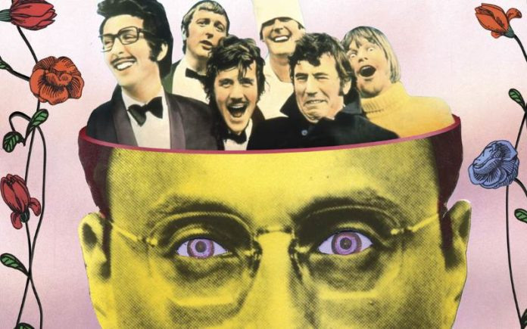
Monty Python

Slide 10
Python Interfaces
IDLE is a cross-platform Python development environment
Python Shell – running 'python' from the Command Line opens this interactive shell
Spyder – a Python IDE
Jupyter – a web – based Python notebook environment
We will be using Spyder and Jupyter

Slide 11
Anaconda
Anaconda is a Python distribution for Windows, macOS and Linux.
See https://www.anaconda.com/
Contains Python itself (in our case 3.6), and all the libraries and tools we need to do development and data analysis
We use Anaconda Navigator

Slide 12
Anaconda / Spyder/ Python Demo

Slide 13
More than just printing
Python is an object oriented language
Practically everything can be treated as an object
“hello world” is a string
Strings, as objects, have methods that return the result of a function on the string

Slide 14
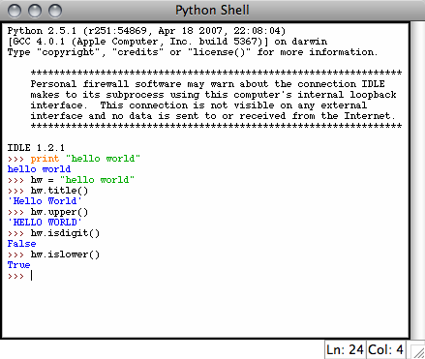
String Methods
Assign a string to a variable
In this case “hw”
hw.title()
hw.upper()
hw.isdigit()
hw.islower()

Slide 15
String Methods
The string held in your variable remains the same
The method returns an altered string
Changing the variable requires reassignment
hw = hw.upper()
hw now equals “HELLO WORLD”

Slide 16
Other Python Objects
Lists (mutable sets of strings)
var = [] # create list
var = [‘one’, 2, ‘three’, ‘banana’]
Tuples (immutable sets)
var = (‘one’, 2, ‘three’, ‘banana’)
Dictionaries (associative arrays or ‘hashes’)
var = {} # create dictionary
var = {‘lat’: 40.20547, ‘lon’: -74.76322}
var[‘lat’] = 40.2054
Each has its own set of methods

Slide 17
Lists
Think of a list as a stack of cards, on which your information is written
The information stays in the order you place it in until you modify that order
Methods return a string or subset of the list or modify the list to add or remove components
Written as var[index], index refers to order within set (think card number, starting at 0)
You can step through lists as part of a loop

Slide 18
List Methods
Adding to the List
var[n] = object
replaces n with object
var.append(object)
adds object to the end of the list
Removing from the List
var[n] = []
empties contents of card, but preserves order
var.remove(n)
removes card at n
var.pop(n)
removes n and returns its value

Slide 19
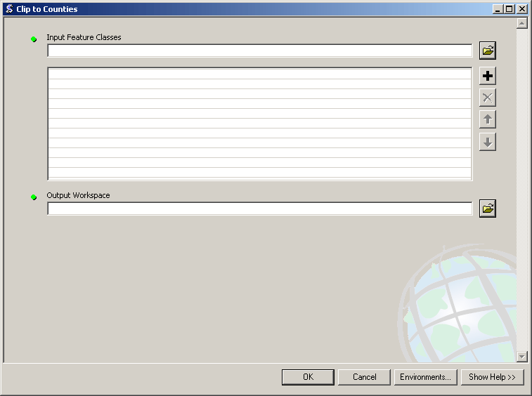
Lists in ArcToolbox
You will create lists:
Layers as inputs
Attributes to match
Arrays of objects
You will work with lists:
List of field names
List of selected features

Slide 20
Tuples
Like a list, tuples are iterable arrays of objects
Tuples are immutable – once created, unchangeable
To add or remove items, you must redeclare
Example uses of tuples
County Names
Land Use Codes
Ordered set of functions

Slide 21
Dictionaries
Dictionaries are sets of key & value pairs
Allows you to identify values by a descriptive name instead of order in a list
Keys are unordered unless explicitly sorted
Keys are unique:
var[‘item’] = “apple”
var[‘item’] = “banana”
print var[‘item’] prints just banana

Slide 22
Indentation and Blocks
Python uses whitespace and indents to denote blocks of code
Lines of code that begin a block end in a colon:
Lines within the code block are indented at the same level
To end a code block, remove the indentation
You'll want blocks of code that run only when certain conditions are met

Slide 23
Conditional Branching
if and else
if variable == condition: #do something based on v == c
else:
#do something based on v != c
elif allows for additional branching
if condition:
elif another condition:
…
else: #none of the above

Slide 24
Looping with For
For allows you to loop over a block of code a set number of times
For is great for manipulating lists:
a = ['cat', 'window', 'defenestrate'] for x in a: print x, len(x)
Results:
cat 3
window 6
defenestrate 12

Slide 25
Looping with For
We could use a for loop to perform geoprocessing tasks on each layer in a list
We could get a list of features in a feature class and loop over each, checking attributes
Anything in a sequence or list can be used in a For loop
Just be sure not to modify the list while looping

Slide 26
Modules
Modules are additional pieces of code that further extend Python’s functionality
A module typically has a specific function
additional math functions, databases, network…
Python comes with many useful modules
arcgisscripting is the module we will use to load ArcGIS toolbox functions into Python

Slide 27
Modules
Modules are accessed using import
import sys, os # imports two modules
Modules can have subsets of functions
os.path is a subset within os
Modules are then addressed by modulename.function()
sys.argv # list of arguments
filename = os.path.splitext("points.txt")
filename[1] # equals ".txt"

Slide 28
Files
Files are manipulated by creating a file object
f = open("points.txt", "r")
The file object then has new methods
print f.readline() # prints line from file
Files can be accessed to read or write
f = open("output.txt", "w")
f.write("Important Output!")
Files are iterable objects, like lists

Slide 29
Error Capture
Check for type assignment errors, items not in a list, etc.
Try & Except
try:
a block of code that might have an error
except: code to execute if an error occurs in "try"
Allows for graceful failure – important in ArcGIS

