Slide 1
Dijkstra's Algorithm Project COP4530
Colby Mullins, Kevin Mikuta, Sara Cathey, Andy Ho
11/23/2025

Slide 2
Background
Dijkstra's Algorithm is a greedy algorithm used to determine the shortest path between points from a source vertex to all other nodes in a graph.
Works best when graphs have a numerical weight. This can represent any arbitrary value, with the most popular being distance, cost, and time. All edges in the graph must also be non-negative.
We will go over our own implementation of Dijkstra's Algorithm and explain the time complexities within our version, as well as give a brief example and explain how Dijkstra's can be used in the real world.

Slide 3
How it works
Our algorithm uses a priority queue that keeps track of the next node
  Priority queue sorts in order of smallest weight; if weights are equal, then they are sorted in lexicographical order.
Visits the unvisited node with the smallest current distance
Relaxes adjacent vertices if dist[v] + w(u, v) < dist[u]
Repeat process until all nodes are visited
  Until the priority queue is empty
This gives the shortest distance from a start vertex to every other vertex in the graph

Slide 4
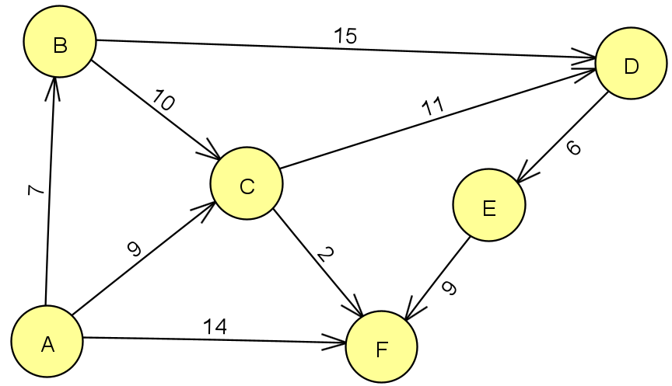
Basic example
We will showcase our implementation of Dijkstra's Algorithm utilizing the graph shown here.
We will have vertex A as our origin.

Slide 5
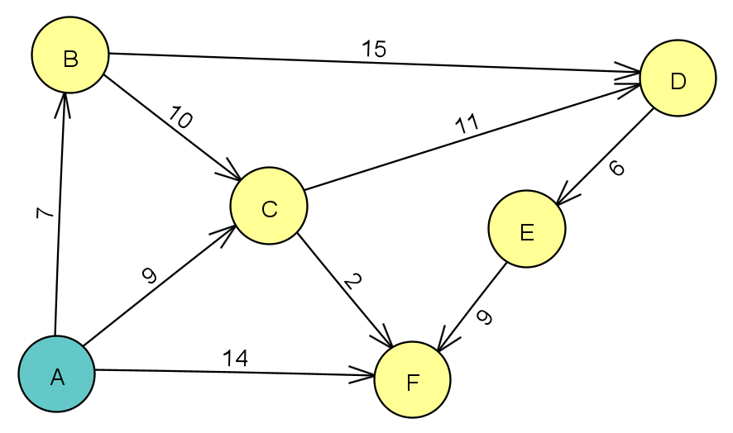
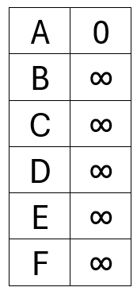
Example

Slide 6
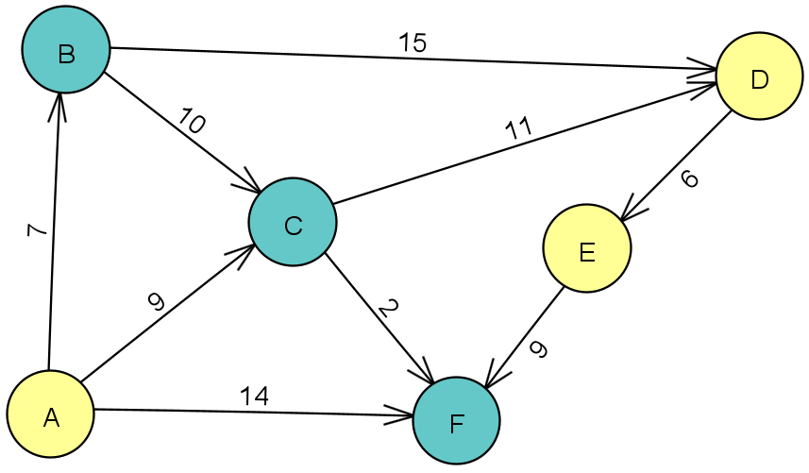
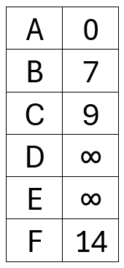
Example

Slide 7
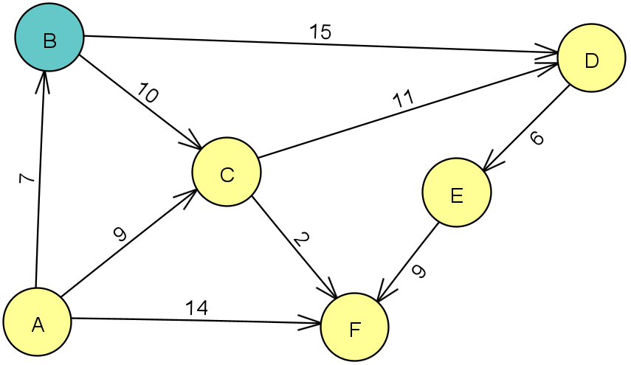
Example

Slide 8
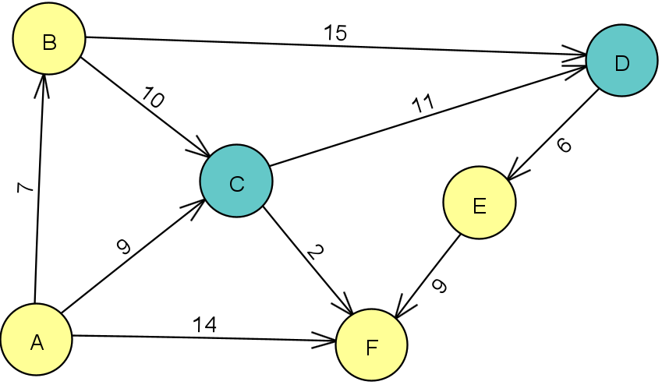
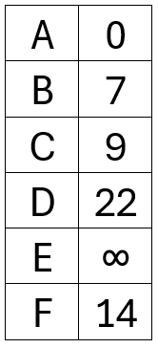
Example
​
A

Slide 9
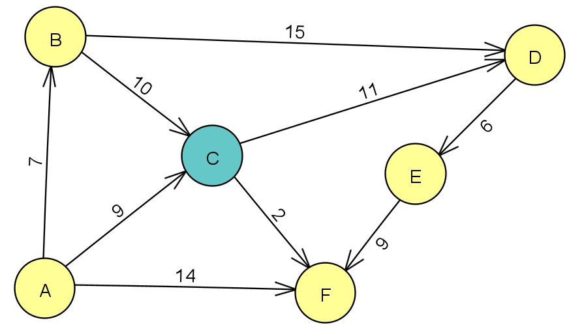
Example

Slide 10
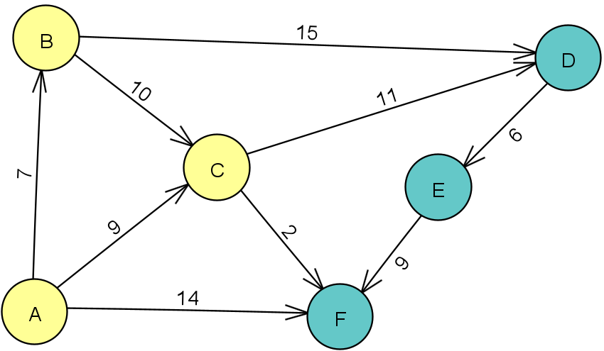
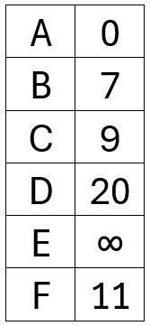
Example
B
E
E
​
A

Slide 11
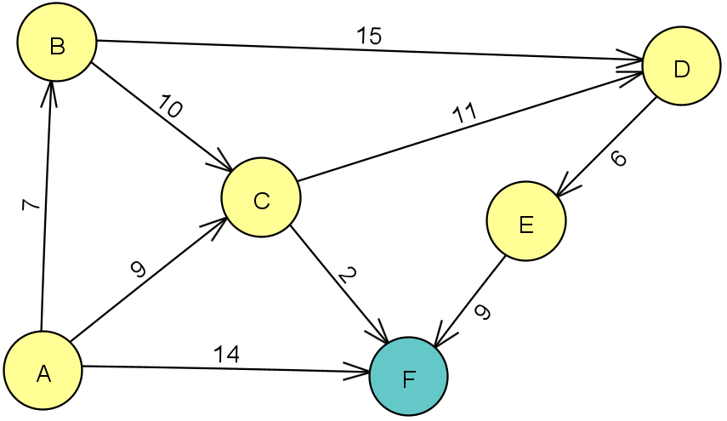
Example

Slide 12
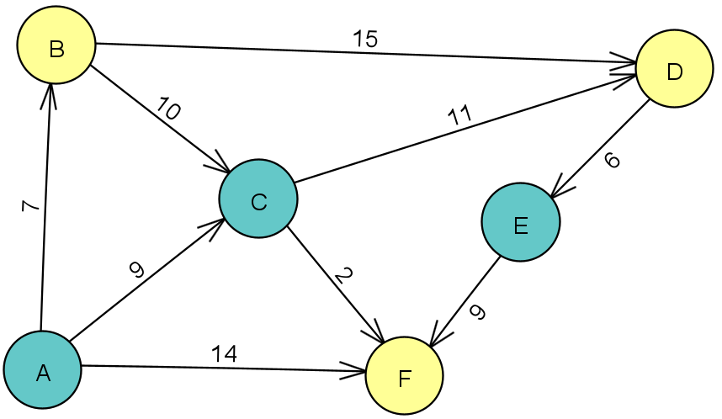
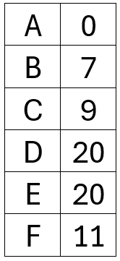
Example

Slide 13
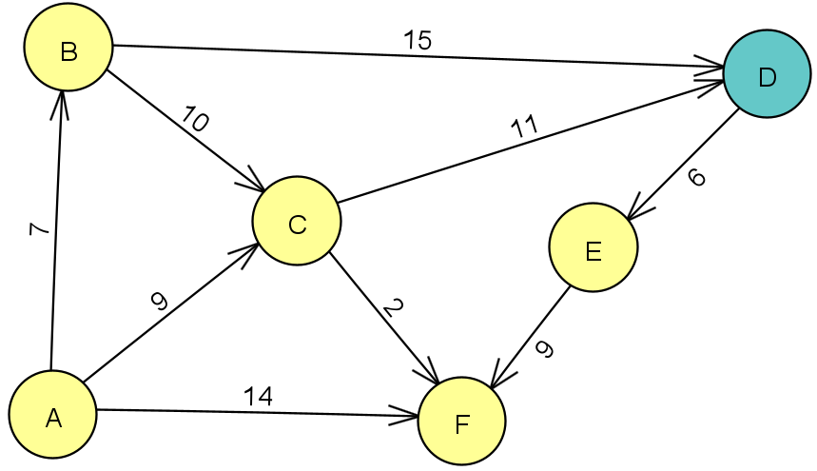
Example

Slide 14
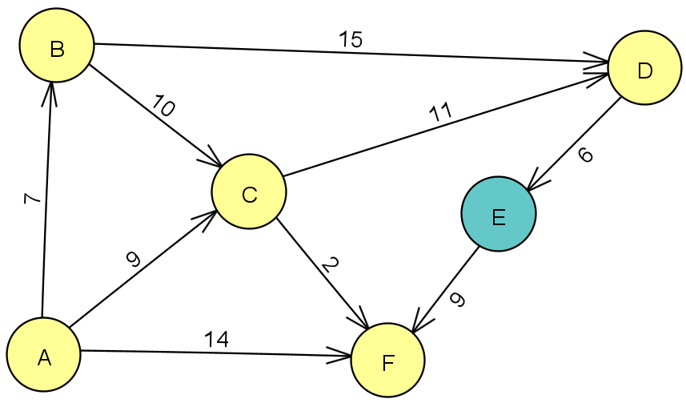
Example
B
C

Slide 15
Example

Slide 16

Example
E
E

Slide 17
Example

Slide 18
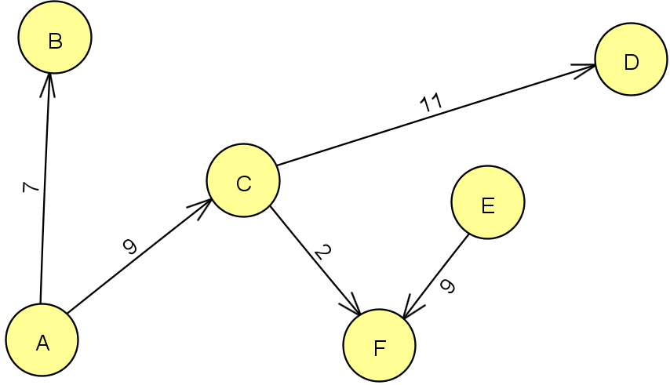
Example

Slide 19
complexities
Our version of Dijkstra's algorithm utilized an adjacency list for the graph. This gives us a space complexity of O(V+E). Our example has 6 vertices and 9 edges, giving a space complexity of O(15).
This is much better than if we used an incidence or adjacency matrix instead, as then the space complexity would be O(54) or O(36) respectively.
We implemented Dijkstra's algorithm with a priority queue, so the time complexity is O((V + E) log V) . For our example graph, this is 39 operations.

Slide 20
Use cases
Mapping services (Google Maps, Waze, etc.)
IP routing
Social networking
A path finding algorithm

Slide 21
Conclusion
In the project, our design correctly implements Dijkstra's algorithm—it successfully computes the shortest distance from a starting vertex to all other vertices in a graph.
It can achieve this with a run time of O((V + E) log V).
We may be able to achieve a potentially faster run time by utilizing a Fibonacci heap, which has a time complexity of O(E + V log V).
However, for a smaller project like this, it is better to use a binary heap as it is much simpler to design.

