Slide 1
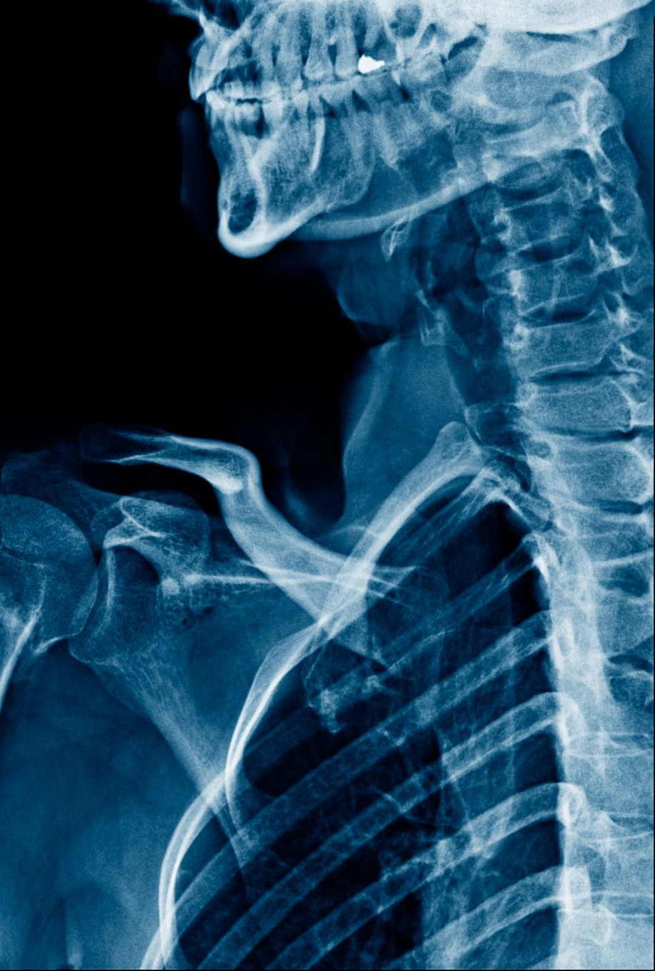
COVID-19 X-RAY Image Classification using Convolutional Neural Networks
Group: 2
Group Members:
Nga Pham Le Phuong (C0829647)
Shivam Choudhary (C0851927)
Mohak Mahendra Patil(C0846492)
Palwinder Kaur(C0849779)
Simranpreet Kaur(C0849778)

Slide 2
Agenda
Introduction of COVID-19 Radiography Dataset
CNNs for X-RAY Image Classification
Preprocessing of the X Ray image data
Building and training the CNN
Prediction X-RAY Image for Covid 19
Detection of X-RAY Image for Covid positive and negative x ray

Slide 3
Introduction
The COVID-19 radiography database is a collection of chest X-ray and CT scan images of COVID-19 patients, pneumonia patients, and healthy individuals.
The dataset, available on Kaggle, was compiled by researchers from Qatar University and the Bangladesh University of Engineering and Technology, and it contains over 24,000 images.
The dataset was created to aid researchers and medical professionals in developing tools and techniques to detect and diagnose covid-19 using radiography images.

Slide 4
COVID-19 Radiography Database
The COVID-19 Radiography Database is a collection of chest X-ray images that have been labeled as COVID-19 positive or negative, as well as images of viral pneumonia and normal cases
The different categories of X-ray images in the dataset
COVID-19 positive
COVID-19 negative
Viral pneumonia
Normal X-Ray

Slide 5
How Covid19 dataset important
COVID-19 detection: Chest X-ray images can be used to detect COVID-19 in patients. The database provides a large and diverse collection of such images that can be used to train machine-learning models to accurately detect COVID-19.
Comparison with other respiratory diseases: The database also includes images of patients with other respiratory diseases such as pneumonia and tuberculosis. This allows researchers to compare COVID-19 chest X-ray images with those of other respiratory diseases, helping to improve the accuracy of COVID-19 diagnosis.
Research and development: The database is a valuable resource for researchers and medical professionals who are developing tools and techniques to detect and diagnose COVID-19 using radiography images.
Open access: The database is publicly available on Kaggle, meaning that researchers worldwide can access it and use it to advance COVID-19 research.

Slide 6
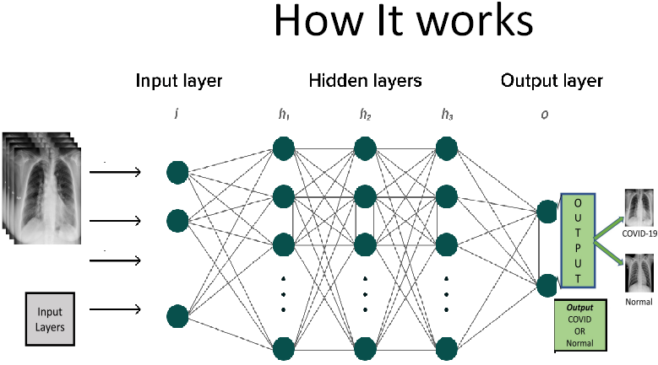
.
How does the CNN model will work
Input layer: The first layer in a CNN takes the input image and applies a set of filters (convolutions) to it. The filters detect features like edges, corners, and textures in the image.
Hidden layers: The output of the input layer is passed through a series of hidden layers, each of which applies additional filters and performs nonlinear operations like pooling and activation functions to extract higher-level features from the image.
Output layer: The final layer in a CNN is a fully connected layer that performs the classification task. It takes the high-level features extracted by the hidden layers and maps them to a set of output classes (in this case, COVID-19 positive or negative).

Slide 7
Challenges
Data quality: One of the biggest challenges with any dataset is ensuring the quality of the data. In the case of the COVID-19 Radiography Database, there may be issues with image quality, incorrect metadata, or mislabeled images that could affect the accuracy of machine learning models trained on the dataset.
Bias: Bias can be introduced into the dataset if the images are not representative of the general population, for example, if the images are mostly from a specific geographic region or demographic. This can affect the generalizability of any machine learning models developed using the dataset.
Privacy concerns: The dataset contains medical images that may contain sensitive patient information. Care must be taken to ensure that patient privacy is protected and that the dataset is used only for research purposes.
Limited samples: While the COVID-19 Radiography Database contains a large number of images, it may not be sufficient for some types of research. Researchers may require access to additional datasets or a larger number of COVID-19 images to train more accurate machine-learning models.

Slide 8
Why CNN and what does it help us to achieve
Early detection:. CNNs can help in accurately identifying COVID-19 in chest X-ray images, enabling early detection of the disease.
Reduced workload on healthcare professionals: Automated image classification using CNNs can reduce the workload on healthcare professionals who need to manually analyze X-ray images for COVID-19 diagnosis. This can help healthcare professionals focus on other critical tasks, such as patient care.
Faster diagnosis:. CNNs can classify chest X-ray images for COVID-19 much faster than humans. This can help in speeding up the diagnosis process and reducing the waiting time for patients.
Scalability: The use of CNNs for image classification is scalable and can be applied to large datasets. This is particular case of COVID-19, where a large number of chest X-ray images need to be analyzed for accurate diagnosis.
Improved accuracy: As CNNs is specifically designed for image classification, It can learn to identify subtle patterns and features in the images, leading to improved accuracy in diagnosis in various image recognition tasks, including COVID-19 detection from chest X-ray images

Slide 9
Data Preprocessing Techniques
Image Preprocessing
Data normalization, resizing, rotation, and flipping to ensure consistency and accuracy in image analysis
Image Segmentation
Separating the lung region from the rest of the image to focus on the affected area
Feature Extraction
Extracting meaningful features from the images to reduce dimensionality and enhance model performance
Data Augmentation
Creating new training data by applying transformations to existing images to increase dataset size and improve model robustness

Slide 10
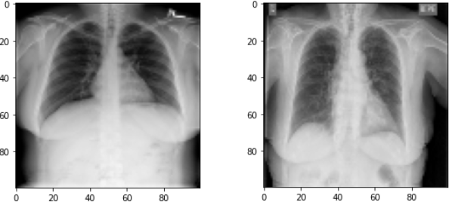
Data Preprocessing
Resizing the images to a uniform size
Converting the images to grayscale or RGB channels,
Normalizing the pixel values

Slide 11
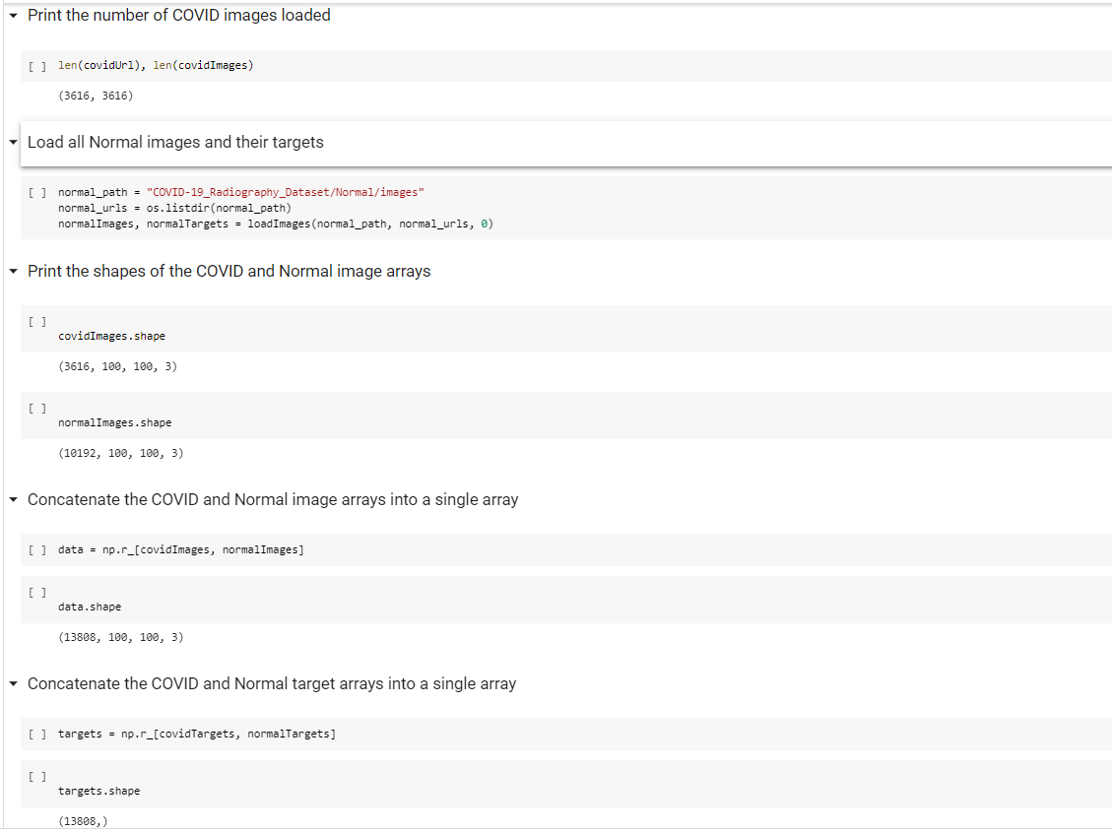

Slide 12
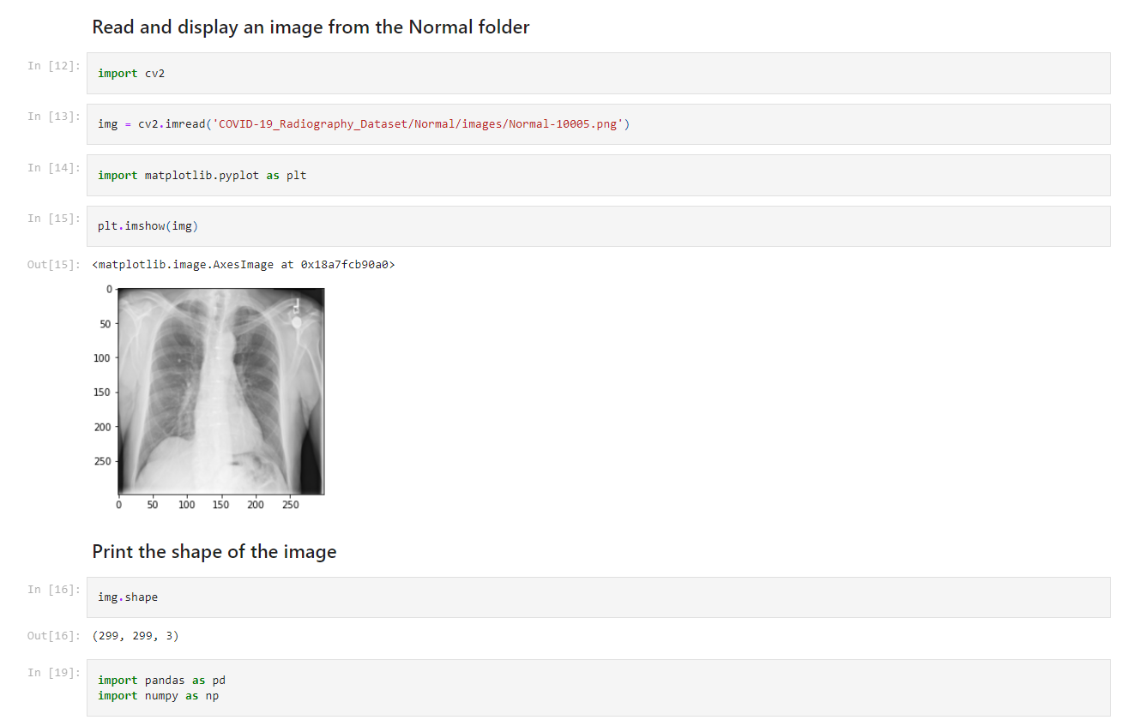

Slide 13
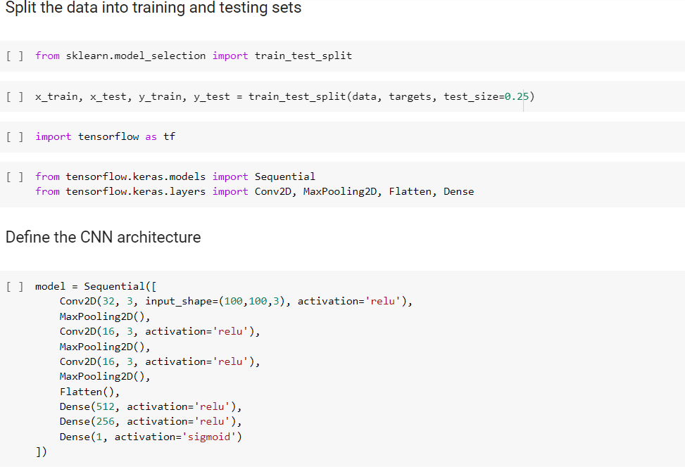
Training the Model
Building and training the CNN

Slide 14
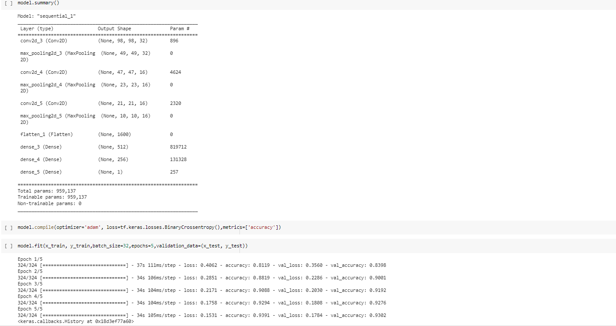

Slide 15
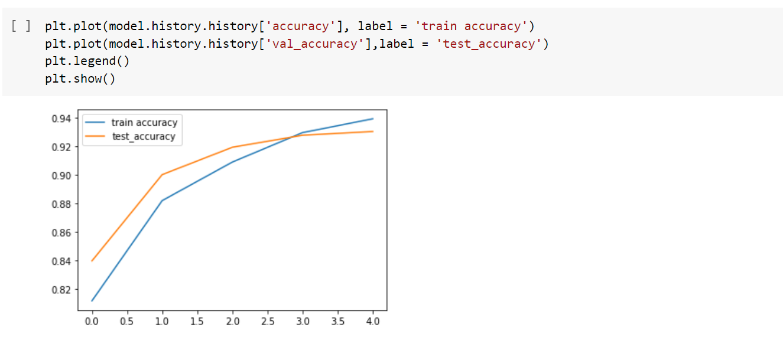
Validation Accuracy

Slide 16
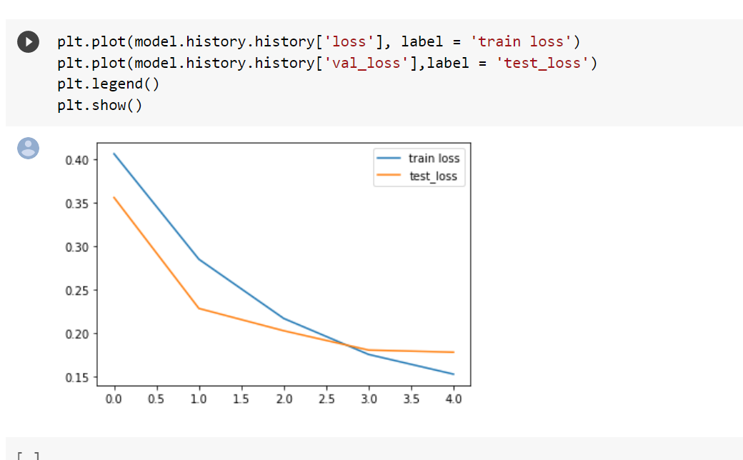
Validation Loss

Slide 17
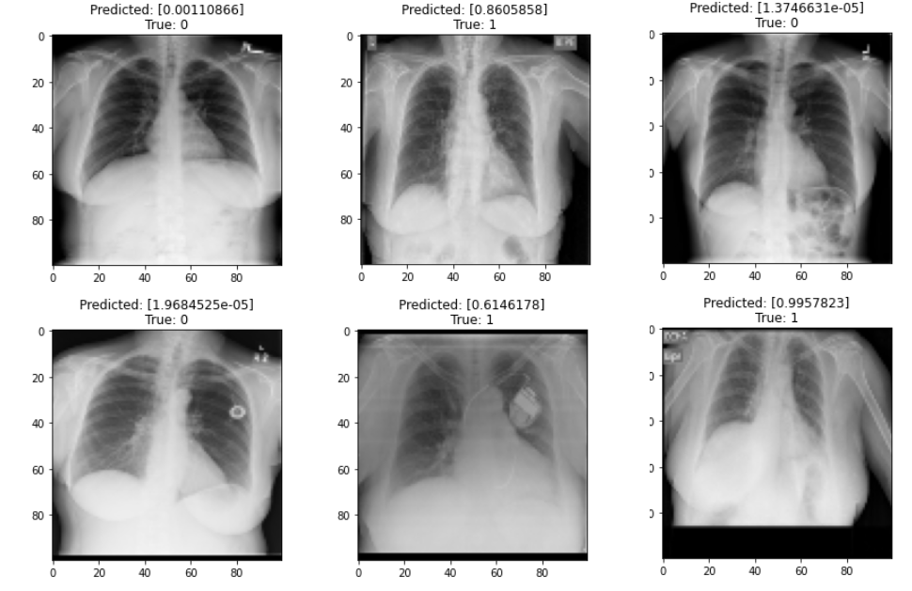
True1: covid-19 Positive True:0 Covid-19 Negative

Slide 18
Summary
As X-ray images have been widely used to diagnose COVID-19 due to their availability and relatively low cost compared to other diagnostic methods such as CT scans or PCR tests.
By Implementing image classification using Convolutional Neural Networks (CNNs) on them can automate the detection of COVID-19 from chest X-ray images and speed up the process of diagnosis and can be implemented for clinical use.

Slide 19
GitHub Code Link:
https://github.com/SharkyRCC/Covid-19-Classification

Slide 20

Thank you

