Slide 1
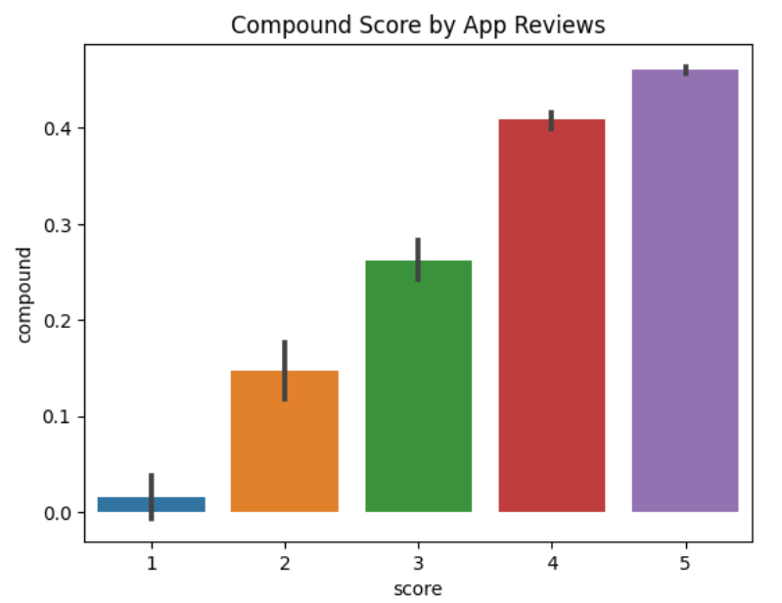
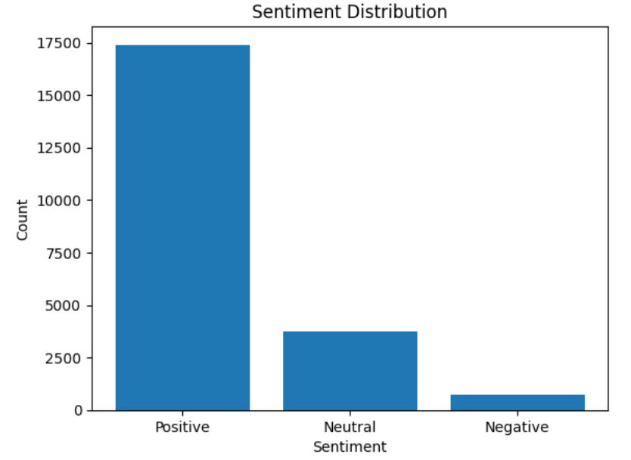
Title: Utilizing Sentiment Analysis for Determining the Optimal Version of App
Author: Sharlene Burboz
Aim/Background:
Sentiment analysis extracts valuable insights from reviews, giving developers and businesses a comprehensive understanding of user sentiments, preferences, and issues associated with their app.
Employing sentiment analysis on user reviews to quantify the sentiment expressed.
Calculating the mean compound scores for different app versions to determine the version that receives the highest overall positive sentiment from user feedback.
Methods:
Collected data of reviews of app named ET Markets from the Google Play Store using Python
Cleaned the raw text data by removing special characters and punctuation, tokenizing the text, removing stop words and performing lemmatization to prepare the data for analysis. Created a word cloud to view the most frequent words.
Utilized a pre-trained machine learning model VADER to analyze the sentiment of each review
Assigned sentiment labels to reviews, categorizing them as "positive“, “neutral” or "negative," based on the sentiment scores generated by the model.
Analyzed sentiment variations across app versions to determine the comparative user sentiment and identify the preferable version.
Results:
VADER sentiment analysis provides sentiment scores and labels (positive, neutral and negative) for Google Play Store app reviews.
The sentiment labels' distribution indicates that 71.43% of the reviews are positive and 20% are neutral and 8.5% are negative, with a mean compound score of 0.4093 highlighting a moderately positive sentiment toward the app.
The mean compound score of version 2.2.8 is 0.47799 which is the highest.
Conclusions:
The app version 2.2.8 attains the highest mean compound score, prompting a more in-depth exploration to discern its positive attributes.
Acknowledgement:

