Slide 1



Analysis
View in Power BI
Last data refresh:
11/27/2022 8:18:49 PM UTC
Downloaded at:
11/28/2022 1:10:55 AM UTC

Slide 2
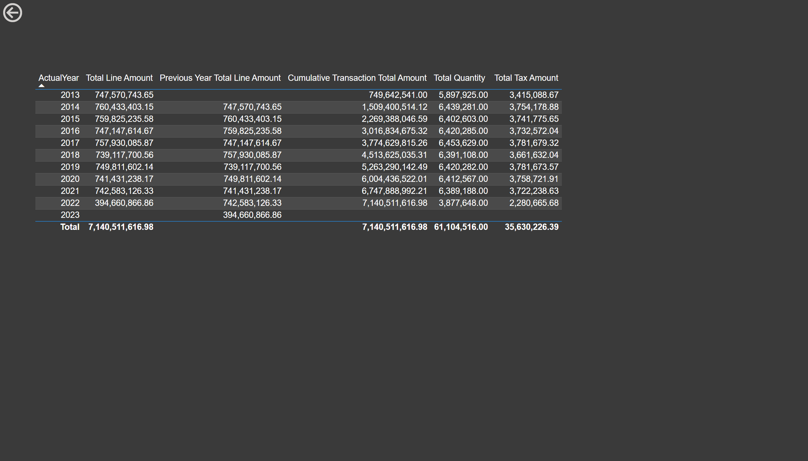
Page 1
Notes:
tableEx
No alt text provided
actionButton
No alt text provided
actionButton
No alt text provided

Slide 3
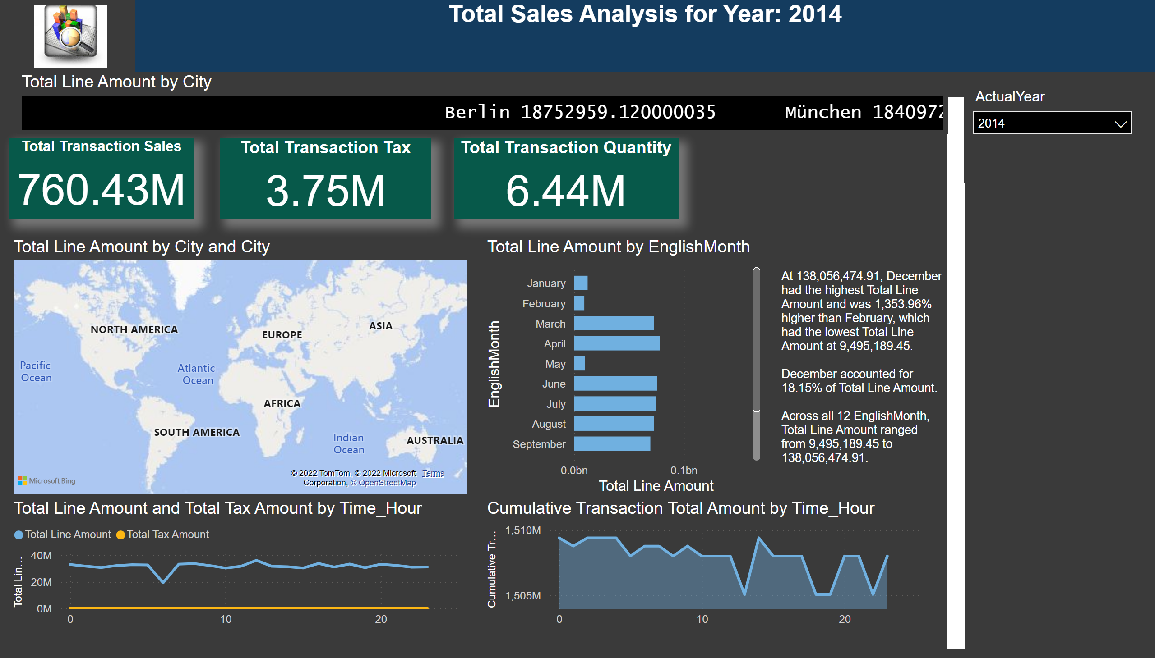
Page 2
Notes:
image
No alt text provided
Total Sales Analysis for Year: 2014
No alt text provided
textbox
No alt text provided
Total Transaction Sales
No alt text provided
Total Transaction Tax
No alt text provided
slicer
No alt text provided
Total Transaction Quantity
No alt text provided
clusteredBarChart
No alt text provided
map
No alt text provided
textbox
No alt text provided
ScrollingTextVisual1448795304508
No alt text provided
lineChart
No alt text provided
stackedAreaChart
No alt text provided

