Slide 1

Inner product encryption
For what? & why?
Privacy in biometrical authentication

Slide 2

For what?
Privacy in biometrical authentication
Functional cryptography
Hamming distance

Slide 3



About evil server
KeyGen -> msk
Registration(msk,registration data) -> registration template (send to server to store)
Calculate Hamming Distance
Authentication(msk, authentication data) -> authentication template (send to server to compare)

Slide 4
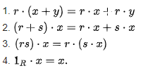
Modules
Suppose that R is a ring and 1_{R} is its multiplicative identity (in our case we’ll use a finite field). A left R-module M consists of an abelian group (M, +) and an operation ⋅ : R × M → M such that for all r, s in R and x, y in M, we have:

Slide 5

Inner Product Encryption, what&why?

Slide 6
length | 500 | 2500
Master secret key generation | 156.906 s. | 28.341 s.
Registration | 184.8437 s. | 27.902 s.
Authentication | 50.9375 s. | 13.8 s.
Hamming distance | 180.7031 s. | 25.931 s.

Slide 7

Problems?

Slide 8
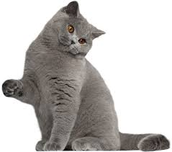
Thank you!

