Slide 1


Slide 2
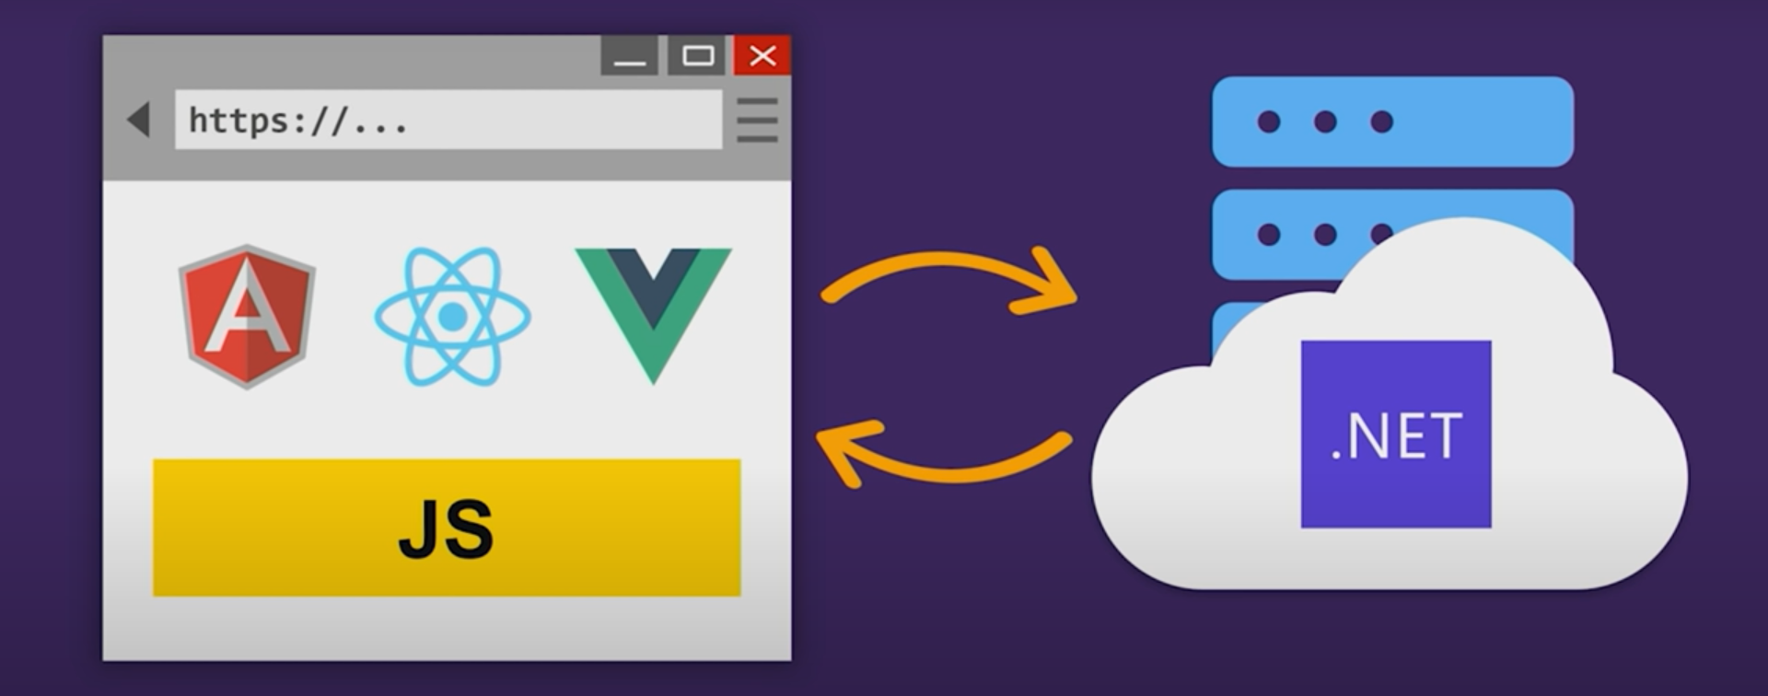

Slide 3
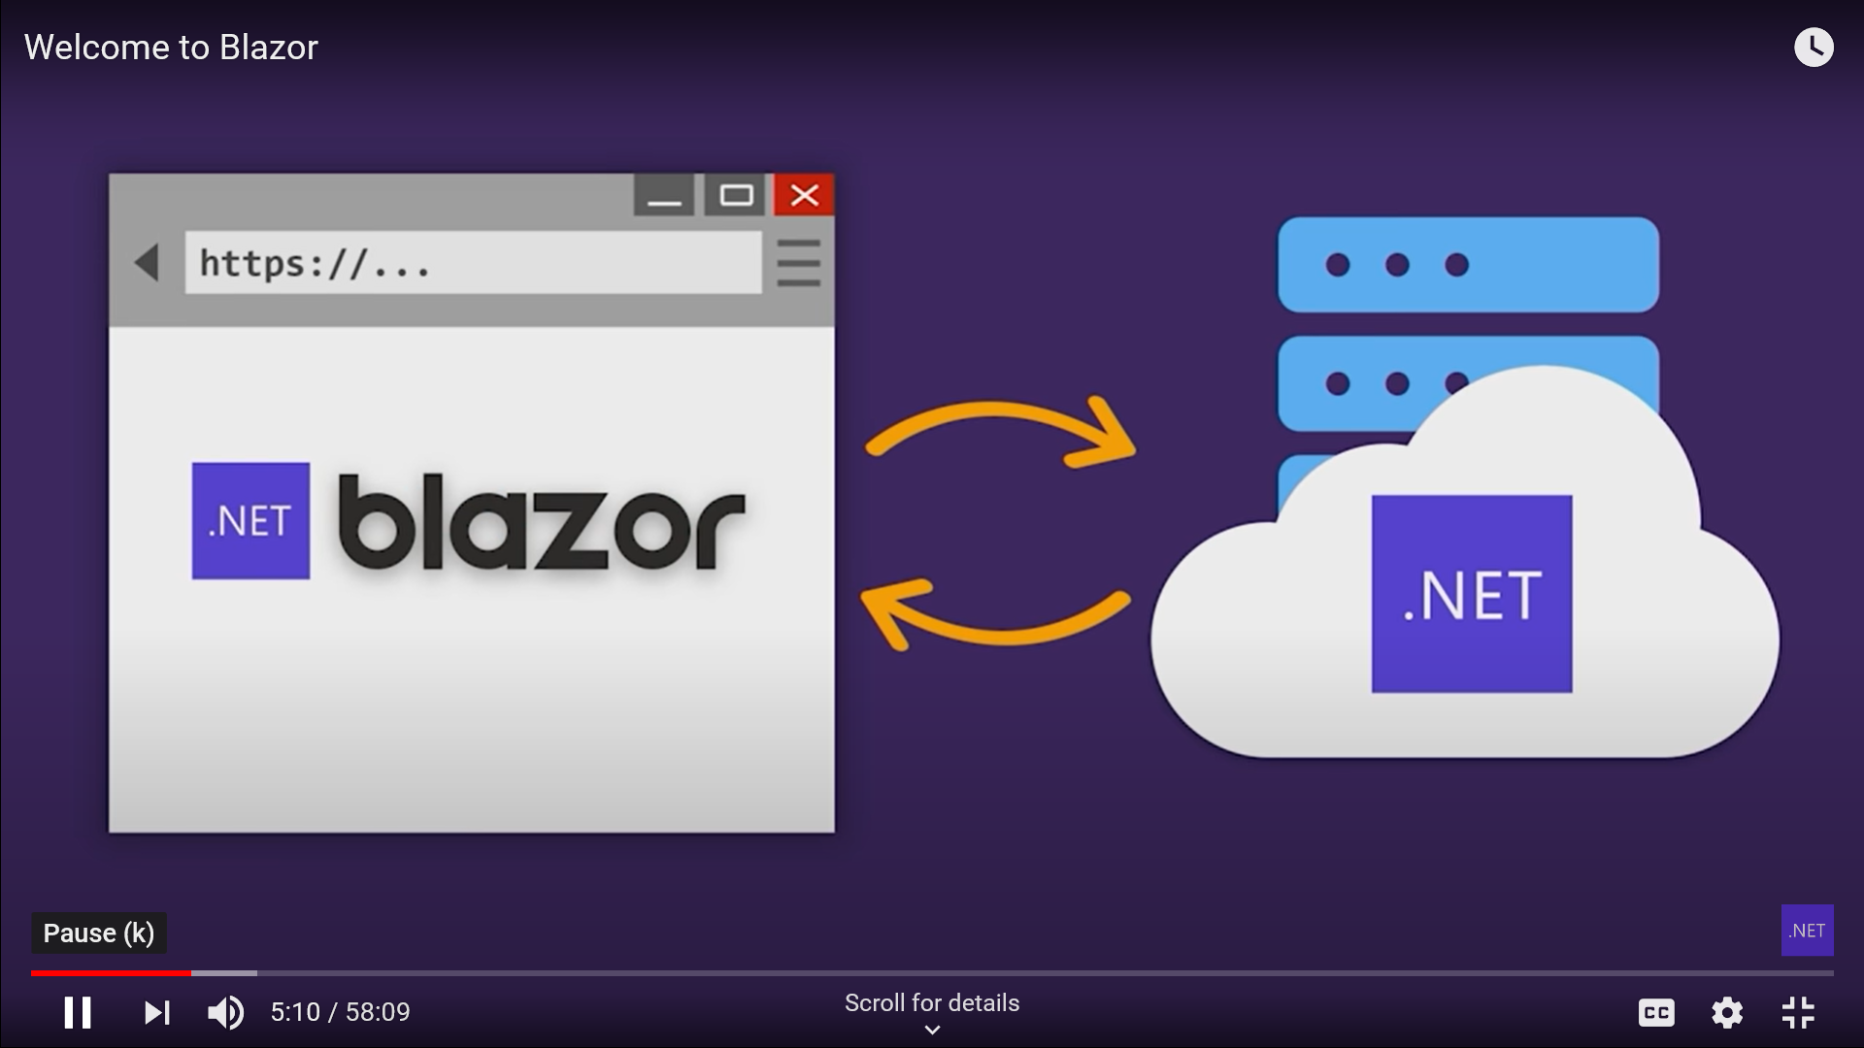

Slide 4
Why Blazor?
Build Client Side Web UI with .NET instead of JavaScript.
Write re-usable web UI Components with C# and Razor.
Share .NET code with both the client and server.
Call into JavaScript libraries & Browser API's as Needed.

Slide 5
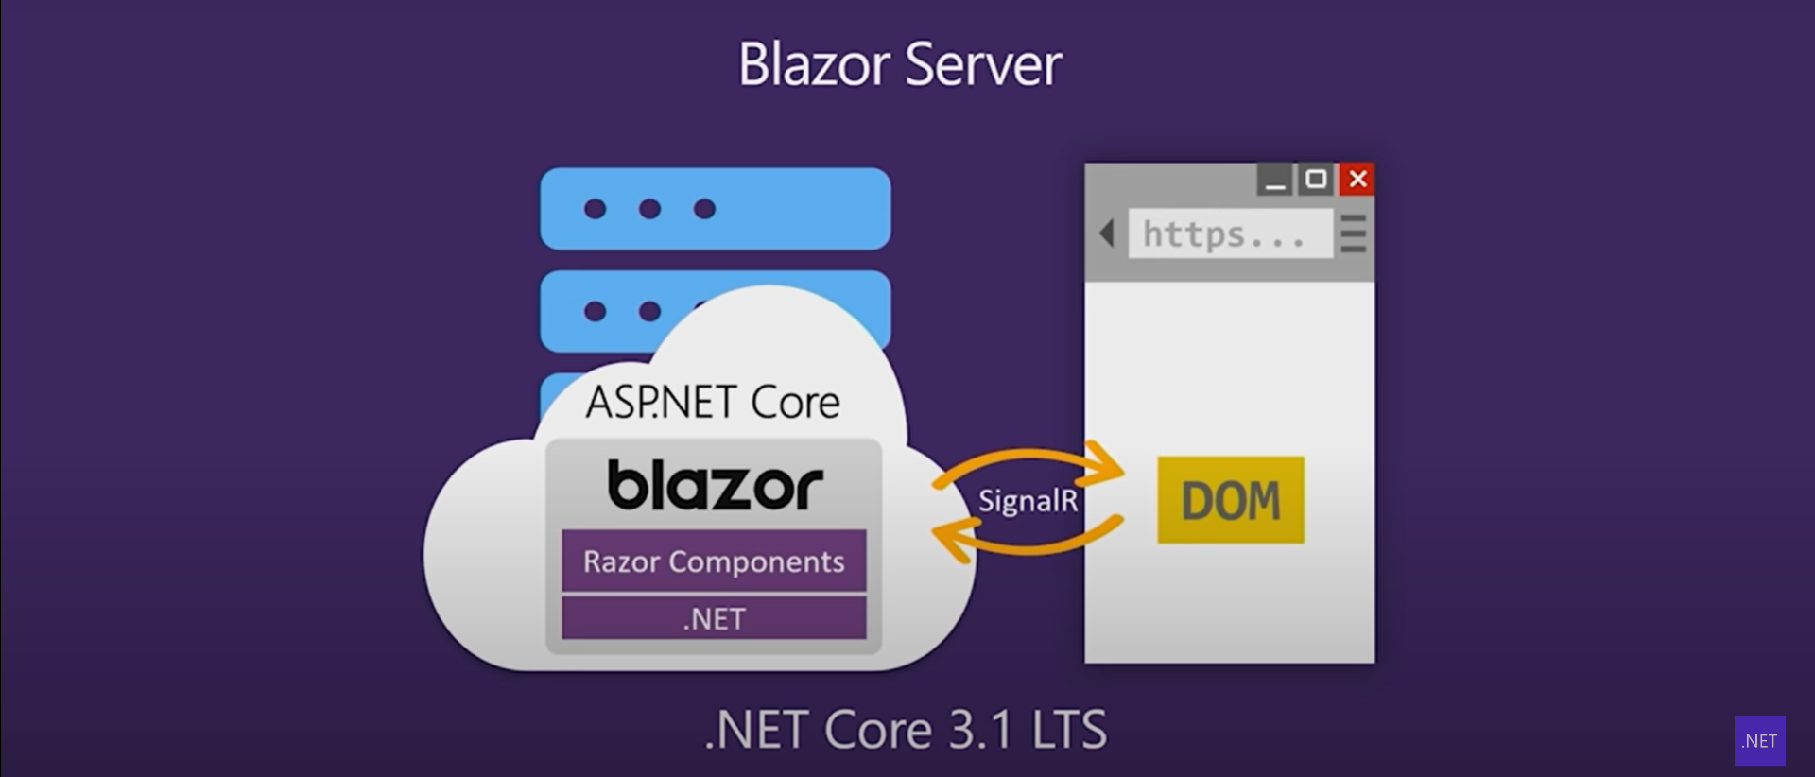

Slide 6
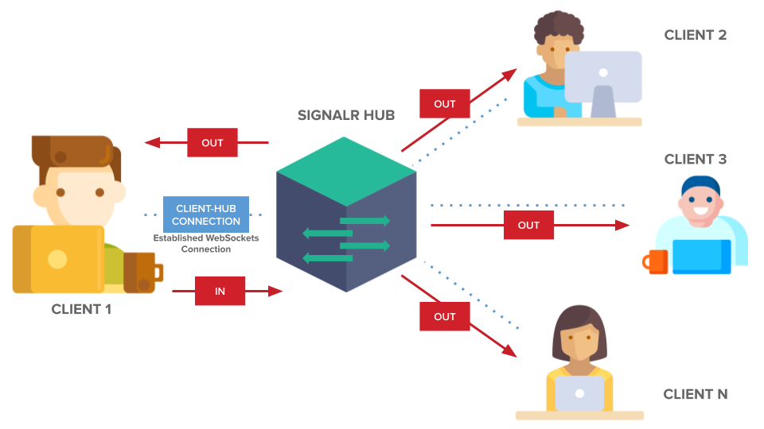

Slide 7
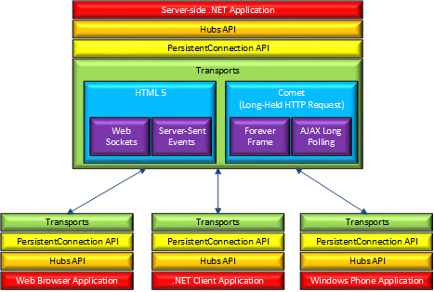

Slide 8
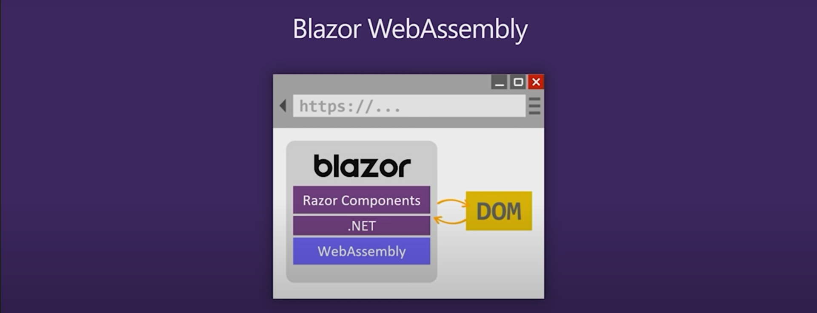

Slide 9
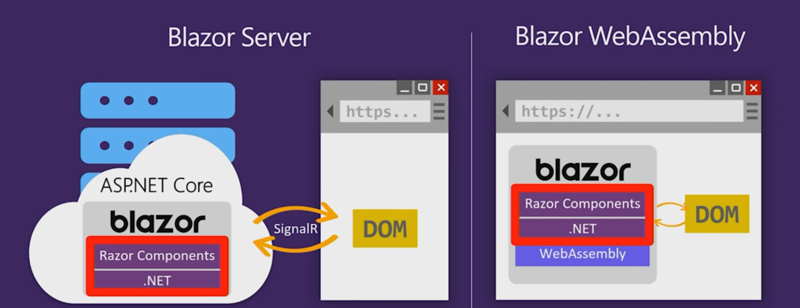

Slide 10
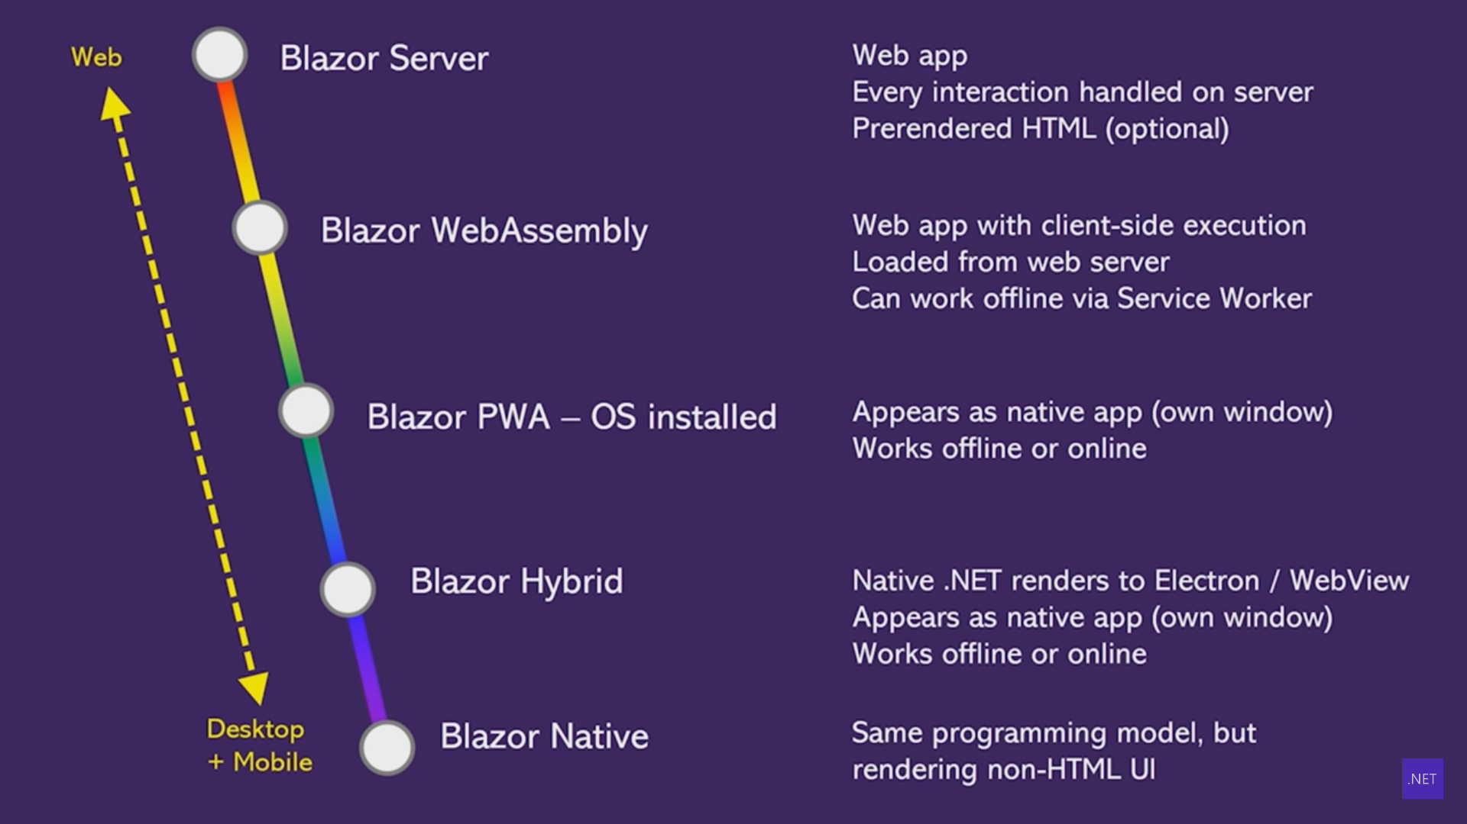

Slide 11
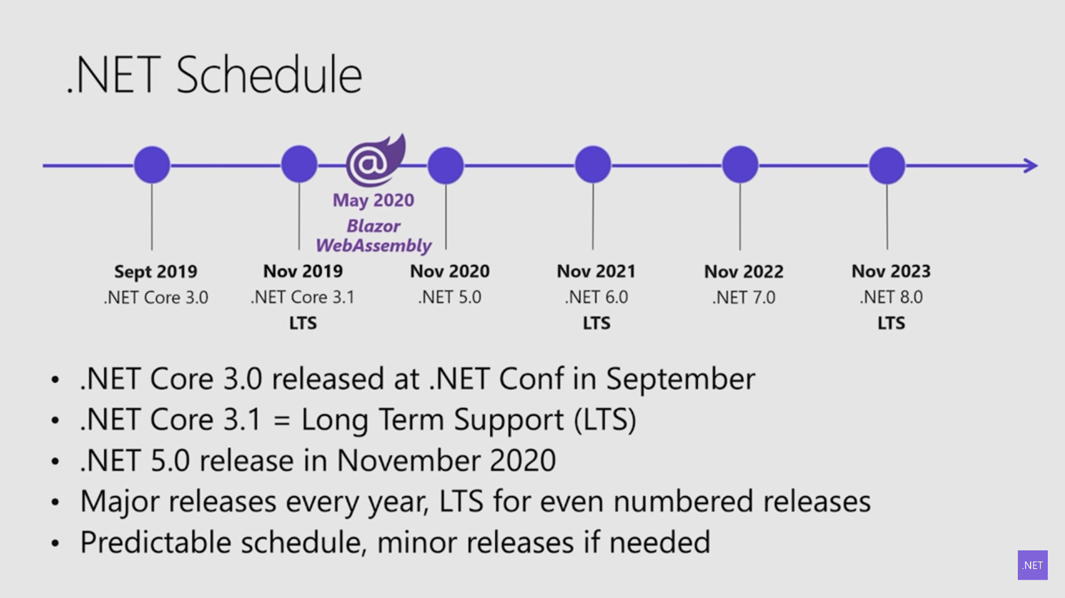

Slide 12
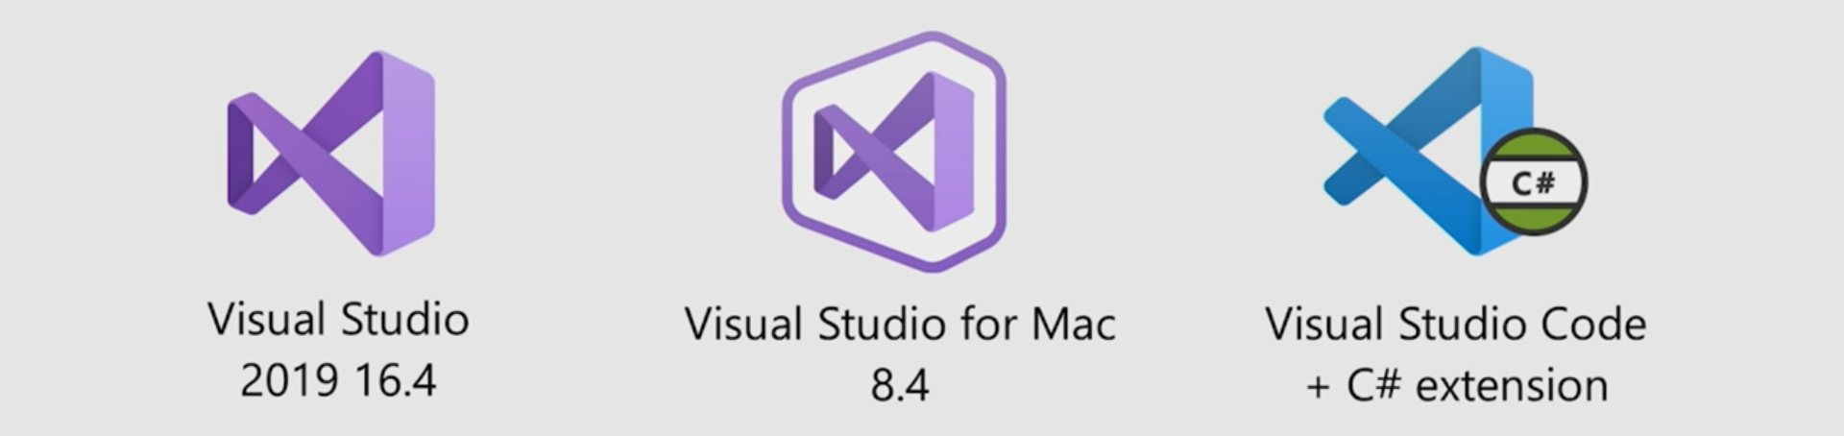
Setting Up Environment
https://blazor.net
Install .NET Core 3.1

