Slide 1
Topic Modelling and Recommender System for Amazon Reviews
Tushar Sharma
DS5230 – Summer 2020

Slide 2
The problem and ideas
Classically, baseline recommender systems are built using user-item-rating and learning the bias for a user-item pair
We will try to introduce a new dimension made of features extracted as topics using Latent Dirichlet Allocations
These text features extracted will can be used to see any improvements in performance along with user-item-rating data
Most modern systems combine various techniques such as Colllaborative Filtering, Content Based Filtering and other techniques
https://en.wikipedia.org/wiki/Recommender_system

Slide 3
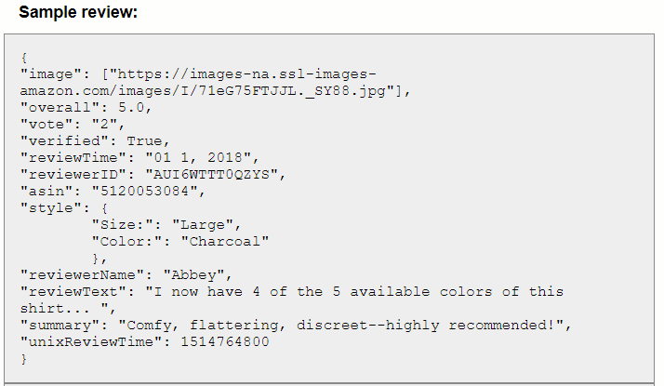
The data and processing - Specifications
Amazon review dataset is part of a well-maintained repository offered by amazon and other distributors (most noticeably by, Julian McAuley, UCSD)
Every shopping category has its own .json.gz file and we use 11 categories with a total of 2,068,055 reviews
Specifications:
memory 24GiB System Memory
processor Intel(R) Core(TM) i7- 8700 CPU @ 3.20GHz – 12 Cores
parallelization multiprocessing — Process-based “threading” interface

Slide 4
The data and processing – Loading
Extracting data and loading into usable data structures consists of two main parts –
Join review files for each shopping category in “.json.gz” format together in a data frame to have reviews and metadata in one place
Extract review-text and perform NLP centered processing like stop word removal, lemmatization and stemming and finally extract word frequency counts

Slide 5
The approach
Baseline recommender
Matrix factorization
Topic Extraction using Latent Dirichlet Allocation
Matrix Factorization with Topic features (-Ongoing)

Slide 6
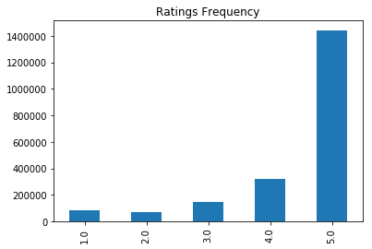
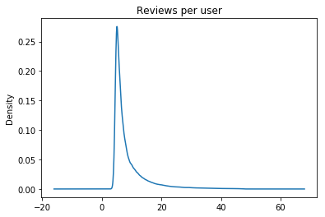
Exploratory Data Analysis- User ratings behaviour

Slide 7
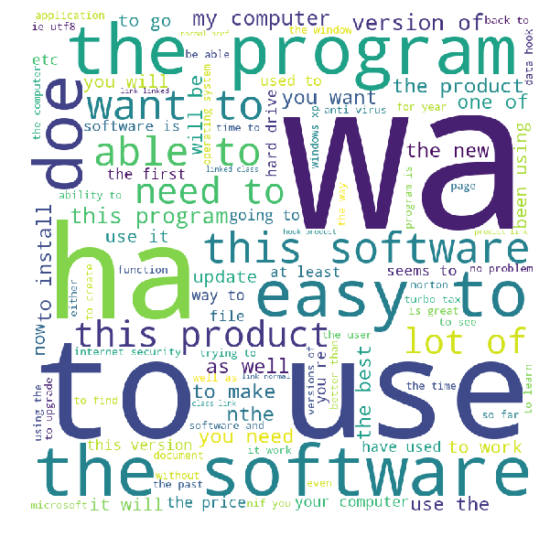
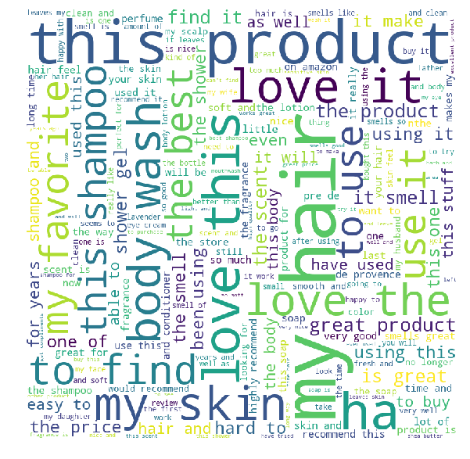
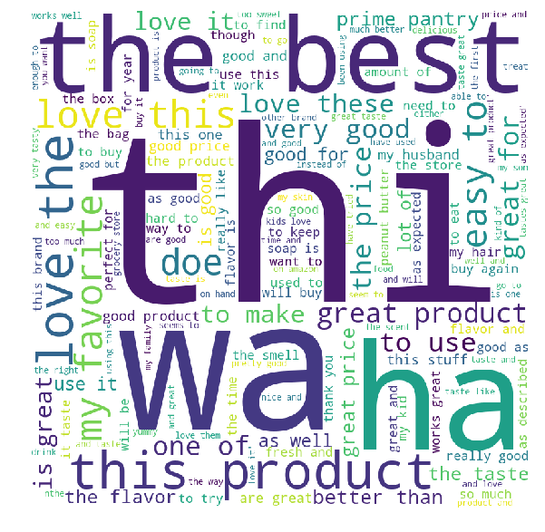

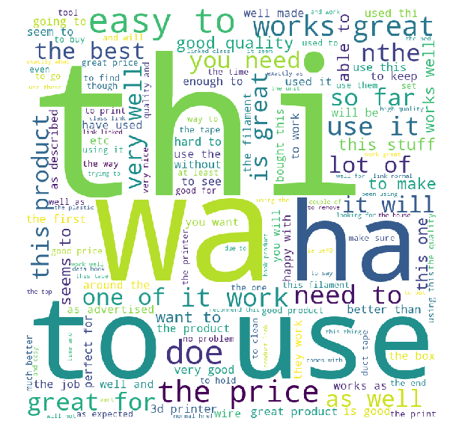
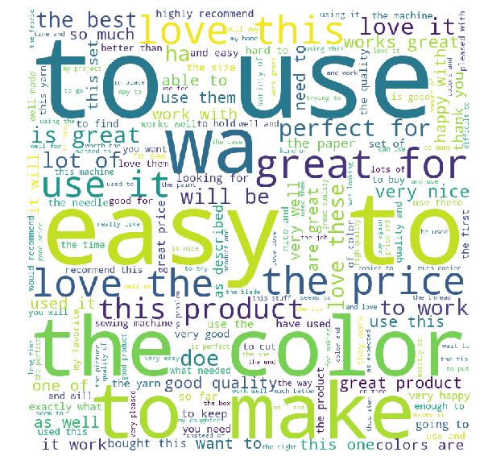
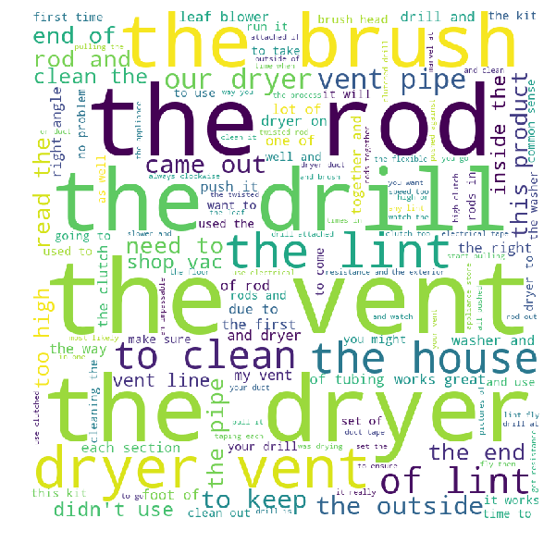
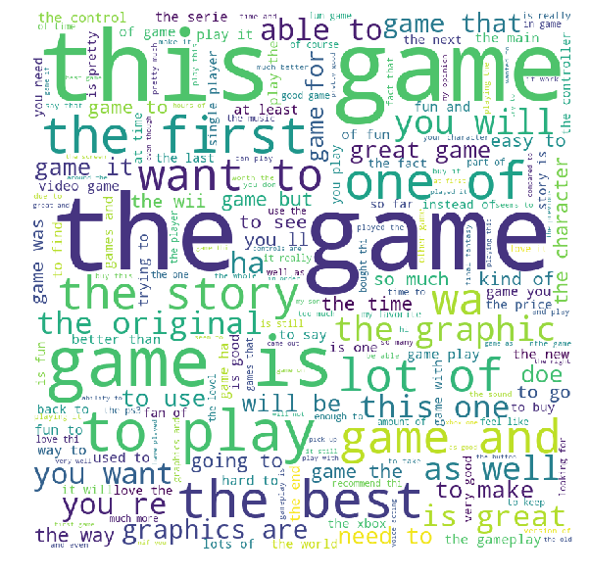
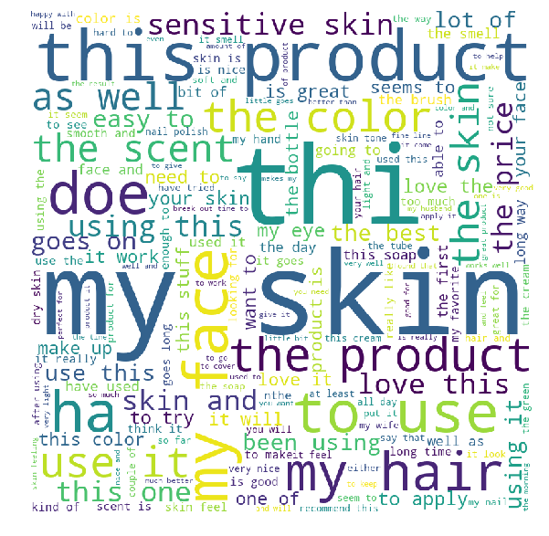
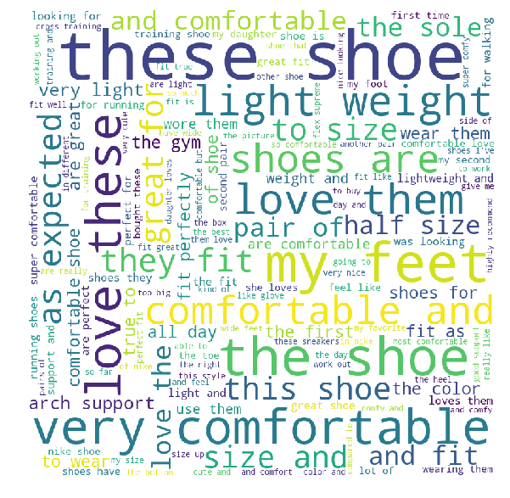
Exploratory Data Analysis- Word Clouds
Software
All_Beauty
Prime_Pantry
Gift_Cards
Industrial_and_Scientific
Arts_crafts_and_Sewing
Appliances
Video_Games
Luxury_Beauty
Amazon_Fashion

Slide 8

Baseline Recommender – Implementation
The baseline rating for user u and item i are predicted as the sum of mean rating, bias learned for user and item
The term µ can be set as the mean rating of products and the baselines can be computed either using Alternating Least Square or Stochastic Gradient Descent
We choose the Stochastic Gradient Descent algorithm for training on training split of the dataset (75%)
The implementation methods are called from ‘surprise’ toolkit which wraps sk-learn base estimators.

Slide 9


Baseline Recommender – Evaluation
After training we get baseline estimates for biases and evaluate on the remaining 25% TEST split of the dataset
Evaluation metrics used are RMSE(Root Mean Square Error) and FCP (Fraction of Concordant Pairs)
Results we get for these metrics—
RMSE: 1.0317, FCP: 0.5665
https://www.ijcai.org/Proceedings/13/Papers/449.pdf

Slide 10

Matrix Factorization (SVD) Recommender
Next, we try to improve on baseline predictions by using Matrix Factorization Methods which uses a similarity index for users as well as items
We have the similarity term added to baseline equation we had earlier.
Another version of CF ignores the bias {b_u} and popularity (b_i) terms also known as Probabilistic Matrix Factorization
In future work, topic extracted from LDA (next) will be used as {q_i} and weights parameters {p_u} will be learned using SGD

Slide 11


Topic Extraction – Latent Dirichlet Allocation
Latent Dirichlet Allocations (LDA) is a model used to discover abstract topics from a collection of documents
Posterior probability distribution function:
Where, z is the topic assigned, \theta is document-topic prior and \beta is topic-word prior
The above function is approximated to and the problem reduces to minimizing the KL divergence between this distribution and the true posterior.

Slide 12
Topic Extraction - Implementation
The process is different for LDA since we need to extract topics relevant to each category
We will split the corpus based on category then apply stemming and lemmatization before vectorization
CountVectorizer() will be used from sklearn implementation alongwith stemmer and lemmatizer from nltk
These tasks will be processing heavy so we will also use pool() from multiprocessor to smoothly preprocess the data
Eventually LDA is applied for extracting top 10 topics from each category

Slide 13
Topic Extraction – Extracted Topics
Topics in LDA model for Software:
Topic #0: product great good price products use amazon easy excellent years
Topic #1: version office new use home open previous like work used
Topic #2: problems update 10 computer problem time machine run new minutes
Topic #3: product need version free online return use don class just
Topic #4: video use easy like feature screen create want used great
Topic #5: just like don work ve works want use fine doesn
Topic #6: really like learn lot game think just good time graphics
Topic #7: years year used ve version use pc home new easy
Topic #8: computer easy use good hard ok recommend bad great works
Topic #9: time tool page design help work high available end experience
Topics in LDA model for All_Beauty:
Topic #0: like recommend buy just product definitely don use great job
Topic #1: size hand pretty fan big sure regular plastic huge isn
Topic #2: favorite excellent product love easy fast price best great difficult
Topic #3: best water ve used like years don just small large
Topic #4: good nice really clean like light stuff feel doesn expected
Topic #5: use day time perfect little product wonderful order better years
Topic #6: just love product soft dry long like buy try really
Topic #7: love years time wish happy available hard long come longer
Topic #8: price amazing amazon able store gift good awesome use set
Topic #9: great product products works used thank wonderful fine stuff work
Topics in LDA model for Gift_Cards:
Topic #0: great gift deal item idea product place price hit come
Topic #1: used awesome work away hope store right 10 pack haven
Topic #2: don know make sure check better gift far look money
Topic #3: easy best order online receive wish thing way print issue
Topic #4: good fast works thank product pretty place value fine wonderful
Topic #5: gift card amazon box happy say purchase like free little
Topic #6: gift card just excellent person wrong people want able favorite
Topic #7: love use amazon year quick need friends old things time
Topic #8: nice perfect expected time quickly exactly quality yes perfectly metal
Topic #9: buy like really extra day hard problem lot time number
Topics in LDA model for Video_Games:
Topic #0: price great fast worth items happy purchase perfect item time
Topic #1: product case excellent amazon box cheap class screen expected black
Topic #2: good sound 10 story graphics short pretty music ok decent
Topic #3: controller xbox games use super pc used button video ve
Topic #4: like just really don good feel thing didn think know
Topic #5: works great work day favorite days issue fine card problems
Topic #6: game like time just games play story really way ve
Topic #7: game fun play love games great like really lot online
Topic #8: new version original old year years better ones color ago
Topic #9: game great best awesome games graphics amazing series fan buy

Slide 14
Future Work and Improvements
The topics extracted from LDA can be used to further improve the performance of a content-based recommender system
Since we know topics being discussed within a category this information might play a vital role in associating similar users together
The learning task can be further evolved by using advanced concepts such as Kernel Density Estimation based model, Bagging and Boosting
Topic extraction pipeline can be improved to have more relevant topics extracted by improving the priors on a category
NLP centered tasks such as word vectorization can be improved using Word and sentence transformers

Slide 15
Thank you

