Slide 1
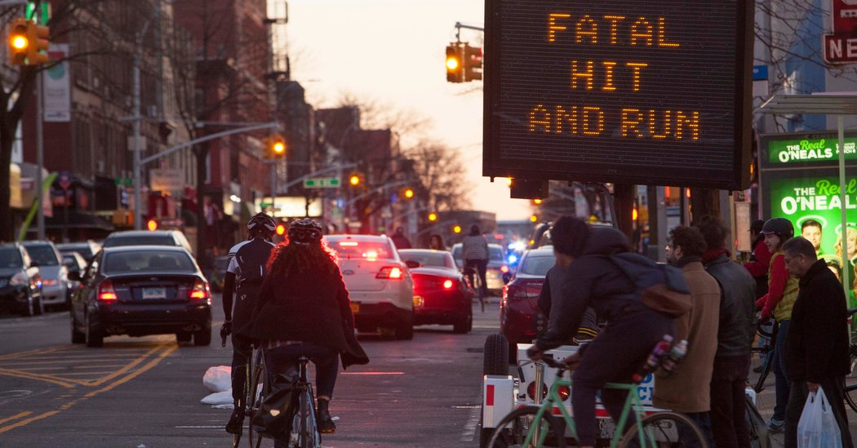
Hourly Analysis on NYPD Vehicle Collisions
Jiahuan Li
Tushar Sharma

Slide 2
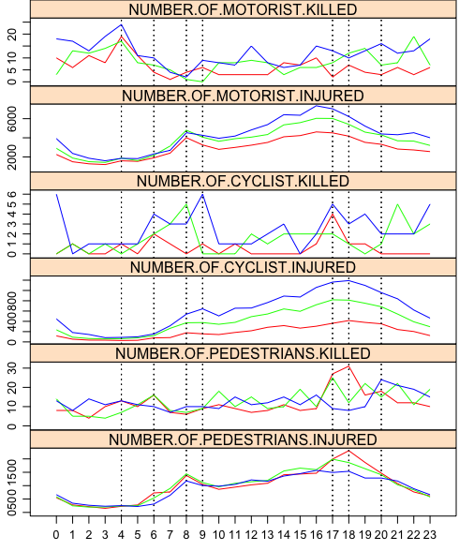
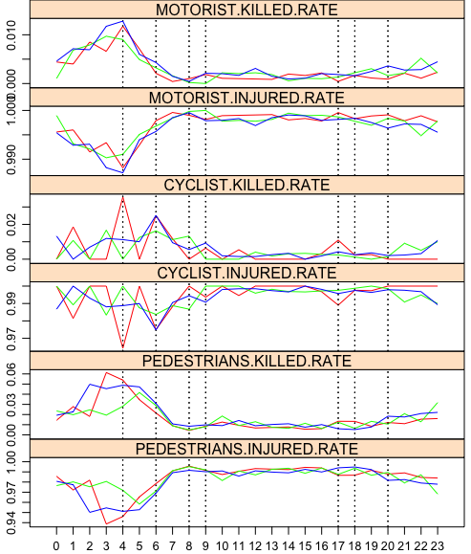
Hourly injuries and death comparison – Counts and Ratio
rush hour
rush hour
dark hours

Slide 3
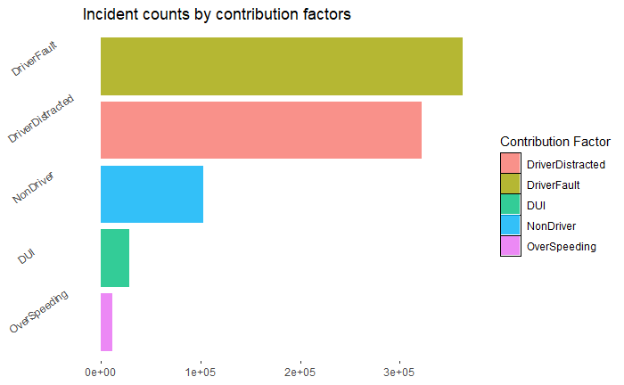
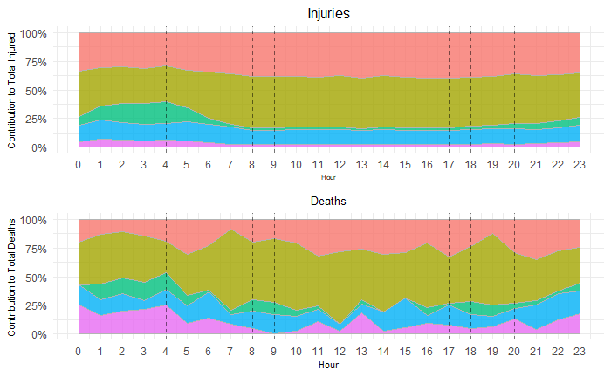
Contribution of factors to incidents and fatalities
Driver’s own Fault and Distracted due to external factors leads to most incidents and fatalities in daytime
Driver not obeying traffic rules contribute most in day time when the injured cases are at peak
DUI incidents happen in night time, being the 3rd most contributing factor to injuries
In the dark hours, over-speeding death cases are high and proper speed check posts can be installed to prevent this

Slide 4
Thank you Q&A

