Slide 1
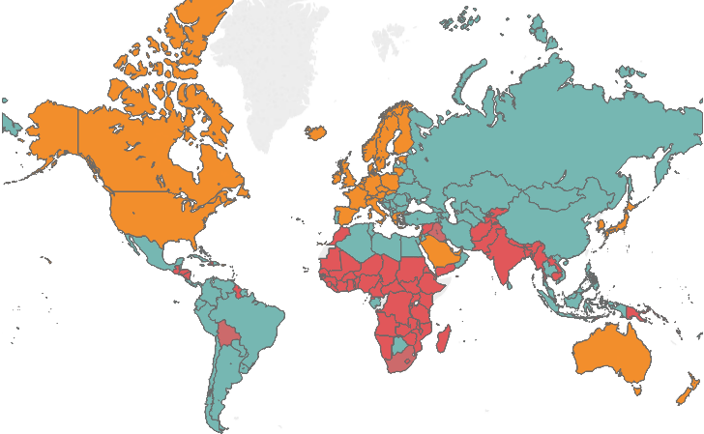
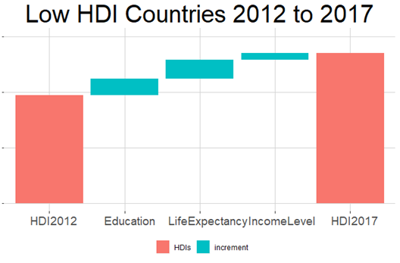

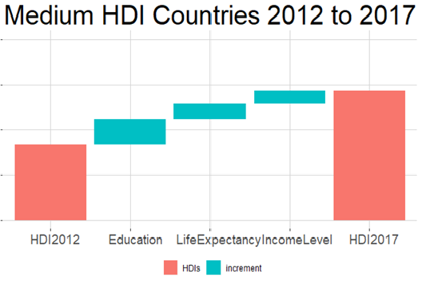
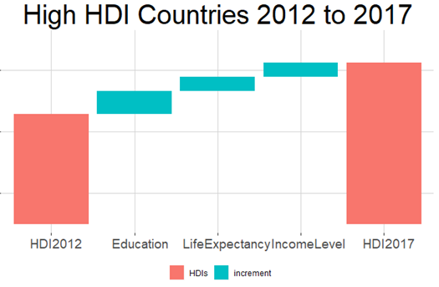
Contribution of 3 components to change in Human Development Index (2012vs2017)
Study on Inequality and its effect on Human Development
HDI Map
+5.15%
+1.97%
+4.61%
0.51
0.49
+1.44%
+1.67%
+2.07%
+1.77%
+2.25%
0.90
+3.36%
0.75
0.88
0.73
Income component has less contribution than Education and Life

Slide 2
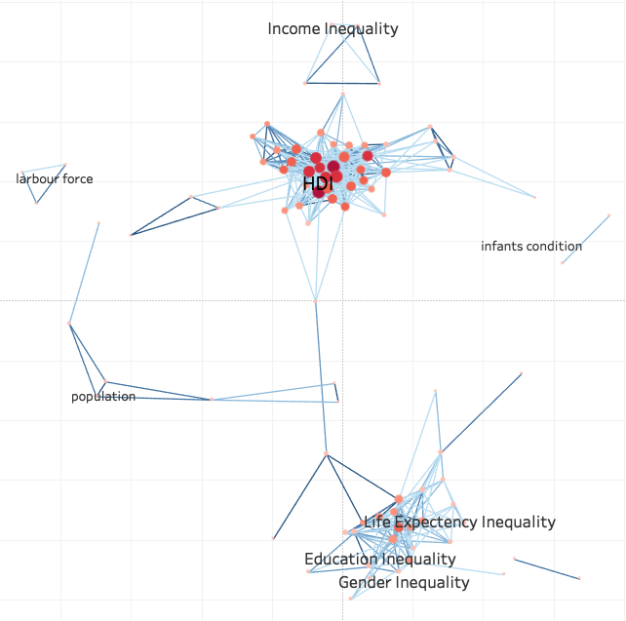
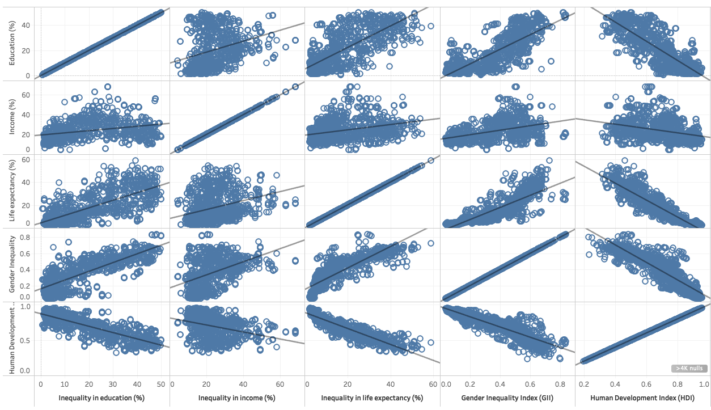
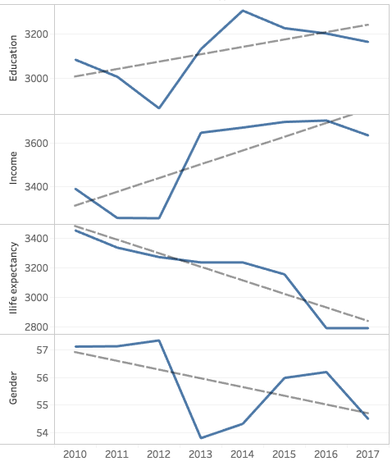
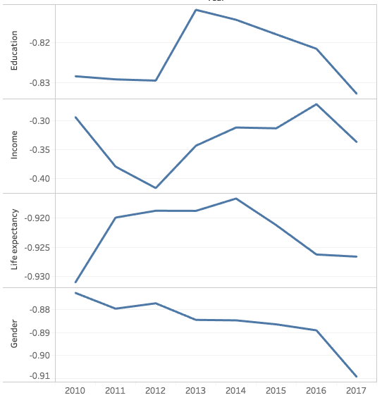
Correlation of inequality with HDI
Inequality correlation with HDI changes over time
Inequality changes over time
Income inequality correlation is not as strong as other inequalities with HDI

Slide 3
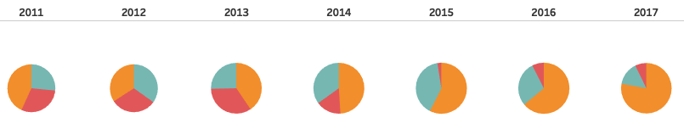
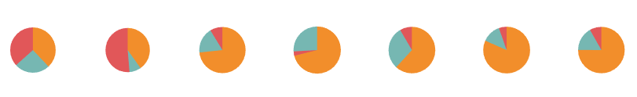
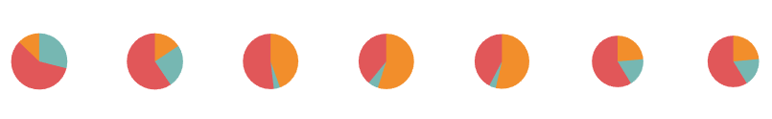
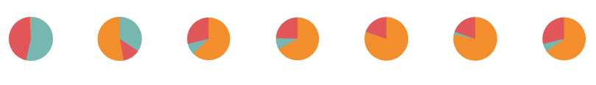
The contribution of different level of countries to total change in inequality index
Inequality in Income growth rate
Inequality in Education growth rate
Inequality in Life expectancy decrease
Inequality in gender discrimination decrease

Slide 4

Conclusions…
We conclude that inequality in various aspects related to development directly affects the growth of HDI for all levels of countries
Also we saw that Income is the least contributing factor to growth compared to education and life expectancy
And income inequality correlation with HDI is not as (negatively) strong as other components
Data source

