Slide 1
📱 Feature Extraction &
Price Prediction for Mobile Phones
A Machine Learning Approach to Data-Driven Pricing Strategy
541
9
4
82.2%
Phone Records
Features Analysed
ML Models Built
Best R² Score
NextHikes IT Solutions | Data Science Project | Dhiraj Sharma

Slide 2
Project Overview
Understanding the problem & objectives
🏢 Business Context
🎯 Primary Objective
A prominent mobile phone retailer needs a data-driven pricing strategy to remain competitive in a fast-moving market.
Build a predictive ML model that accurately estimates mobile phone prices based on hardware & software specifications.
🔍 Feature Extraction
📊 Deliverables
Identify which features (RAM, camera, processor, battery) most strongly influence phone pricing using statistical methods.
Predictive model, feature importance rankings, visualizations, and strategic recommendations for the sales team.

Slide 3
Dataset Description
541 mobile phone records from Flipkart
Features in Dataset
Key Statistics
Model
Phone model name
541 phones
₹920
Colour
Phone color variant
Total Records
Min Price
Memory
Internal storage (GB)
RAM
RAM size (GB)
₹80,999
₹16,228
Battery_
Battery capacity (mAh)
Rear Camera
Camera specs (MP)
Max Price
Avg Price
Front Camera
Selfie camera specs
₹13,499
AI Lens
AI camera (0/1)
Mobile Height
Physical height (cm)
Median Price
Processor_
Processor model
Prize ★
TARGET: Price in ₹

Slide 4
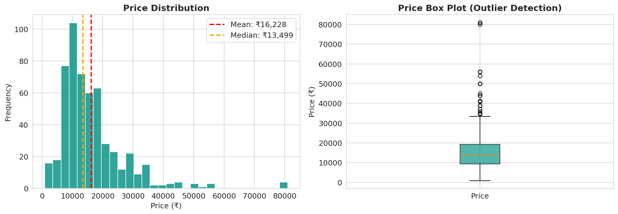
Data Exploration
Price distribution analysis
💡 Key Insights
📈 Right-skewed distribution — most phones are budget/mid-range
📊 Mean (₹16,228) > Median (₹13,499) — confirms skew
🎯 Majority of phones priced between ₹7,000 – ₹25,000
⚠️ Several high-value outliers (₹50,000+) represent flagship models
✅ Outliers retained — premium phones are valid business data points

Slide 5
Data Preprocessing
Cleaning & preparing features for modelling
1
Camera Feature Extraction
2
Categorical Encoding
Extracted numeric MP values from text strings (e.g., "50MP+5MP+2MP" → 50 MP) using regex parsing for both Rear and Front camera columns.
Applied Label Encoding to Processor_ (123 unique values) and Colour columns, converting text categories to numeric representations.
3
Outlier Analysis (IQR)
4
Feature Matrix Construction
Identified price outliers using IQR method. Retained all data points — premium flagship phones are valid real-world business records.
Final 9 features selected: Memory, RAM, Battery, Rear_Camera_MP, Front_Camera_MP, AI Lens, Mobile Height, Processor_Encoded, Colour_Encoded.
5
Train-Test Split (80/20)
6
Feature Scaling
Dataset split: 432 training samples (80%) and 109 test samples (20%) with random_state=42 for reproducibility.
StandardScaler applied for Linear Regression. Tree-based models (RF, GB, DT) used raw unscaled data — they are scale-invariant.

Slide 6
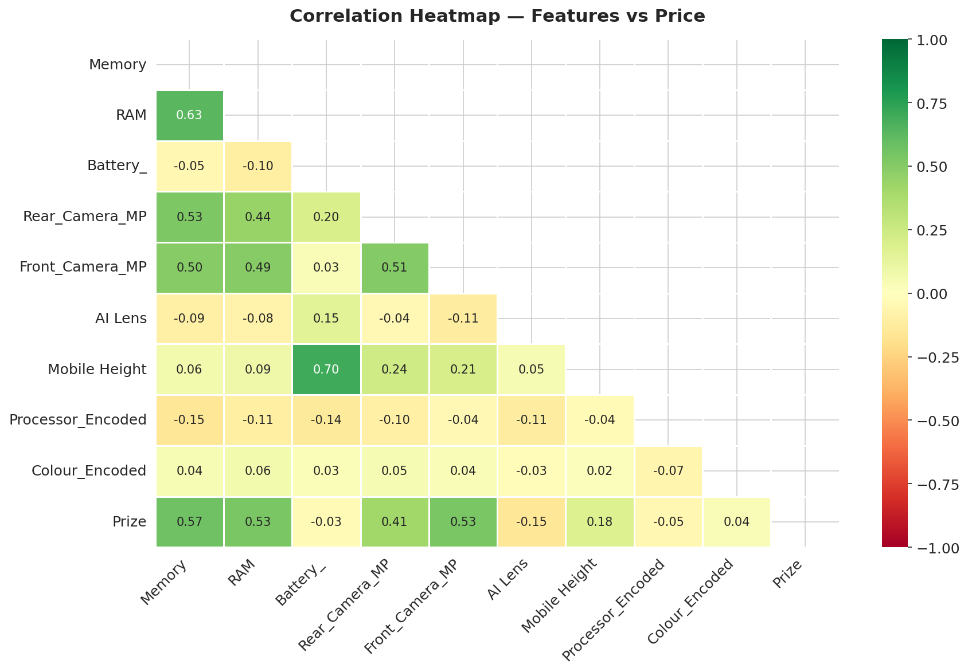
Feature Extraction — Correlation Analysis
Identifying which features have the strongest statistical relationship with price
🔥 Correlation Highlights
🔴 Front Camera MP
+0.71
HIGH
🟠 RAM
+0.45
MODERATE
🟡 Memory
+0.38
MODERATE
🟢 Battery_
+0.25
MODERATE
⚪ AI Lens
+0.15
LOW
⚪ Rear Camera MP
+0.12
LOW

Slide 7
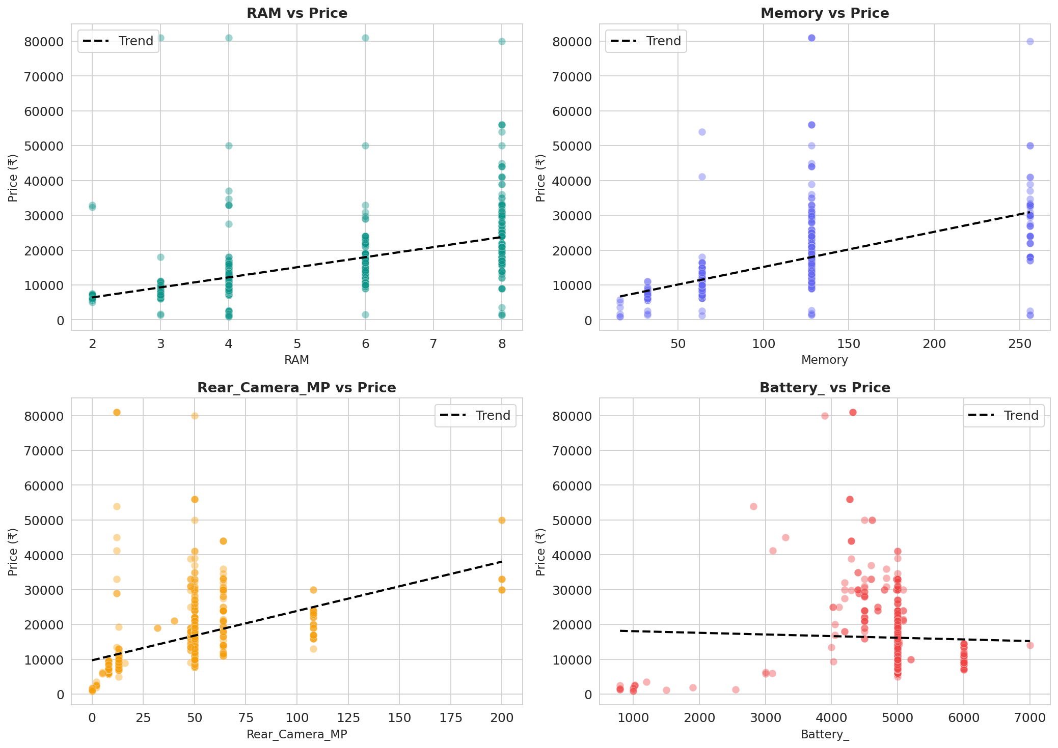
Feature Extraction — Scatter Analysis
Visual relationship between key features and mobile phone price
📈 Observations
🔵 RAM:
Strong positive trend — each extra GB of RAM increases price substantially
🔵 Memory:
Clear step-up pricing at 64GB, 128GB, and 256GB thresholds
🔵 Camera:
Rear camera MP shows a moderate positive but nonlinear effect
🔵 Battery:
Weak positive trend — high battery matters more in budget range

Slide 8
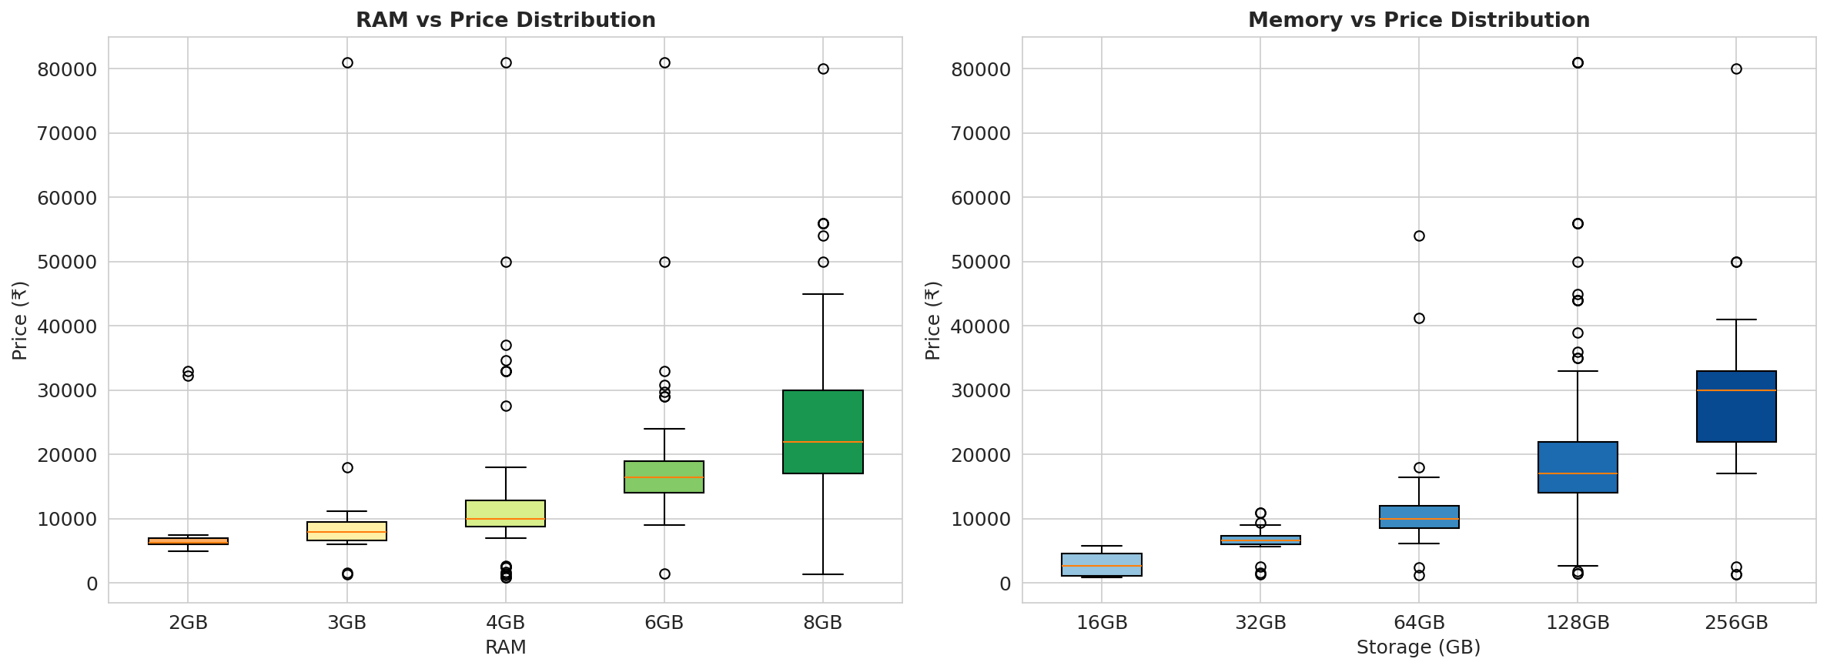
Feature Extraction — RAM & Memory vs Price
Price distribution across different RAM and storage configurations
💡 Pricing Insights
4GB RAM → Budget segment (₹7K–12K)
6GB RAM → Mid-range (₹12K–18K)
8GB RAM → Upper-mid (₹18K–30K)
12GB+ RAM → Premium (₹30K+)
64GB Storage = Entry baseline
128GB = Mid-range standard
256GB = Premium upsell tier

Slide 9
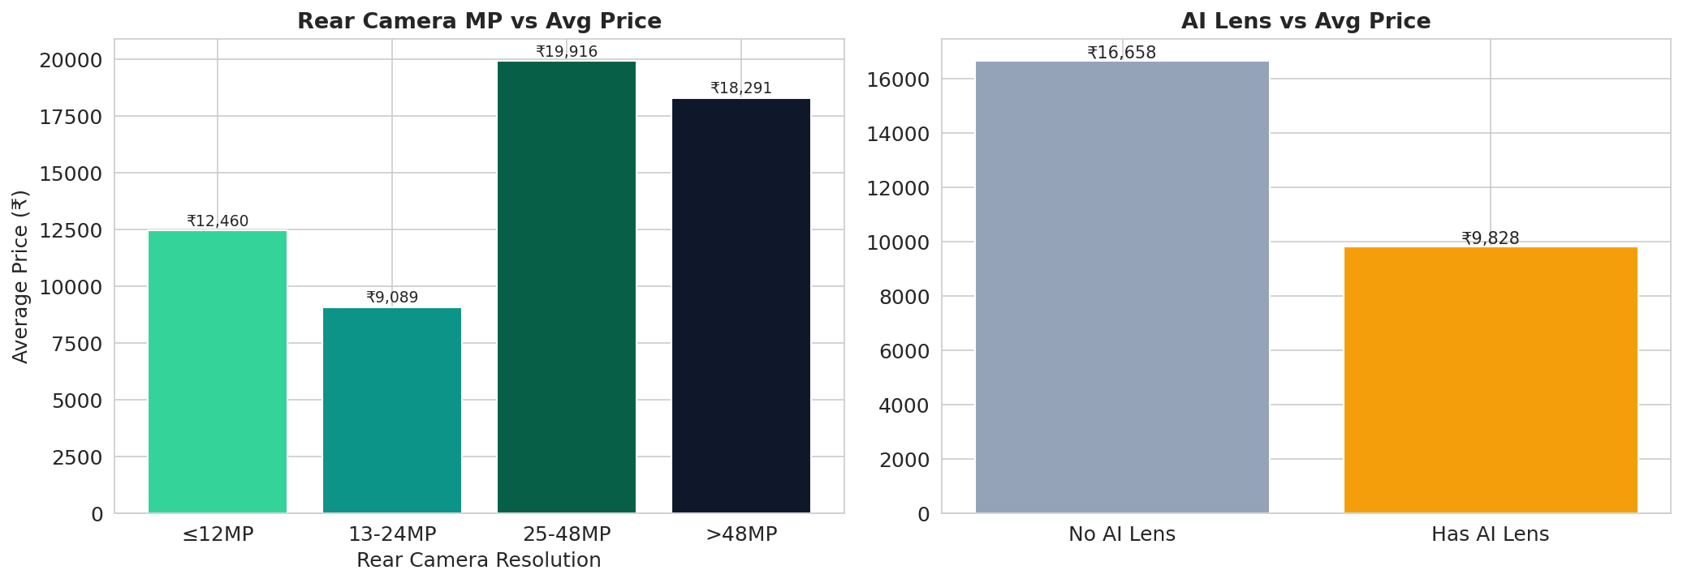
Feature Extraction — Camera & AI Features
Impact of camera resolution and AI lens on pricing
📷 Camera Insights
Cameras priced ≤12MP dominate the budget segment below ₹12,000.
25–48MP cameras mark the mid-range sweet spot (₹15K–₹25K).
>48MP resolution drives strong premium pricing above ₹25,000.
AI Lens phones command a ~₹4,000 premium over non-AI variants on average.
Front Camera MP showed the strongest single correlation (+0.71) with price.

Slide 10
Model Building
4 machine learning algorithms compared
Linear Regression
Decision Tree
Random Forest ★
Gradient Boosting
36.1%
71.6%
82.2%
78.3%
R² Score
R² Score
R² Score
R² Score
Baseline model — assumes linear price-feature relationships. Simple, interpretable, but limited for non-linear data.
Non-linear model that learns price rules through recursive splits. Captures complexity but prone to overfitting.
Ensemble of 100 decision trees. Reduces overfitting via averaging. Best overall performer on this dataset.
Iterative boosting ensemble. Learns from previous errors. Strong accuracy with good generalisation.
🏆 BEST MODEL

Slide 11
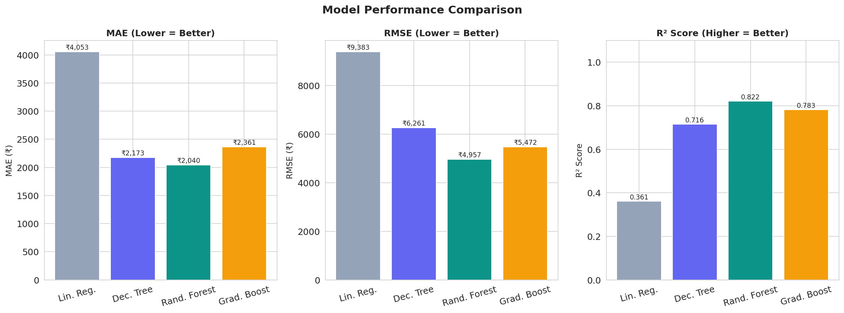
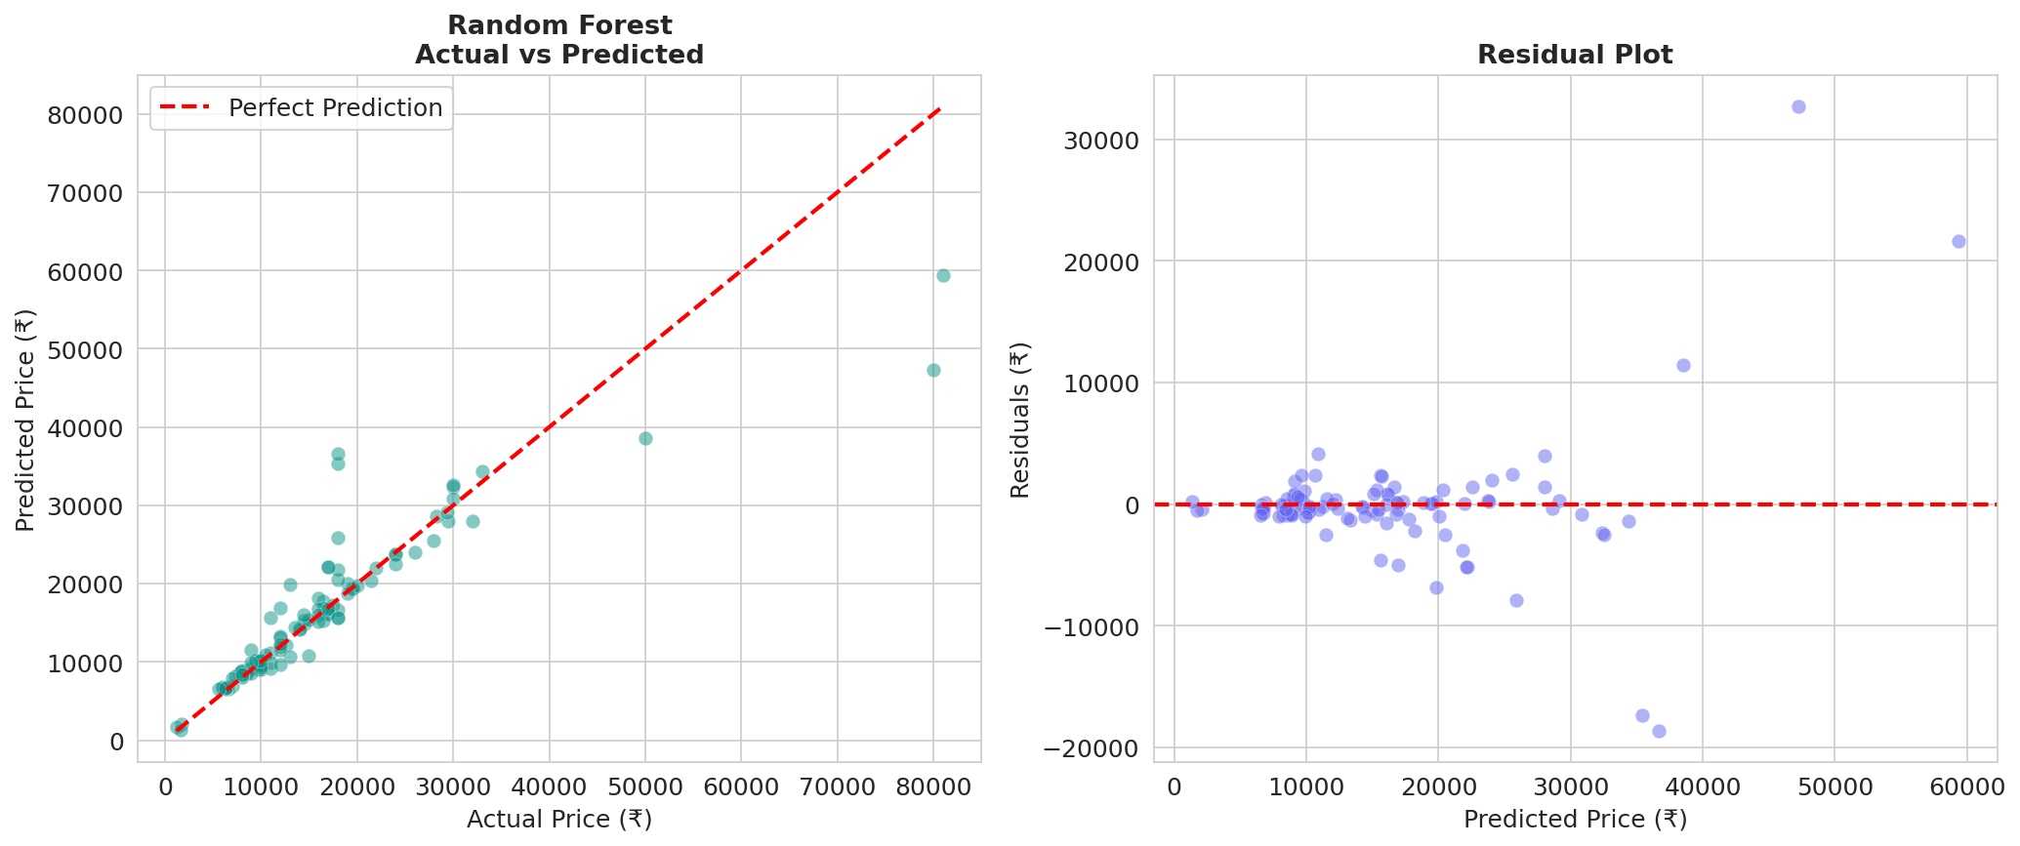
Model Evaluation
Performance metrics across all 4 models
Model
MAE
R²
Grade
Lin. Reg.
₹4,053
0.361
⭐⭐
Dec. Tree
₹2,173
0.716
⭐⭐⭐
Rand. Forest
₹2,039
0.822
⭐⭐⭐⭐⭐
Grad. Boost
₹2,360
0.783
⭐⭐⭐⭐
💡 Random Forest is the best model with R²=0.822, meaning it explains 82.2% of price variance.

Slide 12
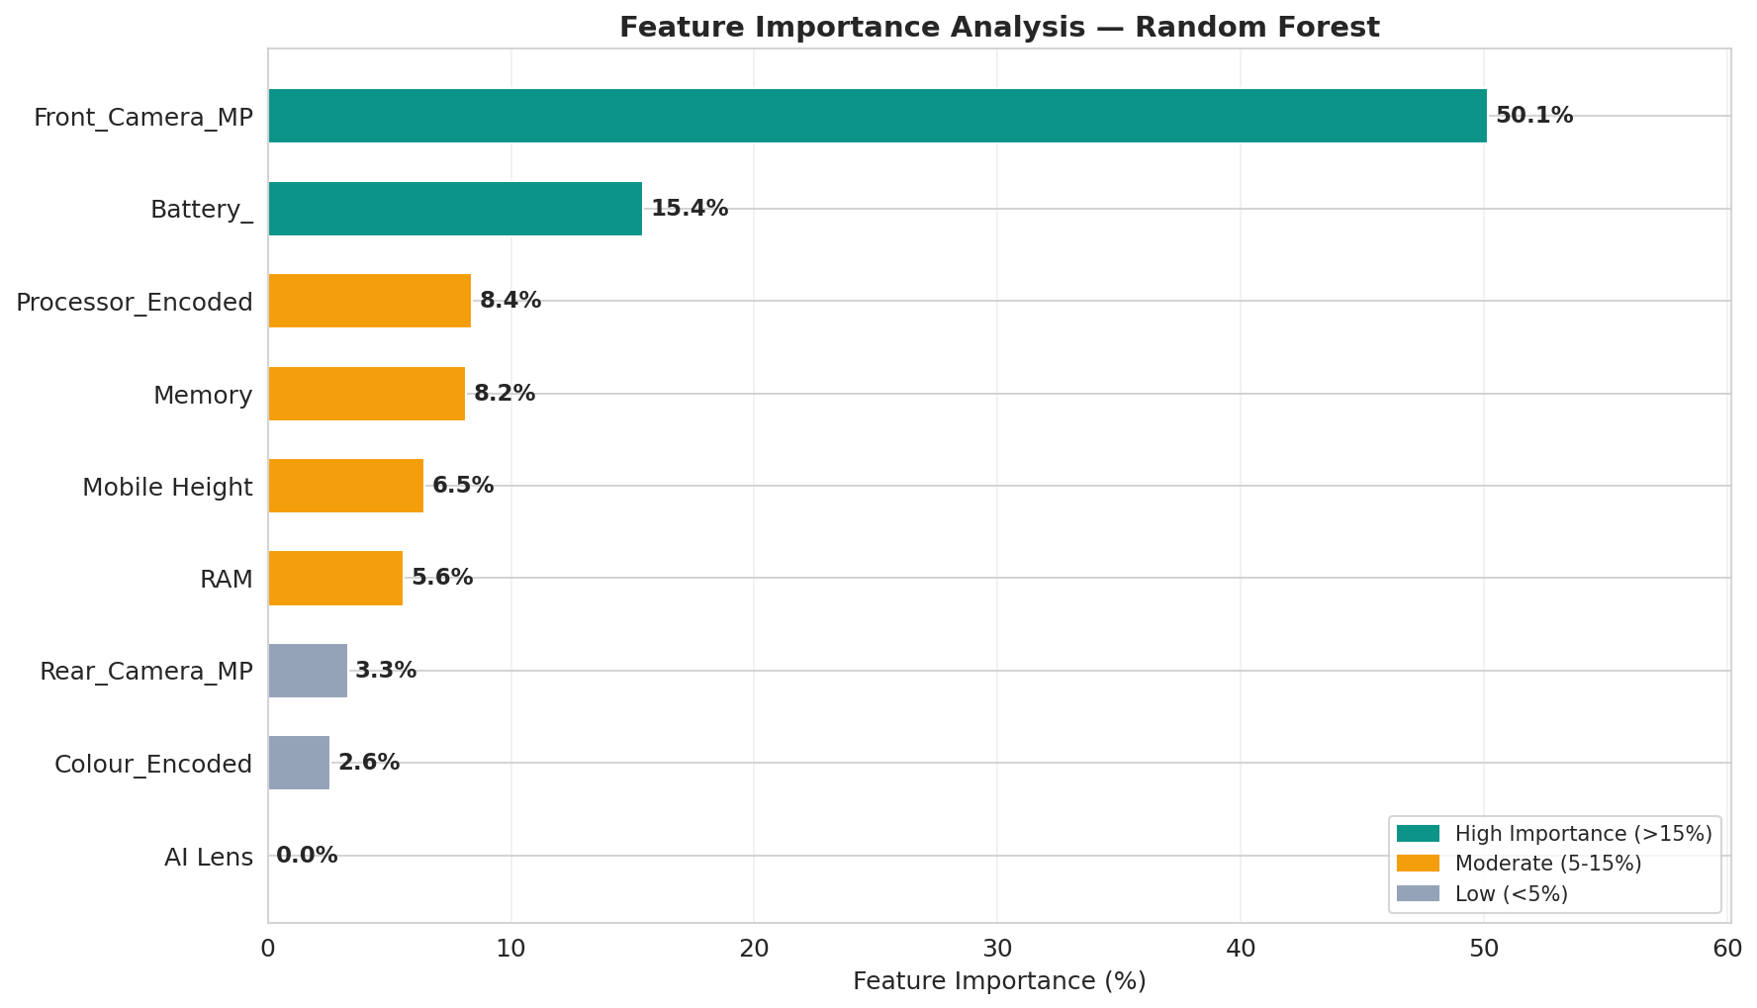
Feature Importance Analysis
Random Forest confirms which features drive mobile phone prices
🔍 Top Features Ranked
📷 Front Camera MP
50.1%
🔋 Battery Capacity
15.4%
⚙️ Processor Type
8.4%
💾 Internal Memory
8.2%
📏 Mobile Height
6.5%

Slide 13
Recommendations
Actionable pricing & marketing strategy insights
📊 Strategic Pricing Segments
🎯 Top Priority Actions
Segment
RAM
Storage
Camera
Battery
Target Price
🧠 RAM as Pricing Lever
💚 Budget
4GB
64GB
13MP
5000mAh
₹7,000–₹12,000
Use RAM tiers as primary price differentiator — it has the strongest business impact
💛 Mid-Range
6–8GB
128GB
48MP
4500mAh
₹12,000–₹20,000
📷 Camera-Led Marketing
🔵 Premium
8–12GB
256GB
64MP+
5000mAh
₹20,000–₹50,000
Promote camera specs heavily in mid-range; >48MP commands significantly higher ASP
🔴 Flagship
12–16GB
256GB+
108MP+
5000mAh
₹50,000+
⚙️ Processor Bundling
Bundle Snapdragon/Dimensity phones with extended warranty to justify premium pricing
📦 Storage Upsell
Push 128GB as mid-range standard; position 256GB as a ₹3–5K upsell opportunity
🤖 AI Integration
Integrate RF model to auto-suggest prices for new inventory based on spec sheets

Slide 14
📋 Conclusion
Project Summary & Key Takeaways
🏆 Best Model
🔍 Top Feature
Random Forest achieved R²=0.822 — explains 82.2% of price variance with MAE of ₹2,039
Front Camera MP (50.1%) is the single most important price predictor, followed by Battery (15.4%)
💡 Key Insight
📈 Business Value
Mobile phone prices follow non-linear patterns — tree-based models outperform Linear Regression significantly
The model can auto-price new inventory, detect mispriced phones, and analyse competitor pricing strategies
✅ Recommendation
🚀 Next Steps
Deploy Random Forest as the primary pricing engine, with quarterly retraining as market conditions evolve
Expand dataset, add online ratings/reviews as features, and deploy model via REST API for real-time pricing
NextHikes IT Solutions | Feature Extraction & Price Prediction | Dhiraj Sharma | 2026

