Slide 1
multiplexer
PRESENTED BY
ADITYA SHARMA
MCA 1ST YEAR
LIB ID: 2224MCA1063

Slide 2
WHAT IS MULTIPLEXER
A multiplexer is a digital circuit that has multiple input and a single output .
The selection of one of the n inputs is done by the select inputs
It has one output selected at a time.
It is also known as DATA SELECTOR.
A multiplexer has
N data inputs
1 output
M selection lines, 2^m=n

Slide 3
BLOCK DIAGRAM
8 x 1
MUX
D7
D6
D5
D4
Y
D3
D2
D1
D0
S2
S1
S0

Slide 4
TRUTH TABLE
S2 | S1 | S0 | Y
0 | 0 | 0 | D0
0 | 0 | 1 | D1
0 | 1 | 0 | D2
0 | 1 | 1 | D3
1 | 0 | 0 | D4
1 | 0 | 1 | D5
1 | 1 | 0 | D6
1 | 1 | 1 | D7

Slide 5
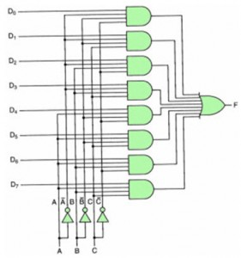
CIRCUIT DIAGRAM

Slide 6


