Slide 1
AIM:
Enabling customers to subscribe to vegetables & fruits that can be
Bought directly from farmers.
FUNCTIONALITIES :
User and Farmer can Register and login .
User can subscribe to the Products provided by farmer.
User will be able to get the Notifications for his subscribed product.
Farmer can upload his products and update the stock.
User can add product to cart and update his requirement
User can buy the products
User can give a valuable feedback to the farmer

Slide 2
FARMER2HOME
OUR ARCHITECTURE
COMPONENTS
BACKEND
SUBSCRIBE
PRODUCT
POJO CLASSES
NOTIFICATION
FARMER2HOME
CART
INTERFACES
FARMER2HOME
TEST CASES
USER
FEEDBACK
REST CONTROLLER
IMPLEMENTATION

Slide 3
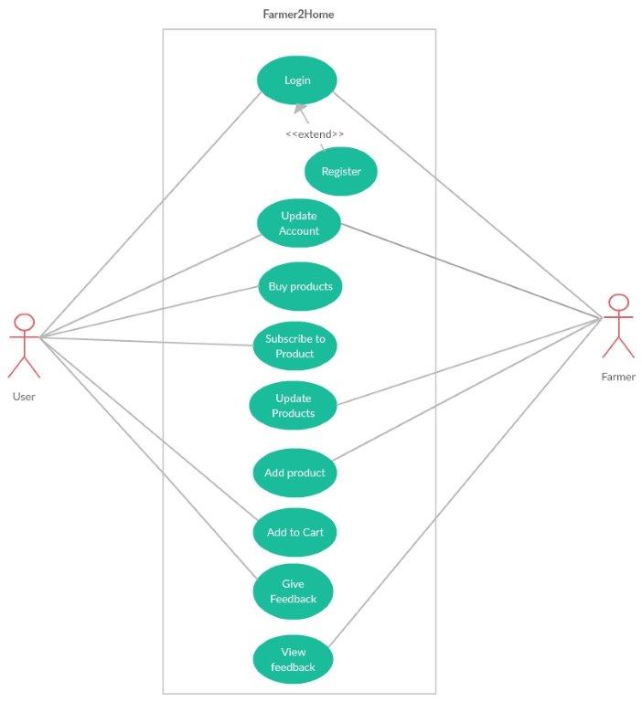
LAYOUT OF THE APPLICATION

