Slide 1
IMAGE CLASSIFICATION
CIS 544-11 Data Mining and Machine Learning
Athena Liao
Nikki Sharma

Slide 2
ANALYSIS
Models for image classification of distinct places

Slide 3
MODEL
A.
B.
C.
D.
Deep Learning
Support Vector Machine
Naïve Bayes
Random Forest

Slide 4
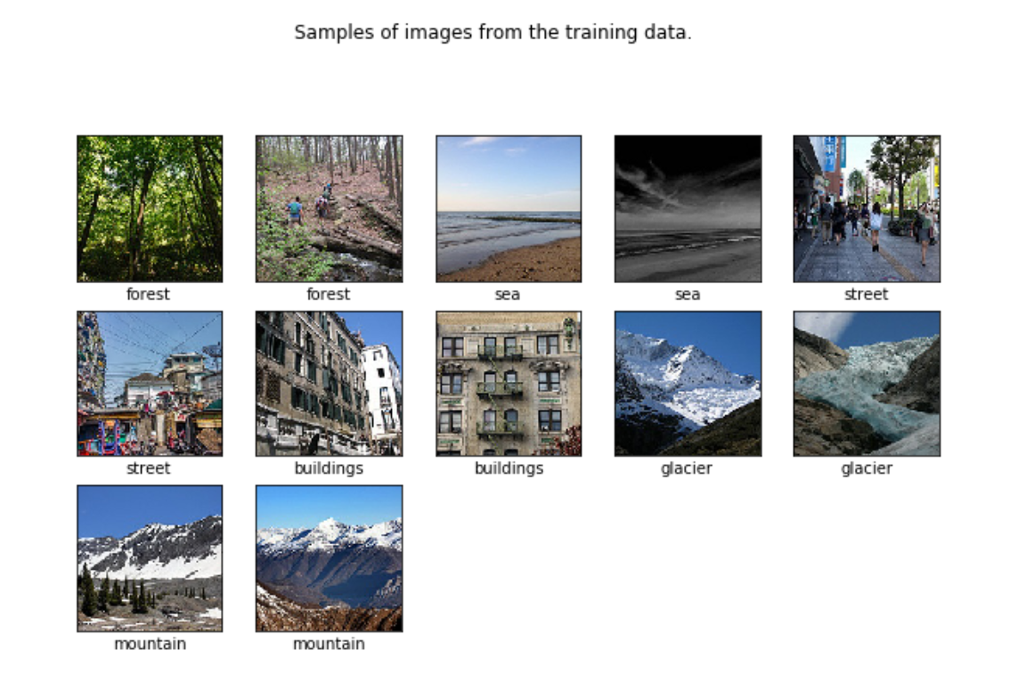
DATA PREPARATION
Label Data
Prepare Train Data
One Hot Encoding

Slide 5
DEEP LEARNING MODEL
1. Build the Model
2.Compile the Model
3.Fit the Model

Slide 6

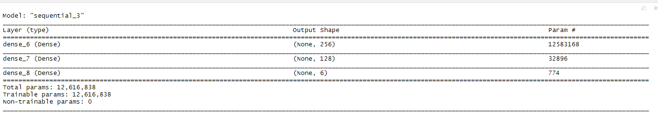


DEEP LEARNING MODEL
BUILD THE MODEL
COMPILE THE MODEL
FIT THE MODEL
Notes:
ReLU is important because it does not saturate; the gradient is always high (equal to 1) if the neuron activates.It is quick to evaluate
ReLU: It is also known as the slope and gives the rate of change of the dependent variable. ReLU is not linear. The simple answer is that ReLU output is not a straight line, it bends at the x-axis.
Softmax is an activation function. Other activation functions include RELU and Sigmoid. ... It computes softmax cross entropy between logits and labels. Softmax outputs sum to 1 makes great probability analysis.

Slide 7
DEEP LEARNING MODEL
Train Data
Test Data
01.
02.
Accuracy : 0.3556982
Loss : 14.96507
Accuracy : 0.3314724
Loss : 15.24046

Slide 8
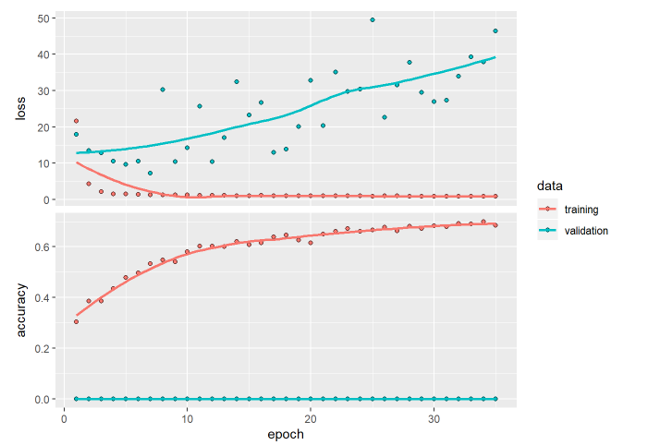
ACCURACY AND LOSS

Slide 9
NAÏVE BAYES

Slide 10
STEPS
1.
Data Preparation
2.
Fit the Model
3.
Prediction

Slide 11
NAÏVE BAYES
Accuracy : 45.2%
Naïve Bayes | Precision | Recall
Class 0 | 0.466 | 0.186
Class 1 | 0.564 | 0.797
Class 2 | 0.385 | 0.502
Class 3 | 0.391 | 0.603
Class 4 | 0.3497 | 0.265
Class 5 | 0.5810 | 0.403

Slide 12
Naïve Bayes
Area under the curve: 0.6196

Slide 13
SUPPORT VECTOR MACHINE

Slide 14
Support Vector Machine
Accuracy : 38.9%
SVM | Precision | Recall
Class 0 | 0.2612 | 0.248
Class 1 | 0.684 | 0.6111
Class 2 | 0.380 | 0.353
Class 3 | 0.323 | 0.4948
Class 4 | 0.292 | 0.273
Class 5 | 0.448 | 0.389

Slide 15
Support Vector Machine
Area under the curve: 0.5594

Slide 16
RANDOM FOREST

Slide 17
Random Forest
Accuracy : 48.7%
RF | Precision | Recall
Class 0 | 0.459 | 0.310
Class 1 | 0.5611 | 0.710
Class 2 | 0.433 | 0.445
Class 3 | 0.421 | 0.649
Class 4 | 0.474 | 0.277
Class 5 | 0.502 | 0.539

Slide 18
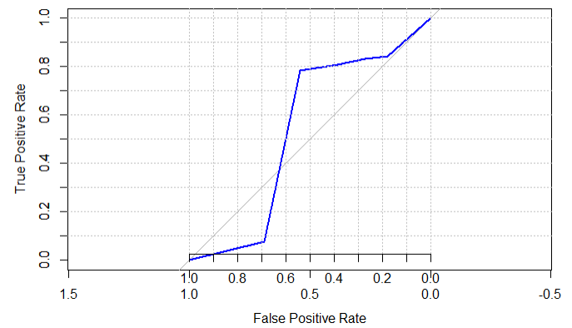
Random Forest
Area under the curve: 0.635

Slide 19
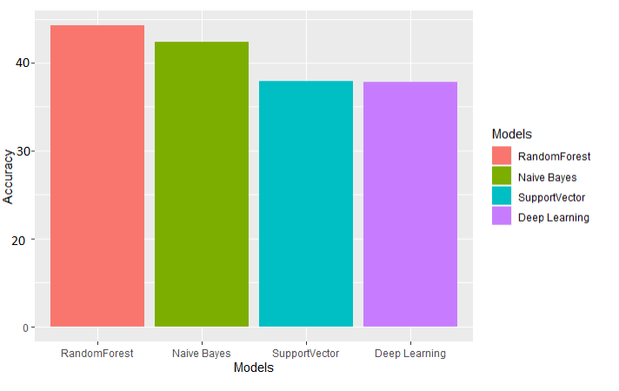
HYPOTHESIS TESTING
ANOVA TEST
p value : <2e-16
Reject Null Hypothesis :
Results are statistically significant

Slide 20
THANK YOU

