Slide 1
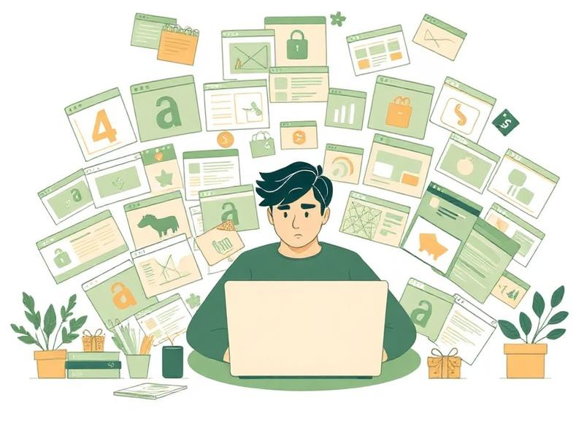
NoGiftCards
"dont buy giftcards, you coward"
The Problem
🎁 47 tabs open. Still buying a candle.
🤦 Gift cards = zero effort energy
💀 "What do they even like?"
Gift-giving is broken. We're fixing it.

Slide 2

How It Works
4 steps. Zero brain cells required.
1
2
3
4
Describe
Analyze
Hunt
Buy
→
→
→
Tell us about them
(or not lol)
"Likes cats, hates mornings."
AI extracts their
personality & interests.
Browser Use agent
searches the real web.
Ranked results with
direct purchase links.
Describe → Analyze → Hunt → Buy

Slide 3
What your friend actually says:
Your friend will love these:
Honestly I could spend all weekend just cooking something new and exploring trails nearby
BioLite CampStove 2+
CAMP
Lightweight, charges your phone while you cook
Lol I know, I'm obsessed with anything outdoors lately
$129.95
Perfect match
Buy Now →
You should get a camping stove! That way you can cook outside too
▶
Victorinox Swiss Chef Knife
CHEF
Wait that sounds SO me haha, something compact though
Pro kitchen quality, compact and easy to clean
$49.95
Top pick
Buy Now →
We analyzed this conversation...
Outdoorsy
Home cook
Minimalist
Osprey Daylite Pack 13L
PACK
Minimal design, fits all trail essentials
$75.00
Trending
Buy Now →
From conversation → to cart-ready gifts in seconds.

Slide 4
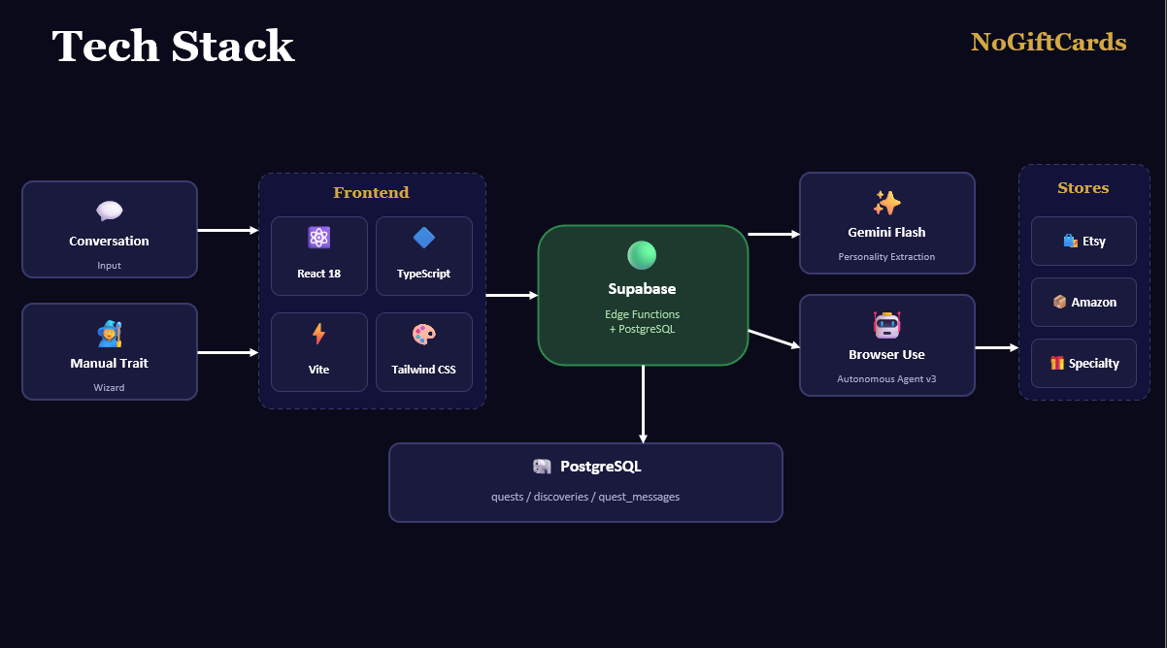
Tech Stack
NoGiftCards
Frontend
✨
Stores
💬
Conversation
⚛️
🔷
Gemini Flash
🛍️ Etsy
🟢
Personality Extraction
Input
React 18
TypeScript
Supabase
📦 Amazon
🧙
Edge Functions
+ PostgreSQL
🤖
⚡
🎨
Manual Trait
Browser Use
🎁 Specialty
Vite
Tailwind CSS
Autonomous Agent v3
Wizard
🐘 PostgreSQL
quests / discoveries / quest_messages

Slide 5
What's Next
👤 Saved Profiles — remember people you love (finally)
👥 Group Gifting — pool money, not ideas
📊 Gift Analytics — track what landed, what flopped
Gift-giving deserves better.
NoGiftCards — dont buy giftcards, you coward

