Slide 1


Dark ship
watch
27/10/2026
Finding ships that go silent in the Gulf of Finland, and showing where they could have been.
ADBMS mini project case study
E004 Ojas Sharma
E024 Shamika Daga
E025 Tanusha Daga
1

Slide 2

Introduction
to our project
27/10/2026
Every big ship carries a radio called AIS, which keeps sending its position, speed and direction.
We collect this live data for free from the Finnish government and keep it in a database.
The database checks every record, remembers where each ship is, and keeps its whole history.
A website then shows everything on a live map of the Gulf of Finland.
2

Slide 3
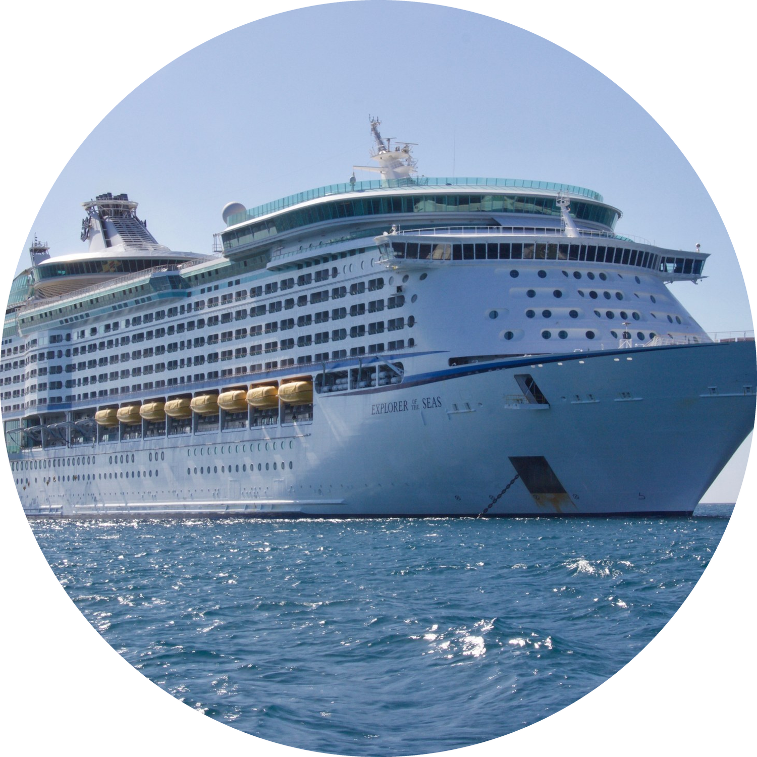
Problem
statement
27/10/2026
Sometimes a ship switches its radio off on purpose, which can hide something illegal.
But most ships that go silent have a normal reason, such as being in port or out of radio range.
Our problem was to tell a normal silence from a suspicious one, and to show where a suspicious ship could have been.
Silent does not always mean suspicious.
3

Slide 4
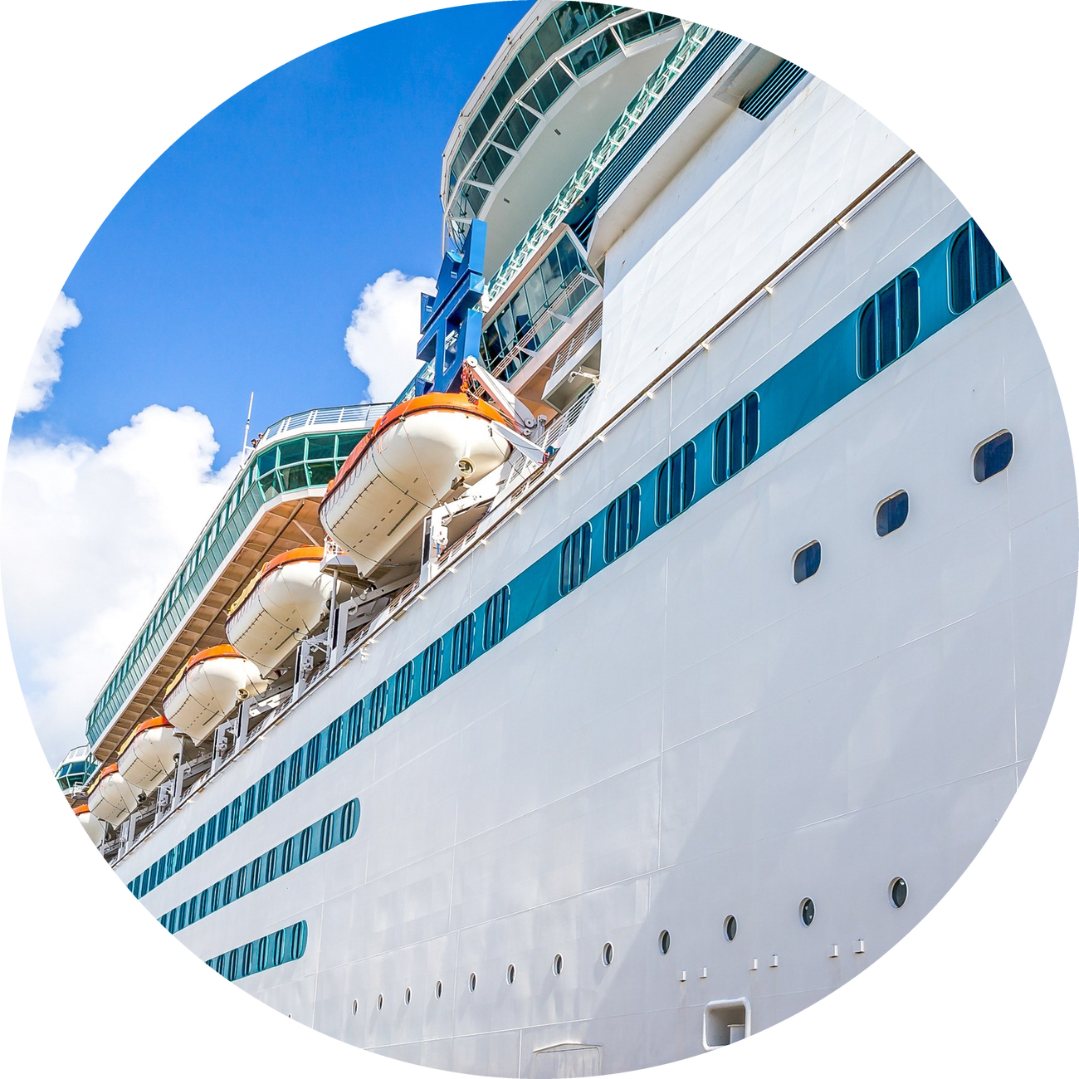
Where the data
comes from
27/10/2026
Ships. Ship positions come from Digitraffic, a free service of the Finnish Transport Infrastructure Agency (meri.digitraffic.fi). We ask for them every minute.
Ship details such as name, size and destination come from the same service every 10 minutes.
Weather and maps. Wind comes from the Finnish Meteorological Institute (opendata.fmi.fi) every 10 minutes, and waves and sea state come from the same institute and Digitraffic every 30 minutes.
The land map is from Natural Earth (naturalearthdata.com), and eight ports were typed in by hand. Both were loaded once.
4

Slide 5
What we
built
27/10/2026
1
The collector. A small program that runs all day. It asks the data sources for news every minute and hands the data to the database.
2
The database. PostgreSQL with PostGIS, which understands maps. It checks, stores and remembers everything, and finds the silent ships.
3
The website. A live map and several pages that show what the database knows. It is built with Python and Leaflet.
5

Slide 6
How data is
collected and checked
27/10/2026
1
Collect. The collector asks each source for new data on its own timer, and tries again if one fails.
2
Wait. New ship records first land in a waiting table, where nothing is checked yet.
3
Check. The database tests every record. For example, it looks for impossible positions, speeds that are too high, and duplicates.
4
Store. Good records are saved in the movement history, and the ship’s latest position is updated.
5
Refuse. Bad records are not lost. They are kept together with the reason they were refused.
In total the database makes nine checks, all as one all-or-nothing step. So far it has stored 105,757 positions and refused 396 records, mostly from one transmitter that reports an impossible speed.
6

Slide 7
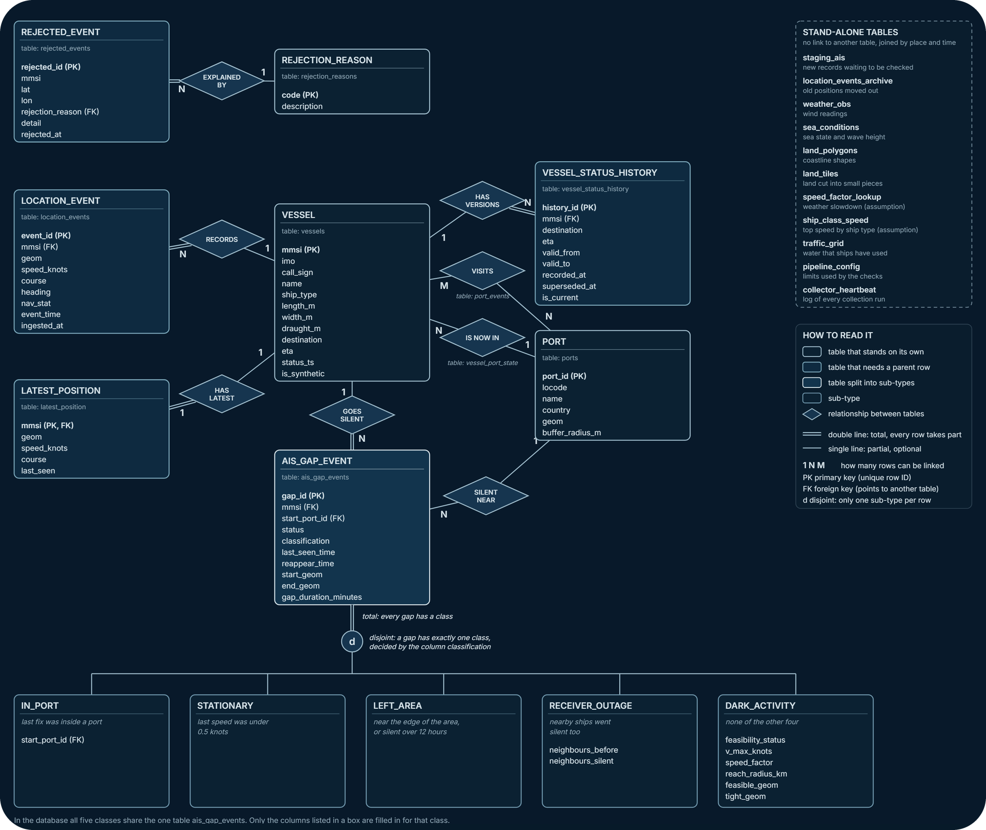
Database
design
27/10/2026
The database has 21 tables. We store ship details, the full movement history, each ship’s latest position, refused records, destination history, ports, silences, weather and land.
Each box in the diagram is a table, and the diamonds show how tables are linked.
Rules inside the database keep the data clean. A ship cannot have two positions at the same time, and two versions of a destination can never overlap.
7

Slide 8
How we mapped to
the three tracks
27/10/2026
1
Mobile, the main track. Ships keep moving, so we keep the latest position of each ship and the full movement history. Duplicates, wrong coordinates and impossible jumps are rejected.
2
Temporal, a bonus track. A ship’s destination and arrival time change. We never overwrite them. Every change becomes a new version, with the time it was true and the time we learned it.
3
GIS, a bonus track. Place is part of the data. Ports are 3 km zones, land is stored as map shapes, and each suspicious silence gets a possible area with the land removed.
8

Slide 9
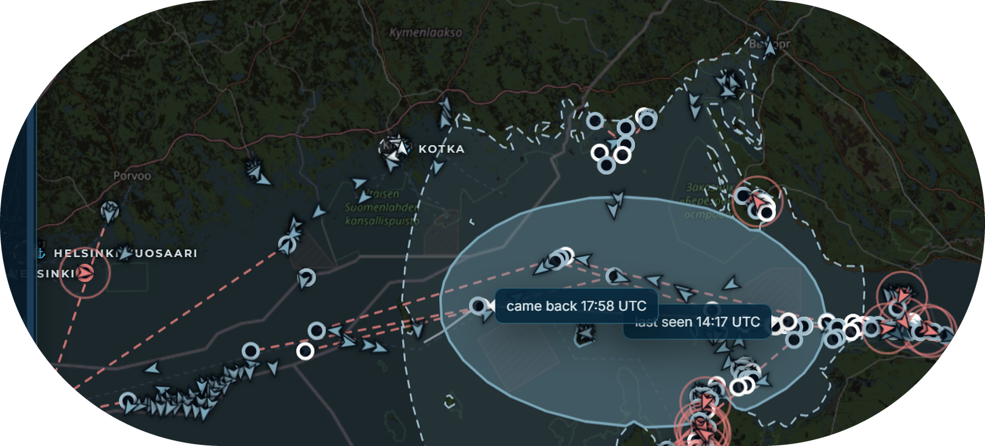
Going dark and
the possible area
27/10/2026
When a ship stays silent for 20 minutes, the database asks four questions.
Was the ship in a port? Was it parked? Did it leave our area? Did the ships around it also go silent?
If the answer to all four is no, the ship is going dark.
A real case: the cargo ship TONGAN, silent for 3 hours and 41 minutes.
The possible area. For such a ship we draw the sea area it could have reached. We use its top speed, the weather and how long it was silent. The area shows what was possible, not what really happened.
9

Slide 10
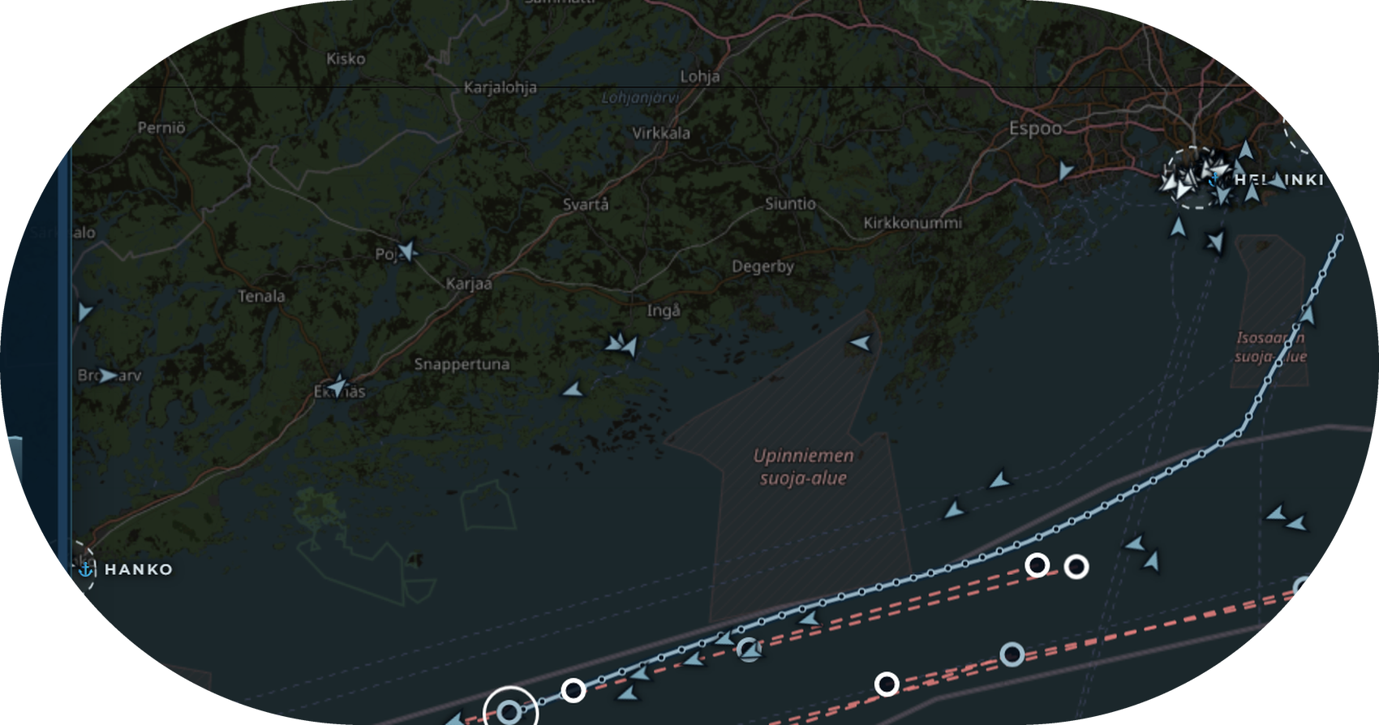
Website:
live tracking
27/10/2026
Every ship is an arrow on the map. Blue ones move, grey ones are parked, white ones are in port and red ones are going dark.
Click a ship to see its speed, its destination and its last 12 hours, and press Replay to watch its trail.
Layers show ports, wind, waves and busy sea lanes.
Demo controls load clearly marked demo ships, so every case can be shown on demand.
10

Slide 11
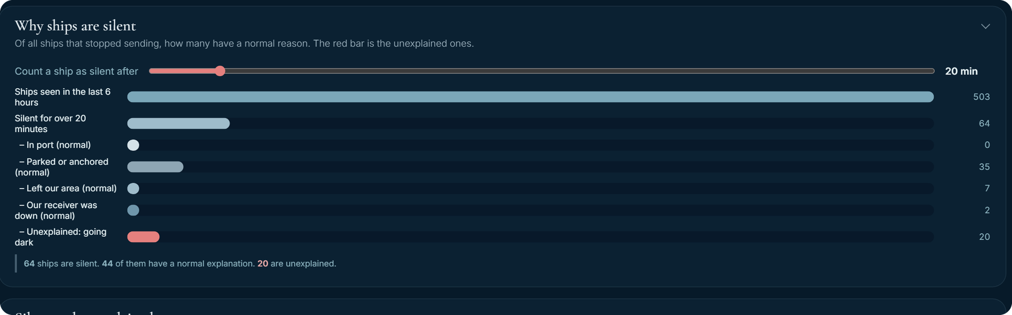
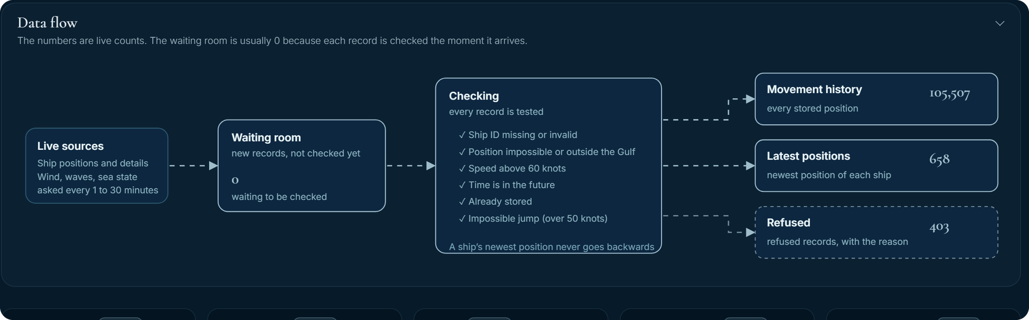
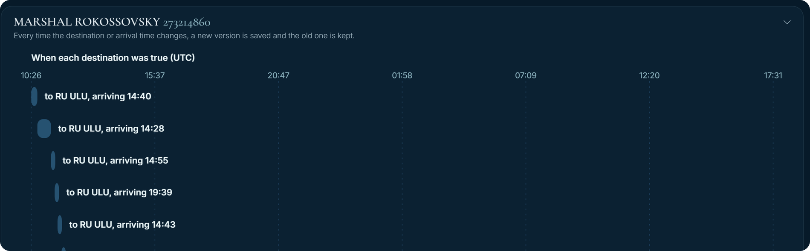
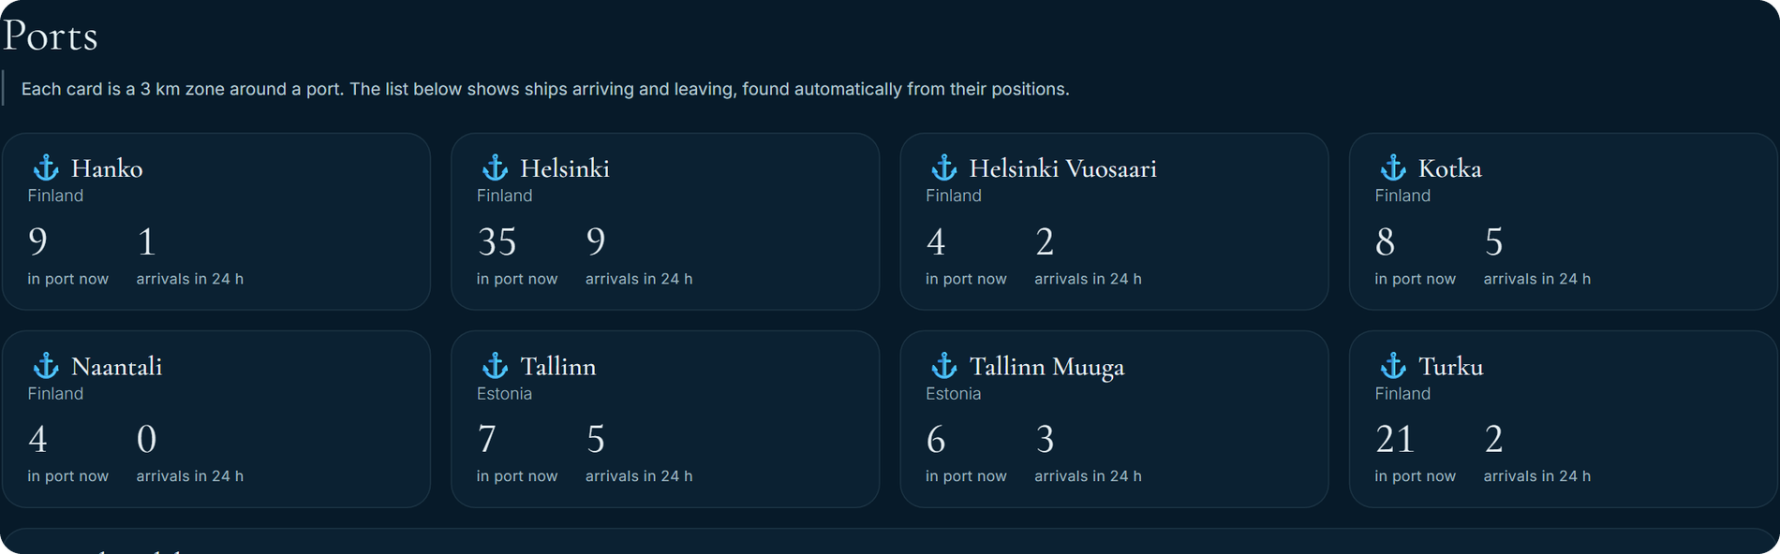
Website:
the other pages
27/10/2026
Going Dark: how many silences have a normal reason and how many do not.
Pipeline: how data flows in, with live counts and refused records.
Temporal: every version of a ship’s destination over time.
Ports: ships inside each port zone, and the arrivals and departures.
11

Slide 12
What the DBA does
in the background
27/10/2026
Safe data. Every record is checked before it is stored, and bad records are refused with a reason.
Permissions. The collector may only add data, and the website may only read it. We tested this with 15 real attempts, and all behaved correctly.
Speed. An index made one search more than 6,000 times faster in our test on 400,000 rows. We measured this ourselves.
Safety net. Two people can change the same ship without losing data, and a backup is restored into a test database and compared.
12

Slide 13
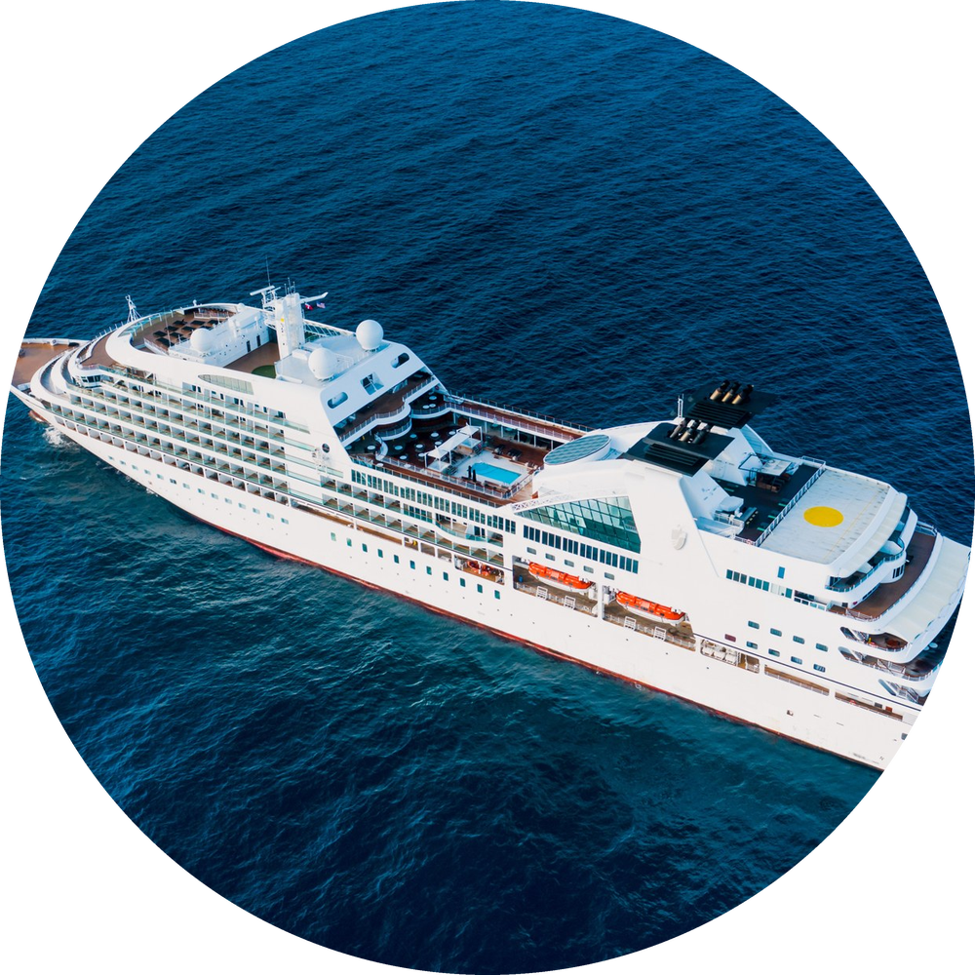
Conclusion
what we learned
27/10/2026
We built a complete live system, from raw ship radio data to a map on screen.
The database does the important work: it checks, remembers, notices and sorts the data.
It tells normal silences from suspicious ones, and shows where a suspicious ship could have been.
The limits are that the land map is rough around islands, and that our speed and weather tables are our own assumptions.
Next, we will show the live map and a going-dark ship, the database tables and refused records, the permission and speed tests, and the backup and monitoring page.
13

Slide 14
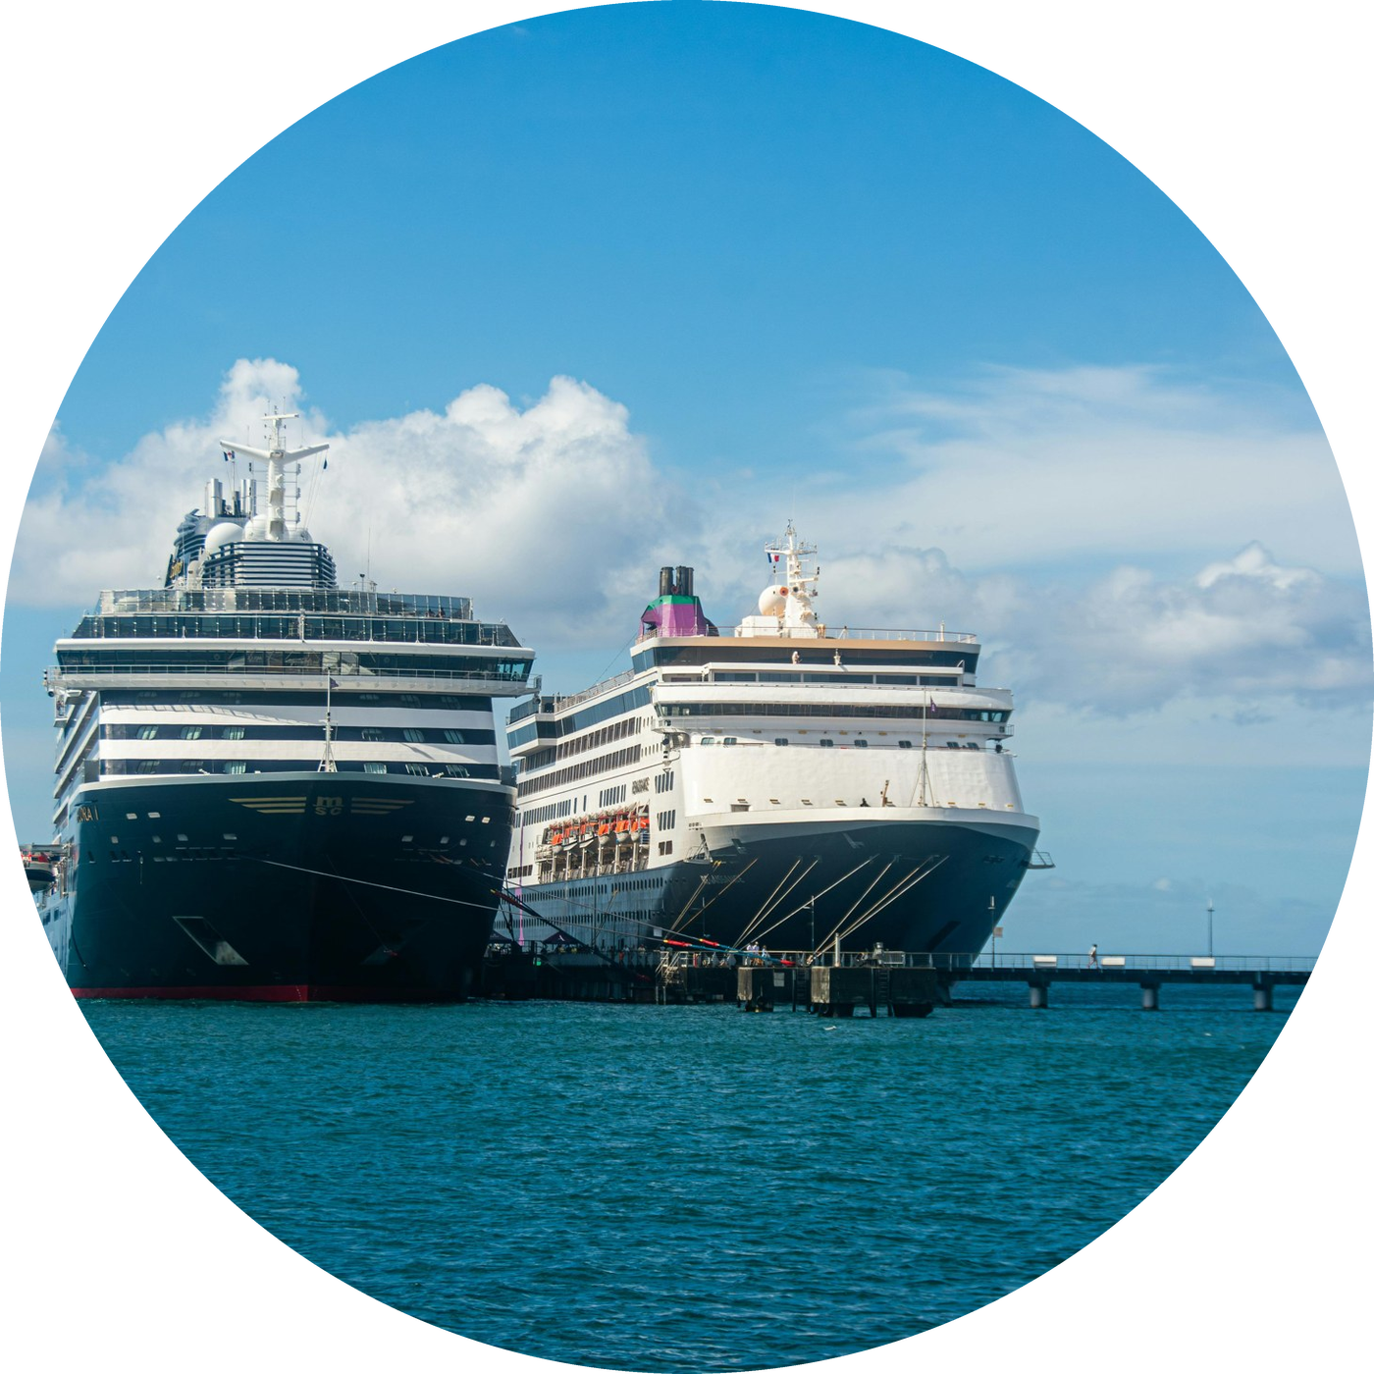
Thank you!
27/10/2026
14

