Slide 1
Stroke Prediction
Pranoti Sharma
Data Science Intensive Capstone Project, June 1st 2021

Slide 2
Problem
World Health Organization (WHO) stroke is the 3rd leading cause of death and 2nd leading cause of disability worldwide. It is also a leading cause of dementia and depression. According to the WHO stroke is responsible for 11% of total deaths world wide. WHO studies have found that preventive strategies have proved effective in reducing stroke mortality.
Identifying if a person can get stroke will help the health care professionals to come up with effective prevention strategies including lifestyle changes

Slide 3
Purpose
Predict if a person is at high risk of getting stroke.

Slide 4
Who Might Care?
Health Care Professionals.
Individuals
Health Organizations

Slide 5
Factors that can cause stroke
Diabetes
Heart Disease
Hypertension
High BMI
Smoking

Slide 6
Data Information
The data set is a CSV file collected from Kaggle
https://www.kaggle.com/fedesoriano/stroke-prediction-dataset
Data contains patients information like,
Average Glucose Level
Gender
Age
BMI
hypertension
heart disease
stroke.
work type
residence type
smoking habit
marital status.

Slide 7
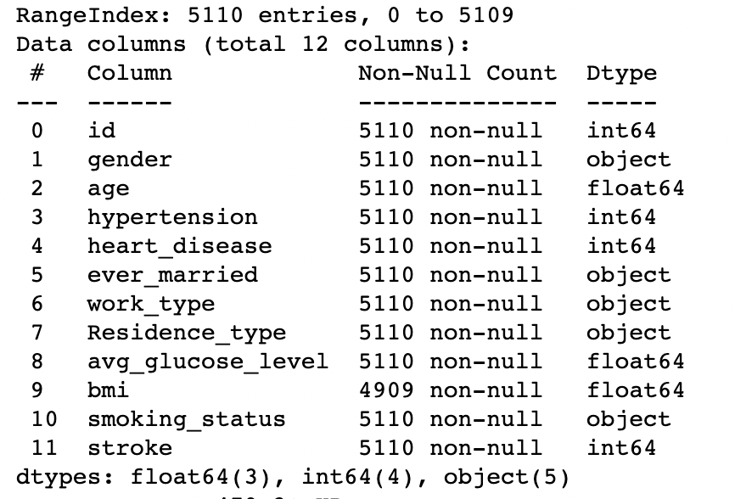
Data Wrangling
Data Exploration
5110 rows
12 columns
Data Types
Categorical
Numeric

Slide 8
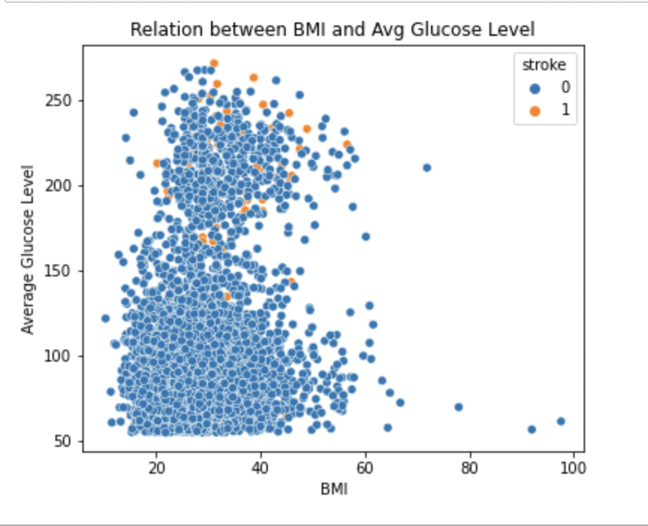
Exploratory Data Analysis
Data Imputation: 201 missing bmi values were replaced with mean bmi value
Visual Analysis of the numeric features and the dependent feature

Slide 9
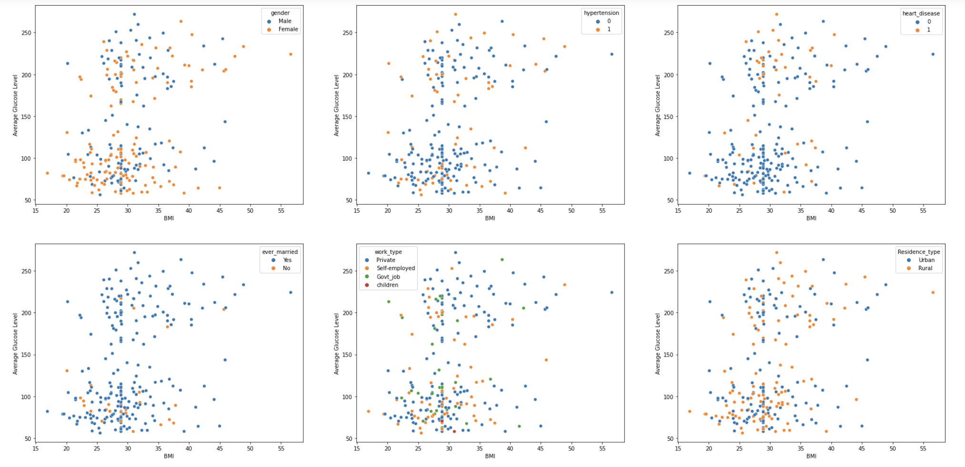
Exploratory Data Analysis
Visual Analysis of categorical and numeric column features

Slide 10
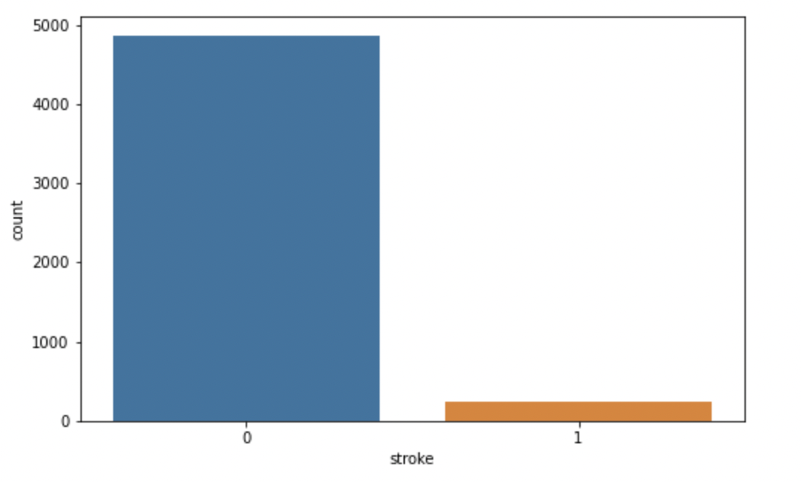
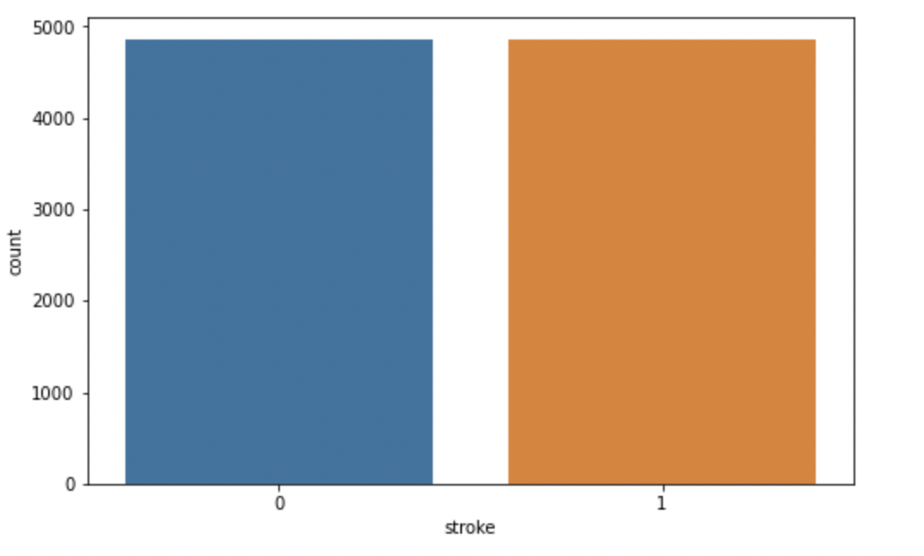
Data Preprocessing
Dummy Variables: Achieved using dummy values 0 and 1
gender -> 'Male', 'Female'
ever_married -> 'Yes', 'No'
work_type -> 'Private', 'Self-employed','Govt_job', 'children', 'Never_worked'
Residence_type -> 'Urban', 'Rural'
smoking_status -> 'formerly smoked', 'never smoked', 'smokes', 'Unknown'
Dataset width increased from 12 columns to 21 columns
Class Imbalance: Achieved using resampling technique
Original Data
Resampled Data
Records with no stroke: 4860
Records with stroke: 250
Records with no stroke: 4860
Records with stroke: 4860

Slide 11
Data Modeling
Overview:
Type : Supervised Learning
Binary Classification: 0 No risk of stroke, 1 High risk of stroke
Tools: Python’s scikit learn

Slide 12
Modeling Steps
Step1:
Data Splitting
80% training set
20% testing set
Data Scaling
Step 2:
Hyperparameter Optimization
RandomSearchCV with random grid and cv=3
RandomForestGridSearchCV with cv=5
Step 3:
Creating and training 4 different models
KNNClassifier
RandomForestClassifier
DecisionTree
LogisticRegression
Step 4:
Performance Evaluation
Model metrics
ClassificationReport
ROC curve

Slide 13
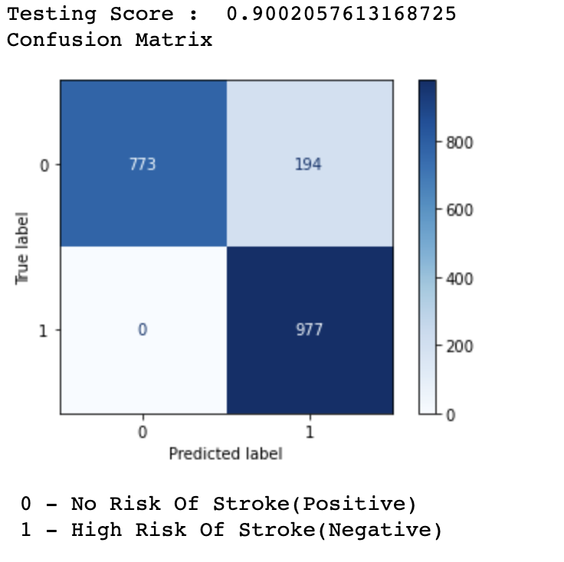
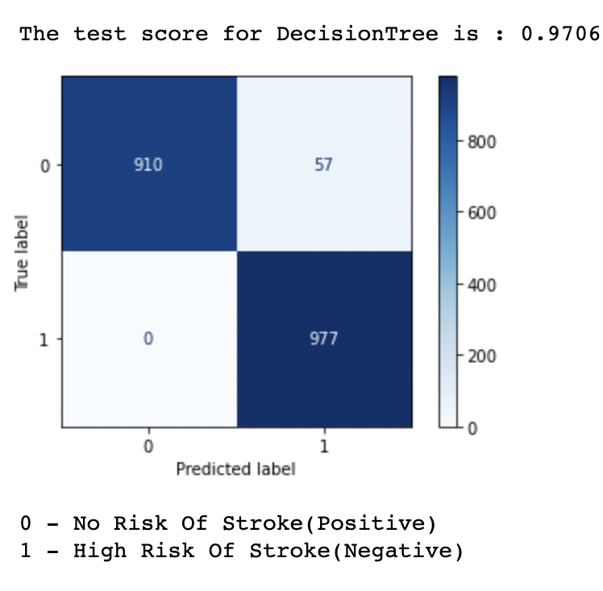
Model Outcomes
KNeighborsClassifier:
Test Score: 90%
967 actual no risk values:
773 correct predictions
194 inaccurately predicted to be at high risk
977 actual high risk values:
977 correct predictions
0 inaccurately predictions
DecisionTree:
Test Score: 97%
967 actual no risk values:
910 correct predictions
57 inaccurately predicted to be at high risk
977 actual high risk values:
977 correct predictions
0 inaccurately predictions

Slide 14
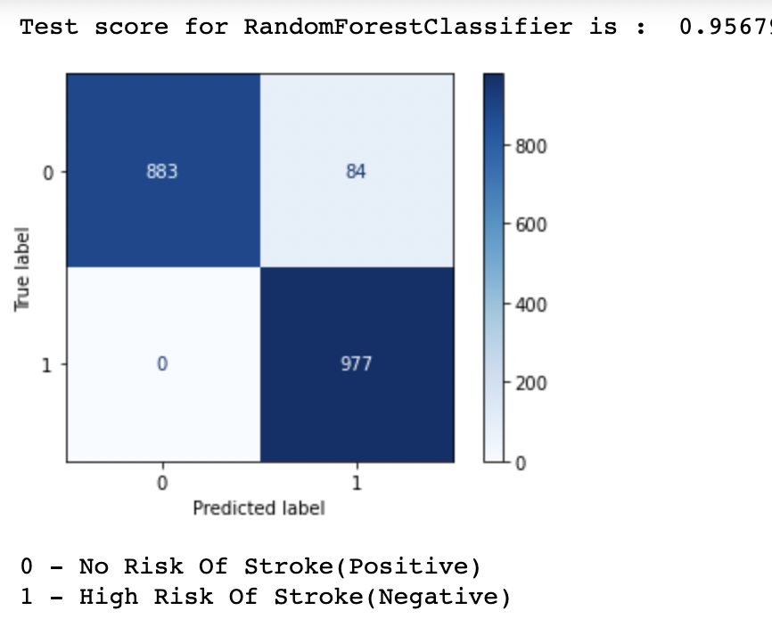
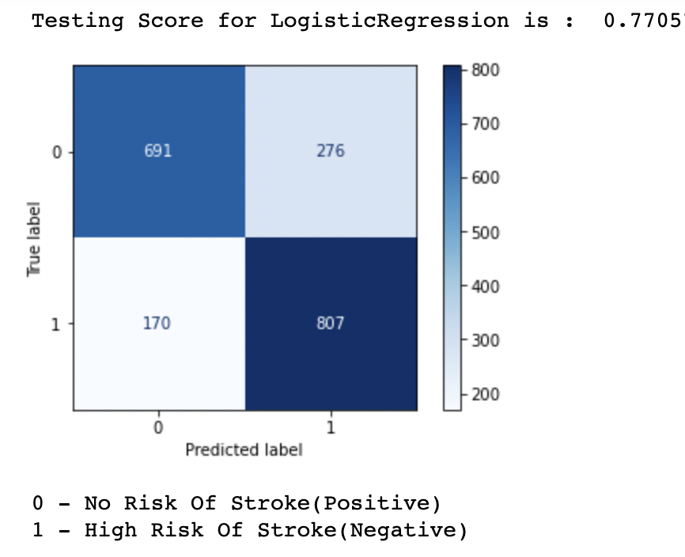
Model Outcomes
RandomForestClassifier:
Test Score: 95%
967 actual no risk values:
773 correct predictions
194 inaccurately predicted to be at high risk
977 actual high risk values:
977 correct predictions
0 inaccurately predictions
LogisticRegression:
Test Score: 77%
967 actual no risk values:
691 correct predictions
276 inaccurately predicted to be at high risk
977 actual high risk values:
807 correct predictions
170 inaccurately predictions

Slide 15
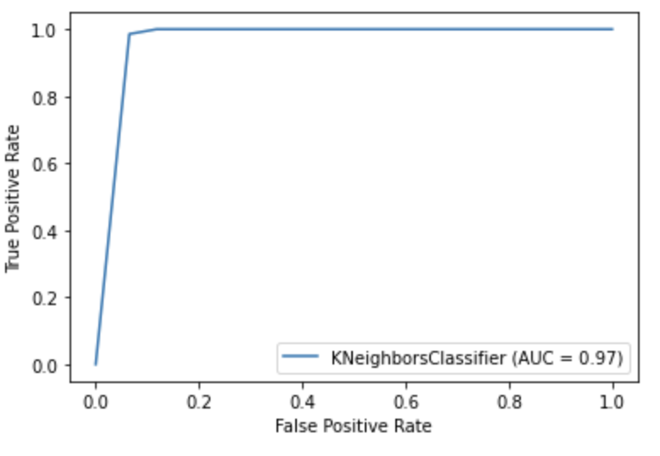
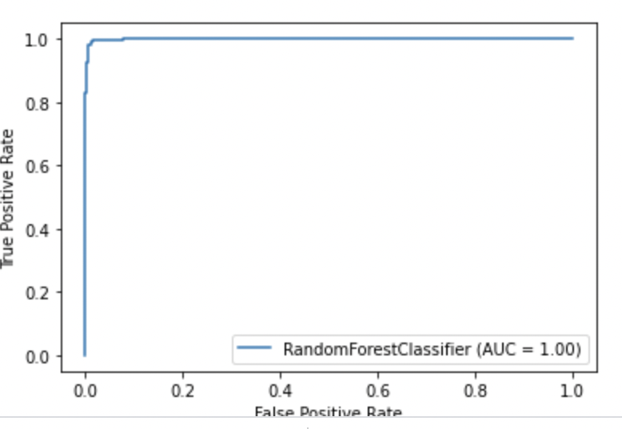
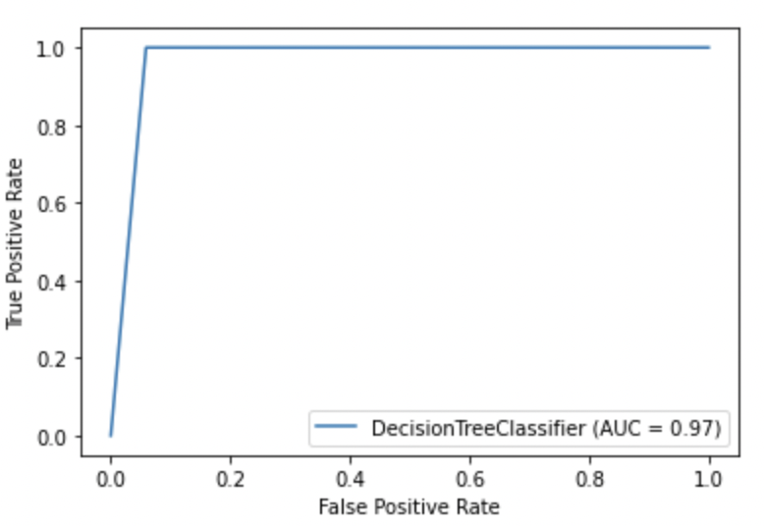
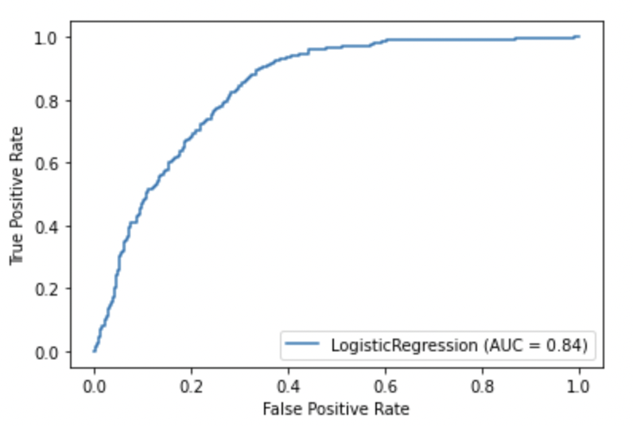
ROC Curve
RandomForestClassifier
KNeighborClassifier:
LogisticRegression:
DecisionTree:

Slide 16
Conclusion
Overview:
Model: RandomForest is the best generalized model compared to the other models implemented
Model Performance: Model has the accuracy rate of 95%
Predictions: The model is balanced and is sensitive towards predicting people with high risk of getting a stroke.

Slide 17
Future Scope
Overview:
Model can be expanded further to predict the risk of mortality along with high risk of getting stroke by
consider features like,
Geological
Country and Region of residence
Medical Facility
Economical
Household income
Number of members in family

