Slide 1
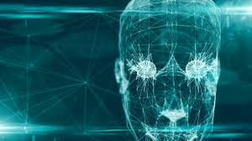
1
Age Classification And Gender Prediction Model
15.AUGUST.2020
Created By,
Ritik Sharma
Reviewed By,
Rekha R.
iHub IT Solutions
Soorya Complex, Soorya IT Park Mangalore ihubonline.co

Slide 2
AIM
Age classification and Gender prediction
Project Overview
Age and Gender prediction using Deep Learning based Face Detector in OpenCV for face detection and pretrained Age and Gender caffe models for Age Classification and Gender prediction
Library Used
OpenCV(cv2)
math
time
argparse
Explanation For Each Library Used

Slide 3

1.OpenCV
OpenCV (Open Source Computer Vision Library) is an open source computer vision and machine learning software library. OpenCV was built to provide a common infrastructure for computer vision applications and to accelerate the use of machine perception in the commercial products. Being a BSD-licensed product, OpenCV makes it easy for businesses to utilize and modify the code
Features of OpenCV Library
Using OpenCV library, you can −
>Read and write images
>Capture and save videos
>Process images (filter, transform)
>Perform feature detection
>Detect specific objects such as faces, eyes, cars, in the videos or images.
>Analyze the video, i.e., estimate the motion in it, subtract the background, and track objects in it.
Installation of cv2(openCV) for windows users
->Run this command to your command line with desired environment active
>pip install opencv-python
2.time
Python program can handle date and time in several ways. Converting between date formats is a common chore for computers. Python's time and calendar modules help track dates and times
Use of time library in project
Use to find total execution time taken by the model for giving the output

Slide 4
3.math
The Python Math Library provides us access to some common math functions and constants in Python, which we can use throughout our code for more complex mathematical computations. The library is a built-in Python module, therefore you don't have to do any installation to use it
Use of math library in project
Use to extract common mathematical operations like Mean,Median,Max,Min etc in the code
4.argparse
argparse is the “recommended command-line parsing module in the Python standard library.” It’s what you use to get command line arguments into your program
parser=argparse.ArgumentParser(description='Use this script to run age and gender recognition using OpenCV.') parser.add_argument('--input', help='Path to input image or video file. Skip this argument to capture frames from a camera.')
We first create a parser object with a description. Then the variable input is created using parser.add_argument(). The type of the variable is set to string and a help message is provided.

Slide 5
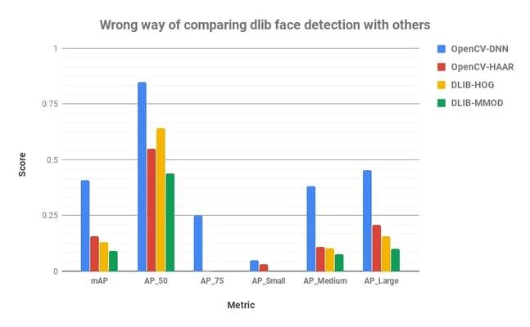
Face Detection Algorithm Used
Deep Learning based Face Detector in OpenCV
This model was included in OpenCV from version 3.3. It is based on Single-Shot-Multibox detector and uses ResNet-10 Architecture as backbone. The model was trained using images available from the web, but the source is not disclosed. OpenCV provides 2 models for this face detector
Floating point 16 version of the original caffe implementation ( 5.4 MB )
8 bit quantized version using Tensorflow ( 2.7 MB )
!! We are Using Tensorflow version of face detector in the project
dnn face detector
Why DNN Face Detector
Precision scores of 4 models
-> Most accurate out of the four methods
-> Works for different face orientations – up, down, left, right, side-face etc
-> Detects faces across various scales ( detects big as well as tiny faces )
!! Note : dlib face detector cannot detect small scale faces and able to detect faces of size upto ~(70×70)

Slide 6
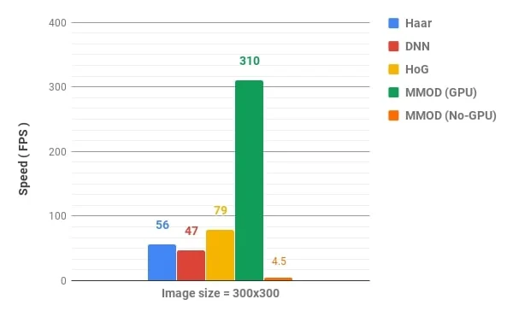
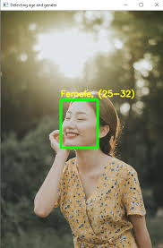
Speed Comparison
-> Dlib HoG is the fastest method on CPU. But it does not detect small sized faces ( < 70x70 )
-> DNN face detector Runs at real-time on CPU
So considering all the points we are taking use of DNN face detector in the project
Age and Gender Pretrained Caffe Models
Lets First Understand Caffe..
CAFFE (Convolutional Architecture for Fast Feature Embedding) is a deep learning framework, originally developed at University of California, Berkeley. It is open source, under a BSD license. It is written in C++, with a Python interface
A caffe model has 2 associated files
1.prototxt — The definition of CNN goes in here. This file defines the layers in the neural network, each layer’s inputs, outputs and functionality..
(In the project age_deploy.prototx and gender_deploy.prototxt are two prototxt files used)
2.caffemodel — This contains the information of the trained neural network (trained model)..
(In the project age_net.caffemodel and gender_net.caffemodel files are used)

Slide 7
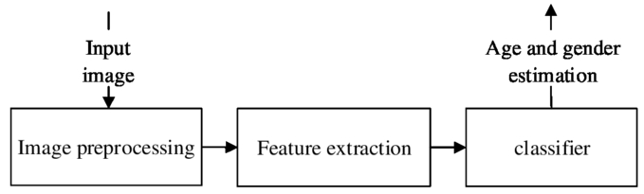
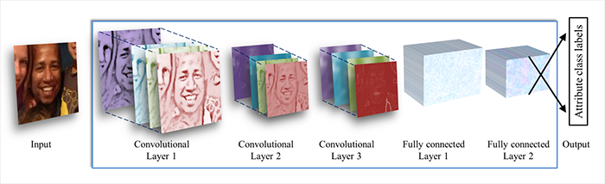
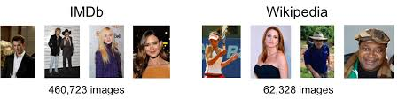
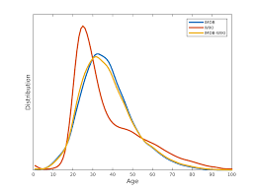
model pipeline
age and gender detector deep learning model
architecture
Dataset Used For Training Of Age And Gender Models
IMDB-WIKI dataset
(this is the largest publicly available dataset of face images with gender and age labels for training)
Age distribution in dataset

Slide 8
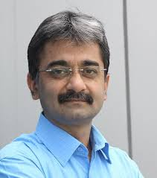
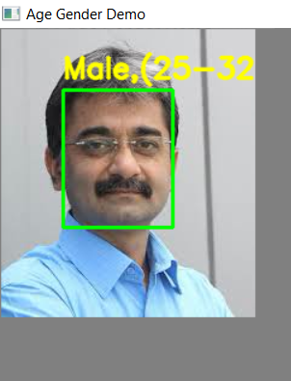
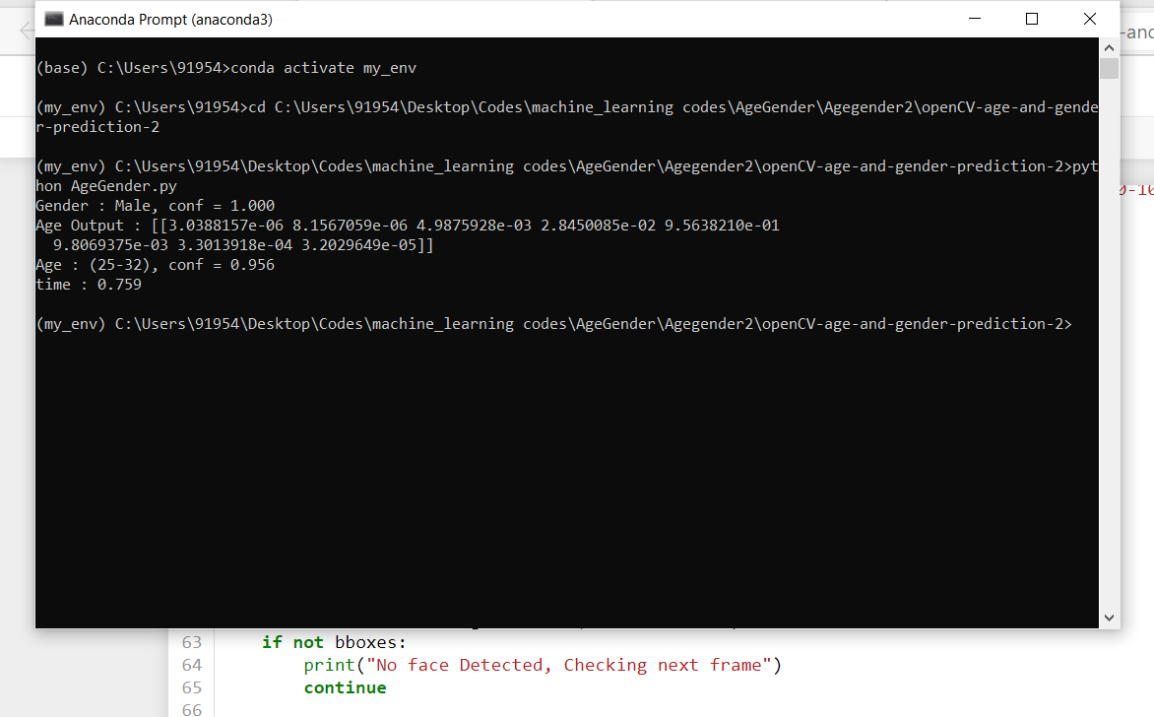
Model Result
input to the model
Output
Command window's output display

Slide 9
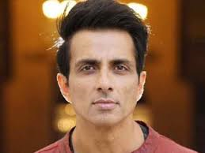
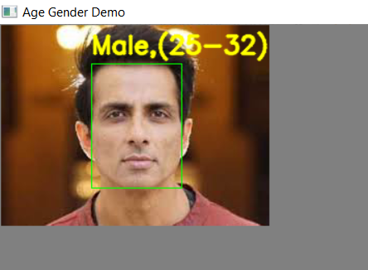
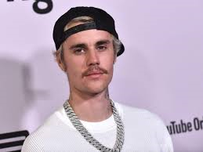
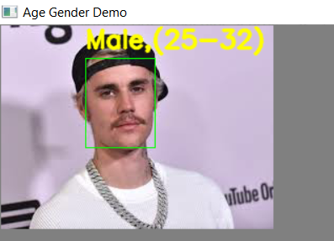
AgeGender Model
input to the model
output of the model
!!! Now we can see that actor sonu sood age is 47 years old born on 30 July 1973 but model is predicting his age in interval 25-32 which is wrong classification but it is giving the right gender output
input to the model
output
Now we can see that singer justin bieber age is 26 and our model is classifying his age in right interval 25-32 and gender prediction is right as well

Slide 10
References
https://www.learnopencv.com/face-detection-opencv-dlib-and-deep-learning-c-python/
(for face detection)
https://www.pyimagesearch.com/2020/04/13/opencv-age-detection-with-deep-learning/
(for age detection)
https://towardsdatascience.com/predict-age-and-gender-using-convolutional-neural-network-and-opencv-fd90390e3ce6
(for Age and Gender model)
Source Code and pretrained models for the project
https://github.com/SharmaRitik/Age-Classification-And-Gender-Prediction.git

