Slide 1
Project Management and Team Collaboration Tool
Technology Stack: React.js | Java Spring Boot | MySQL
Team Members:
• Ritikesh Kumar – 22781A05H4
• Amit Kumar – 22781A05H1
• Ajit Kumar – 22781A05H0
• Aryan Kumar – 22781A05E7
Project Guide:
Vijay Kumar K.S
Mentor
SVCET Autonomous | CSE | 2025-2026

Slide 2
Abstract
Problem Overview
Organizations face challenges in managing multiple projects, tracking task progress, and ensuring effective team collaboration across distributed teams.
Purpose of the Project
To develop a comprehensive web-based project management system that streamlines task allocation, progress monitoring, and team communication.
Solution Approach
A full-stack web application built with React.js frontend and Java Spring Boot backend, utilizing MySQL for persistent data storage.
JWT-based authentication ensures secure access, while role-based authorization enables appropriate access control for users, managers, and administrators.
RESTful API architecture enables seamless communication between frontend and backend components.

Slide 3
Objectives
1. Task Management
To provide an intuitive interface for creating, assigning, and tracking tasks with priorities, deadlines, and status updates.
2. Team Collaboration
To enable effective team collaboration through project-based member management and role assignments.
3. Project Organization
To develop a centralized system for organizing multiple projects with status tracking and progress visualization.
4. User Authentication
To implement secure user authentication using JWT tokens and role-based access control (USER, MANAGER, ADMIN).
5. Efficiency and Usability
To improve overall project workflow efficiency through a responsive, user-friendly web interface.
6. Administrative Control
To provide administrative capabilities for user management, role assignment, and system-wide project oversight.

Slide 4
Literature Survey
Existing Project Management Tools
• Jira (Atlassian)
Enterprise-grade, complex setup, high learning curve
• Trello
Kanban-based, limited for complex workflows
• Asana
Feature-rich but requires paid plans for advanced features
• Microsoft Project
Desktop-focused, expensive licensing
Common Technologies Used
• Frontend: React, Angular, Vue.js
• Backend: Node.js, Java, Python
• Databases: PostgreSQL, MongoDB, MySQL
• Authentication: OAuth, JWT, SAML
Identified Limitations
• High cost for small teams
• Complex configuration requirements
• Limited customization options
• Steep learning curves

Slide 5
Existing System
Traditional Project Management Methods
• Manual tracking using spreadsheets (Excel/Google Sheets)
• Email-based task assignment and status updates
• Physical documentation and progress reports
• Standalone desktop applications without collaboration features
• Informal verbal communication for task delegation
Problems Identified
• Lack of Real-time Tracking
No centralized visibility into task progress
• Poor Collaboration
Difficulty in coordinating distributed team members
• Data Inconsistency
Multiple versions of documents causing confusion
• Limited Accessibility
Information tied to specific devices/locations
• Inefficient Reporting
Manual effort required for progress reports
• No Role-based Access
Security and permission management challenges

Slide 6
Proposed System
Web-Based Solution
A modern, full-stack web application providing comprehensive project management and team collaboration capabilities.
Key Features
+ User Authentication with JWT-based security
+ Project Management with CRUD operations
+ Task Tracking with priorities and deadlines
+ Team Collaboration with role-based access
+ Admin Dashboard for system management
+ Progress Visualization with metrics
Advantages Over Existing Systems
• Centralized Data
All project information in one accessible location
• Real-time Updates
Instant visibility into task and project status
• Secure Access
JWT authentication with role-based permissions
• Cross-platform
Accessible from any device with a web browser
• Scalability
Designed to handle growing teams and projects
• Cost-effective
Open-source technologies reduce licensing costs

Slide 7
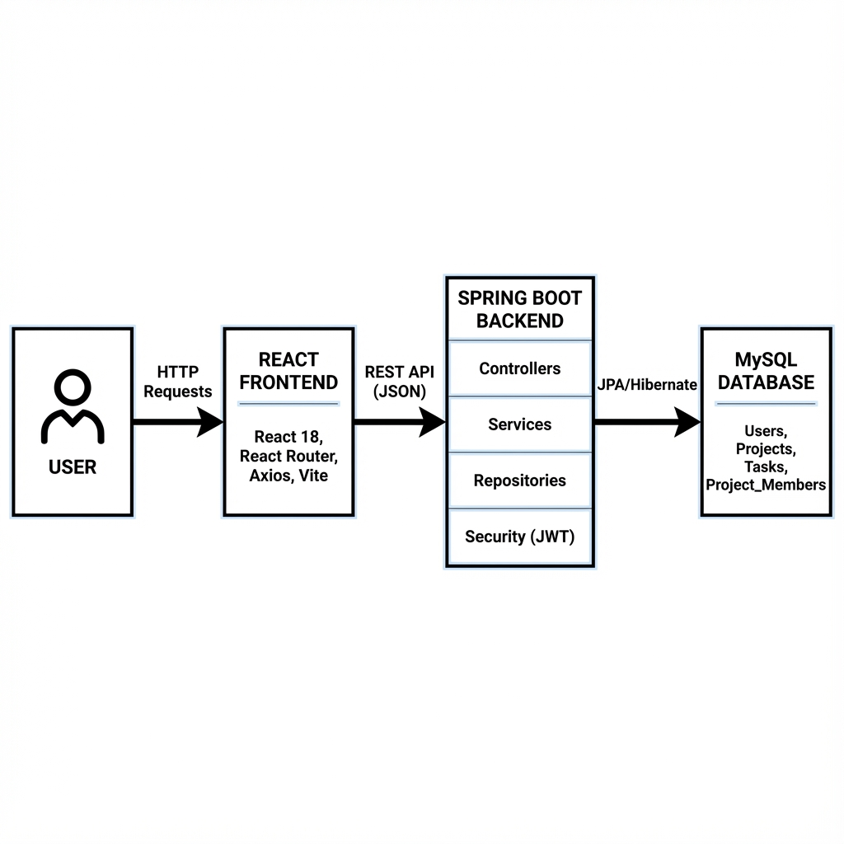
System Architecture - Block Diagram
Three-tier Architecture: React Frontend > Spring Boot REST API > MySQL Database

Slide 8
THANKYOU

