Slide 1



Donation machine
Team members: Arooj fateh (624185), Sapan sharma (6352819), Alanna McNulty (6275168), Alexander Bowles (6089957), Alex Orvitz (5517693), Samantha Laffin (5017538), Brian Jenkins (6063481)

Slide 2

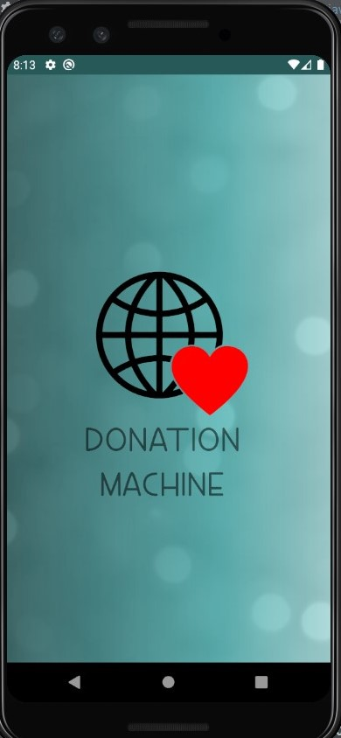
Introduction to the Project
Goal was to provide a platform to connect non-profit organizations and needy individuals with people who have goods available to donate, but are unsure of where to go
We wanted to make it easier for donors to find non-profit organizations and individuals who were in need of what they had available to donate, whether its clothes, toys, canned goods, or funds
Non-profits, as well as needy individuals, are able to add listings for what they need most so that donors can easily find what is needed where
Each non-profit organization has a profile outlining its objectives and location, and has buttons which allow donors to easily contact the organization via email or phone if necessary
The search engine allows donors to filter through organization by their needs

Slide 3
Team Members and Responsibilities
Sapan Sharma: ScrumMaster, Firebase setup and management,
Arooj Fateh: User profile page, create post page, update user profile information
Alanna McNulty: Non-profit information page, update non-profit profile information
Brian Jenkins: Sign-up, login functionality, instrumental/integration unit testing, fragment management
Alex Orvitz: Home page, navigation component, search engine and filters
Alexander Bowles: Past donations list, favourites page, UI improvements
Sam Laffin: Notifications (push notifications and notifications sent through email and text message), documents management
All team members collaborated on all additional documents i.e., project proposal, SRS document, sprint reports

Slide 4
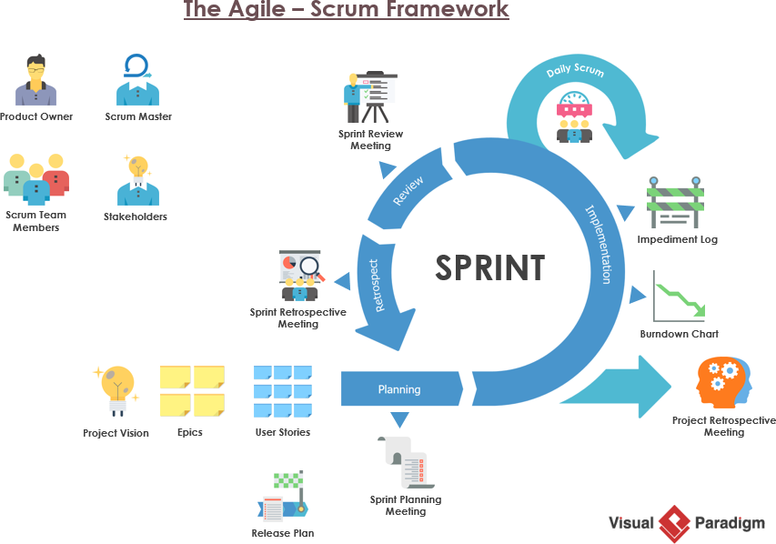
Software Development Process
The Scrum agile development process was used
The responsibilities of each team member per sprint was managed using Jira
Each sprint lasted one month
One month was selected rather than a week since each task was large, and this would give more time for each team member to finish their assigned tasks. Sprint reports also helped us monitor and keep track of our progress.
Weekly meetings held on Microsoft Teams
Meetings held during sprints were used for everyone to update the team on their progress, and let the team know if any issues appeared
Meetings were held weekly rather than daily due to other school and work commitments

Slide 5
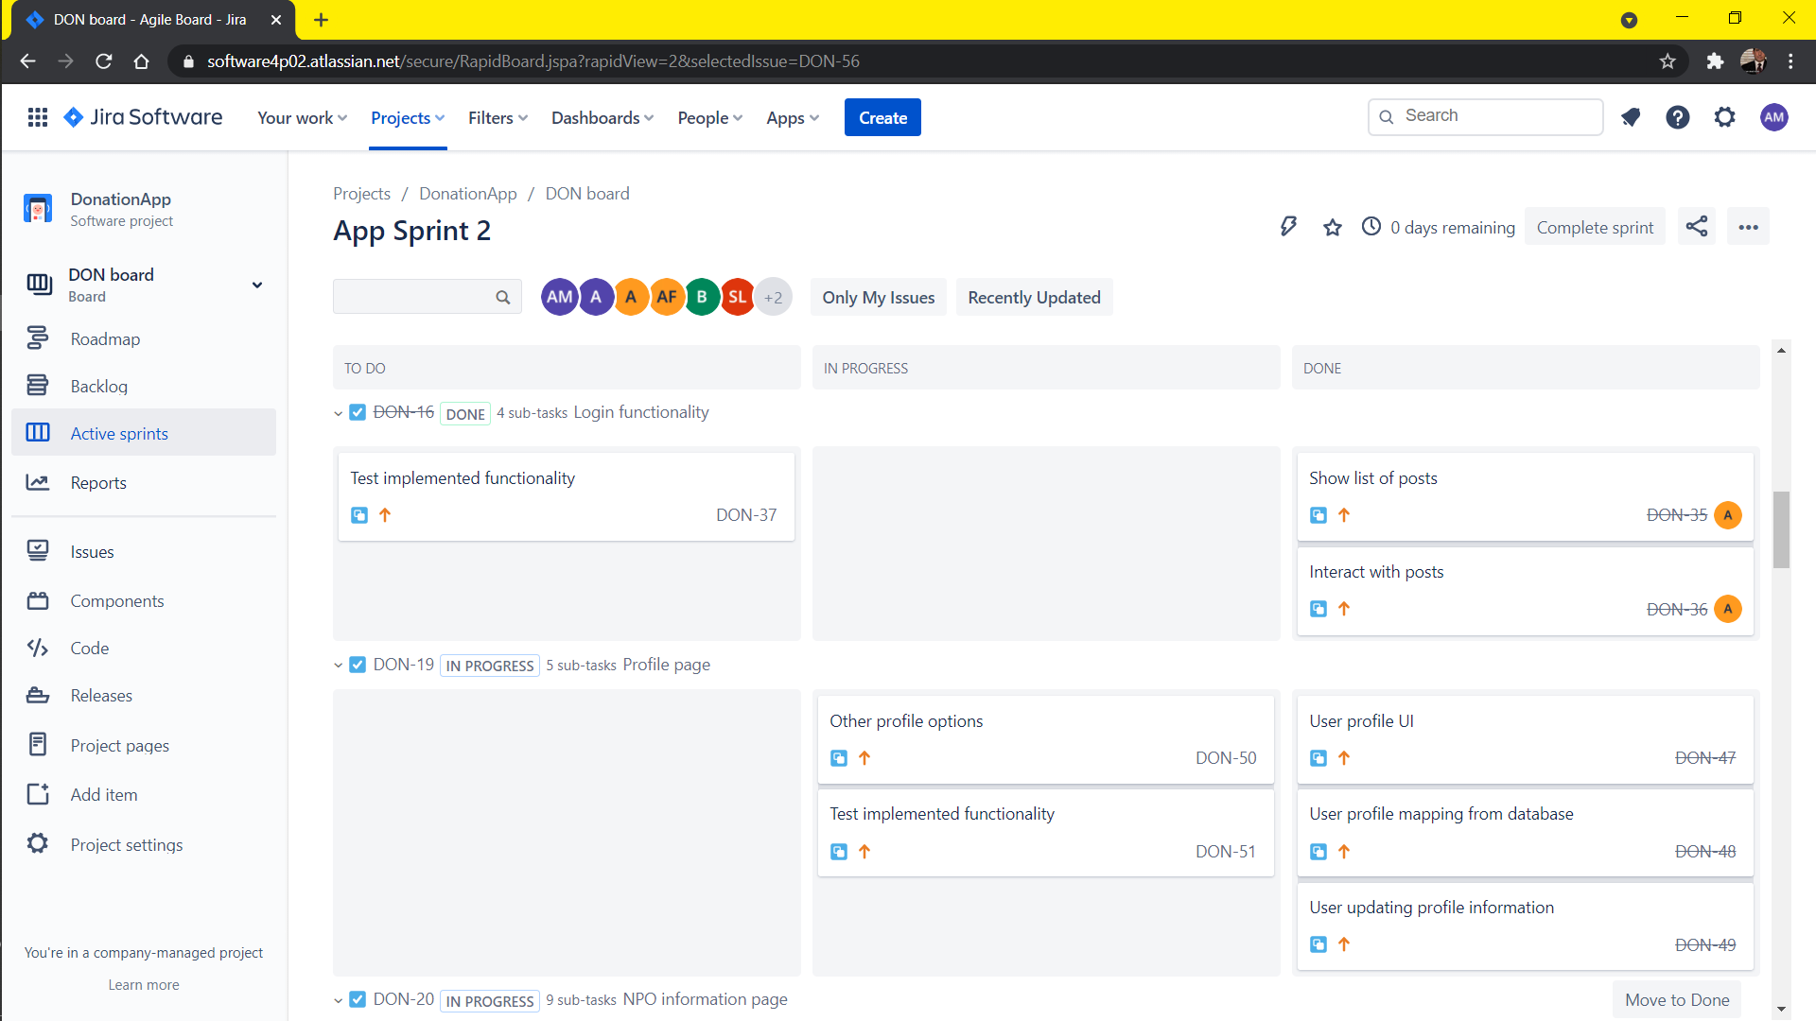
Jira
Notes:
Give a short explanation of how Jira works – moving issues, assigning issues, etc

Slide 6
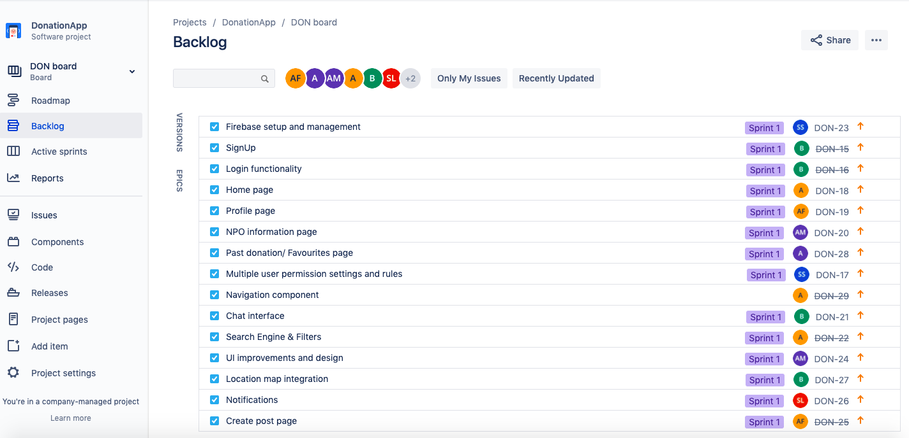

Slide 7
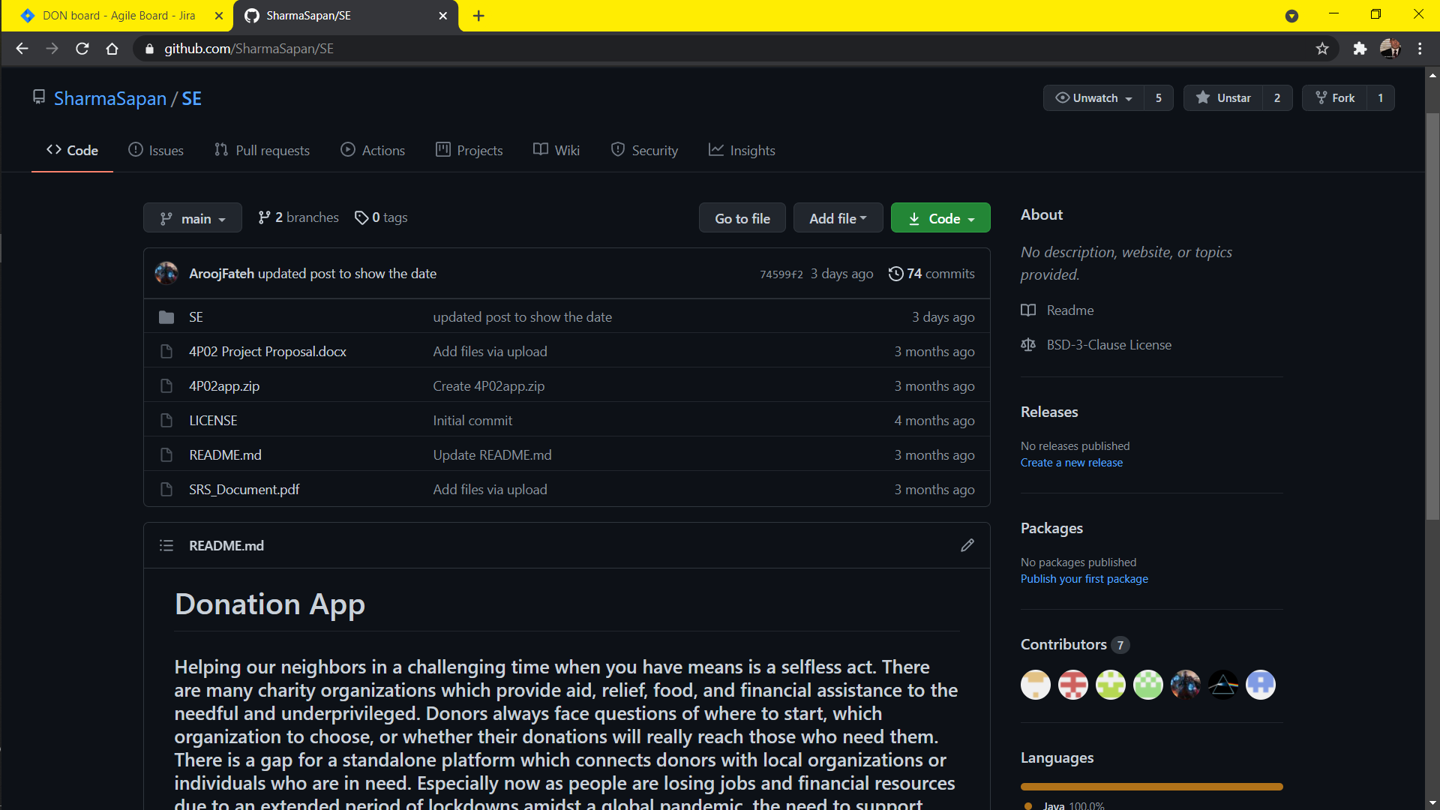
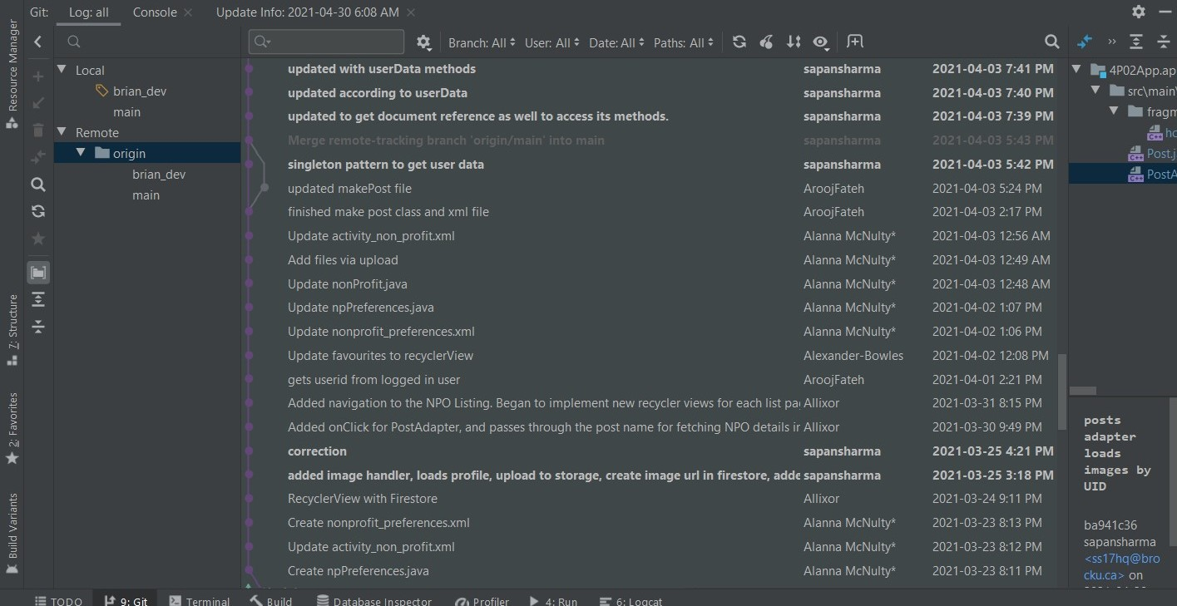
Github

Slide 8
REQUIREMENT PROCESS
Chosen technologies:
Database: Firebase
Firebase Authentication was used for all login information and management
Firebase Firestore was used for additional profile information, such as names and addresses
Firebase Storage was used to store photos along with their unique IDs
Android Studio
Testing: Espresso, JUnit4, Firebase Emulator
Non-Functional Requirements:
Performance, safety, security, software quality, business rules

Slide 9
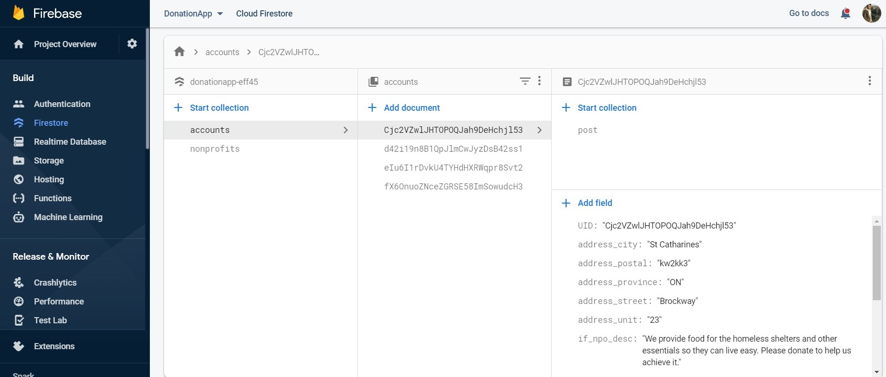
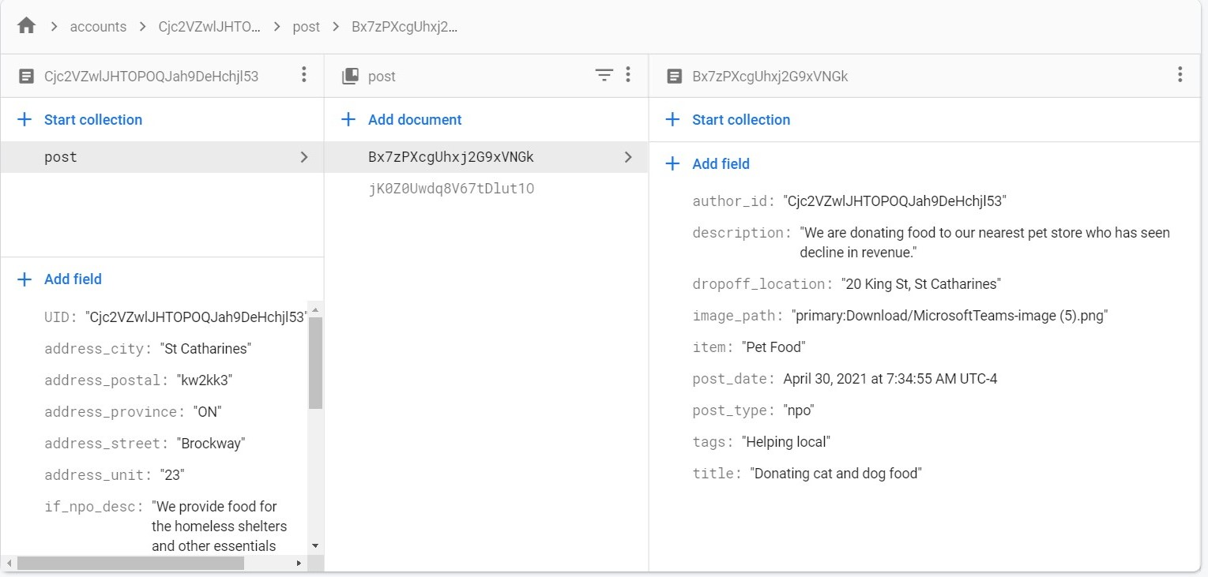
Firebase Authentication and Firestore
Notes:
Give short explanation of firestore, why we used it instead of the realtime database, any limitations it has, what the collections are for, etc

Slide 10
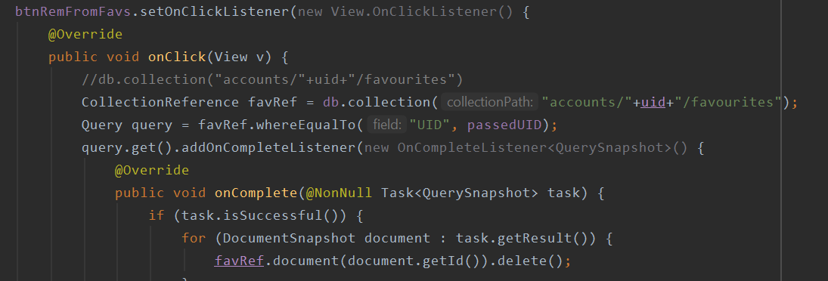
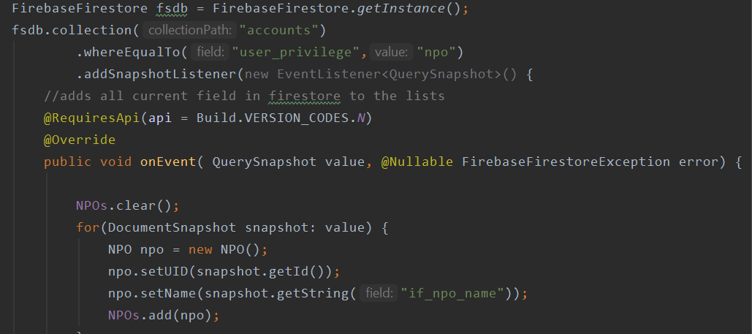
Example Query and List Populating

Slide 11
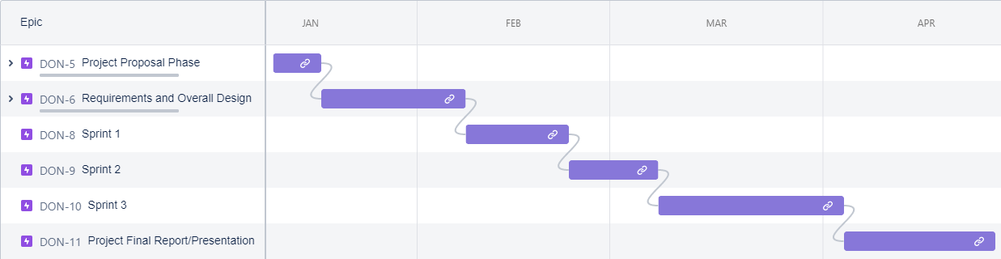
Original Product Timetable

Slide 12
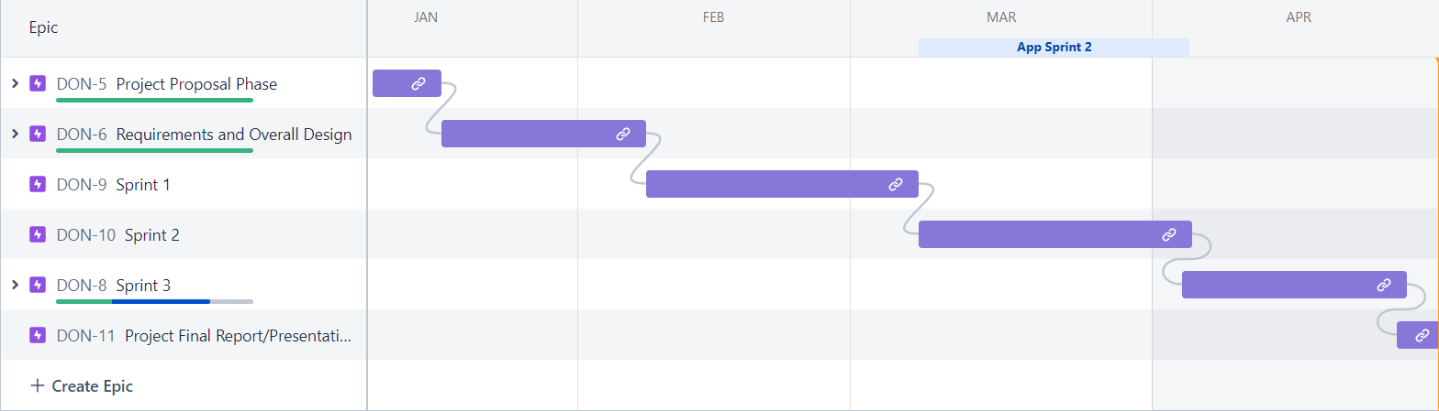
Actual Product Timeline

Slide 13
Sprint 1 (February 8th – March 7th)
Major tasks completed: navigation between pages, Firebase set up, sign-up and log-in functionality, favourited items retrieval, initial GUI
Remaining tasks: chat interface, location map integration, create post page, notifications, remaining buttons, settings pages, search engine

Slide 14
Result of sprint 1
Became accustomed to android studio as the development environment for the app and firebase as the primary database management system.
Got a hand on Github which helped us commit and push our changes onto the central repository with ease. Also pull/update each other’s code onto our local repositories.
The completed functionality provided us with the ability to navigate between pages and also test some basic functionalities of the app.
Found what things would work and what would not. Prevented Scope creep by creating a clear guideline to ship features.
Broken large tasks into smaller consumable chunks of user stories.

Slide 15
Sprint 2 (March 8th – April 3rd)
Major tasks completed: user settings pages, GUI changes, Firebase structure revised, push notifications, create post page, additional buttons
Remaining tasks: chat interface, search engine, location map integration, additional notifications

Slide 16
Result of sprint 2
Sprint 2 consisted of completion of a lot of tasks that were pending in sprint 1 as well as additional that were meant for sprint 2.
Since around most of the functionalities were implemented by this point, it helped us gain a better insight of the overall design of the app itself.
It also provided us with the ability to test additional functionalities and complicated features of the app.
When implementing we found few redundant structures. We also updated the database to reflect these changes.
We introduced the idea of using fragments instead of activities to try and improve the flow of the app and performance in a more user-friendly way.

Slide 17
Sprint 3 (April 4th - April 29th)
Major tasks completed: search engine, testing, final GUI changes
Tasks removed: additional notifications, location map integration, chat interface

Slide 18
Result of sprint 3
Had all required functionality added to the app
Added tests to ensure that the app works as expected for a variety of test cases
Selected the final GUI design and added it to the app

Slide 19
Main Challenges Faced During Development
Some features took longer to complete than originally thought, and as a result other features got pushed to later sprints
After Sprint 1, larger tasks were broken into smaller sub-tasks to make it easier for everyone to show the progress made
Some features, such as sending emails through the app, could not be tested using the Android Emulator provided in Android Studio
We ended up having to remove some features due to time constraints
Most of us had not used Github prior to this project; resulted in some confusion caused such as having a few extra branches as well as having trouble adding code from Android Studio to Github
Some group members hadn’t developed an Android app before

Slide 20
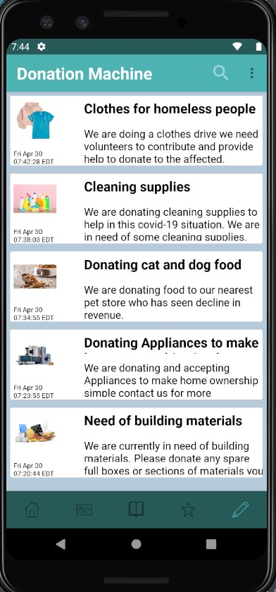
Development Methods
Donation Machine is an Android application
IDE: Android Studio (fork of IntelliJ)
Database: Firebase Firestore
Authentication Protocol: Firebase Authentication
Google's Firebase is tightly integrated with our application
It facilitates our database and authentication methods
We chose this service so that our applications security could be managed by a trusted third party
This makes it easy to meet Google's security standards when publishing to the Play Store
Database is housed on a cloud server with heavy security 'barriers'
User authentication passes through secure channels

Slide 21
Testing
UI and Integration Testing
Tools: JUnit 4, Espresso, Firebase Emulator
Used in testing user interaction with UI components.
Including button clicks, text inputs, activity/fragment navigation etc.
Tested scenarios in which users may call to the database or authentication services
Including account creation, profile updates, various Firestore document changes
Firebase Emulator Suite
Firebase provides a local emulator suite powered by Node JS.
Allows for a development environment to be deployed on a local machine
Used during integration testing to ensure Firestore authentication and database calls could be made before

Slide 22
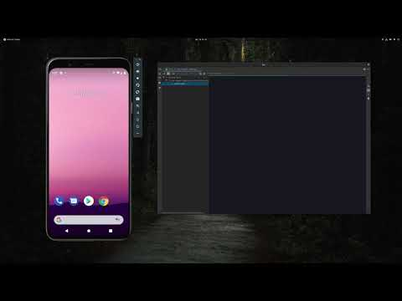
Instrumental Testing Demonstration

Slide 23
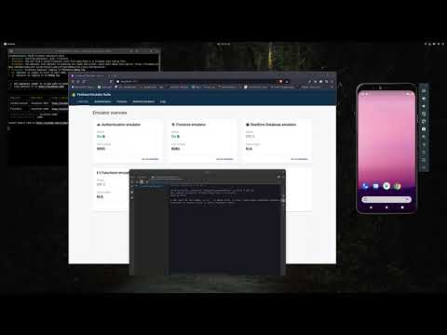
Integration Testing Demonstration

Slide 24
Future Testing Considerations
Mocked Unit Tests
Firebase doesn't natively support class mocking
These unit tests could have allowed for an easier solution while testing database calls
However, these calls would not have been 'real'. No entries would have been made to the database
Firebase Test Lab
Firebase provides a service which could have tested our app across multiple devices simultaneously
Not part of the Firebase 'Free Tier'. Requires a Spark plan (pay-as-you-go)
In order to limit costs, our team tested the application on two API versions across several devices manually
Android API 28, 29 and 30 specifically
Various pixel and Nexus devices.

Slide 25
Deployment Activities and Challenges
Although we only secured one functional release, we used the following methods to ensure a streamlined approach to the deployment process.
App configuration
Every release (or update of code) required testing on the appropriate devices to ensure compatibility.
By opting out of the Firebase Test Lab, this process was very tedious
Code Maintenance and Reuse
We are strong believers in ensuring that our code can be well maintained across releases
During our deployment activities we focused on building strong, modular code such that our deployment process would be more streamlined
Google Play Store
One of our biggest challenges during the deployment process was ensuring that each release followed the guidelines set out by Google.
Interacting with Google's official deployment tool added an extra layer of complexity to our application
We created test suite for Markers to test which is by invite. Please let us know an email to send invite

Slide 26
Additional Features
The following features had to be removed due to time constraints:
Chat integration
Notifications via email and text message
Location map integration
These features were not essential to the functionality of the app, but were going to be used as a way to make the app easier to use
If this app is developed further in the future, these features would be good to add

Slide 27
References
[1] Firebase Documentation: https://firebase.google.com/docs
[2] Android Development Documentation: https://developer.android.com/docs
[3] Jira website: https://www.atlassian.com/software/jira
[4] Android Studio: https://developer.android.com/studio

Slide 28
Questions?

