Slide 1
Internal API For A Fake Financial Institution Using Python

Slide 2
Index
Tech-Stack
2. Core Features
3. Architecture
4. Project Setup & Installation
5. Production Hardening Checklist

Slide 3
TECH-STACK
Category | Tools
Language | Python 3.x
Framework | FastAPI
Database | SQLite (dev) → PostgreSQL recommended for prod
ORM | SQLAlchemy
Validation | Pydantic v2
Auth | JWT (PyJWT)
Testing | Pytest
Docs | Built-in Swagger + ReDoc

Slide 4
Core Features Implemented
Feature | Status
Create customers & authenticate using phone + PIN | ✔
Create bank accounts with initial deposit | ✔
Multiple accounts per customer | ✔
Transfer funds between any two accounts | ✔
Retrieve account balance | ✔
Retrieve account transfer history | ✔
Automated test suite (pytest) — all tests passing | ✔ (25/25)
Seed initial customers on startup | ✔

Slide 5


Architecture
Client
FastAPI
Business Logic
Authenticated
SQLAlchemy ORM Models
Not Authenticated
SQLite DB

Slide 6
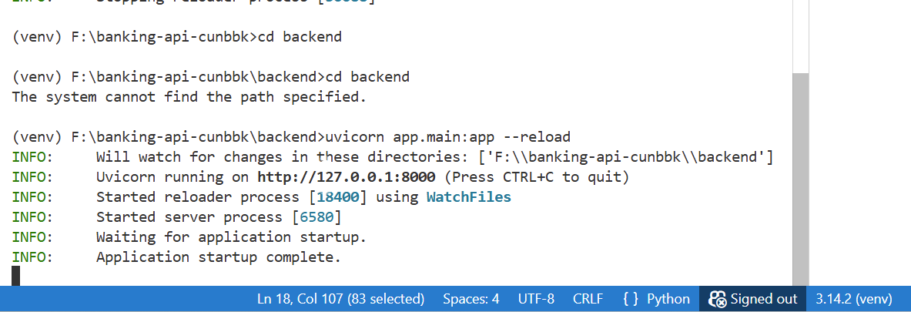
Project Setup & Installation
Installation commands:
git clone <repo-url>
cd project-name
python -m venv venv
source venv/bin/activate ( mac/linux)
venv\Scripts\activate
pip install -r requirements.txt
uvicorn app.main:app --reload
API Docs available at:
Swagger UI: http://localhost:8000/docs

Slide 7
Database :
Database auto-creates tables on first run.
Default customer seed runs automatically via lifespan.
Admin account auto-generated.
4. Create account:
POST /accounts/
Authorization: Bearer <token>
{
"customer_id": 5,
"initial_deposit": 500
}
5. Transfer Money:
POST /transfers/
Authorization: Bearer <token>
{
"from_account_id": 1,
"to_account_id": 2,
"amount": 200
}
6. Transfer History
GET /accounts/{id}/transfers
Authorization: Bearer <token>
1. Customers:
POST /customers/
{
"name": "Alice",
"phone_number": "9991113333",
"pin": "1234"
}
2. Login Customer (returns JWT)
POST /customer/auth/login
{
"phone_number": "9991113333",
"pin": "1234"
}
3. Balance
GET /accounts/{id}/balance
Authorization: Bearer <token>

Slide 8
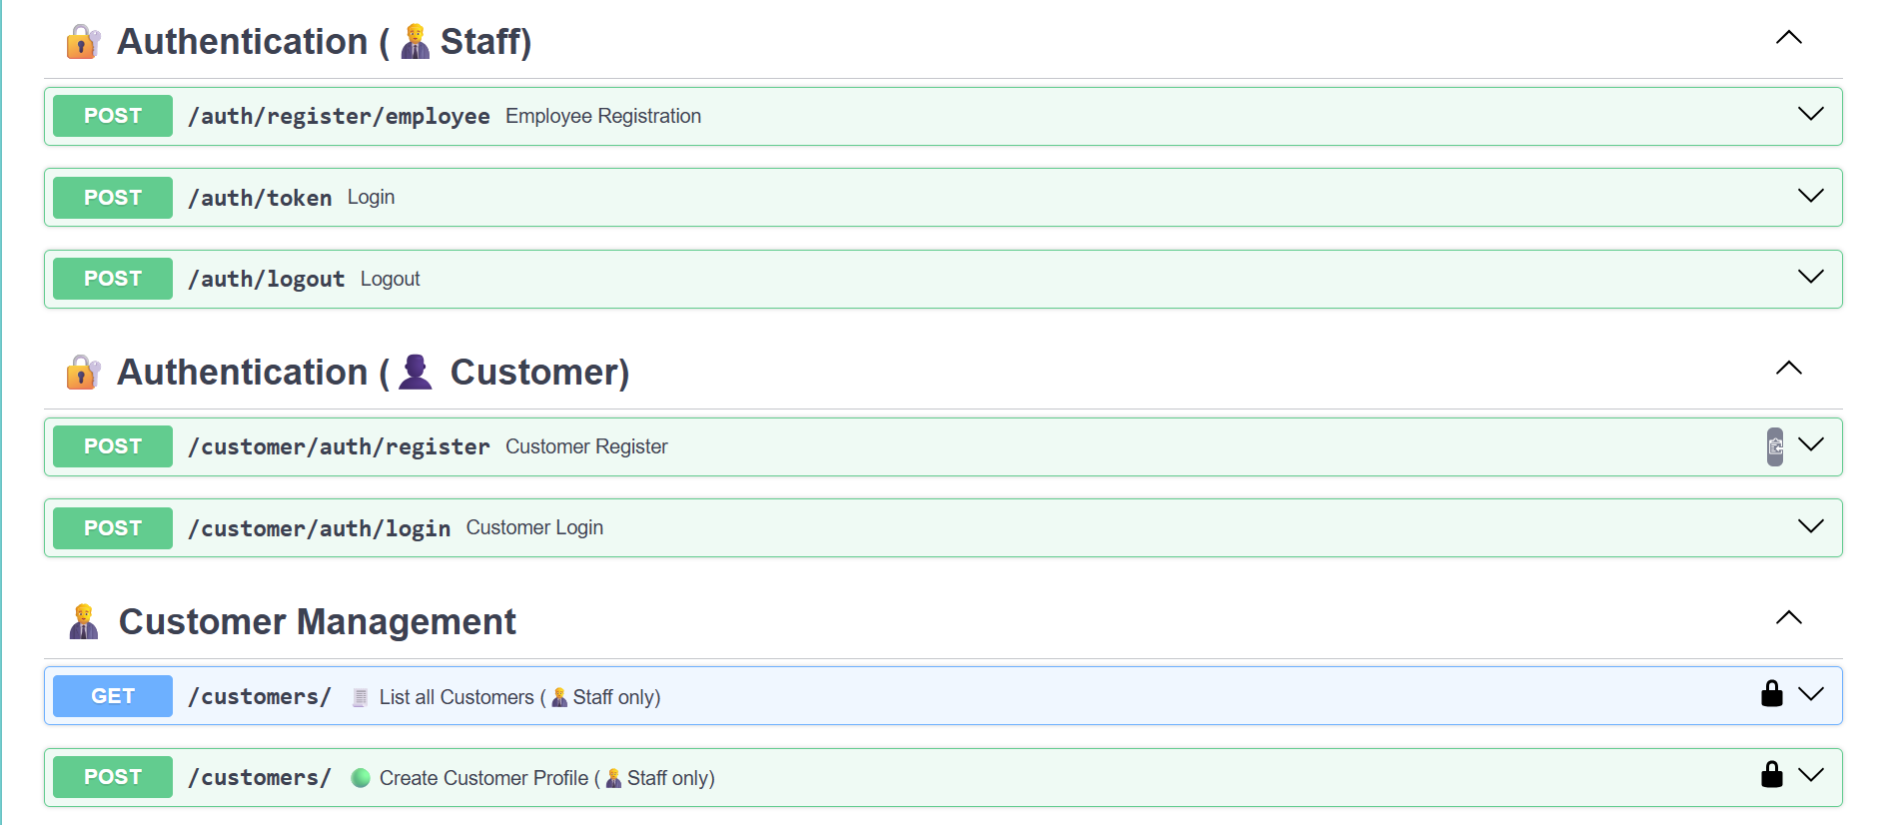
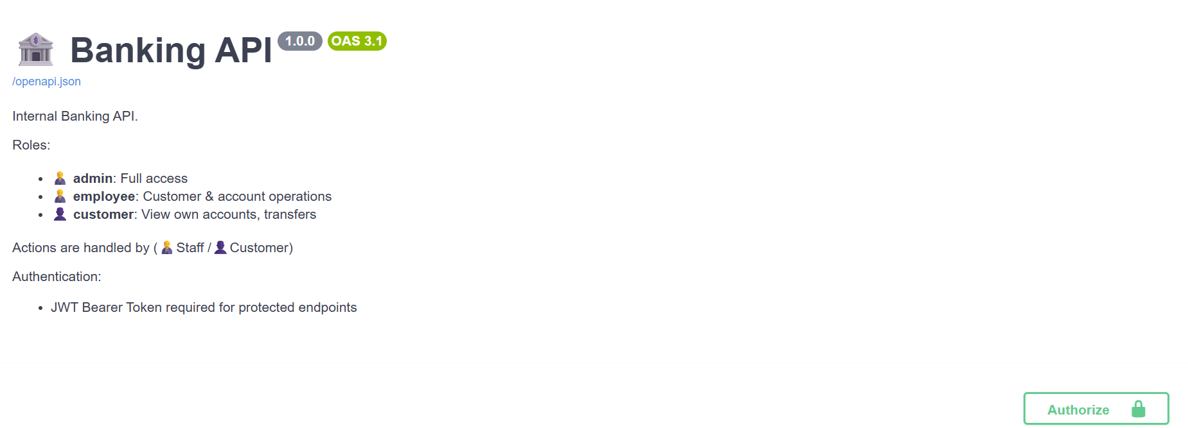
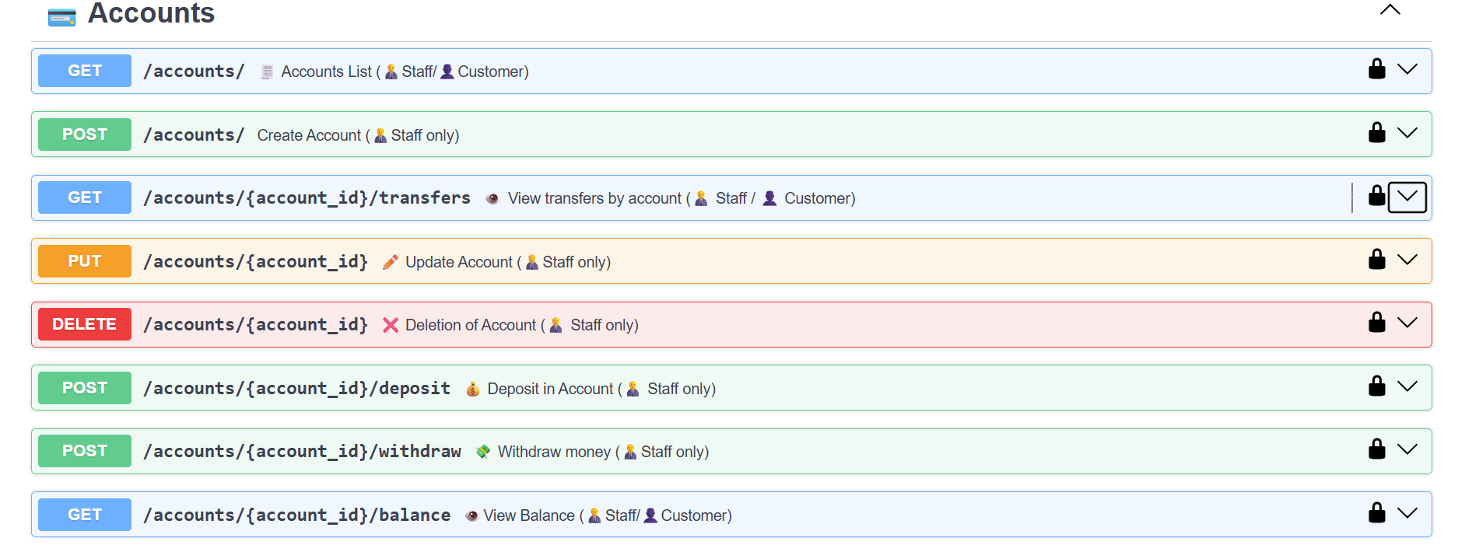
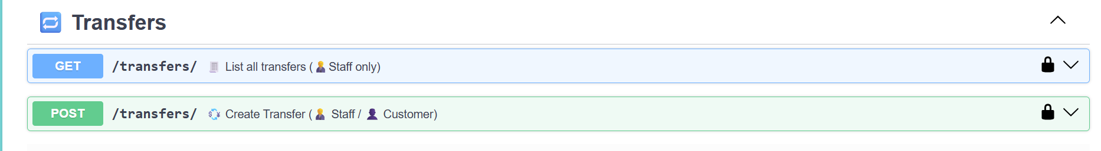

Slide 9
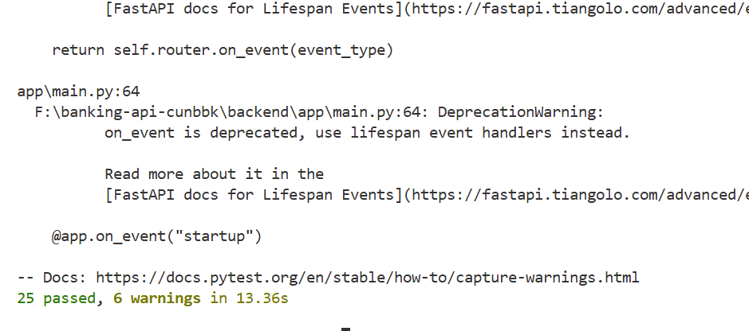
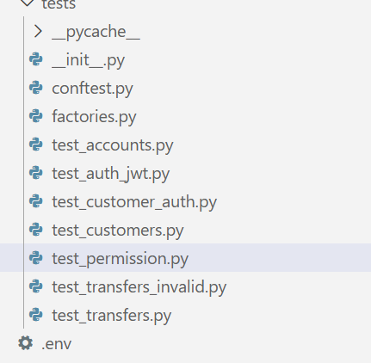
Run tests:
pytest -q
Test File | Purpose
conftest.py | Global fixtures for DB session and TestClient setup.
factories.py | Helper functions to quickly create sample customers/accounts for tests.
test_accounts.py | Validates account creation, balance check, update, delete & transfer history.
test_auth_jwt.py | Tests JWT authentication and role-based authorization behavior.
test_customer_auth.py | Ensures customer registration and PIN login workflows behave correctly.
test_customers.py | Tests customer CRUD basics like creating multiple customers.
test_permission.py | Verifies RBAC rules (who can create/delete/access accounts).
test_transfers_invalid.py | Covers invalid transfer scenarios (same account, insufficient funds, invalid IDs).
test_transfers.py | Tests successful transfers and transfer history after transactions.

Slide 10
🏁 Production Hardening Checklist
Before going live:
🔐 Security & Authentication
Enforce JWT on all endpoints (not bypass via test mode)
Add rate limiting to prevent fraud
Add failed login lockout & logging
🏛 Infrastructure
Move from SQLite → PostgreSQL
Run via Docker + compose
Add automated database migrations (Alembic)
📈 Observability
Structured logging
Monitoring + metrics tracing
Audit logs for all transfers
🌍 Scalability
Background workers for large transfer queues
Pagination for transaction history
🧪 Testing
Add coverage reporting
Add concurrency & load tests

