Slide 1

Present for friend
Sharma Vijay
Kudas Aigerim

Slide 2

Notes:
We often have a problem in choosing a present for our friend.

Slide 3
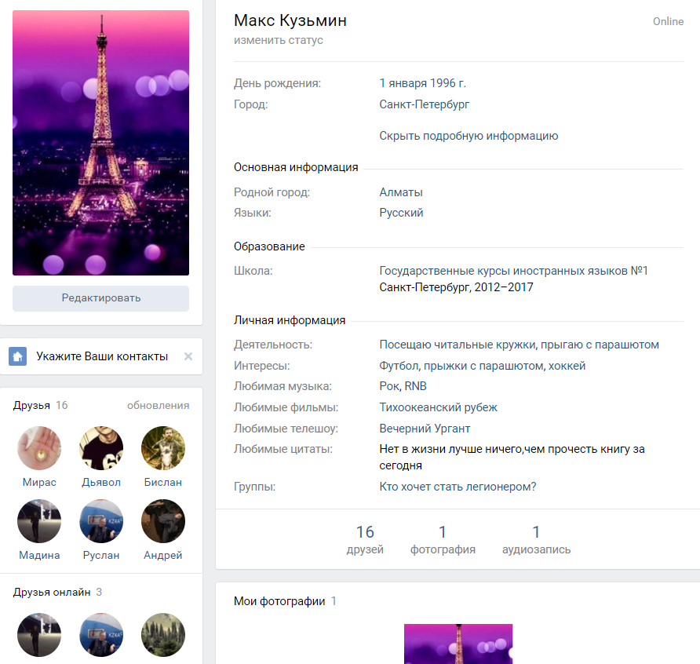
Where can our service get the information?
Notes:
So our service will help us.

Slide 4
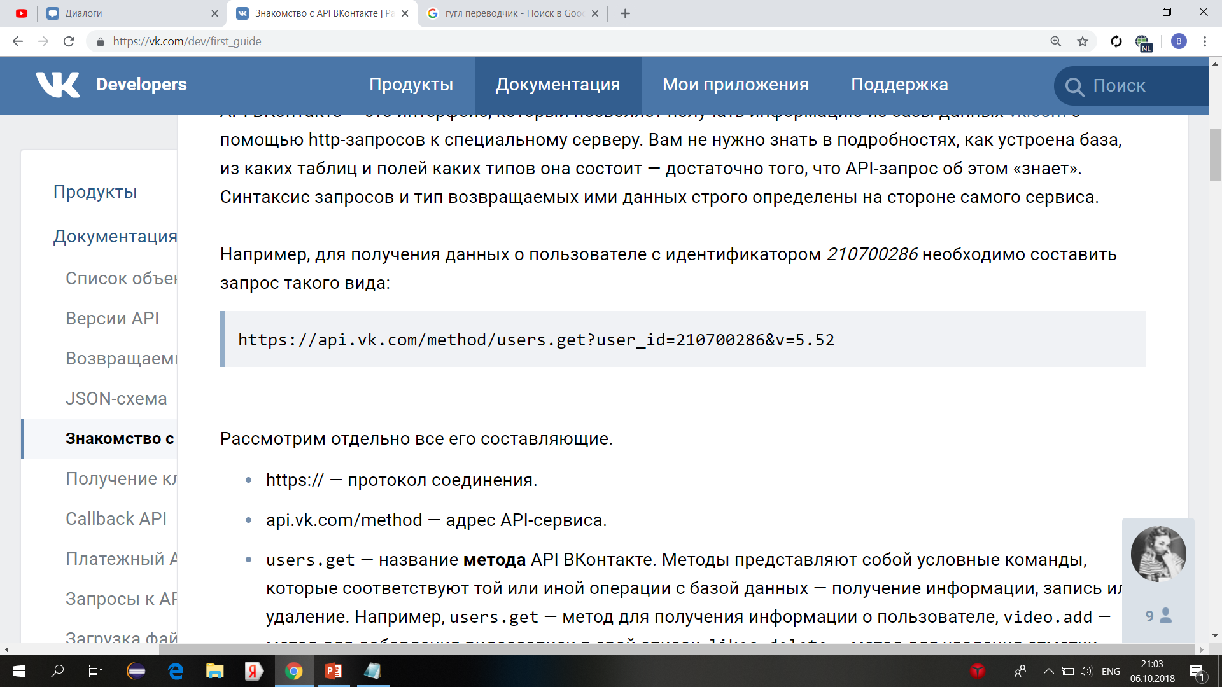
What about Dataset?
We can use API of vkontakte. For example to get information about user with identifier 210700286 we have to make request like this:
Notes:
We will use API of Vkontakte. There are many video lessons how to use it.

Slide 5

We don’t have competitors…
Notes:
We didn’t find any app or service like our one.

Slide 6
Thank you !

