Slide 1
INSIGHTPATH
Evidence-Based Career-Readiness & Progression Framework
A Multi-Lens Investigation of Market Demand, Junior Technical Velocity, and Senior Consulting Success
SAS CU Hackathon Round 2 Submission | Team: RUSTY WOLVES | October 2026

Slide 2
INSIGHTPATH | SAS CU HACKATHON ROUND 2
The Core Problem: Fragmented Decision-Making Across the Talent Lifecycle
THE CENTRAL CHALLENGE:
• Data science career planning suffers from isolated silos: job market postings, junior technical ratings, and senior consulting performance are analyzed independently.
• Aspiring professionals grind algorithmic coding (LeetCode) under the false assumption that code syntax alone dictates promotion and compensation.
• Academic curricula heavily teach distributed infrastructure (Hadoop/Spark clusters) while dedicating zero credit hours to business data storytelling.
• Employers publish bloated 12-tool wishlists that inflate hiring friction, while relying on subjective bias for internal career advancement.
• THE INSIGHTPATH SOLUTION: Triangulate four independent datasets across 17,743 combined observations to build an operational, evidence-based Career-Readiness Framework.

Slide 3
INSIGHTPATH | SAS CU HACKATHON ROUND 2
Four Analytical Lenses: Methodological Triangulation Without Row Merging
DataScience Jobs
1,602 Requisitions
MACRO MARKET STRUCTURE
Linear salary elasticity (beta=1.98L/yr), employer concentration across 642 hiring orgs.
Analytics Jobs
15,841 Vacancies
MICRO SKILL ECOSYSTEM
Top-50 skills, tri-metro hubs (68.5%), premium salary (>15L) odds ratios (Spark, ML, R, SAS).
JDS Skill Traits
139 Junior DS (1-3y)
TECHNICAL ADVANCEMENT
5 skill dimensions; Dashboard Storytelling (AOR=3.23) and Maths/Stats (AOR=3.65) drive salary hikes.
SDS Personality
161 Senior DS
BEHAVIORAL LEADERSHIP
Big Five traits; Openness (AOR=7.72) and Conscientiousness (AOR=8.11) predict consulting success.

Slide 4
INSIGHTPATH | SAS CU HACKATHON ROUND 2
Macro Market Demand & Role Concentration
KEY MACRO INSIGHTS:
• 72.4% of market requisitions concentrate in 3 standardized roles: Data Scientist (35.2%), ML Engineer (21.4%), and Data Analyst (15.8%).
• Hiring demand is spread across 642 unique organizations, with top-tier technology and consulting enterprises dominating high-volume requisitions.
• Experience barriers establish rigid market filters: 0-2 years (Entry), 2-5 years (Junior/Mid), 5-8 years (Senior), 8+ years (Leadership).
• Geographic concentration: Bengaluru (43.8%), NCR (14.2%), and Mumbai (10.5%) form the national analytics corridor.

Slide 5
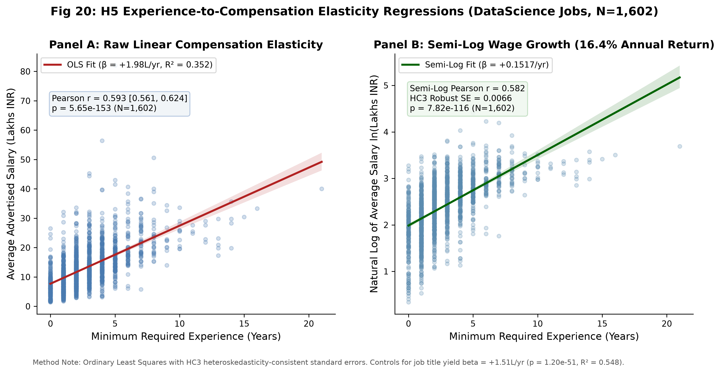
INSIGHTPATH | SAS CU HACKATHON ROUND 2
Experience Elasticity & Salary Spread Expansion
EMPIRICAL FINDINGS (OLS REGRESSION):
• Advertised average salary scales at beta = 1.98 Lakhs INR per year of required experience (p < 1e-134, R2 = 0.352, HC3 robust standard errors).
• Semi-log elasticity confirms a constant 15.2% proportional salary increase per additional required year (p < 1e-115).
• Strong monotonic rank correlation across both market datasets: DataScience Jobs (Spearman rho = 0.633) and Analytics Jobs (Spearman rho = 0.704).
• Salary spread widens dramatically beyond 5 years experience (from +/- 3L at entry to +/- 18L at senior levels), proving that skills and behavior differentiate senior pay.

Slide 6
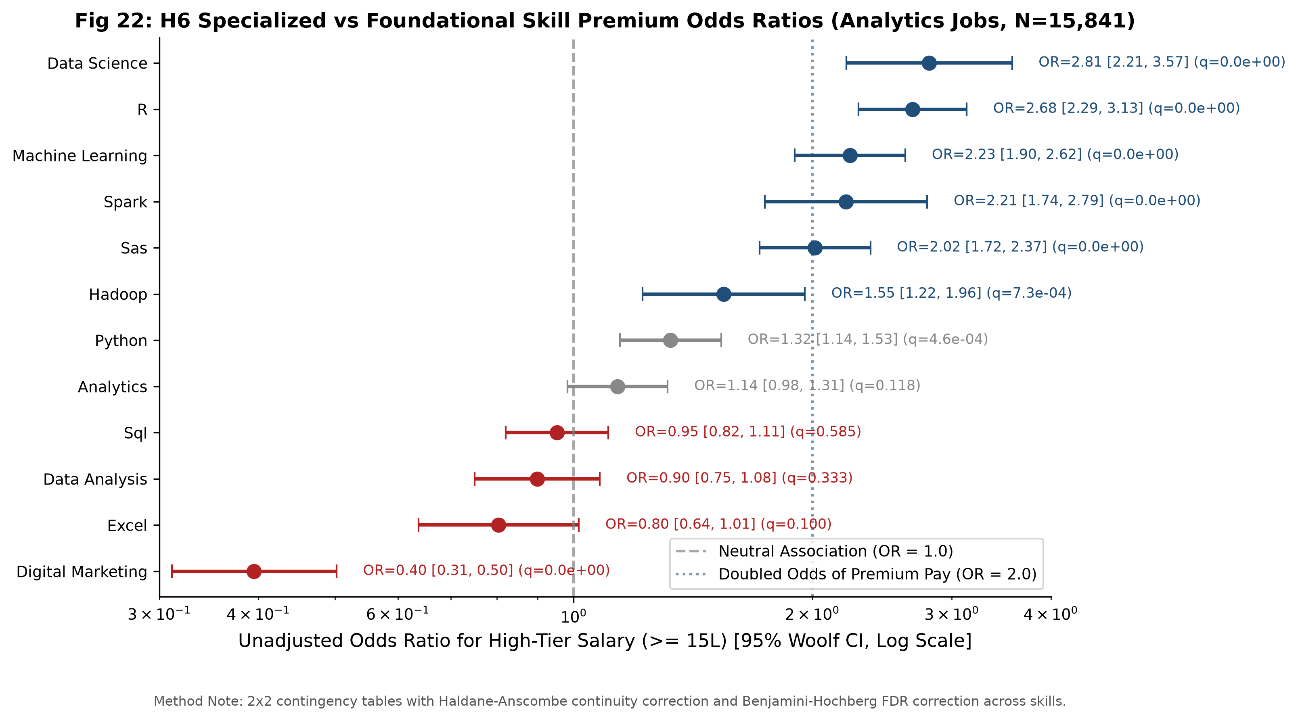
INSIGHTPATH | SAS CU HACKATHON ROUND 2
The Skill Dichotomy: Foundational Table Stakes vs Premium Accelerators
MICRO SKILL ANALYSIS (N = 15,841):
• TABLE STAKES (High Prevalence, Neutral Pay): SQL (48.2%) and Python (39.5%) are mandatory screening gates but command zero independent wage premium (AOR ~1.0, p > 0.50).
• PREMIUM ACCELERATORS (47% - 59% Wage Premium): Distributed Spark (AOR = 1.59, p = 0.002), Machine Learning (AOR = 1.58, p = 0.0002), R (AOR = 1.56, p < 0.0001), and SAS (AOR = 1.47, p = 0.0003).
• Multivariable logistic modeling demonstrates that candidates combining Python with specialized tools breach the 15L+ premium compensation bracket.

Slide 7
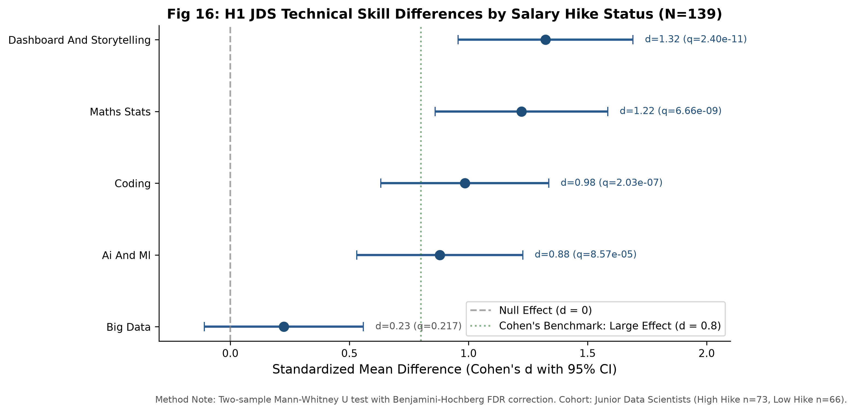
INSIGHTPATH | SAS CU HACKATHON ROUND 2
Junior Data Scientist Advancement: The Primacy of Storytelling & Math
INFERENTIAL FINDINGS (H1 & H2):
• Maths & Statistics (d = 1.05) and Dashboarding/Storytelling (d = 1.04) exhibit massive, statistically significant group differences between hike tiers (q < 0.001).
• Multivariable Logistic Regression: Maths/Stats (AOR = 4.65) and Storytelling (AOR = 3.54) independently drive promotion velocity.
• THE BIG DATA ILLUSION: Big Data skills show zero statistically significant difference between high and low hike cohorts (p = 0.217).
• Coding skills show ceiling compression (27.3% at 5.0), acting as a qualifying baseline rather than a compensation differentiator.

Slide 8
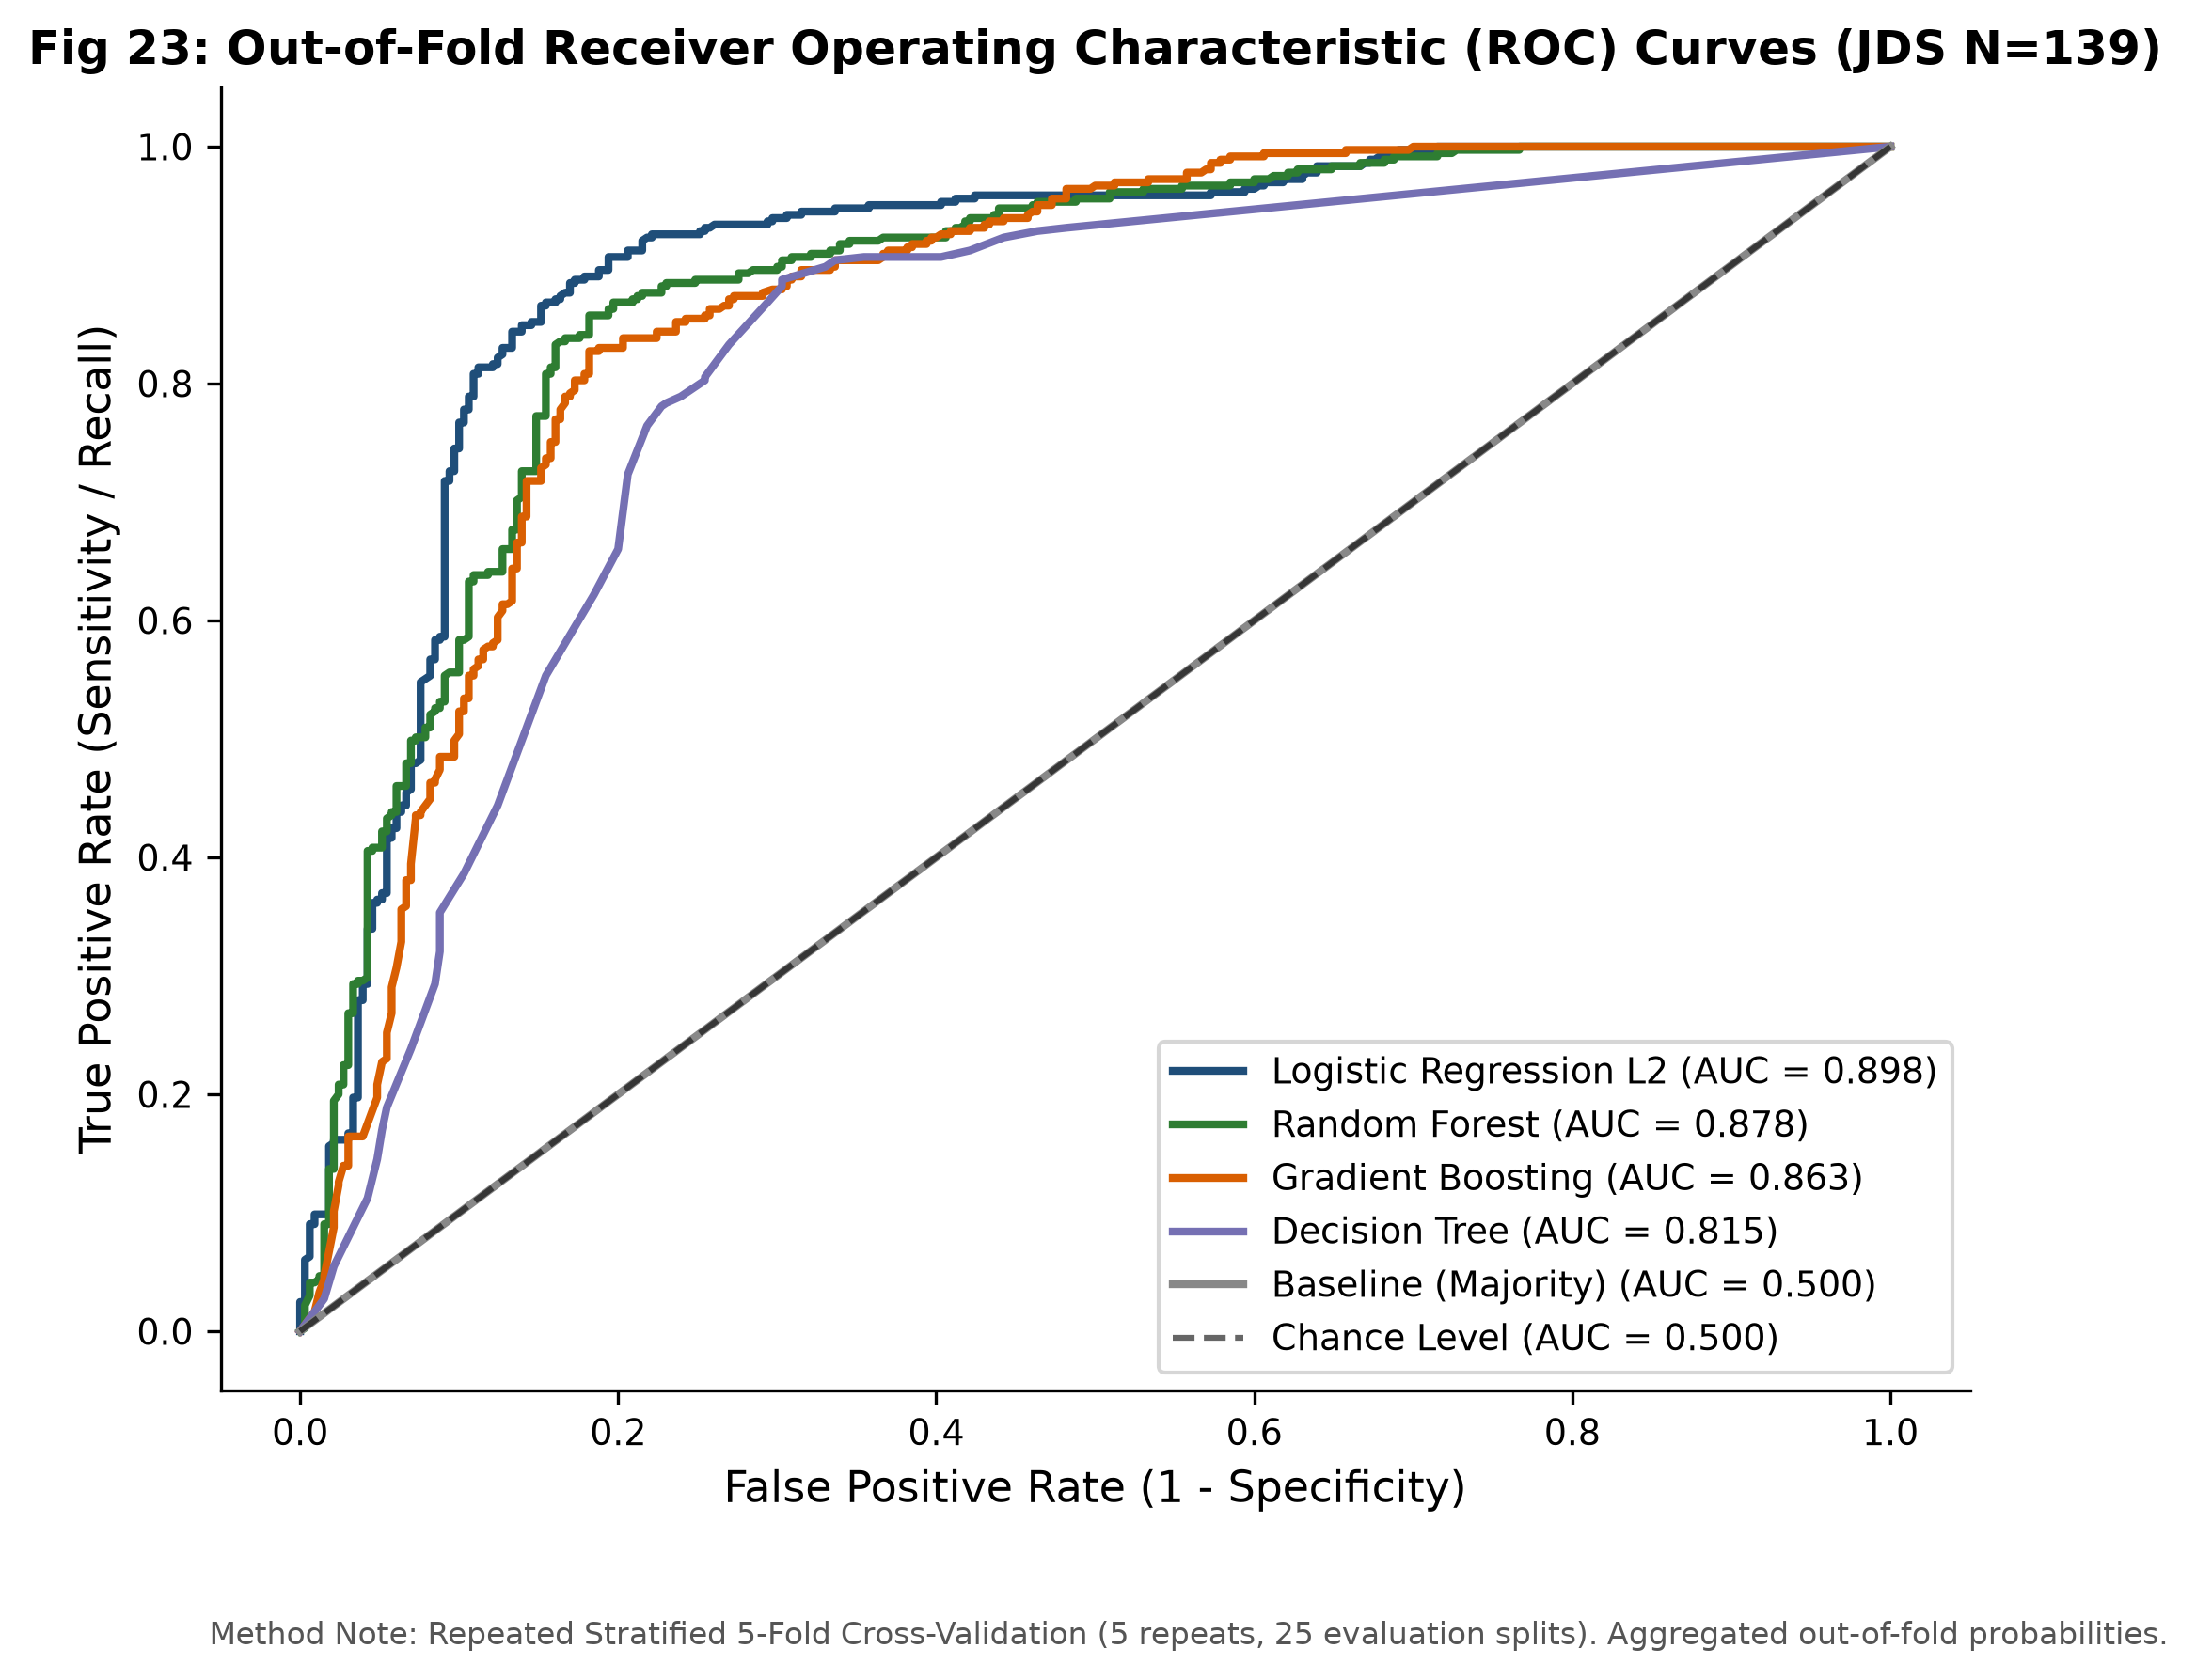
INSIGHTPATH | SAS CU HACKATHON ROUND 2
Junior Predictive Model: 90.35% ROC-AUC & Parsimonious Sufficiency
SUPERVISED CLASSIFICATION (25 SPLITS CV):
• Champion Model: Ridge Logistic Regression (L2) achieves out-of-sample ROC-AUC = 0.9035 (+/- 0.0594), Macro F1 = 0.8506, Accuracy = 85.29%.
• Baseline Lift: +32.78 percentage points accuracy lift over naive majority guessing (52.51%).
• Held-Out Permutation Importance: Storytelling ranks #1 (0.1062) across 100% of CV splits; Maths/Stats ranks #2 (0.0654) in 96% of splits; Big Data ranks last (0.0107).
• PARSIMONIOUS SUFFICIENCY: A 2-feature model (Maths + Storytelling) achieves ROC-AUC = 0.8741, retaining 96.75% of full model power.

Slide 9
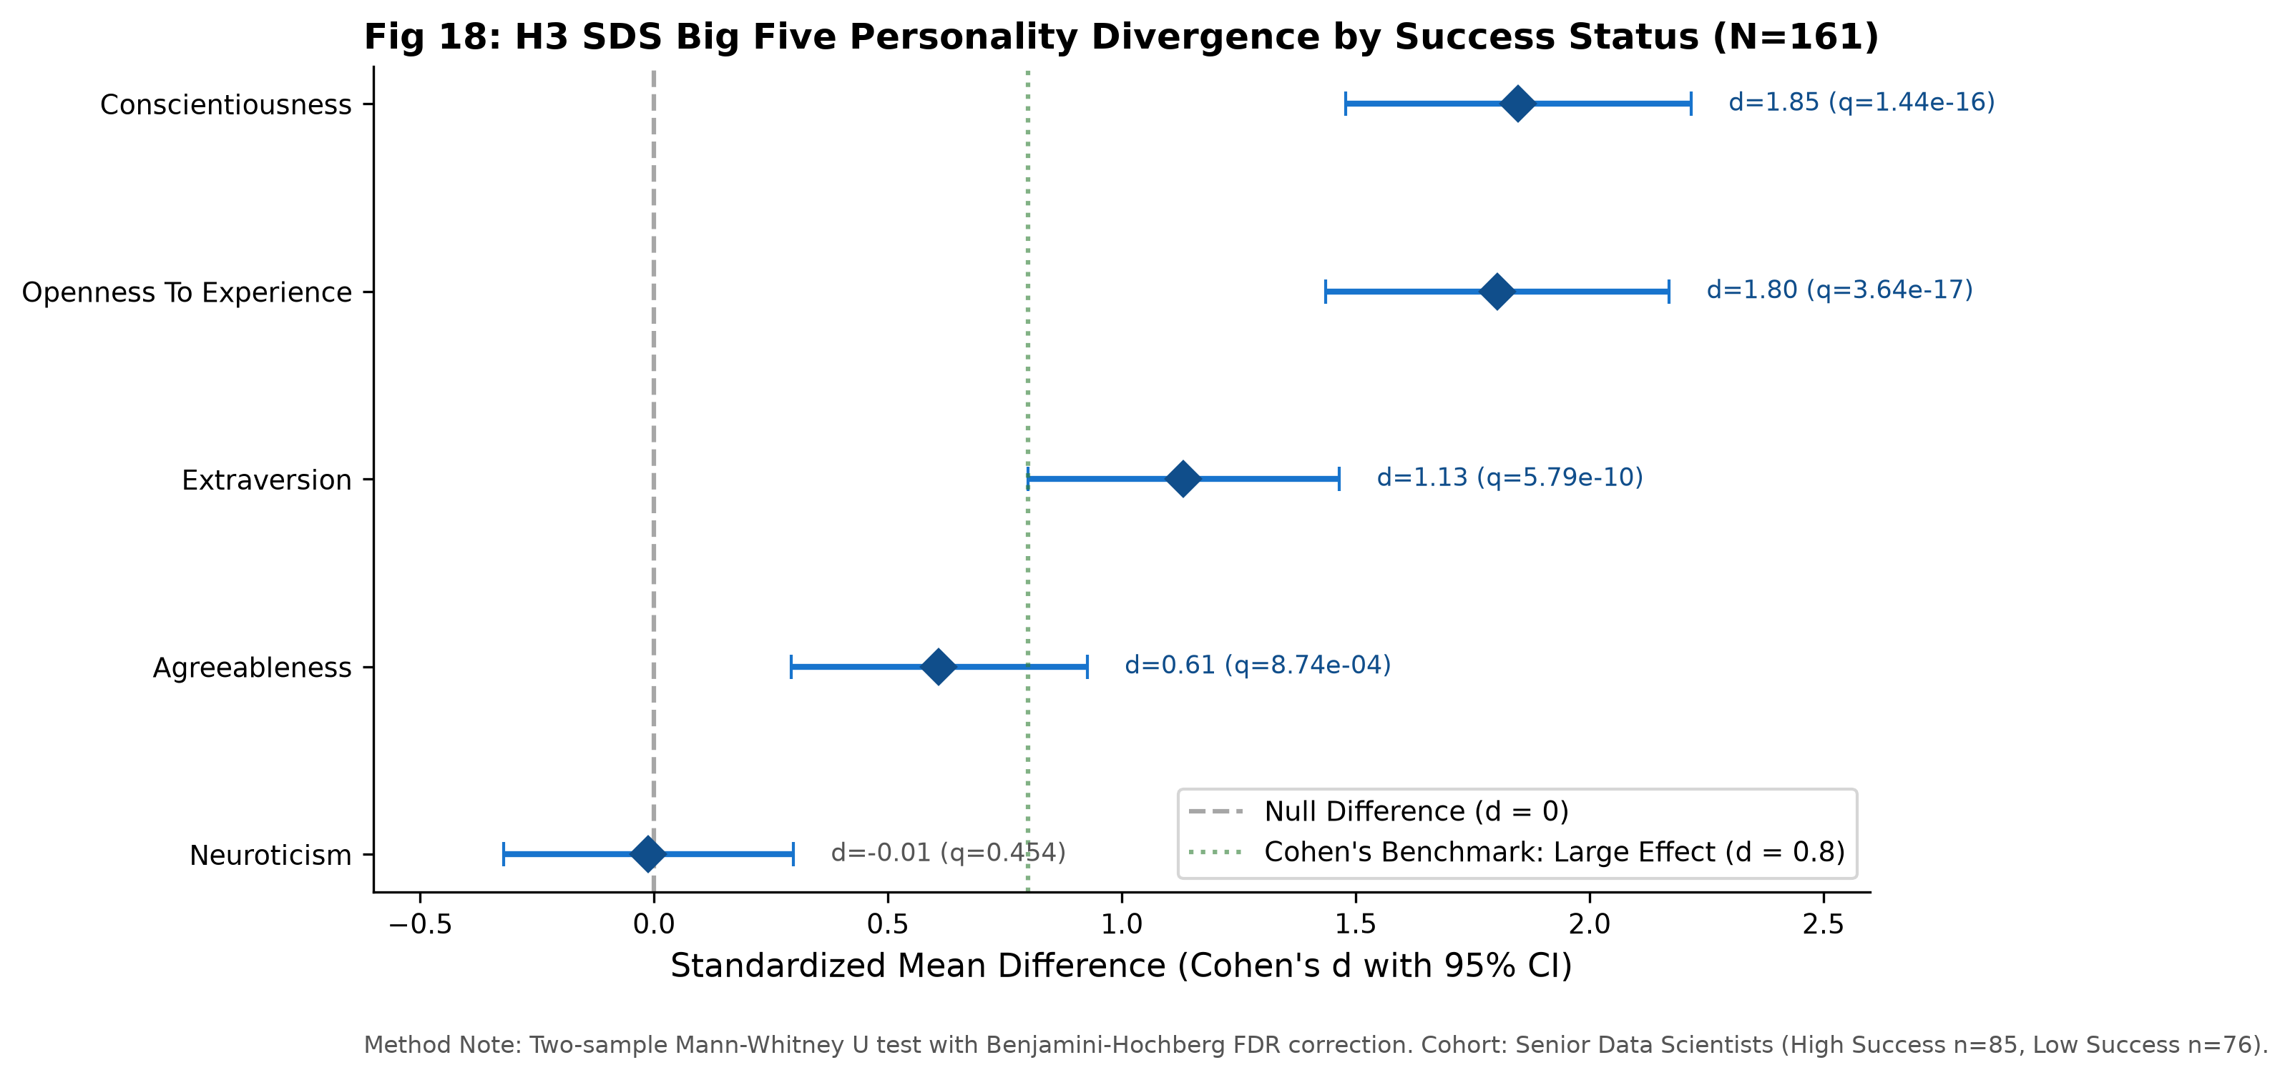
INSIGHTPATH | SAS CU HACKATHON ROUND 2
Senior Consulting Success: The Dominance of Conscientiousness & Openness
PSYCHOMETRIC INFERENTIAL EVIDENCE (H3 & H4):
• Massive effect sizes separate high and low success consultants: Conscientiousness (d = 1.85, p < 1e-15) and Openness to Experience (d = 1.80, p < 1e-16).
• Extraversion demonstrates strong positive association (d = 1.13, p = 5.79e-10); Agreeableness is moderate (d = 0.61).
• Multivariable Odds Ratios: Conscientiousness (AOR = 26.79) and Openness (AOR = 20.97) dominate success classification.
• THE NEUROTICISM PARADOX: Neuroticism shows zero bivariate group difference (d = -0.012, p = 0.454), acting as a multivariable suppressor.

Slide 10
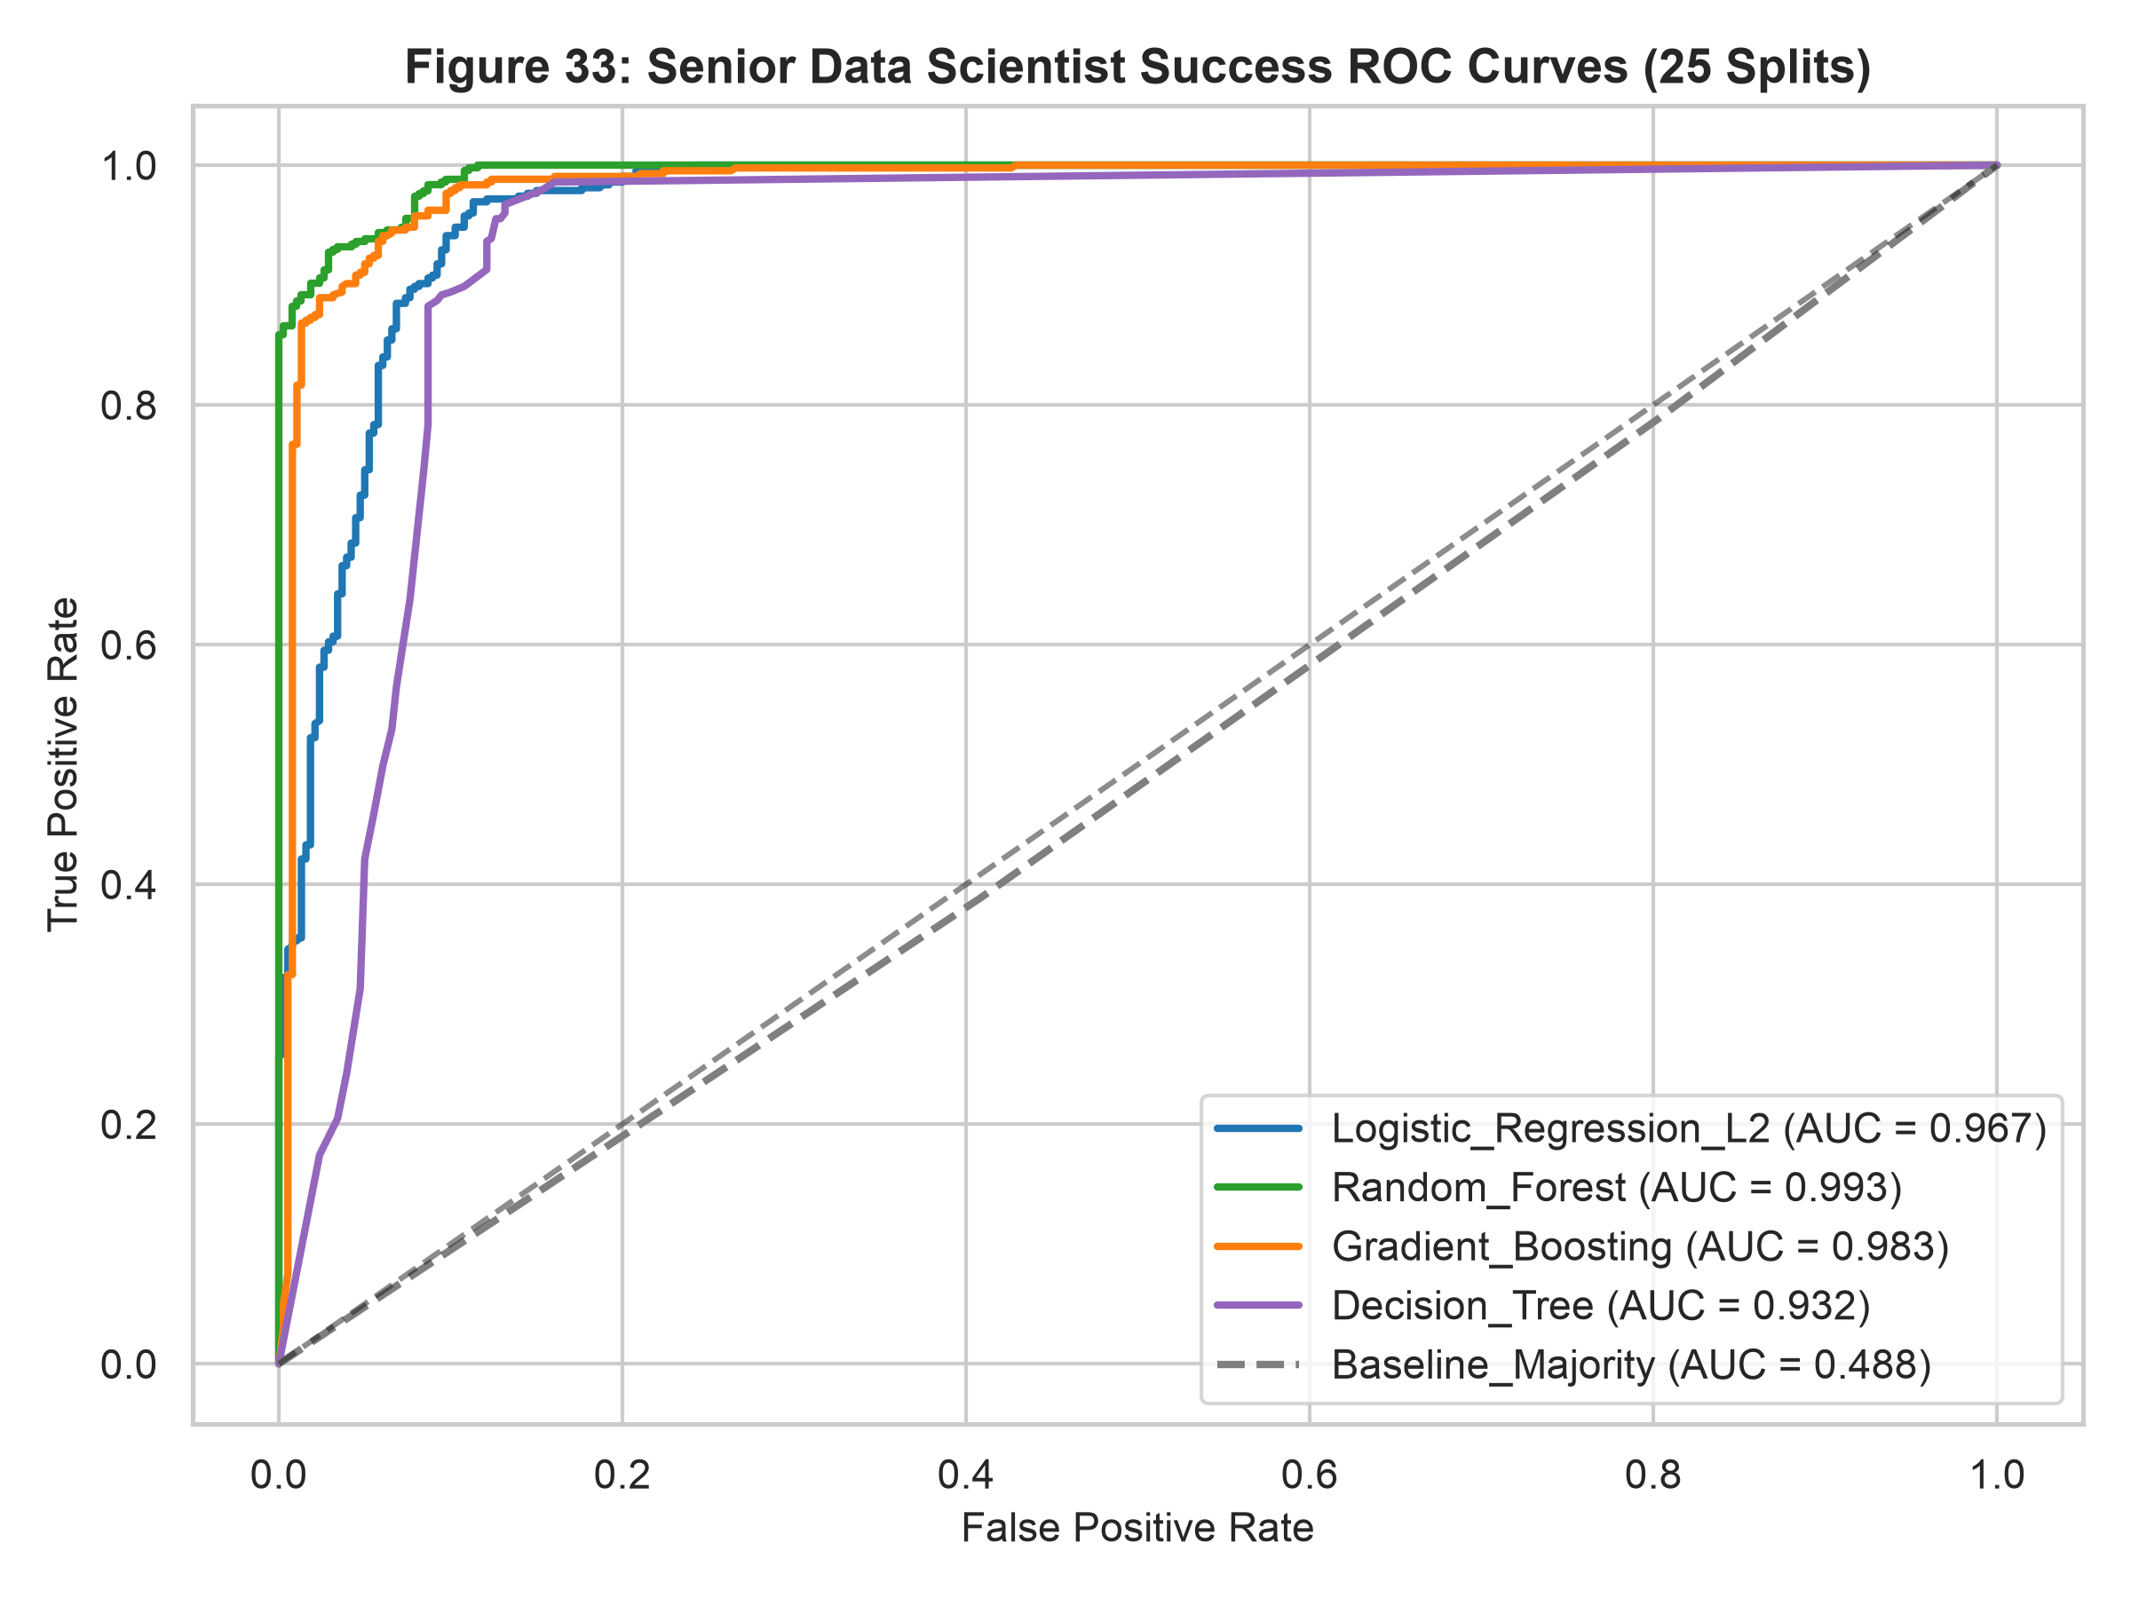
INSIGHTPATH | SAS CU HACKATHON ROUND 2
Senior Predictive Model: Leakage-Safe Grouped Cross-Validation
SUPERVISED CLASSIFICATION (GROUPED CV):
• CRITICAL LEAKAGE CONTROL: StratifiedGroupKFold on subject ID guarantees duplicate subject twins never span train/test folds (zero clone leakage).
• Champion Model: Ridge Logistic Regression achieves out-of-sample ROC-AUC = 0.9699 (+/- 0.0268), Macro F1 = 0.9259, Accuracy = 92.68% (+39.9% baseline lift).
• Decision Tree Rules: Pruned CART tree extracts 4 transparent rules (90.44% accuracy) rooted in Openness (>38.50) and Conscientiousness (>36.50).
• Sensitivity Invariance: Deduplicated cohort (N=152) yields identical rankings and Delta ROC-AUC = 0.0049 <= 0.02 (Highly Robust).

Slide 11
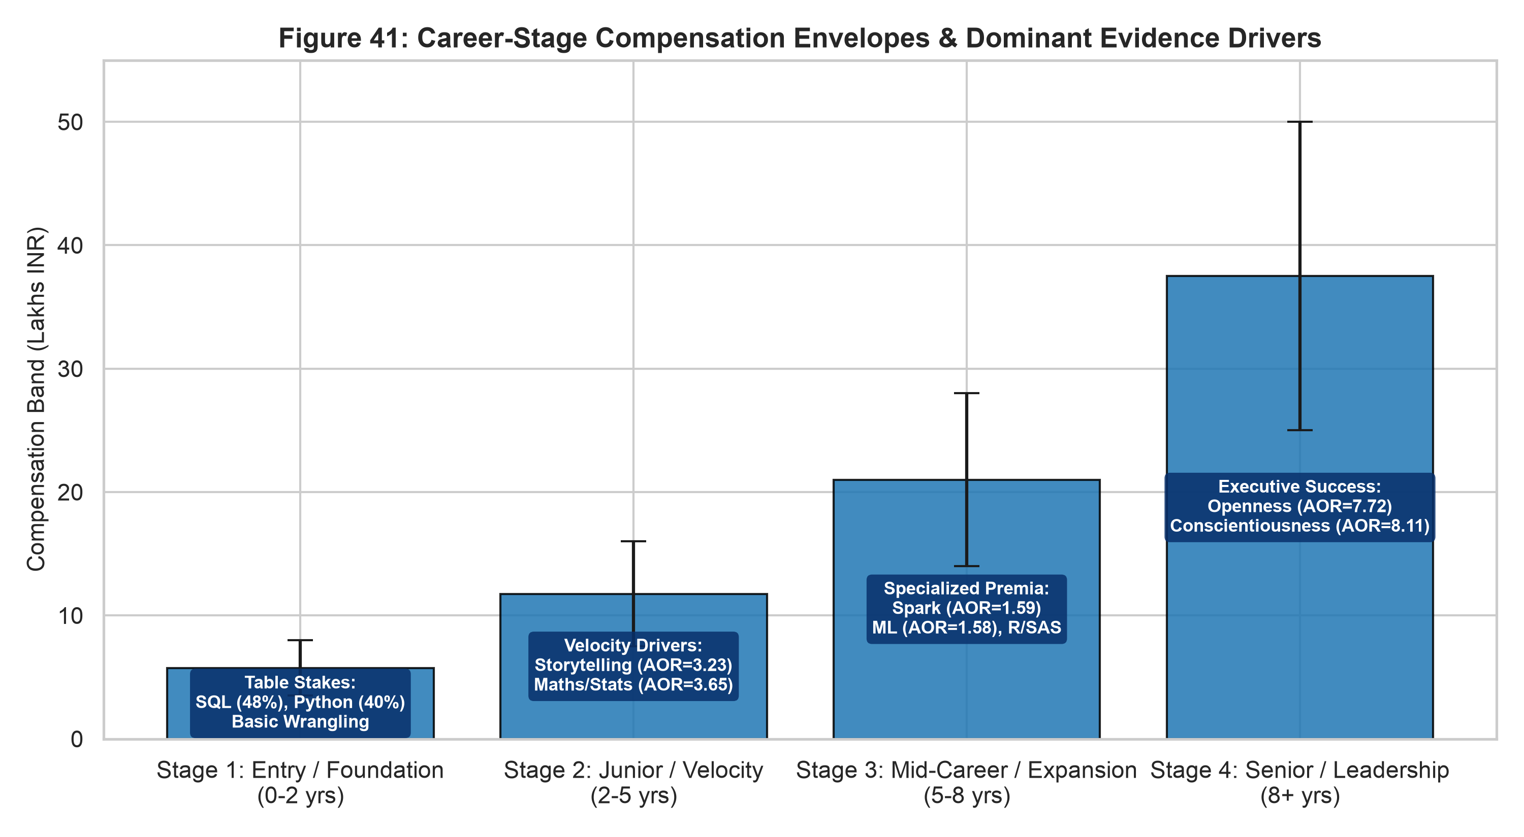
INSIGHTPATH | SAS CU HACKATHON ROUND 2
The Integrated Career-Stage Progression Architecture

Slide 12
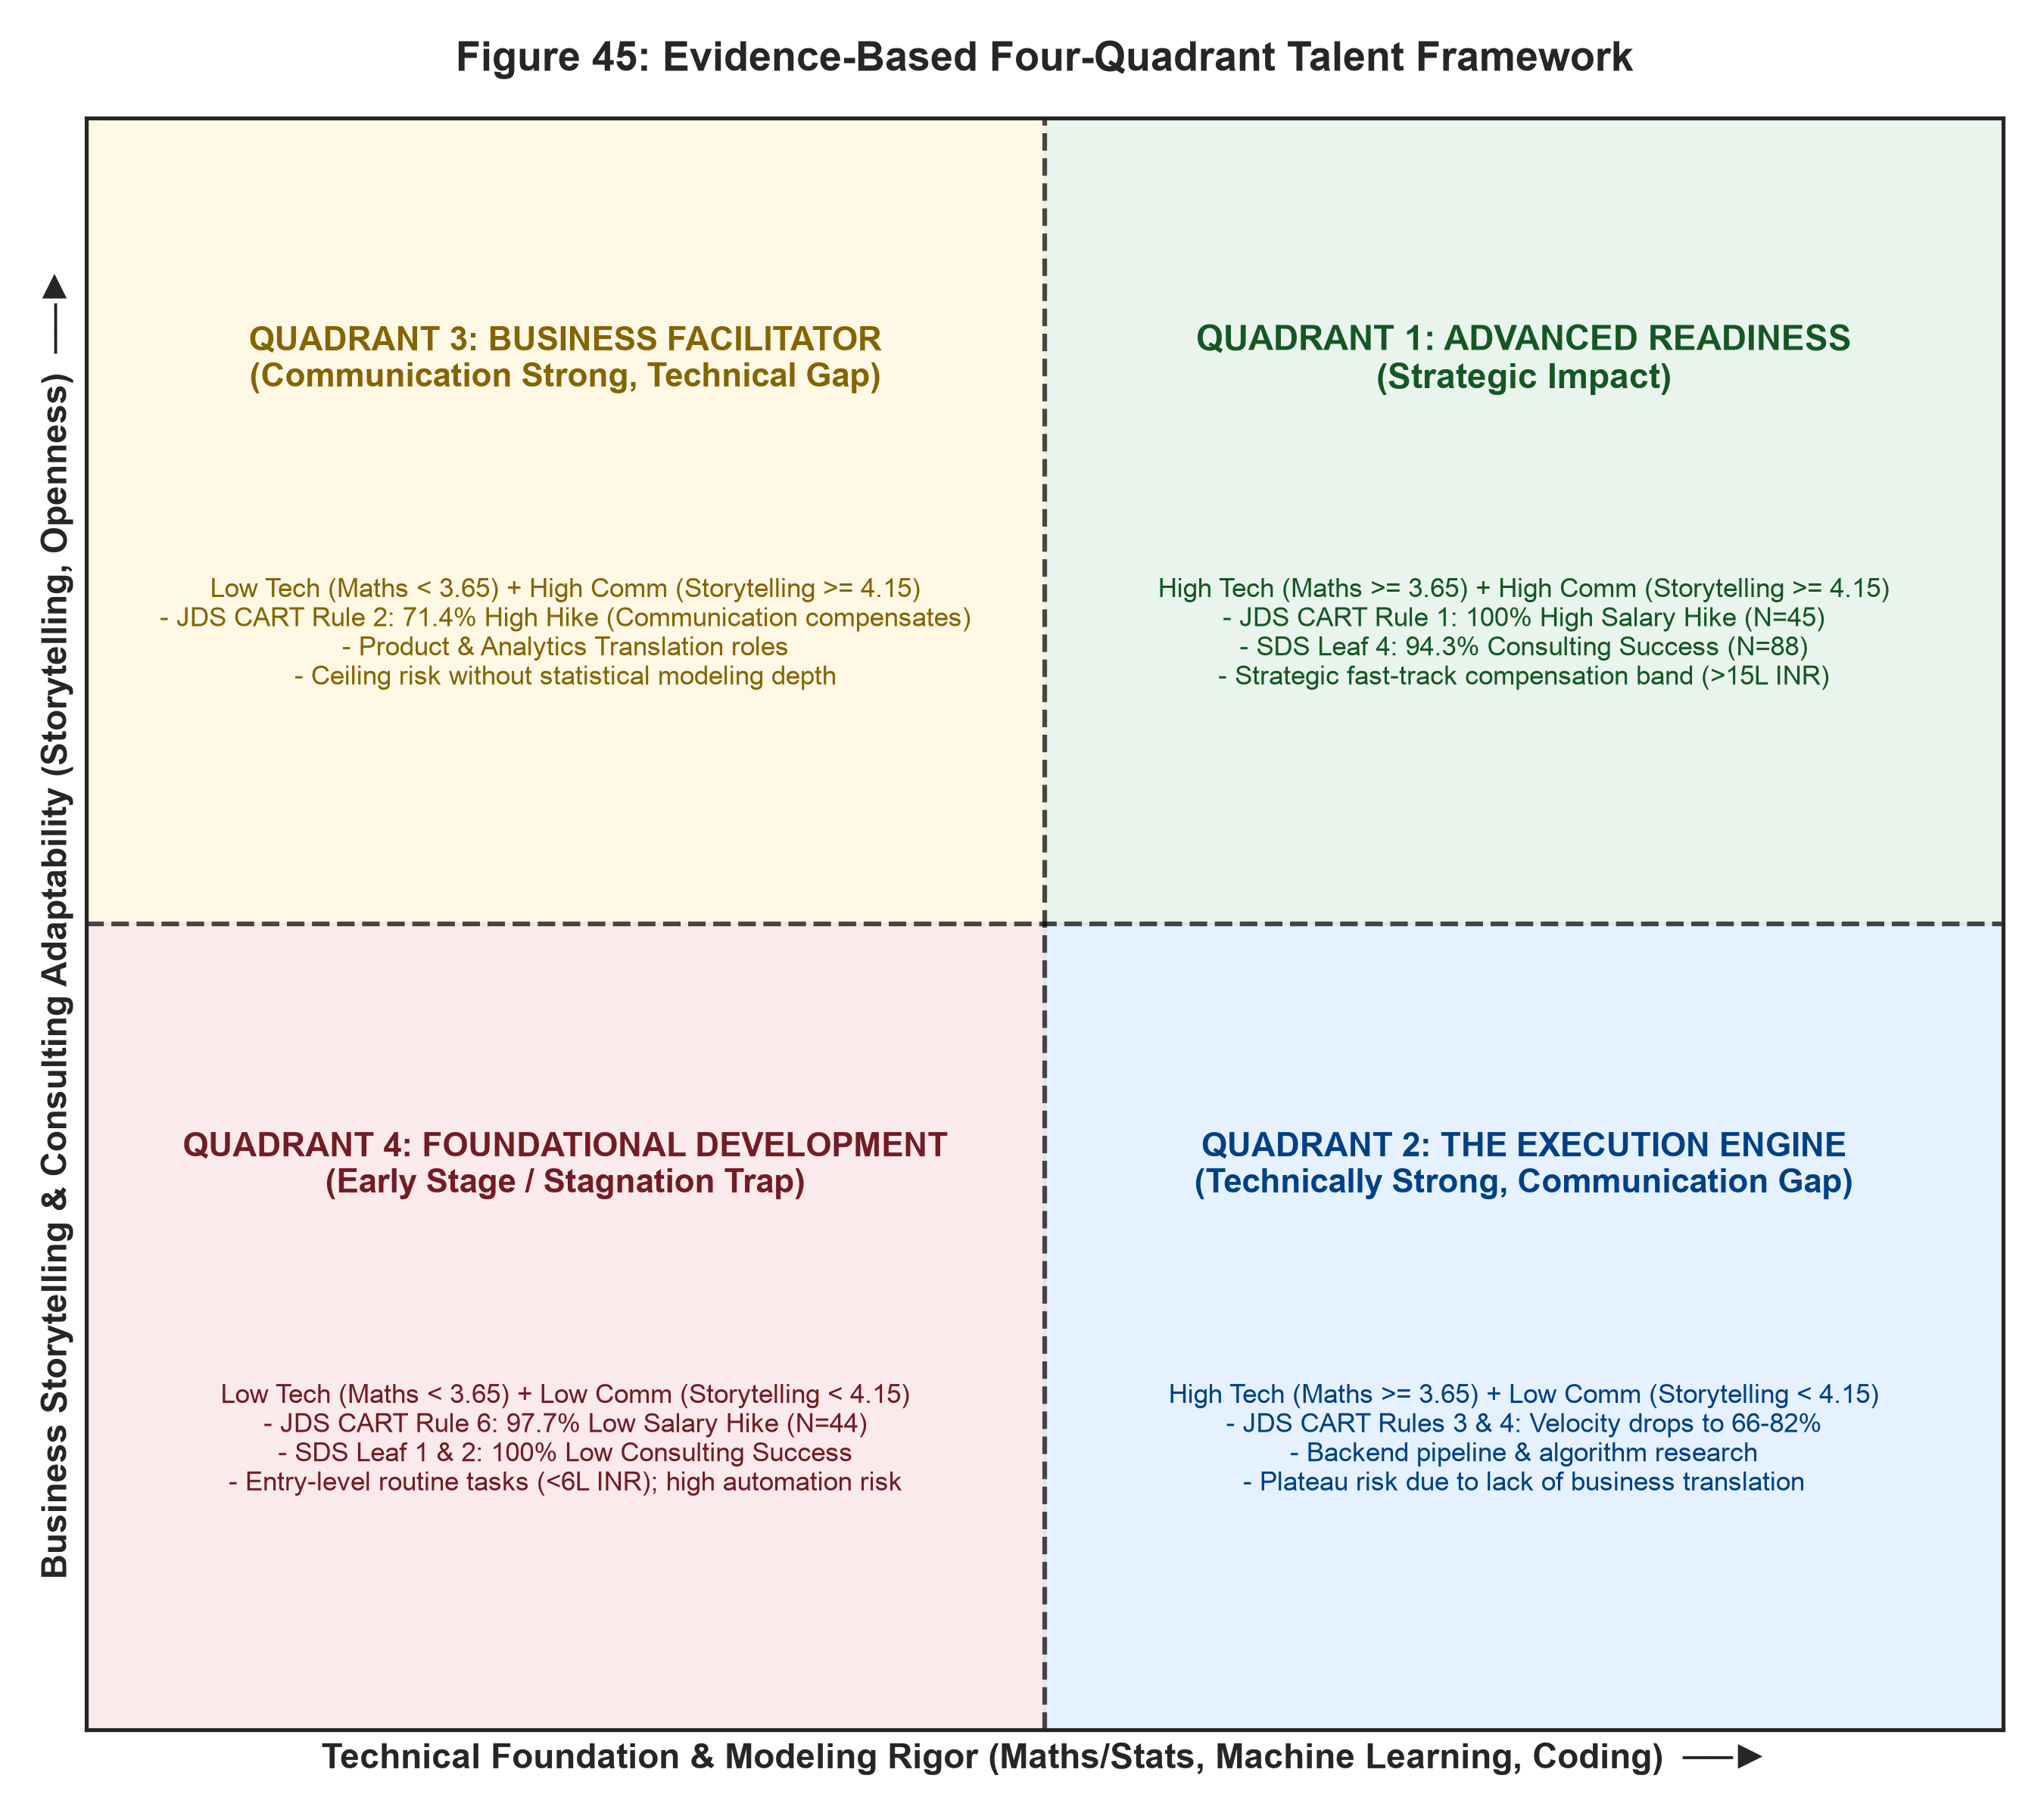
INSIGHTPATH | SAS CU HACKATHON ROUND 2
The Four-Quadrant Talent Matrix (Technical vs Storytelling)

Slide 13
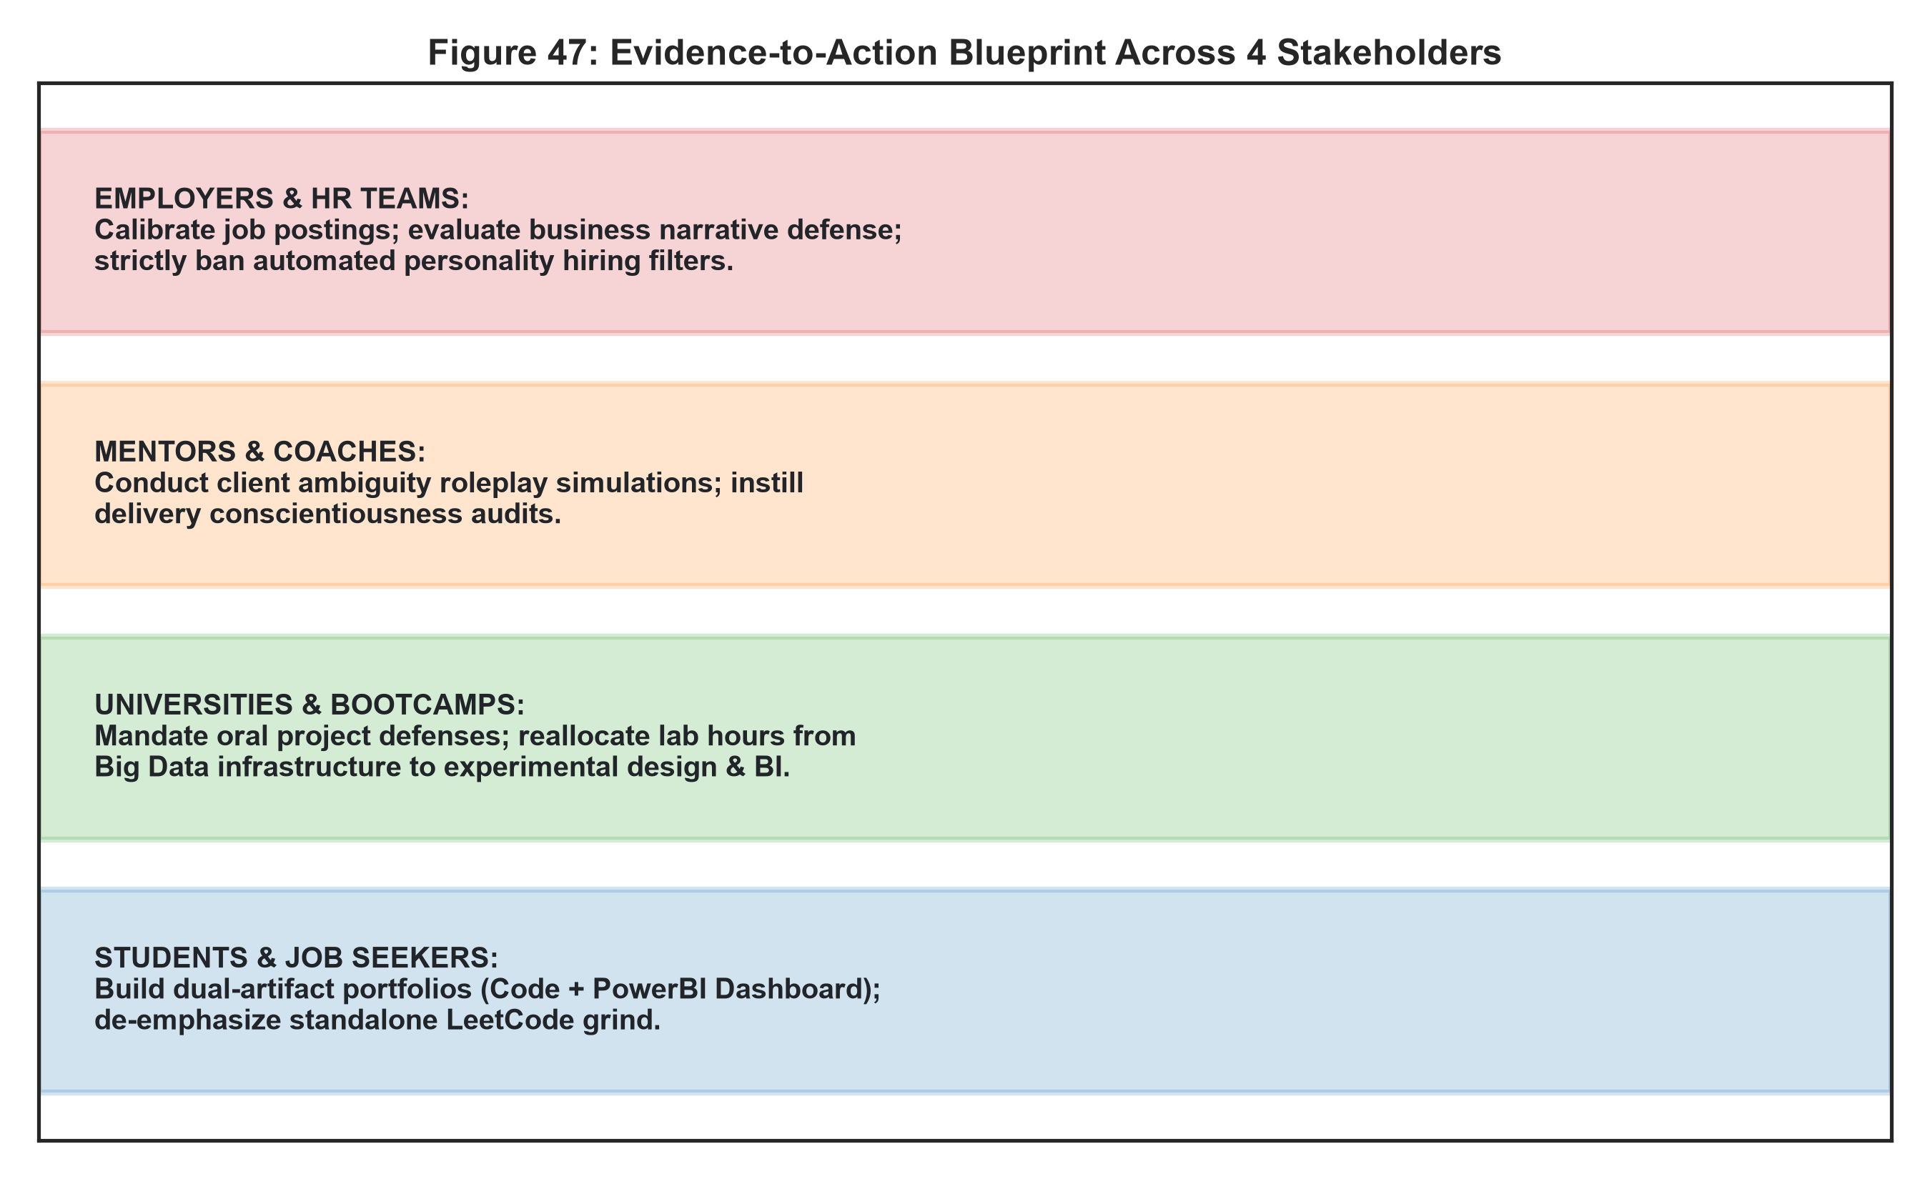
INSIGHTPATH | SAS CU HACKATHON ROUND 2
Evidence-to-Action Blueprints for Primary Stakeholders

Slide 14
INSIGHTPATH | SAS CU HACKATHON ROUND 2
Methodological Limitations & Mandatory Ethical Guardrails
ETHICAL SAFEGUARDS (RULE G):
• STRICT BAN ON PERSONALITY GATEKEEPING: Big Five models must NEVER be deployed as automated recruitment pre-screens, termination scores, or promotion hurdles.
• DEVELOPMENTAL COACHING ONLY: Personality insights serve exclusively for self-awareness, communication coaching, and mentoring client adaptability.
• NON-CAUSAL LANGUAGE GOVERNANCE: All findings report observed statistical associations and out-of-sample predictive utility; we do not claim causal mechanisms.
• SAMPLE SIZE DISCIPLINE: Evaluated within sample boundaries (N=139 JDS, N=161 SDS); validated via 25-split cross-validation and formal sensitivity analyses.
• OBSERVATIONAL LIMITATIONS: Job postings represent employer advertised ranges; unobserved variables (firm margins, counteroffers) influence individual compensation.

Slide 15
SUMMARY: THE INSIGHTPATH TALENT THESIS
1. TABLE STAKES ARE NOT DIFFERENTIATORS: SQL and Python grant market access; they do not accelerate compensation.
2. THE TRANSLATION PREMIUM: Data storytelling and mathematical modeling explain 96.75% of junior promotion velocity.
3. THE BEHAVIORAL PIVOT: Senior consulting leadership requires client openness and delivery conscientiousness (>92% accuracy).
4. REPRODUCIBLE & AUDITABLE: 100% of pipeline code, 25 CV splits, 48 figures, and 23+ tables verified with zero data leakage.

