Slide 1
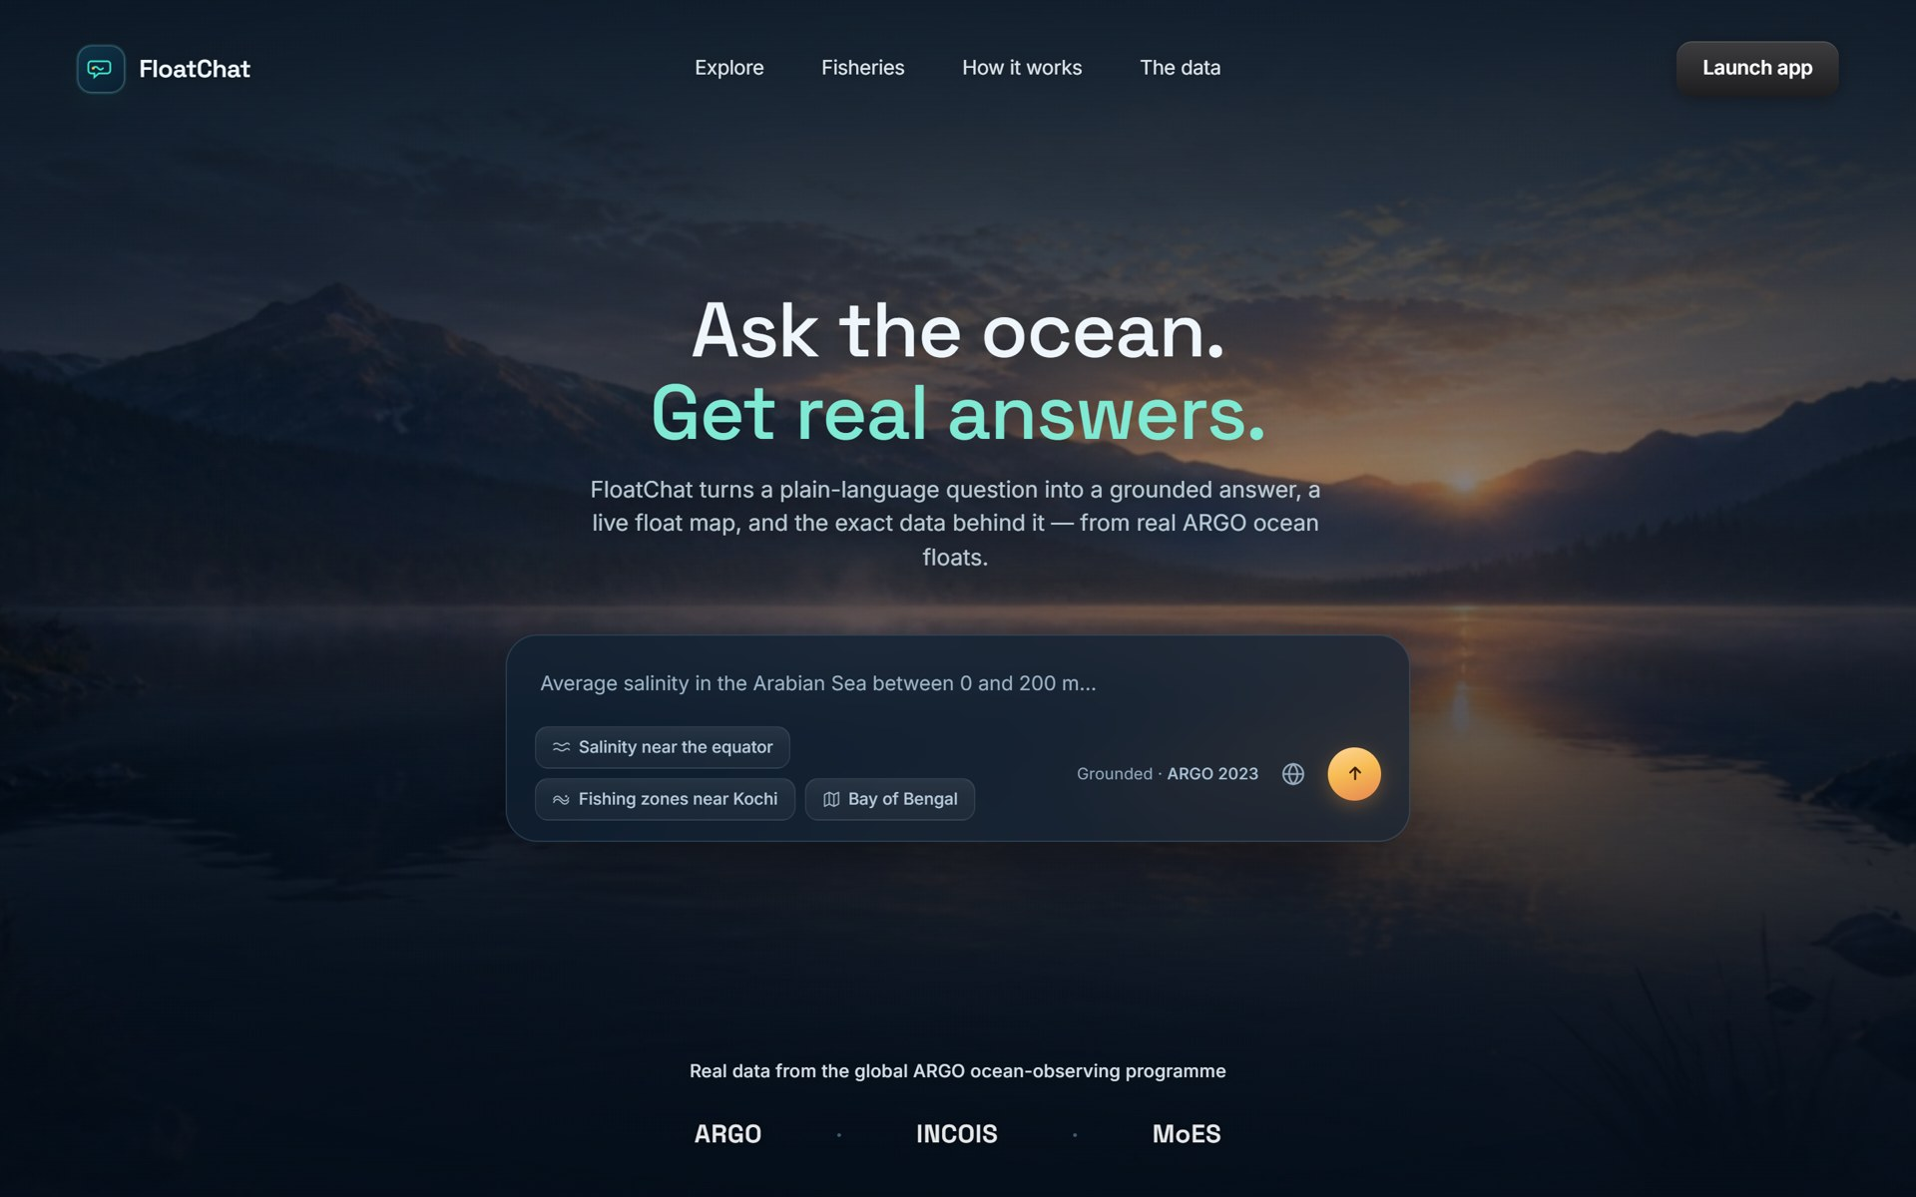
FloatChat
Ask the ocean. Get real answers.
Plain-language access to real ARGO ocean-float data — a grounded answer, a live float map, a chart and the exact SQL behind it.
ANALYTICA 2026 · Problem PS26-033 · MoES / INCOIS
Presented by Aditya Sharma
LIVE http://80.225.245.19
github.com/Sharmaditya2k05/Floatchat
Notes:
FloatChat is a web app that turns a plain-language question about the ocean into a validated SQL query over real ARGO float data, and returns a grounded one-sentence answer plus a map, chart and the SQL itself. Live at http://80.225.245.19; code on GitHub.

Slide 2




The ocean is measured — but the data is locked away
INTRODUCTION
ARGO is the world's largest ocean-observing programme. Its data is public, free and continuous. Almost nobody outside a small group of specialists can use it.
The scale of what's out of reach
~4,000
Ships as NetCDF
A scientific binary format with its own conventions — no spreadsheet, no search box.
autonomous floats drifting in every ocean
Quality-control flags
100,000+
Every reading carries a QC flag (1 good … 4 bad, 9 missing) and a real-time vs delayed-mode version. Pick wrong and the answer is wrong.
new profiles every year since 2000
Pressure, not depth
Floats record pressure in decibars; "above 200 m" needs a TEOS-10 conversion first.
3M+
Code before every answer
One question = install tools, write Python, handle xarray. Students, fisheries officers and policymakers are locked out.
profiles in total — temperature, salinity, pressure to 2 km
Notes:
The data exists and is open, but the access barrier is technical: NetCDF files, QC flags, delayed-mode conventions, pressure-to-depth conversion. The problem statement (PS26-033) asks to make ARGO data usable by non-specialists.

Slide 3








Objectives and intended users
INTRODUCTION
Ask in plain language
Who it is for
English or an Indian language (Hindi, Tamil, Bengali, Telugu, Malayalam) — no query syntax.
Students & educators
learn from real measurements
Never invent a number
Every figure in the answer must come from a real database row — the answer is checked, not trusted.
Fisheries officers & fishermen
where is the water productive this week?
Show the work
Policymakers
Map of the floats, an auto-chosen chart, the result table and the exact SQL under every answer.
answers without a data team
Researchers & the public
Serve fishermen too
quick looks, with the SQL to go deeper
Potential fishing zones from live satellite SST and chlorophyll, in fishermen's words and ports.
Notes:
Four objectives drive the design: natural-language input, grounded answers, full transparency (map/chart/table/SQL), and a fisheries layer. Users range from students to fisheries officers.

Slide 4
What FloatChat does
01
SECTION 01
One question in → answer, map, chart, table and SQL out

Slide 5
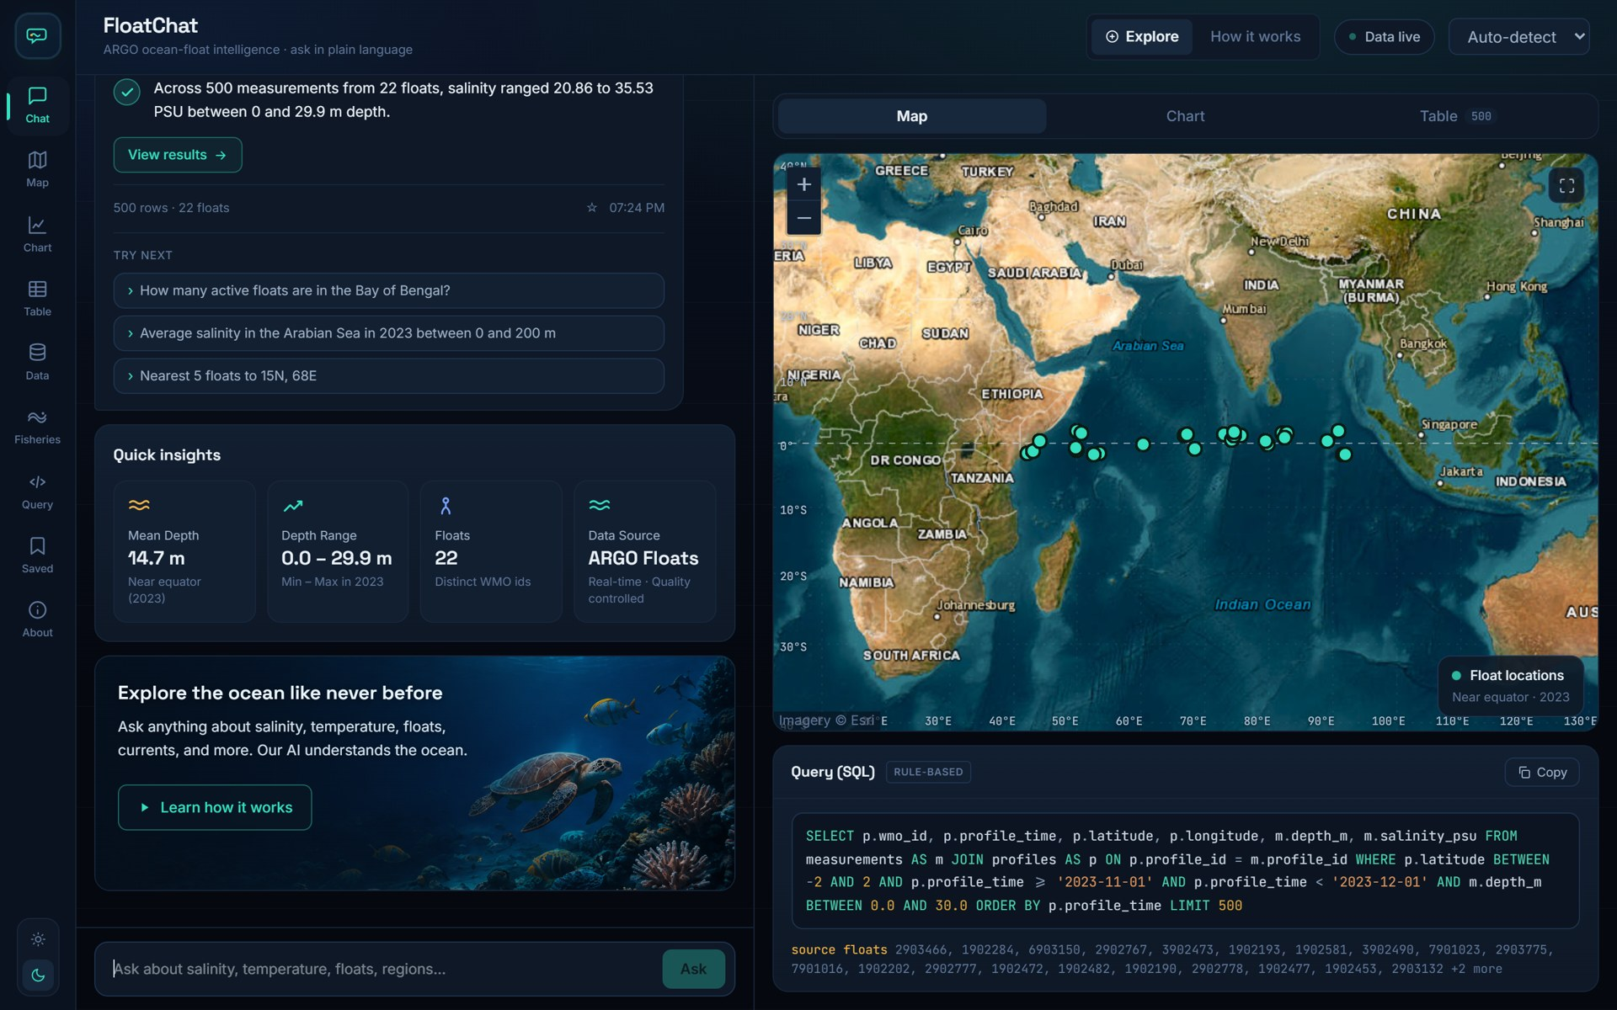
From one question to a grounded answer
WHAT IT DOES
1
You ask
typed, or tapped from the examples; language auto-detected
2
FloatChat writes one SQL query
LLM with schema retrieval, or the offline rule engine
3
The query is validated and run
read-only, one SELECT, allow-listed tables, 5 s timeout
4
You get the answer and its evidence
one grounded sentence · map · chart · table · SQL · follow-up suggestions
"Show me salinity near the equator in November 2023" on the live server — answer, satellite float map, SQL.
Notes:
Walk through the screenshot: the chat on the left holds the question and the one-sentence answer; the right panel shows the map with the floats that answered, with Chart and Table tabs; the SQL panel sits underneath with the engine badge (llm or rule).

Slide 6




Key features (all implemented)
WHAT IT DOES
Six input languages
Grounded answers
Map · chart · table
English + हिन्दी, தமிழ், বাংলা, తెలుగు, മലയാളം. langdetect picks the language; a gazetteer keeps place names intact before translation.
The sentence may only use numbers that appear in the returned rows or in the question — otherwise the safe template answer is used.
Leaflet satellite map of the floats, a Plotly depth-profile or monthly trend chart, and the raw rows — chosen automatically from the result shape.
SQL you can read
Fisheries intelligence
Works without an LLM
The exact query, the engine that wrote it (LLM or rule) and the source float IDs under every answer. History and saved questions.
Potential fishing zones derived nightly from NOAA OISST sea-surface temperature and VIIRS chlorophyll, around 9 Indian ports.
A deterministic rule engine covers the core query families (aggregate, nearest-N, float profile, time-series, counts) when no model is configured.
Notes:
Every feature here is in the codebase: lang.py (languages), summarize.py (grounding), viz.py + MapView/ChartView/TableView (visuals), SqlPanel + SidePanels (SQL, history, saved), ingest/fisheries_fetch.py (fisheries), fallback_nl2sql.py (rule engine).

Slide 7
How it is built
02
SECTION 02
Stack · architecture · request pipeline · data pipeline · deployment

Slide 8






Technology stack — verified from the repository
HOW IT IS BUILT
Frontend
Backend API
Database
frontend/package.json
requirements.txt
db/schema.sql
React 18 + TypeScript, Vite 5
Tailwind CSS 4
Leaflet 1.9 (satellite map)
Plotly.js (charts)
Python 3.11 · FastAPI · uvicorn
psycopg 3 (Postgres driver)
sqlglot (SQL parsing/validation)
langdetect · httpx · pandas
PostgreSQL 16 + PostGIS 3.4
GEOGRAPHY points + GiST index
Read-only role floatchat_ro
7 tables: 4 ARGO + 3 fisheries
NL → SQL brain
Data ingestion
Ops
app/nl2sql.py · rag/
ingest/
deploy/ · docker-compose.*.yml
TF-IDF schema + example retrieval
LLM via OpenAI-compatible API: Groq, OpenAI, xAI, Ollama; or Anthropic
Rule-based fallback engine
Grounding check on the answer
argopy (Ifremer ERDDAP, expert mode)
xarray · netCDF4 · gsw (TEOS-10)
NOAA CoastWatch ERDDAP (OISST, VIIRS)
COPY bulk load
Docker Compose (db · api · web)
Caddy 2 (static + /api proxy)
Oracle Cloud Always Free VM
cron nightly fisheries refresh · pytest
Notes:
Everything on this slide is taken from the manifests: frontend/package.json, requirements.txt, db/schema.sql, .env.example (LLM providers), docker-compose files.

Slide 9
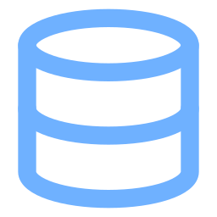





System architecture
HOW IT IS BUILT
Oracle Cloud VM · Docker Compose (3 containers) · ubuntu, 1 GB RAM + 4 GB swap
api · FastAPI (app/main.py)
lang.py detect + translate
db · PostgreSQL 16 + PostGIS
rag/retriever.py TF-IDF schema docs
floats · profiles · measurements · regions
pfz_advisories · sst_composites · chlorophyll
roles: floatchat_ro (SELECT only) · floatchat_admin (ingest)
Browser
React SPA (Vite)
Leaflet · Plotly
web · Caddy 2
serves frontend/dist
/api/* → api:8000
nl2sql.py LLM (llm.py) | fallback_nl2sql.py
validate.py sqlglot allow-list, LIMIT
execute.py read-only, 5 s timeout
summarize.py grounded sentence
viz.py · suggest.py GeoJSON, series, follow-ups
LLM API (optional)
ARGO · Ifremer ERDDAP
NOAA CoastWatch ERDDAP
Groq / OpenAI / Anthropic / Ollama — nl2sql.py and summarize.py
argopy, expert mode → ingest/build_db.py (one-off, by month × tile)
OISST SST + VIIRS chlorophyll → fisheries_fetch.py, nightly cron
Notes:
Three containers on one VM. Caddy serves the built React app and reverse-proxies /api to FastAPI. FastAPI runs the pipeline modules top to bottom and talks to PostGIS with a read-only role. External services: the LLM API (optional — the live demo runs the rule engine), ARGO's ERDDAP for the one-off ARGO load, and NOAA's ERDDAP for the nightly fisheries refresh.

Slide 10
What happens when you ask a question (POST /api/chat)
HOW IT IS BUILT
1
Detect language, translate
Response — real reply from the live server
lang.py: langdetect → gazetteer protects place names → English question
{
"question": "Current fishing zones near Kochi",
"language": "en",
"engine": "fallback", // or "llm"
"sql": "SELECT pz.zone_name, ... LIMIT 20",
"answer": "Found 20 active fishing-zone
advisories — nearest is Kochi
PFZ-1 (likely sardine, mackerel);
SST 29 to 30.6 °C.",
"chart_kind": "map",
"columns": [...], "rows": [...],
"row_count": 20,
"series": null,
"geojson": { "type": "FeatureCollection" },
"float_ids": [],
"suggestions": ["...", "...", "..."]
}
2
Retrieve context (RAG)
retriever.search(q, k=6): TF-IDF over schema docs + few-shot examples (rag/index.json)
3
Write one SQL statement
nl2sql.generate_sql: LLM with SYSTEM_PROMPT; rejected SQL → one retry; any failure → rule engine
4
Validate
validate_sql: no ';', keyword denylist, sqlglot parse, single SELECT, 7 allowed tables, LIMIT ≤ 500
5
Execute
execute.run_query: psycopg, default_transaction_read_only=on, statement_timeout=5000 ms
6
Summarize (grounded)
summarize(): template sentence; LLM phrasing accepted only if its numbers ⊆ result numbers
7
Visualize + suggest
viz.infer_kind → map / profile / timeseries; build_geojson, build_series; 3 follow-up questions
Notes:
This is the exact order in app/main.py chat(). Steps 4 and 6 (amber) are the safety gates: nothing reaches the database unless it is a single read-only SELECT on allowed tables, and nothing reaches the user as a number unless it came from the rows.

Slide 11
Core implementation — NL→SQL with a safety net
HOW IT IS BUILT
app/nl2sql.py — LLM first, rule engine as the always-available fallback
app/validate.py — parse with sqlglot, allow-list tables, cap rows
def generate_sql(question): # app/nl2sql.py
docs = retriever.search(question, k=RAG_TOP_K)
prompt = (f"RELEVANT SCHEMA: {schema_docs}"
f"FEW-SHOT EXAMPLES: {example_docs}"
f"USER QUESTION: {question} SQL:")
try:
raw = chat(SYSTEM_PROMPT, prompt) # llm.py
try:
return validate_sql(raw), "llm", docs
except SQLValidationError as e: # retry once
raw = chat(SYSTEM_PROMPT, prompt +
f"Your previous SQL was rejected: {e}")
return validate_sql(raw), "llm", docs
except Exception: # LLM off / failed
pass
sql = fallback_generate(question) # rule engine
return validate_sql(sql), "fallback", docs
ALLOWED_TABLES = {"floats", "profiles", "measurements",
"regions", "pfz_advisories", "sst_composites", "chlorophyll"}
DENYLIST = re.compile(r"\b(insert|update|delete|drop|alter|"
r"create|truncate|grant|copy|pg_sleep|...)\b")
def validate_sql(sql, max_rows=500): # app/validate.py
if ";" in sql:
raise SQLValidationError("multiple statements")
if DENYLIST.search(sql):
raise SQLValidationError("disallowed keyword")
tree = sqlglot.parse(sql, read="postgres")[0]
if not isinstance(inner, (exp.Select, exp.Union, ...)):
raise SQLValidationError("only SELECT statements")
for t in tree.find_all(exp.Table):
if t.name.lower() not in ALLOWED_TABLES | cte_names:
raise SQLValidationError(f"table '{t.name}'")
if not limit and not _is_aggregate(inner):
inner.limit(max_rows) # force LIMIT 500
return tree.sql(dialect="postgres")
Prompt = retrieved schema docs + few-shot examples + question → the model can only name real tables and columns
Validation is structural (AST), not string matching — CTEs, UNIONs and subqueries are walked; aggregates may skip the LIMIT
The rule engine (fallback_nl2sql.py, ~350 lines) parses regions, ports, months, depths and the five query families with regular expressions
Notes:
Snippets are condensed from the real files. Key design: the LLM is optional and untrusted; every path ends in validate_sql().

Slide 12
Grounded answers and read-only execution
HOW IT IS BUILT
app/summarize.py — the model may phrase, never invent
app/execute.py · db/roles.sql — three layers of protection
def summarize(question, columns, rows, kind): # app/summarize.py
base = _template_summary(question, columns, rows, kind)
if not rows:
return base
# numbers the answer may use: anything in the rows,
# plus numbers the user typed (years, depths, coords)
allowed = _allowed_numbers(columns, rows) | _numbers(question)
try:
candidate = chat("...write ONE short sentence. Use ONLY "
"numbers that appear in the rows...",
f"Question: {question}\n\nRows:\n{table}")
if candidate.endswith((".", "!", "?")) \
and _numbers(candidate) <= allowed: # grounding gate
return candidate
except Exception:
pass
return base # always safe
def run_query(sql): # app/execute.py
options = ("-c default_transaction_read_only=on "
f"-c statement_timeout={TIMEOUT_MS}")
with psycopg.connect(DATABASE_URL, options=options,
connect_timeout=5) as conn:
cur = conn.execute(sql)
return {"columns": [d.name for d in cur.description],
"rows": [[_jsonable(v) for v in r] for r in cur]}
-- db/roles.sql: the API's role can only read
CREATE ROLE floatchat_ro LOGIN PASSWORD '...';
GRANT SELECT ON ALL TABLES IN SCHEMA public TO floatchat_ro;
API endpoints (app/main.py)
GET /health
API + DB status (header pill)
POST /chat
the full pipeline → answer, map, chart, SQL
POST /query
run a user-edited SQL through the same validator
GET /floats
float positions for the context map
GET /data/overview
row counts, date range, table previews, sources
GET /fisheries/overview
PFZ / SST / chlorophyll status + sources
Notes:
Defence in depth: validator (what SQL), read-only transaction + role (what it can touch), statement timeout (how long). The grounding gate compares the set of numbers in the candidate sentence with the set of numbers in the rows.

Slide 13



Data pipeline — from ARGO and NOAA servers to PostGIS
HOW IT IS BUILT
Fetch
Transform
Load
Serve
ingest/fetch.py
ingest/transform.py
ingest/load.py
db/schema.sql
argopy DataFetcher(src='erddap', mode='expert') per month × 25° tile, 3 retries
flatten to one row per level · keep QC ∈ {1,2} · prefer *_ADJUSTED · ascending only · depth_m = gsw.z_from_p
COPY bulk insert · profiles ON CONFLICT DO NOTHING · GEOGRAPHY points · GiST + time indexes
floats → profiles (1 per float cycle) → measurements (1 per depth level); regions polygons
Fisheries layer — ingest/fisheries_fetch.py (nightly cron, 03:30 UTC)
On the live server
NOAA OISST v2.1 daily SST + anomaly (ncdcOisst21NrtAgg), last 14 days, 0.5° stride, box 5–24°N 66–92°E
NOAA VIIRS chlorophyll-a (nesdisVHNSQchlaDaily), last 7 days, cloud-free cells only
PFZ derivation: warm SST band + high chlorophyll within 150 km of 9 ports (Kochi, Chennai, Visakhapatnam, Mumbai…); ≥ 25 km offshore, ≤ 15 mg/m³, 3 zones per port, valid 3 days
Re-runs replace the window, so tables never grow unbounded; every row carries a source tag
5,299
3.6 M
ARGO profiles
measurements
19,530
27
SST grid cells (14 days)
fishing zones (9 ports)
ARGO window: Jan 2023 – Nov 2023 · Indian Ocean
Notes:
The ARGO load is a one-off batch (ingest.build_db) that can be run for any date range; the fisheries layer refreshes itself every night from open NOAA feeds. Figures on the right were read from the live database when this deck was built.

Slide 14




Deployment — the whole stack on a free 1 GB cloud VM
HOW IT IS BUILT
Oracle Cloud Always Free
On the server (captured during deployment)
VM.Standard.E2.1.Micro · 1 OCPU · 1 GB RAM · 45 GB disk · ap-mumbai-1 · Ubuntu 20.04 · public IP 80.225.245.19
$ docker compose -f docker-compose.micro.yml ps
NAME IMAGE STATUS
floatchat-api floatchat-api Up
floatchat-db postgis/postgis:16-3.4 Up (healthy)
floatchat-web caddy:2-alpine Up :80->80
$ free -m
total used free available
Mem: 952 496 72 212
Swap: 4095 410 3685
$ curl http://80.225.245.19/api/health
{"status":"ok","db":"ok"}
docker-compose.micro.yml
db (postgis/postgis:16-3.4, shared_buffers=96MB) · api (built on the VM from Dockerfile) · web (caddy:2-alpine serving a frontend/dist built on the laptop)
deploy/server_setup.sh
installs Docker + Compose, adds a 4 GB swap file, opens 80/443 in Ubuntu's iptables (Oracle images block all but SSH)
deploy/install_cron.sh
crontab: refresh_fisheries.sh every night → fisheries_fetch --days 14 inside the api container; log at ~/fisheries_refresh.log
Why not build on the server?
Secrets
A Vite/Node build of the 5 MB Plotly bundle exceeds 1 GB RAM. The frontend is built on the laptop and only the small Python image is built on the VM — the one change that made the free shape workable.
one .env on the VM: LLM provider/key, random POSTGRES_PASSWORD; DATABASE_URL points at the read-only role; restart: unless-stopped on every container
Notes:
The repo's original guide targeted a 12 GB ARM VM; this deployment runs on the 1 GB AMD shape instead, which required building the frontend off-box, swap, lower Postgres memory settings and loading the ARGO data on the server in chunks.

Slide 15
The application
03
SECTION 03
Screenshots taken from the live deployment at http://80.225.245.19

Slide 16
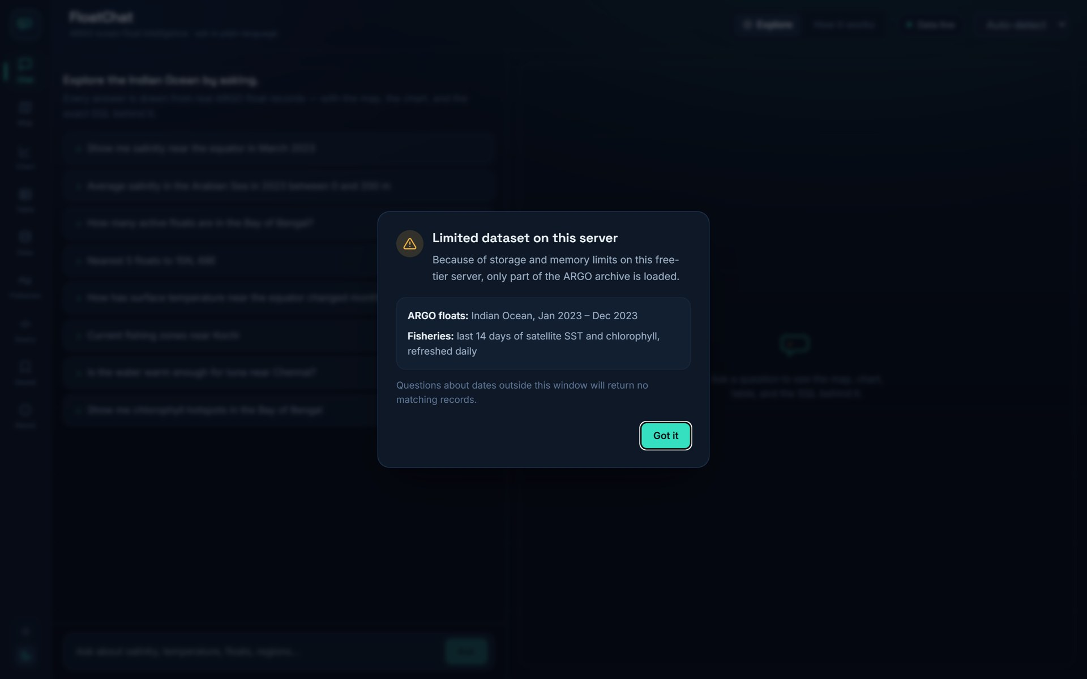
Landing page and the data-limit notice
DEMONSTRATION
Landing: hero question box with example chips; links to Explore, Fisheries, How it works, The data.
On launch, a one-time notice reads /api/data/overview and states exactly which ARGO window this server holds.
The landing page lets a visitor type a question before entering the app; the crossfade hands the question straight to the chat.
Because the free VM holds a subset of the archive, the notice makes 'no matching records' outside the window understandable rather than looking like a bug.

Slide 17
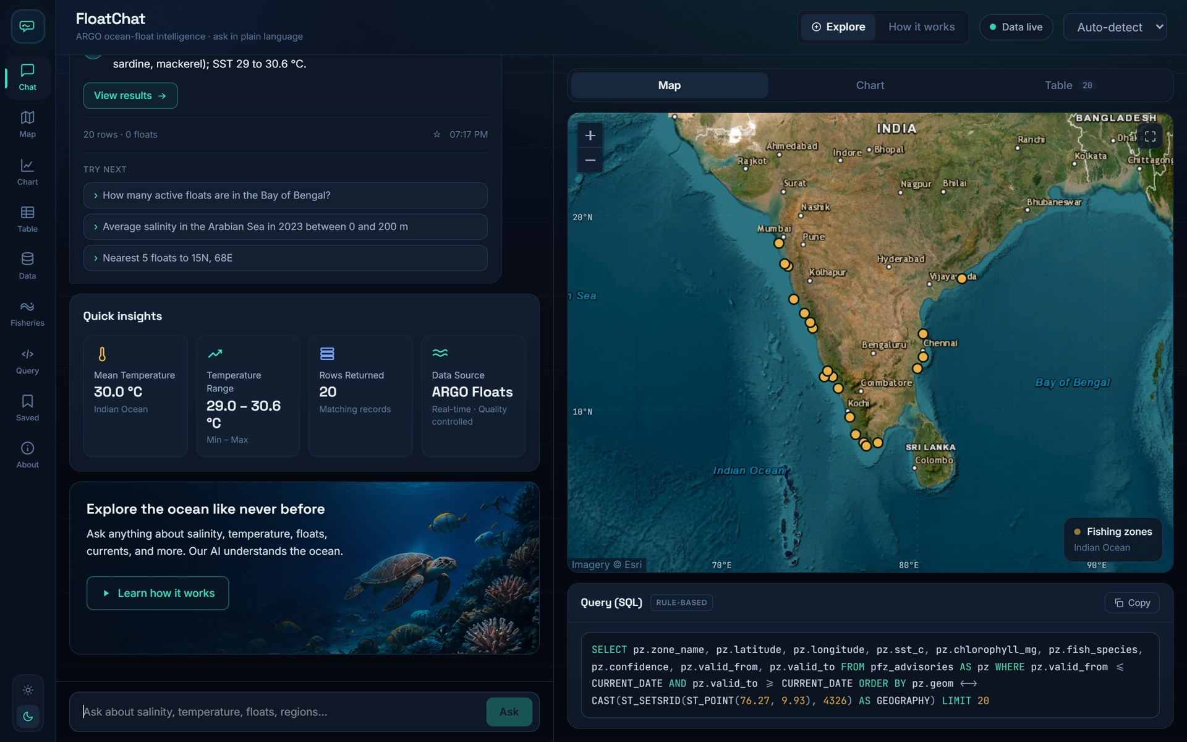
Explore — fishing zones near Kochi
DEMONSTRATION
Chat
The question, the grounded one-sentence answer (nearest zone, likely species, SST range) and quick insights.
Map
PostGIS orders zones by distance from Kochi (76.27°E, 9.93°N) with the <-> operator; popups show species and validity.
SQL panel
The exact query the rule engine wrote, the engine badge, and a button to save the question.
Follow-ups
Three suggested next questions generated from the result shape.
"Current fishing zones near Kochi" → 20 active zones from today's NOAA data, drawn in amber on the satellite map.

Slide 18
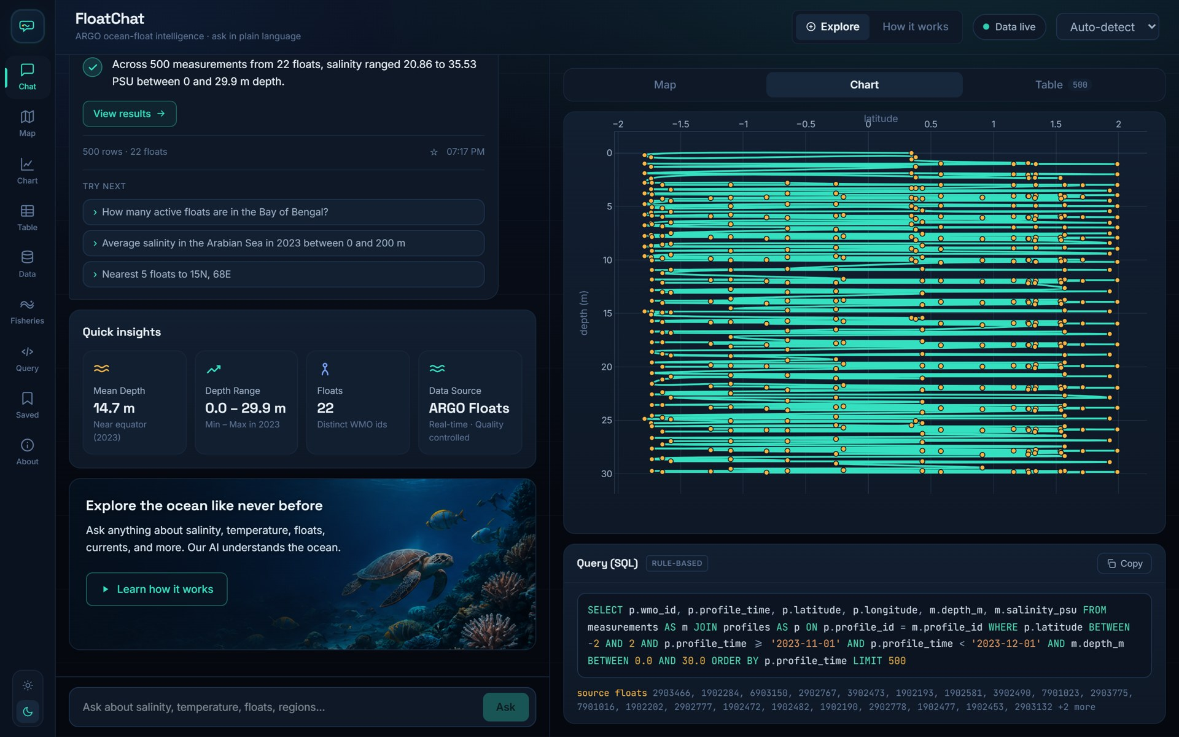
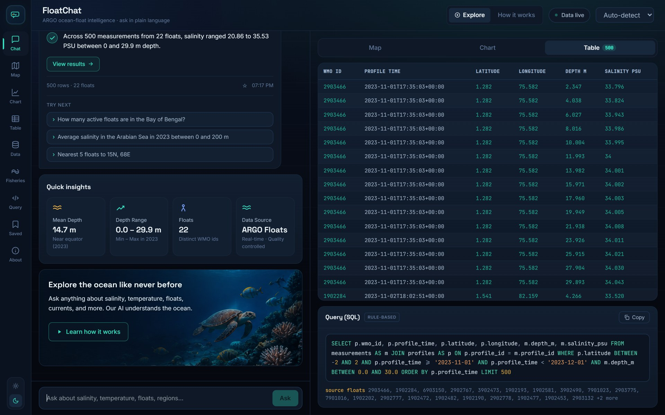
Explore — chart and table views of the same answer
DEMONSTRATION
Chart tab: Plotly depth-profile chart built automatically from the 500 returned rows (22 floats, 0–30 m).
Table tab: the raw rows (float, cycle, depth, salinity…) — capped at 500 by the validator.
viz.infer_kind() looks at the columns: positions → map, depth column → profile chart, month/year column → time series, single aggregate row → KPI sentence.
The tab badge shows row_count; the same response object feeds all three views, so what you see in the table is exactly what was charted and summarised.

Slide 19
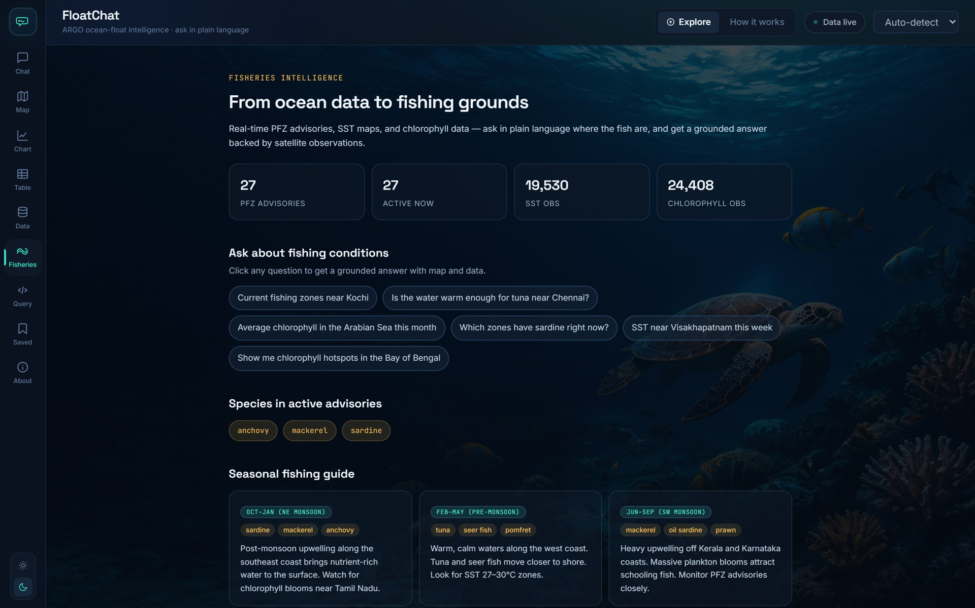
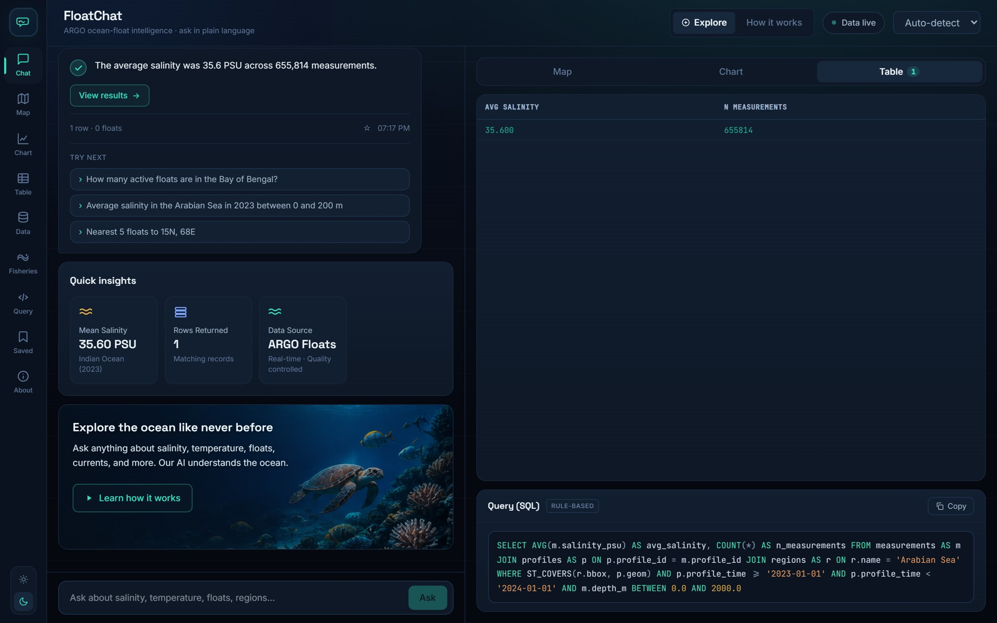
Fisheries tab and a question in Hindi
DEMONSTRATION
Fisheries: what is loaded (PFZ, SST, chlorophyll with sources and dates), port shortcuts, seasonal guide.
"अरब सागर में 2023 में औसत लवणता" — detected as Hindi, translated with the place-name gazetteer, answered from the data.
The fisheries overview is served by GET /fisheries/overview and labels derived zones honestly: computed with the INCOIS PFZ recipe, not an official INCOIS advisory.
Language handling lives in app/lang.py: langdetect chooses the language, region/port names are protected, and the rest is translated before the SQL step.

Slide 20
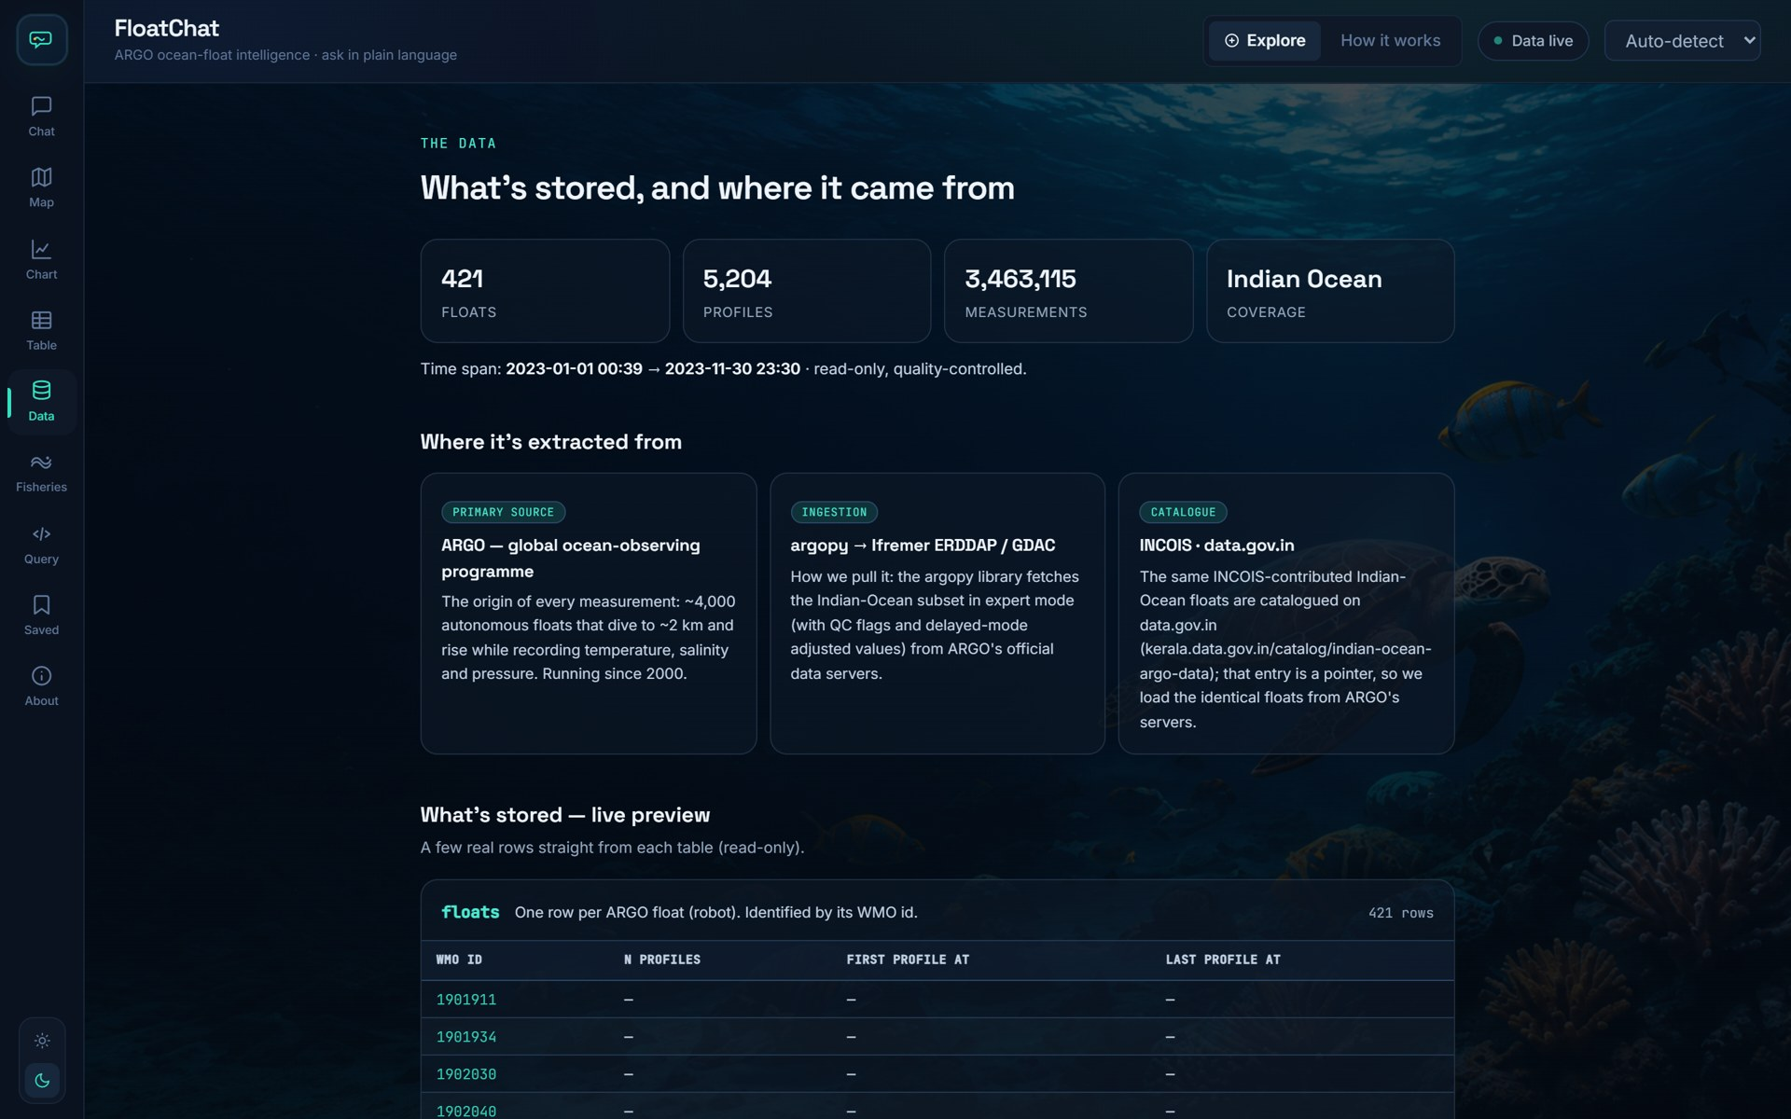
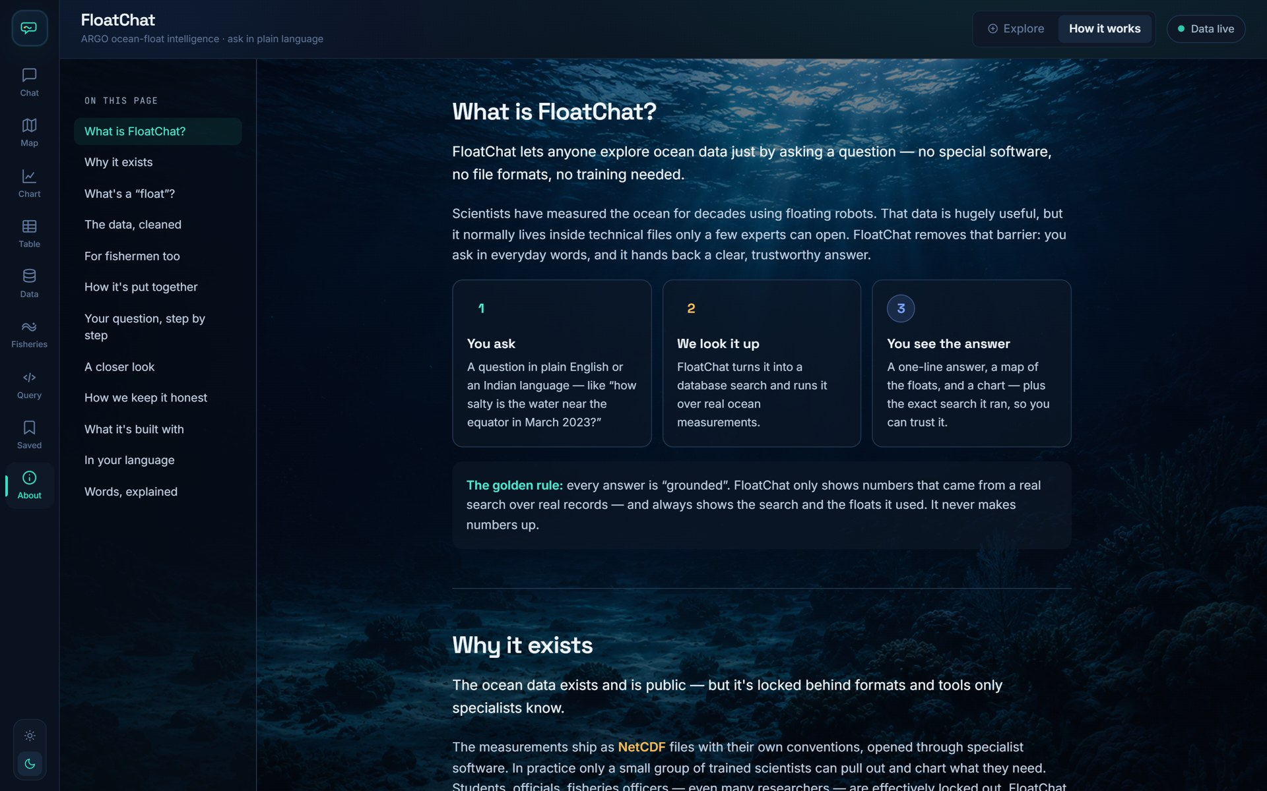
Provenance and the built-in explainer
DEMONSTRATION
The data: live counts and date range, a preview of every table, and where each dataset comes from.
How it works: a plain-language walk from question to grounded answer, for non-technical users.
Both pages are driven by the API, not hard-coded: GET /data/overview runs live COUNT queries and table previews on every visit.
A light theme is available from the sidebar; the choice is remembered in localStorage.

Slide 21


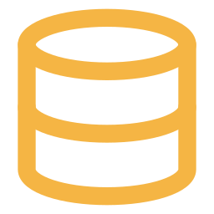

Challenges faced and current limitations
REFLECTION
What happened
What was done / mitigation
1 GB of RAM for the whole stack
The repo's guide assumed a 12 GB ARM VM. On the free 1 GB shape the frontend build crashed and Postgres had no headroom.
Build the frontend off-box, stock Caddy image, 4 GB swap, Postgres tuned to 96 MB buffers, ARGO loaded in 3-month chunks on the server.
NOAA renamed its SST dataset
fisheries_fetch.py requested ncdcOisst21NrtAgg_LonPM180, which now returns HTTP 404, so the fisheries load failed.
Switched to ncdcOisst21NrtAgg (same grid, 0–360° longitude; the Indian box is unaffected). Verified on the live server: 19,530 SST cells, 27 zones.
Only part of the archive is online
Full 2019–2023 (≈40 M rows) will not fit comfortably in 1 GB; the live server holds the 2023 Indian-Ocean window.
The data-limit notice shows the exact loaded range; questions outside it return 'no matching records' rather than guesses.
No LLM on the live demo
LLM_PROVIDER=none, so every answer comes from the rule engine (engine: fallback). Unusual phrasings it cannot parse are rejected rather than guessed.
Adding a Groq key to .env enables the LLM path with the same validator; the rule engine stays as fallback.
Plain HTTP, ephemeral IP, no accounts
The demo IP changes if the VM is stopped; there is no login. The API is public but read-only, row-capped and time-limited.
A reserved IP and a domain (Caddy auto-TLS via SITE_ADDRESS) are a config change away.
Notes:
All five are evidenced in the repository or the deployment logs: docker-compose.micro.yml and the deploy guide (memory), the fisheries_fetch.py commit (NOAA 404), DataLimitNotice.tsx (data window), .env (LLM off), Caddyfile (TLS via SITE_ADDRESS).

Slide 22






Future enhancements (not yet implemented)
REFLECTION
Turn on the LLM path
Full 2019–2023 archive
HTTPS, domain, reserved IP
Set LLM_PROVIDER=groq on the server. Better handling of free-form questions and superlatives; the validator and grounding gate already cover it.
Move to an A1 Flex VM (12 GB) when capacity allows and restore the full dump — the compose file and scripts already exist.
One SITE_ADDRESS line gives Caddy a Let's Encrypt certificate; a reserved public IP survives VM restarts.
Dense retrieval
Official INCOIS PFZ feed
Offline-first mobile view
EMBED_BACKEND=sentence-transformers (MiniLM) is wired in rag/retriever.py but not installed — better schema recall for paraphrased questions.
ingest/fisheries.py already loads INCOIS / ISRO CSV exports; an automated feed would replace the derived zones with official advisories.
A PWA that caches the last fisheries sync for use at sea, where connectivity drops.
Notes:
Each item builds on hooks that exist in the code today; none is implemented in the live demo.

Slide 23


Conclusion
Open ocean data, finally askable.
Safety by construction
AST validation · allow-list · read-only role · timeout · grounding gate
Works with or without an LLM
rule engine covers the core families; the model only adds fluency
FloatChat turns a plain question into a validated, read-only SQL query over real ARGO and NOAA data, and answers with evidence: a grounded sentence, a map, a chart, the rows and the SQL.
It runs end-to-end on a free 1 GB cloud VM, refreshes its fisheries layer every night, and is honest about what it holds.
Built for Indian waters
Indian-Ocean ARGO pilot · 9 ports · 5 Indian languages · PFZ from NOAA
Try it
http://80.225.245.19 · github.com/Sharmaditya2k05/Floatchat
Notes:
Close with the live URL. Key takeaways: grounded by design, degrades gracefully without an LLM, and deployed for real on free infrastructure.

