Slide 1
Intelligent QA Dashboard
Real-Time Automation Insights for Smarter Testing Decisions
Technologies : Java, Spring Boot, Selenium, Playwright, Postman, Power BI

Slide 2
Introduction
🎯 Objective: Build a real-time QA Automation dashboard
📊 Why: Transparent QA process, early detection of issues, actionable insights

Slide 3
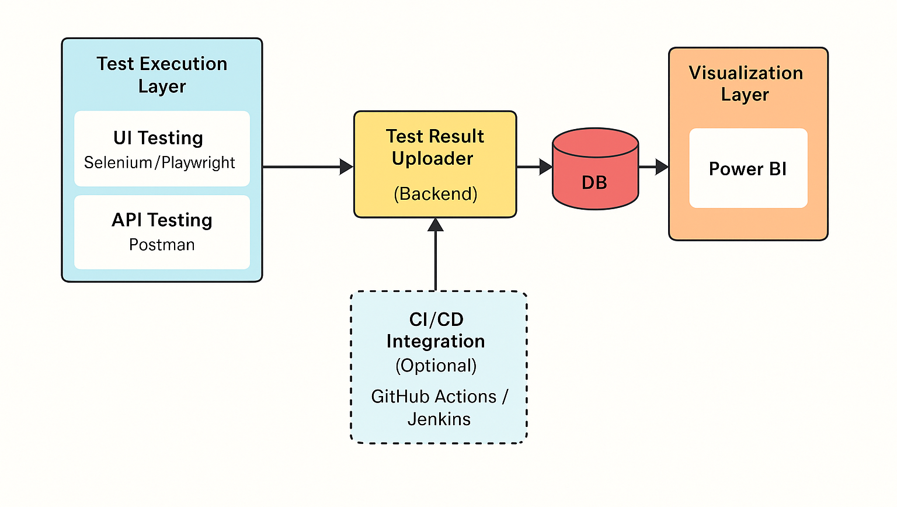
QA – Dashboard :

Slide 4
Project Scope
✅ Utility for ongoing use, not just a one-time dashboard
📂 Modules:
- UI Test Execution (Selenium/Playwright)
- API Test Execution (Postman/Newman)
- Backend Data Upload (Spring Boot APIs)
- SQL Database for storing results
- Power BI for real-time visualization

Slide 5
Key Features
🟢 Real-time results & trend analysis
📌 Module-wise pass/fail breakdown
🔍 Screenshot preview for failed tests
📈 API latency & response insights
🔁 Flaky test detection across builds

Slide 6
Target Users
👩‍💻 QA Engineers - Track test quality
👨‍💻 Developers - Monitor code change impacts
🧑‍💼 Product Managers - Measure release readiness
🏢 Stakeholders - Validate release confidence

Slide 7
Timeline
🗓️ Week 1: Setup Project, DB Schema, Spring Boot APIs
🗓️ Week 2: Integrate Test Results (Selenium + Postman)
🗓️ Week 3: Power BI Visualizations, Live DB Connection
🗓️ Week 4: Finalize Dashboard, Host on GitHub Pages

Slide 8
Tech Stack
🖥️ Backend: Java + Spring Boot
🧪 Testing: Selenium, Postman (opt: Playwright )
🗃️ Database: MySQL
📊 Visualization: Power BI
🌐 Hosting: GitHub Pages (for presentation layer)

Slide 9
Deliverables
📌 REST API for test result submission
📌 Database with test logs
📌 Power BI dashboard (module-wise, trend-based)
📌 GitHub static page + LinkedIn Post with walkthrough

Slide 10
What Makes It Unique?
💡 Full-stack QA utility integrating Dev + Testing + Analytics
♻️ Reusable across multiple projects/releases
📊 Business-friendly & developer-aware dashboarding
🚀 Real-time, smart visibility into quality metrics

Slide 11
Contact :
🌍 Demo:
🔗 LinkedIn: Rahul_Sahariya_Rrsr
🙏 Thanks for your time & feedback!

