Slide 1
Employee Data Analysis using Excel
STUDENT NAME :sharmila.k
REGISTER NO :312204250
DEPARTMENT :B.com accounting and finance
COLLEGE :annai violet arts and science college

Slide 2
PROJECT TITLE
Creating an employee performance scorecard in excel.

Slide 3


AGENDA
Problem Statement
Project Overview
End Users
Our Solution and Proposition
Dataset Description
Modelling Approach
Results and Discussion
Conclusion
3/21/2024 Annual Review

Slide 4

PROBlEM STATEMENT
To write a problem statement on employee performance, you need to identify the specific area of performance that is problematic, such as low productivity, high absenteeism, or poor quality of work.

Slide 5

PROJECT OVERVIEW
When you create a PerformancePoint scorecard, you can either use a wizard to step you through the process or you can create your scorecard manually. For more information, see Create a scorecard by using Dashboard Designer on TechNet.
.

Slide 6

WHO ARE THE END USERS?
.
An employee scorecard is a digital record that managers use to monitor and review an employee's performance. The scorecard will usually outline the employee's role in the company, key responsibilities, daily tasks, required skills and qualities

Slide 7

OUR SOLUTION AND ITS VALUE PROPOSITION
Implementing an employeee scorecard with a balanced approach as part of performance management in your organization improves alignment between employees and the company, connects employees to organizational goals, and unites everyone under a set structure which eases communication and makes it easier to see results.

Slide 8
Dataset Description
An MS Excel scorecard summarizes the organization's performance by showing key performance indicators and quality standards for those metrics.
When creating a scorecard, you typically set overall objectives, including various performance targets for a group or organization.
You can fill in the targets with additional KPIs that reflect each sub-objectives. Remember that scorecards may differ depending on the organization or institution

Slide 9

THE "WOW" IN OUR SOLUTION
Create and use pivot tables for dynamic data analysis, summarizing and filtering performance data. Regularly update the spreadsheet and review performance data. Schedule regular check-ins and data refreshes. Ensure data accuracy and consistency by validating data inputs and using data protection features.
3/21/2024 Annual Review
9

Slide 10
MODELLING
Follow these steps to create a balanced scorecard:
Outline your purpose. ...
Create specific objectives and performance measures. ...
Strategically map each perspective. ...
Analyze performance. ...
Share and communicate results. ...
Develop strategic changes and initiatives. ...
Implement the changes.
10

Slide 11
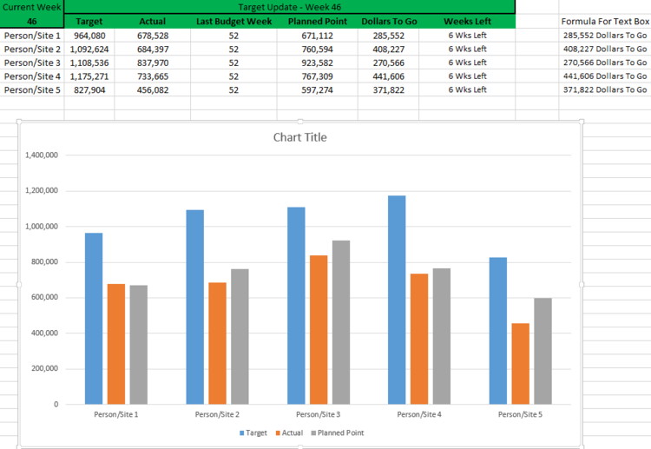
RESULTS
11

Slide 12
conclusion
Even though employee evaluation may have a bad reputation, it’s still a must-have for organizations of all sizes. As Peter Drucker, famously said, “If you can’t measure it, you can’t improve it.” Employee evaluation forms, digital or on paper, are still the most widely used method to measure performance across all positions in your company.
To make sure your employee evaluation form is effective, focus on providing objective and honest rating. Include both numeric scales and open-ended questions to collect quantitative and qualitative data.

